Slide 1

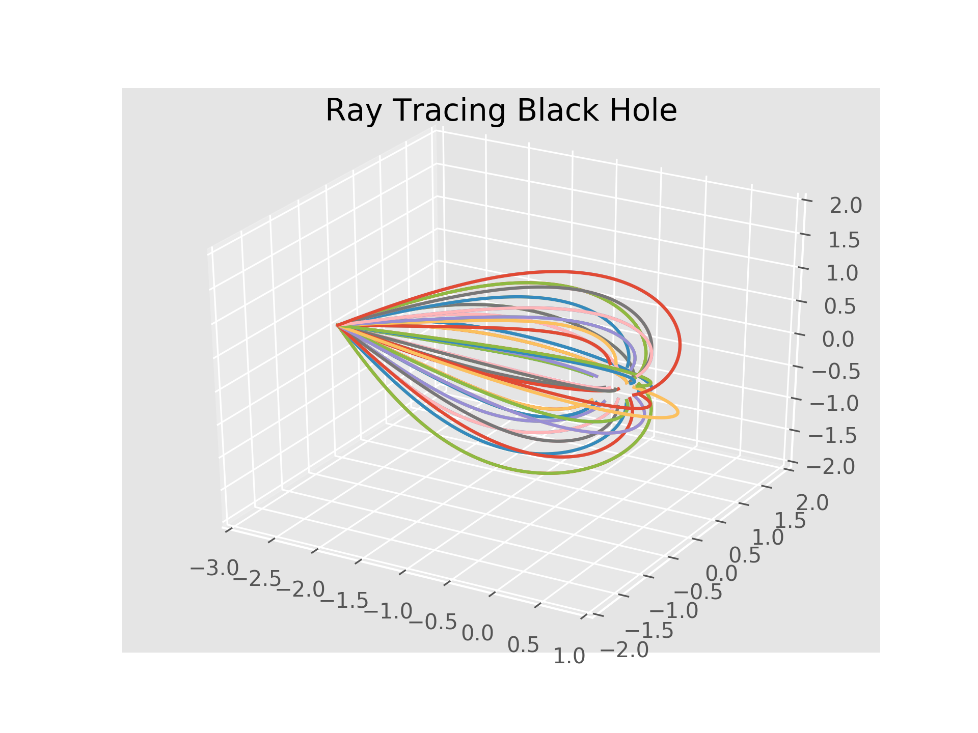


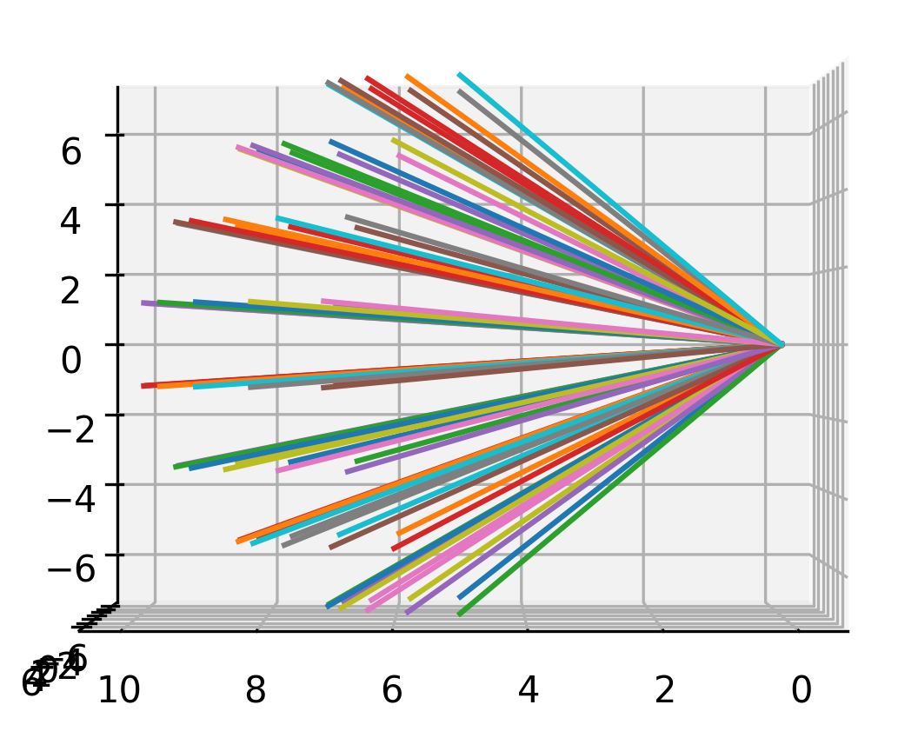

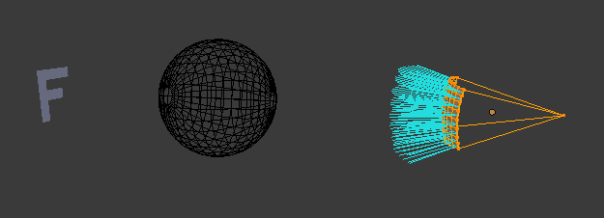

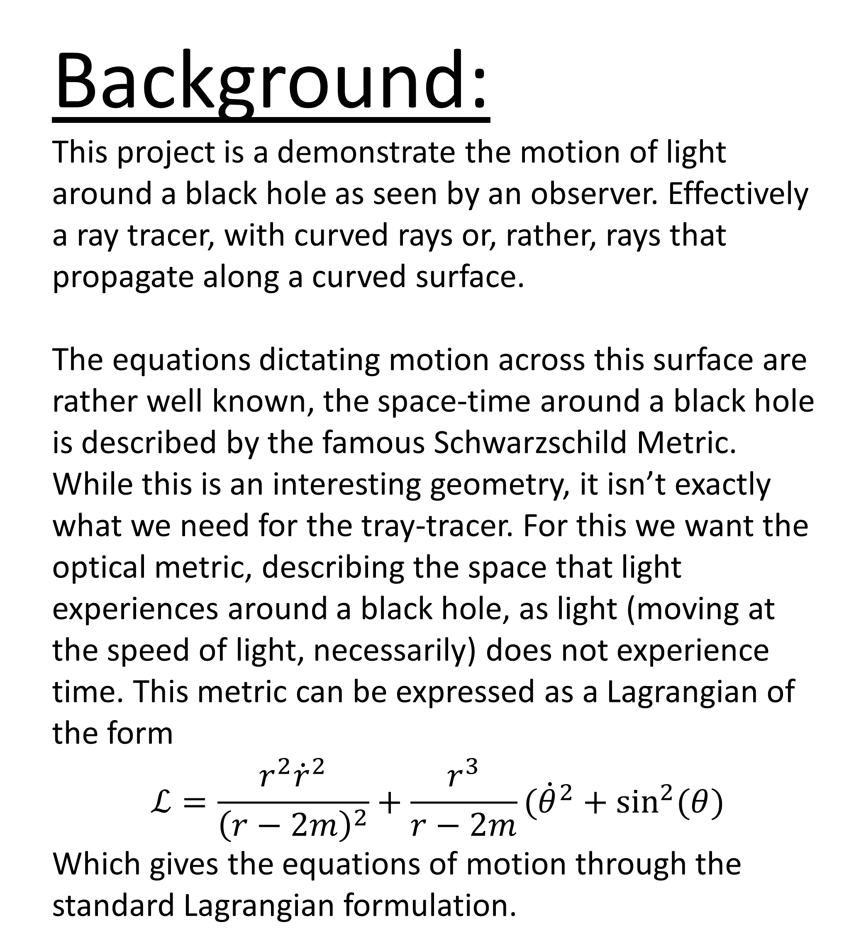
Schwarzschild Ray Tracer
Reid Baker and Tyler Cox
Background:
This project is a demonstrate the motion of light around a black hole as seen by an observer. Effectively a ray tracer, with curved rays or, rather, rays that propagate along a curved surface.
The equations dictating motion across this surface are rather well known, the space-time around a black hole is described by the famous Schwarzschild Metric. While this is an interesting geometry, it isn’t exactly what we need for the tray-tracer. For this we want the optical metric, describing the space that light experiences around a black hole, as light (moving at the speed of light, necessarily) does not experience time. This metric can be expressed as a Lagrangian of the form
$$ℒ=\frac{r^{2}{\dot{r}}^{2}}{{\left(r−2m\right)}^{2}}+\frac{r^{3}}{r−2m}({\dot{θ}}^{2}+\sin^{2}{(θ)}$$
Which gives the equations of motion through the standard Lagrangian formulation.
Method:
The concept behind creating this effect is rather simple, though the execution saw some difficulties. The idea is to create a spherical sector as the lens, and from rectangular segments of the lens, emit particles to follow their equations of motion until they encounter an obstacle, the black hole, or the boundaries of the allowed area
Because the equations of motion are solved through the Lagrangian formulas, they necessarily follow a conservation of energy, therefore the Verlet integrator was seen as appropriate
m = 0.0
m = 0.1
m = 0.2
m = 0.3
m = 0.4

