Slide 1


Introduction to OWASP Zap
As cyber threats become more sophisticated, it's essential to know how to protect your systems from attacks. OWASP Zap is a widely used open-source tool for testing web applications and APIs, and in this presentation, we will show you how to use it to strengthen security in your Kubernetes Cluster.
By: Mariam Osama Saleh

Slide 2
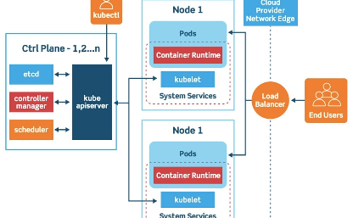
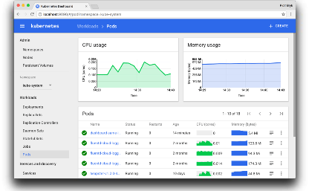
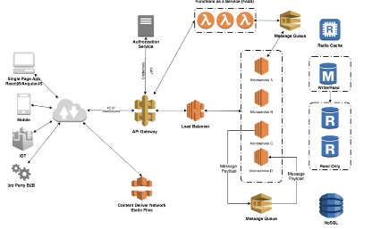
Overview of Kubernetes Cluster
Kubernetes is an open-source platform for automating deployment, scaling, and management of containerized applications. In a Kubernetes Cluster, nodes run containerized applications and communicate with each other to support the application's scaling and availability.
Kubernetes provides a web-based user interface, the Kubernetes Dashboard, for managing and monitoring the health of your Cluster. It allows you to manage resources such as deployments, services, and pods, and provides a high-level view of your applications' status and performance.
Designed to scale, a Kubernetes Cluster can run anywhere, on-premises, in hybrid configurations, or in public, private, or multi-cloud environments. It provides tools for container management, automatic scheduling, and monitoring, allowing developers to focus on their applications while Kubernetes takes care of infrastructure management.

Slide 3
Step-by-Step Guide to Installing and Configuring OWASP Zap
1
Download OWASP Zap
You can download OWASP Zap from the official website. Choose the appropriate version for your operating system.
Install OWASP Zap
2
Follow the installation instructions provided on the website. Once installed, open OWASP Zap.
3
Configure OWASP Zap to work with Kubernetes Cluster
In OWASP Zap, go to Tools > Options > Local Proxy. Set the Port to 8080 and click on Save.

Slide 4
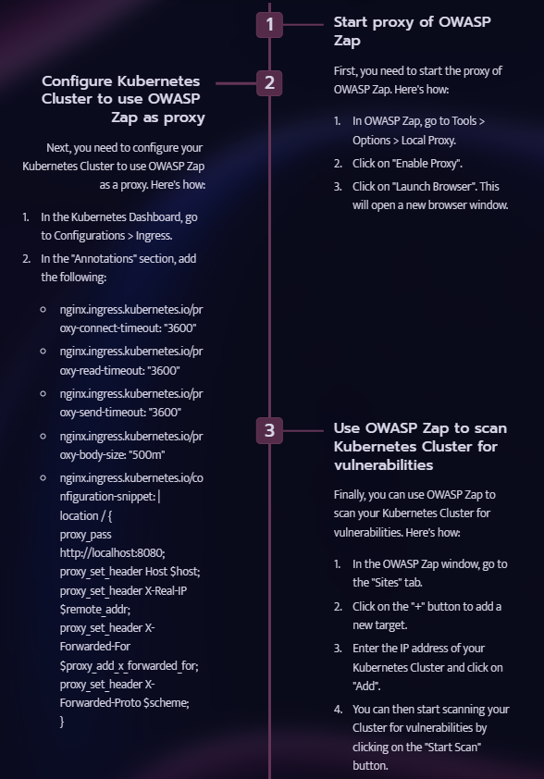
Scanning for Vulnerabilities in Kubernetes Cluster using OWASP Zap

Slide 5
Using OWASP Zap as a Proxy for Kubernetes Cluster
Why use OWASP Zap as a Proxy?
How to use OWASP Zap as a Proxy
Using OWASP Zap as a proxy allows you to intercept and view all the traffic going to and from your Kubernetes Cluster. You can then use OWASP Zap to monitor the traffic and scan for vulnerabilities, making it an essential tool for improving the security of your Cluster.
To use OWASP Zap as a proxy, simply configure your Kubernetes Cluster to use the OWASP Zap proxy by following the steps outlined in the previous section. Once configured, you can start scanning your traffic for vulnerabilities in the OWASP Zap window.

Slide 6
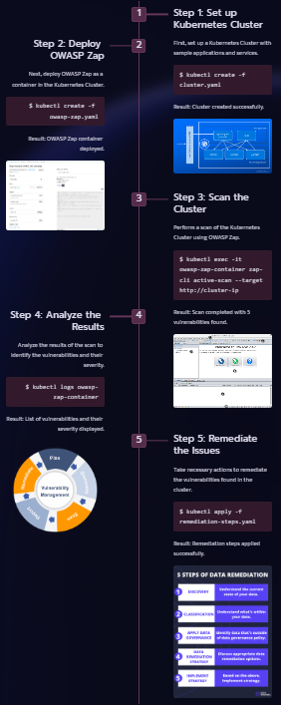
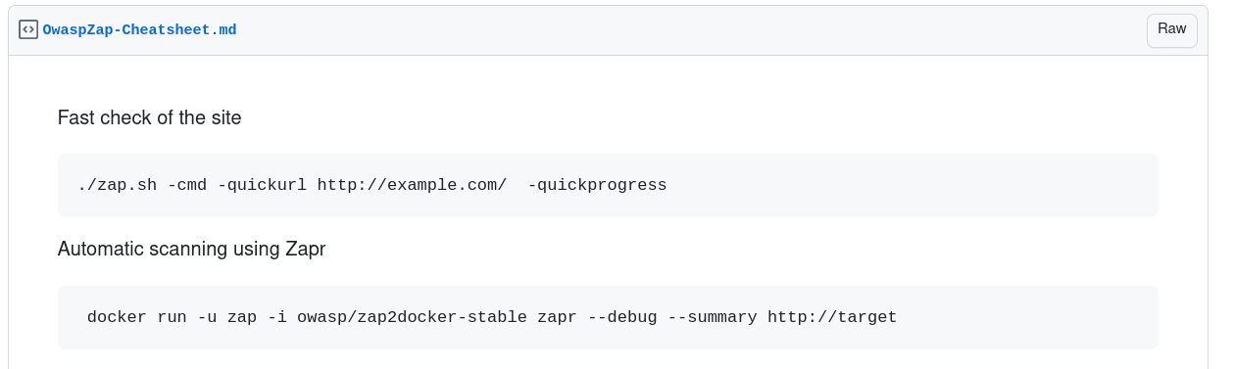
Real-time examples and demonstrations of testing Kubernetes Cluster with OWASP Zap

Slide 7
Cluster Configuration
Here's an example YAML configuration file for a Kubernetes cluster:
apiVersion: v1 kind: Config clusters: - name: my-cluster cluster: certificate-authority: /path/to/ca.pem server: https://my-cluster.example.com:6443 users: - name: my-user user: client-certificate: /path/to/client-cert.pem client-key: /path/to/client-key.pem contexts: - name: my-context context: cluster: my-cluster user: my-user namespace: my-namespace current-context: my-context

Slide 8
OWASP ZAP
OWASP ZAP (Zed Attack Proxy) is an open-source web application security scanner. It is widely used to identify vulnerabilities and security issues in web applications.
Here's an example YAML configuration file for running OWASP ZAP:
apiVersion: v1 kind: Pod metadata: name: owasp-zap spec: containers: - name: owasp-zap image: owasp/zap2docker-stable command: - zap-baseline.py - -t - http://example.com volumeMounts: - name: zap-vol mountPath: /zap/wrk volumes: - name: zap-vol emptyDir: {}

Slide 9
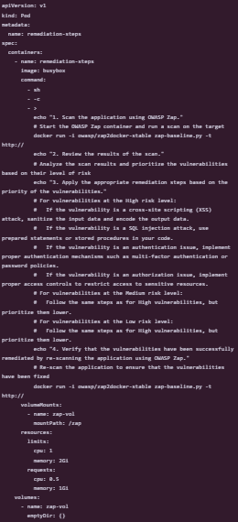
remediation-steps.yaml

Slide 10

Additional Resources and GitHub Repositories for Kubernetes and OWASP Zap Testing
1
OWASP Zap Homepage
2
Kubernetes Documentation
3
Kubernetes GitHub Repository
Visit the official homepage for OWASP Zap to learn more about the tool and its features.
Explore the official documentation for Kubernetes to learn more about its features and capabilities.
Check out the source code of Kubernetes on its GitHub repository.
4
OWASP Zap User Guide
5
OWASP Zap GitHub Repository
Read the user guide for OWASP Zap to learn how to use the tool effectively.
Check out the source code of OWASP Zap on its GitHub repository.

