Slide 1
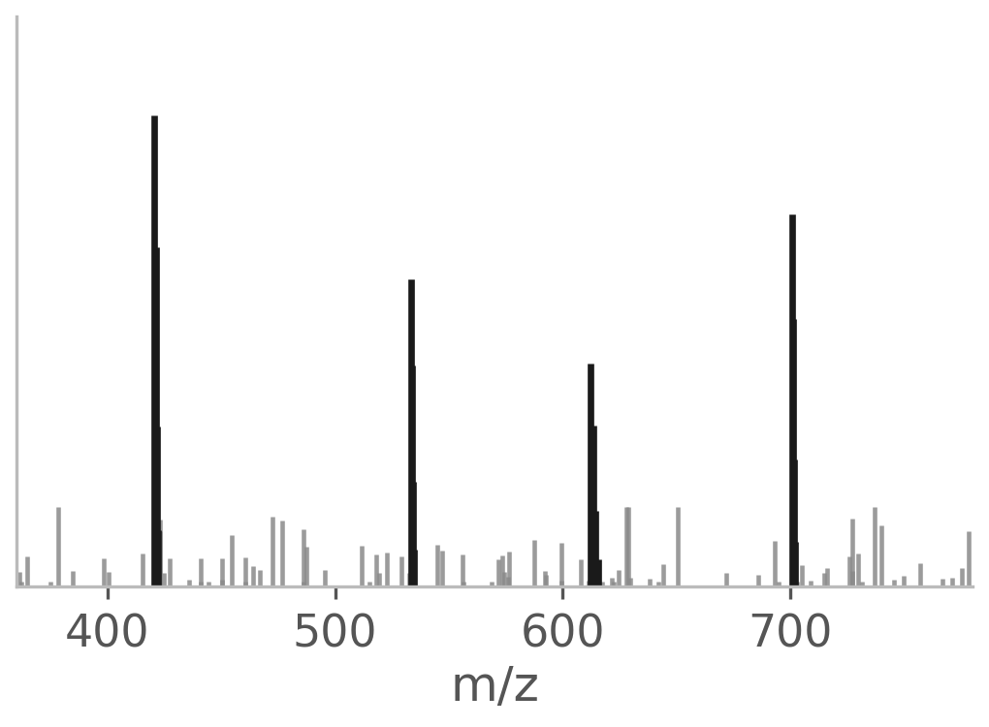
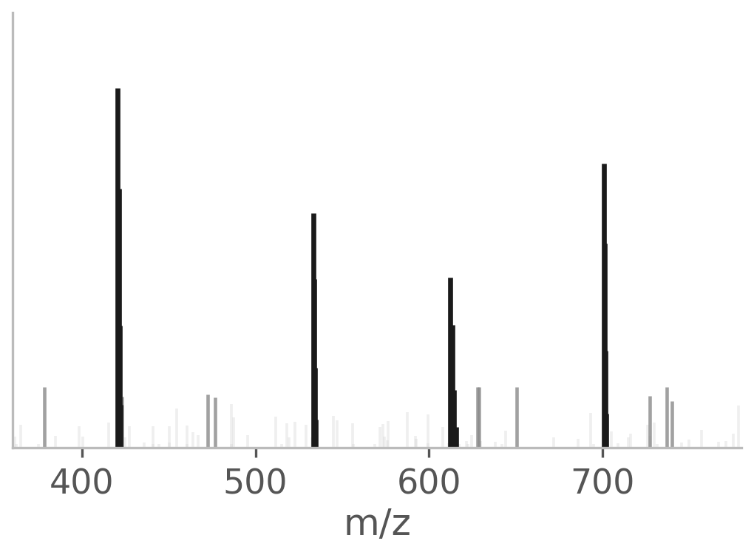
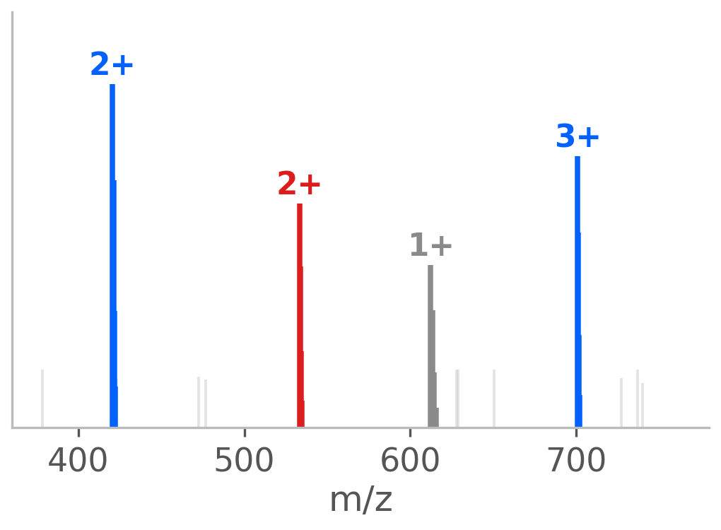
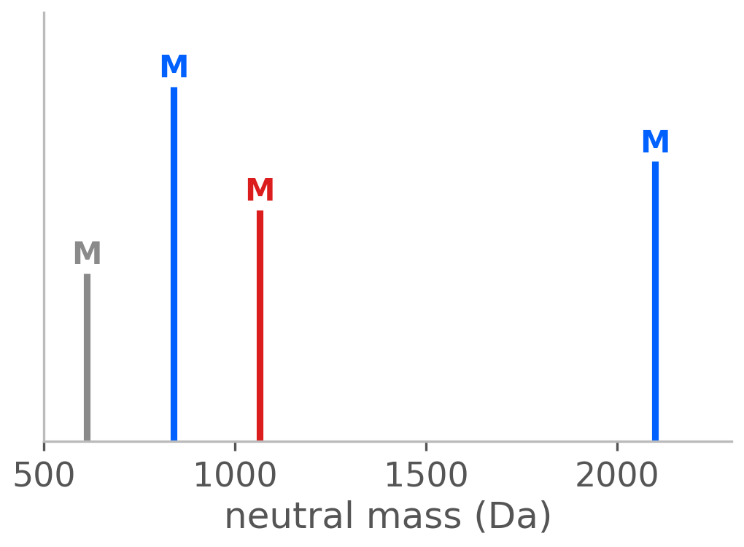
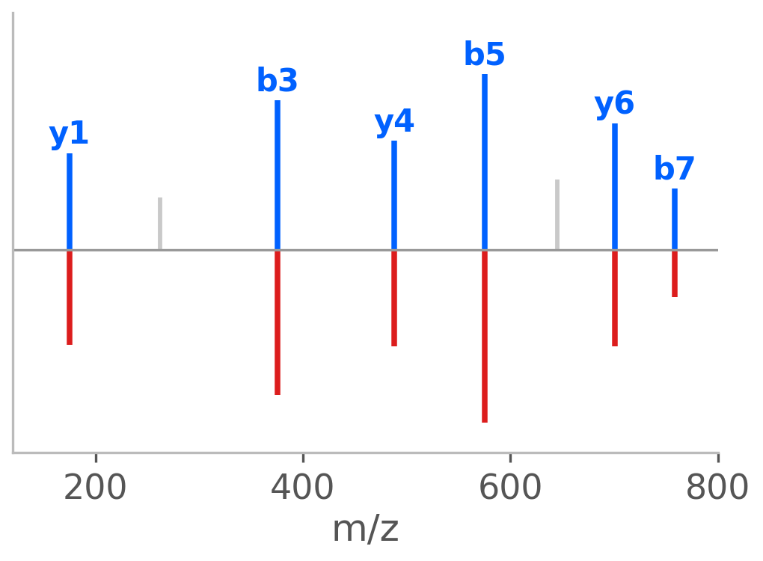







spxtacular
$ pip install spxtacular
Chainable spectrum processing for mass spectrometry: from raw centroids to neutral masses to PSM scores, in Python.
1 Raw centroids
2 Denoise
3 Deconvolution
4 Neutral masses
5 Match & score
frags = pt.fragment("PEPTIDEK", ion_types=("b", "y"), charges=(0,))
spec.denoise(method="mad").deconvolute(charge_range=(1, 5)).decharge().score(frags)
File readers
Fast deconvolution
Publication figures
Reporter ions
Interoperability
Bruker · mzML · Thermo RAW
MGF · MS2 · MSP · mzSpecLib
Greedy isotope-cluster scoring
Numba JIT acceleration
plotly or matplotlib backends
Journal sizes · PDF/SVG export
TMT · TMTpro · iTRAQ
Impurity-corrected channels
matchms · spectrum_utils
spectrl URL-safe tokens
github.com/tacular-omics/spxtacular · tacular-omics.github.io/spxtacular · MIT license · part of the tacular-omics ecosystem
Notes:
[Sources]
- https://github.com/tacular-omics/spxtacular (supported readers and public interoperability APIs)
- https://github.com/tacular-omics/spectrl (compact spectrum token format)

