Slide 1
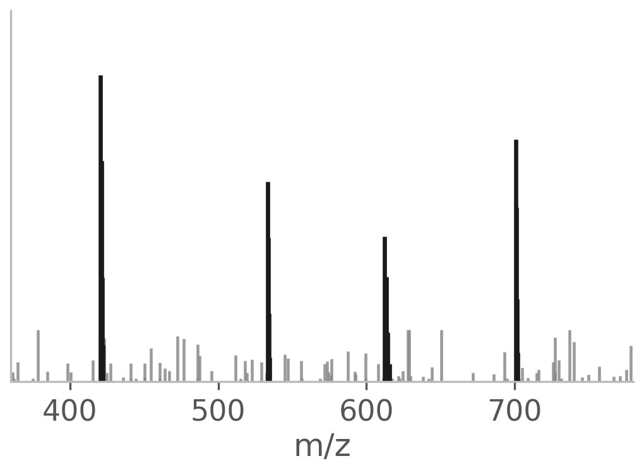
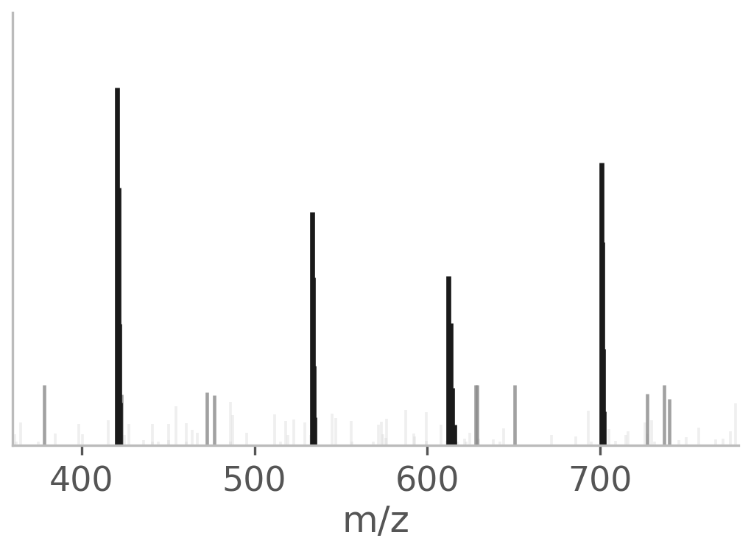
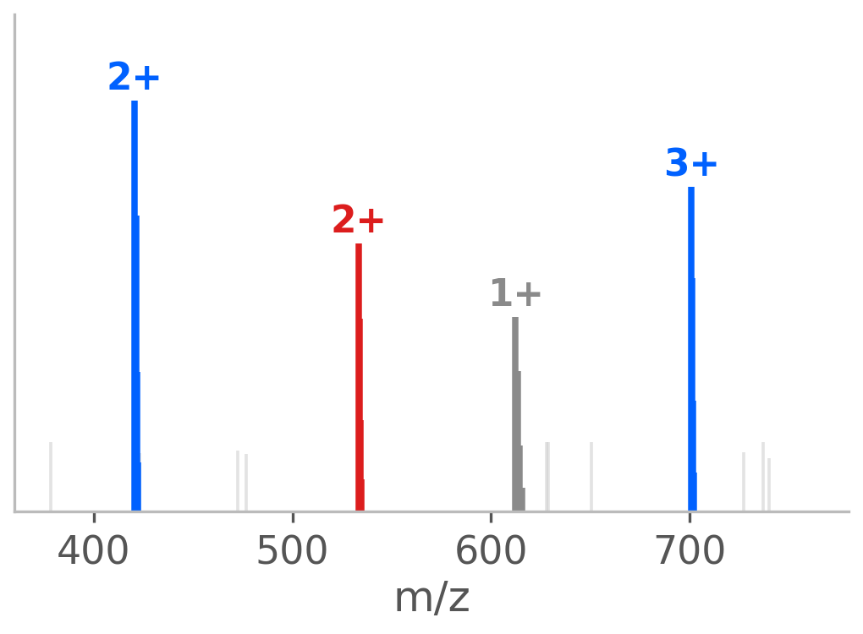
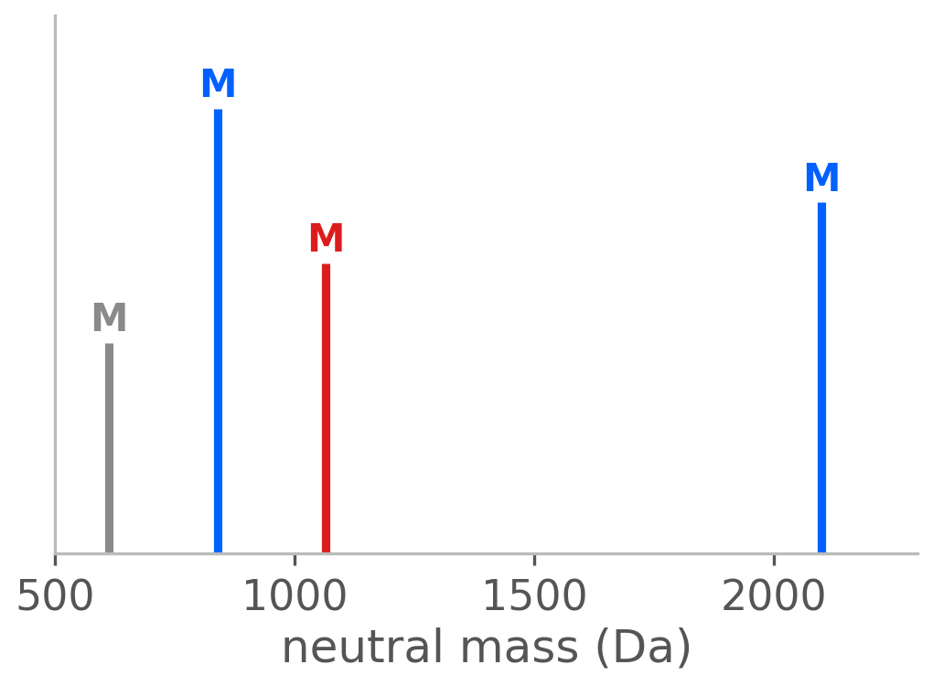
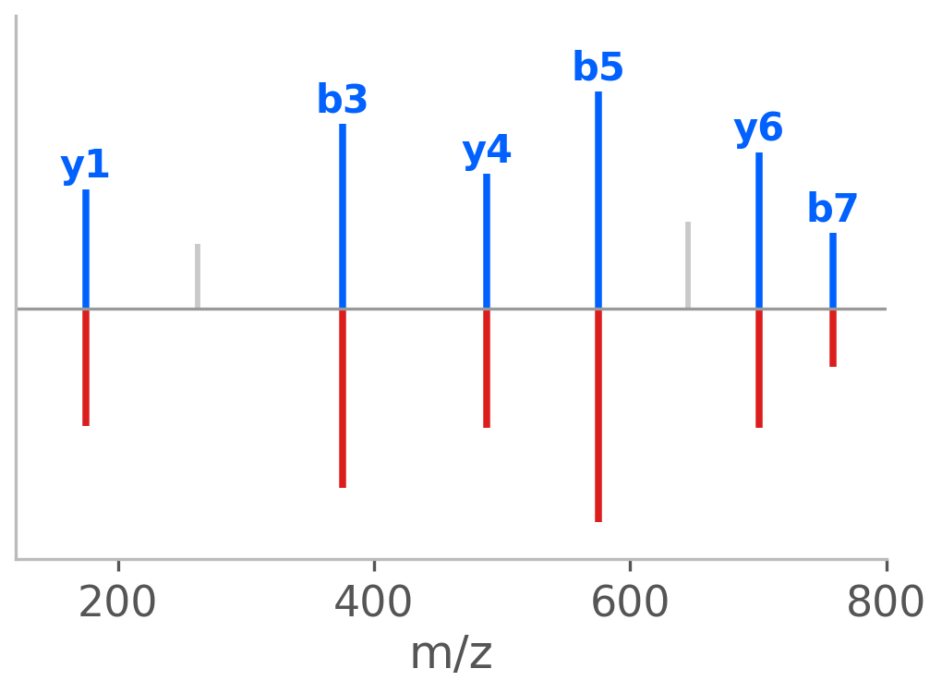




spxtacular
$ pip install spxtacular
Chainable spectrum processing for mass spectrometry: from raw centroids to neutral masses to PSM scores, in Python.
1 Raw centroids
2 Denoise
3 Deconvolution
4 Neutral masses
5 Match & score
spec.denoise(method="mad").deconvolute(charge_range=(1,5)).decharge().match_fragments().score()
File readers
Fast deconvolution
Ecosystem adapters
Spectrum sharing
Bruker · mzML · Thermo RAW
MGF · MS2 · MSP · MS1/MS2
Greedy isotope cluster scoring
Numba JIT accelerated scoring
matchms + spectrum_utils adapters
Bidirectional ecosystem conversion
Compact URL-safe spectrl tokens
Backend-free sharing with spectrl
github.com/tacular-omics/spxtacular · tacular-omics.github.io/spxtacular · MIT license · part of the tacular-omics ecosystem
Notes:
[Sources]
- https://github.com/tacular-omics/spxtacular (supported readers and public interoperability APIs)
- https://github.com/tacular-omics/spectrl (compact spectrum token format)

