Slide 1
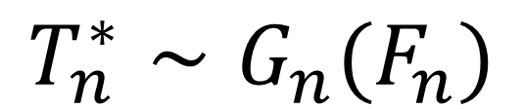
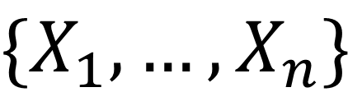
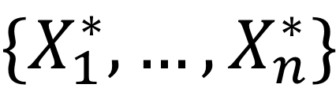
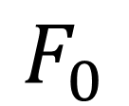
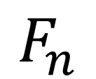
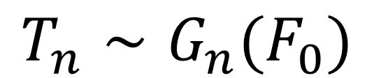
Test statistic
$$F_{0}$$
Data sampling
$$\{X_{1}, …,X_{n}\}$$
$$T_{n}∼G_{n}(F_{0})$$
LLN (Glivenko-Cantelli)
Bootstrap approximation
Test statistic
$$F_{n}$$
Data sampling
$$\{X_{1}^{∗}, …,X_{n}^{∗}\}$$
$$T_{n}^{∗}∼G_{n}(F_{n})$$

