Slide 1
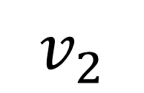
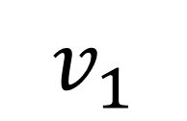
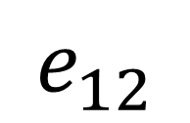
adjacent
$$v_{1}$$
incident
incident
$$v_{2}$$
$$e_{12}$$

