Slide 1






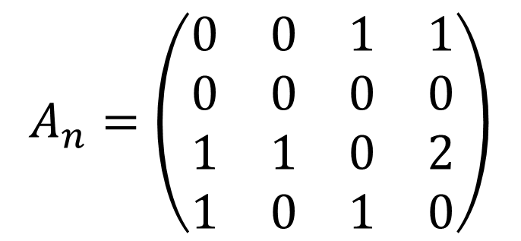

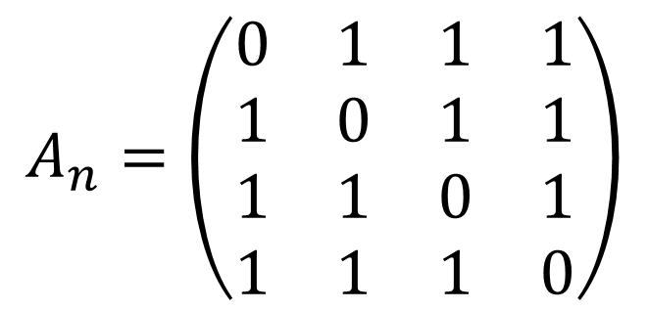



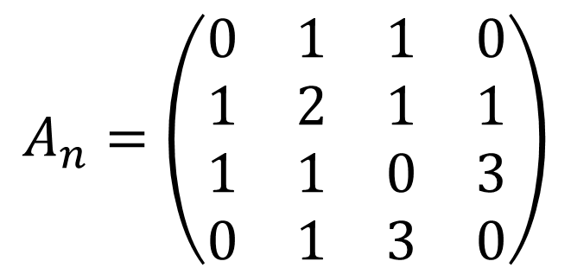


$$v_{1}$$
$$v_{3}$$
$$A_{n}=\left(\begin{matrix}0 & 1 & 1 & 1 \\ 1 & 0 & 1 & 1 \\ 1 & 1 & 0 & 1 \\ 1 & 1 & 1 & 0\end{matrix}\right)$$
$$v_{2}$$
$$v_{4}$$
$$v_{1}$$
$$v_{3}$$
$$A_{n}=\left(\begin{matrix}0 & 1 & 1 & 0 \\ 1 & 2 & 1 & 1 \\ 1 & 1 & 0 & 3 \\ 0 & 1 & 3 & 0\end{matrix}\right)$$
$$v_{2}$$
$$v_{4}$$
$$v_{1}$$
$$v_{3}$$
$$A_{n}=\left(\begin{matrix}0 & 0 & 1 & 1 \\ 0 & 0 & 0 & 0 \\ 1 & 1 & 0 & 2 \\ 1 & 0 & 1 & 0\end{matrix}\right)$$
$$v_{2}$$
$$v_{4}$$

