Slide 1


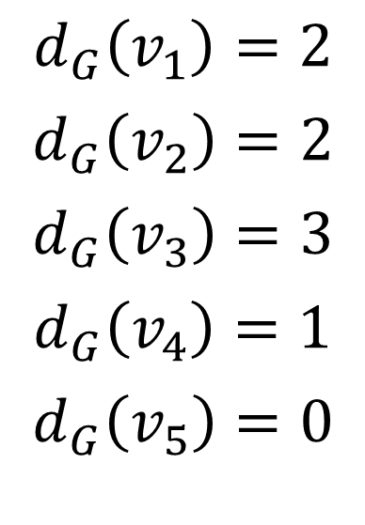



end vertex
$$v_{3}$$
$$v_{4}$$
$$d_{G}\left(v_{1}\right)=2$$
$$d_{G}\left(v_{2}\right)=2$$
$$d_{G}\left(v_{3}\right)=3$$
$$d_{G}\left(v_{4}\right)=1$$
$$d_{G}\left(v_{5}\right)=0$$
isolated vertex
$$v_{5}$$
$$v_{1}$$
$$v_{2}$$

