Slide 1
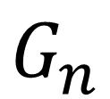
$$G_{n}$$
1
4
2
intransitive triad
7
3
6
5
8
$${\left(G_{n}\right)}_{2,4}>0,{\left(G_{n}\right)}_{4,7}>0,{\left(G_{n}\right)}_{2,7}=0$$

