Slide 1
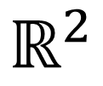




$$ℝ^{2}$$
$$S_{n}$$
$$C(s, ∙ )=0$$
$$C(s, ∙ )=ρ$$
$$s$$

