Slide 1

“Data is today’s most valuable asset — and the most targeted.”
Name: Adarsh Pandey
Subject: PCB LAB
Topic: Cybersecurity & Real-World Corporate Incidents

Slide 2
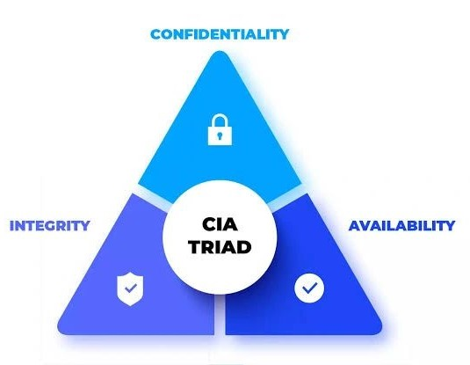
Cybersecurity?
Protects systems, networks, and data from digital attacks.
A subset of Information Security (which includes physical & digital protection).
Goals — The CIA Triad:
Confidentiality → Keep data private.
Integrity → Keep data accurate.
Availability → Keep systems running.

Slide 3
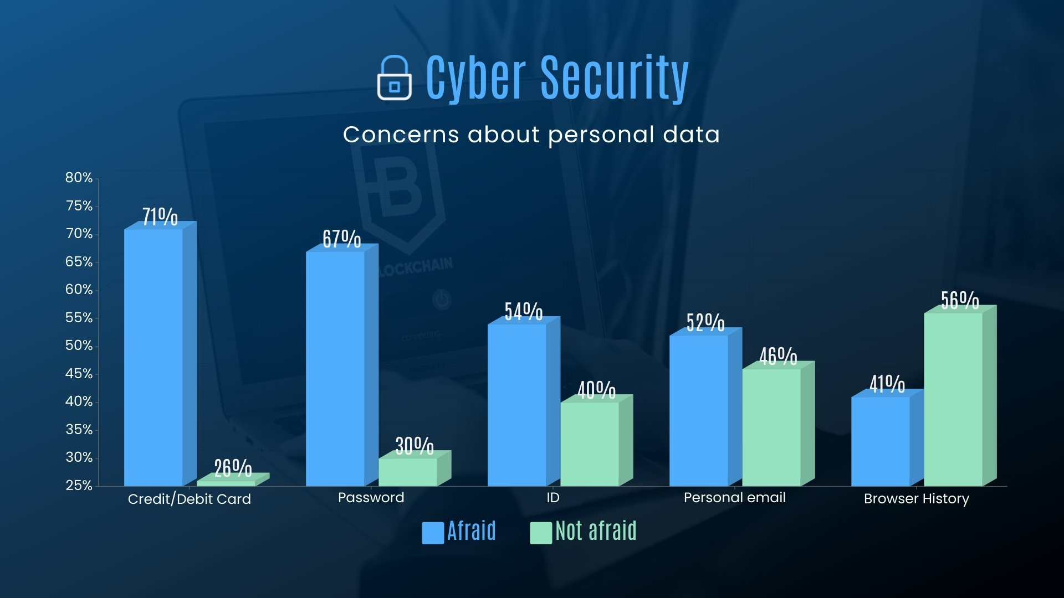
Why Cybersecurity?
Corporates hold valuable customer & financial data.
Breaches lead to financial loss, reputation damage, and legal penalties.
India saw over 2 million cyberattacks in 2023 (CERT-In).
Key domains: Network, Cloud, Application, Endpoint, Incident Response.

Slide 4
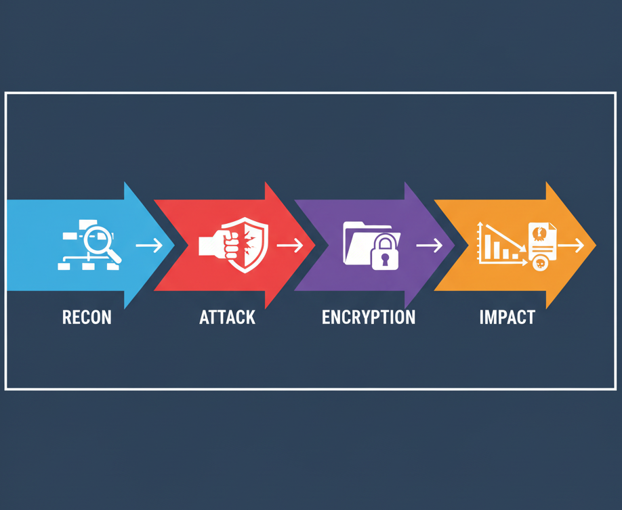
Case Study 1: AIIMS Delhi Ransomware Attack (2022)
Type: Ransomware (systems locked, ransom demanded).
Impact: 1.3 TB data encrypted; hospital services down for 2 weeks.
Weaknesses exploited:
  Outdated servers (5 compromised).
  Poor network segmentation.
  Weak backup & access control.
Lesson: Regular patching, isolated backups, stronger IAM.

Slide 5

Case Study 2: Juspay Data Breach (2020)
Sector: FinTech (payment gateway for Amazon, Swiggy, etc.)
Breach: 3.5 crore customer records leaked to dark web.
Cause: Developer’s leaked AWS access key.
Impact: Exposed phone numbers, emails, masked card data.
Lesson: Secure cloud IAM, rotate credentials, audit access.

Slide 6

Key Learnings & Prevention
Keep systems patched and updated.
Encrypt sensitive data; maintain offline backups.
Limit privileges — least-access policy.
Conduct employee awareness training.
Prepare an incident response plan.

Slide 7
Conclusion
Cybersecurity = business survival, not just IT.
India’s attacks show how one weakness can halt operations.
“It takes years to build trust, but one breach to lose it.”
THANK YOU!
ANY QUESTIONS?

