Slide 1
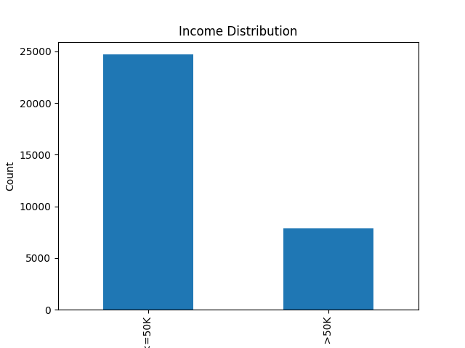
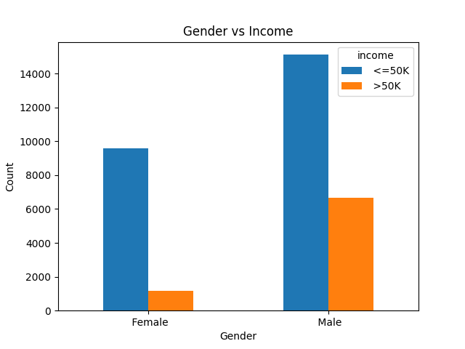
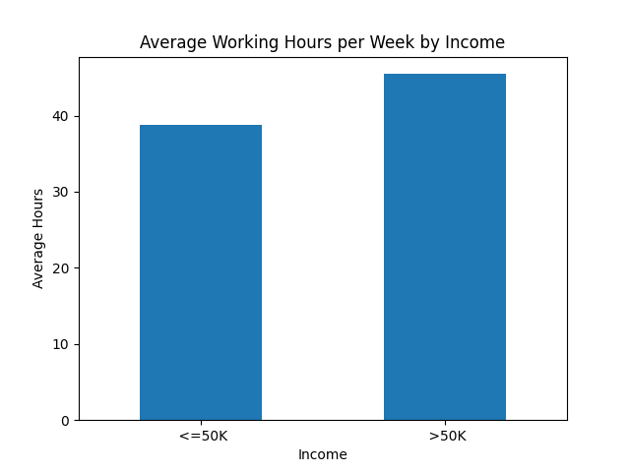
EDA & Business Intelligence DashboardIncome Dataset
Total Records: 32,561High Income (>50K): ~7,800Low Income (<=50K): ~24,700
Key Insights:* Majority of people earn <=50K * Higher working hours link to higher income * Education strongly impacts income

