Slide 1
Swagger / OpenAPI in a .NET API
kauno kolegija | Faculty of Technologies
Documenting, testing and consuming SimpleStudentApi
Group PSe-5
Autumn 2026
Lecture + practice
Lecturer: Tadas Bulis
Notes:
Goal: students leave able to add Swagger to a .NET Minimal API, use Swagger UI to test it, and call the API from the frontend through a client generated from the OpenAPI contract. Both lab projects in code-examples are already updated.

Slide 2
What we cover today
OVERVIEW
Five blocks — the last one is your practice
1
What Swagger and OpenAPI are
Terms, and why an API needs a contract
2
Adding Swagger to the API
One package, four lines of setup, then describing endpoints
3
Working in Swagger UI
Read, try out, see errors, copy curl
4
Using the contract in the frontend
A generated typed client instead of hand-written HTTP calls
5
Practice and your documentation
Lab tasks, and where OpenAPI fits in the project documentation
Notes:
Blocks 1–4 are the tools; block 5 is what they do in the lab and what goes into their documentation.

Slide 3
OpenAPI is the contract between the backend and everyone who calls it: one machine-readable file that people read, tools test, and generators turn into client code.
THE IDEA
LT: OpenAPI – API kontraktas · Swagger UI – interaktyvi jo peržiūra
Notes:
In a heterogeneous system the parts are written by different teams in different languages. The API contract is what lets them agree without reading each other's code.

Slide 4
Four names you will hear
TERMS
They are often mixed up — here is who is who
1
OpenAPI Specification
2
Swagger
The standard (OAS 3.x) for describing HTTP APIs in JSON or YAML: paths, parameters, request bodies, responses, schemas. Vendor-neutral, maintained under the Linux Foundation.
The original name of the specification (until 2015) and today SmartBear's family of tools around it. Swagger UI is the web page that renders an OpenAPI file.
3
Swashbuckle.AspNetCore
4
NSwag
The NuGet package we use in the API: it reads our .NET endpoints, generates swagger.json and hosts Swagger UI at /swagger.
A generator that reads swagger.json and writes a typed C# (or TypeScript) client. We use it in the frontend.
Notes:
Common confusion: 'Swagger' is not a .NET thing. The same swagger.json could come from a Java, Python or Node backend — the frontend would not care.

Slide 5
Swagger in our Docker lab
WHERE IT FITS
Same containers as before — two new paths
HTML pages
HTTP + JSON
EF Core
Browser
you, a student
Frontend :6011
Razor Pages
uses IStudentApiClient
API :6001
Minimal API + EF Core
Swashbuckle → /swagger
SQL Server :1433
StudentDb
your browser → localhost:6001/swagger (try the API directly)
compiled into the frontend
/swagger/v1/swagger.json
StudentApiClient.g.cs
generated C# client
swagger.json
the contract
NSwag generates (design time)
Notes:
Two new paths: (1) the browser can open Swagger UI on the API directly through the host port; (2) at design time NSwag reads swagger.json and writes the client class that is compiled into the frontend.

Slide 6
Adding Swagger: 1 package, 4 lines
STEP BY STEP — API
SimpleStudentApi/Program.cs
1
Install the package
Swashbuckle.AspNetCore from NuGet
// SimpleStudentApi.csproj
<PackageReference Include="Swashbuckle.AspNetCore"
Version="10.2.3" />
// Program.cs
builder.Services.AddEndpointsApiExplorer();
builder.Services.AddSwaggerGen(o =>
{
o.SwaggerDoc("v1", new OpenApiInfo
{ Title = "SimpleStudentApi", Version = "v1" });
});
var app = builder.Build();
app.UseSwagger(); // /swagger/v1/swagger.json
app.UseSwaggerUI(); // /swagger
2
Register the generator
AddEndpointsApiExplorer + AddSwaggerGen
3
Serve the JSON
app.UseSwagger() → /swagger/v1/swagger.json
4
Serve the UI
app.UseSwaggerUI() → /swagger
dotnet add package Swashbuckle.AspNetCore
Notes:
Live demo: open Program.cs in the lab, show the four lines, run, open /swagger. AddEndpointsApiExplorer is needed for Minimal APIs (controllers get it automatically).

Slide 7
Metadata turns code into documentation
DESCRIBING ENDPOINTS
Each call only adds information to swagger.json — runtime behaviour does not change
Code | Appears in Swagger as
.WithName("CreateStudent") | operationId → method CreateStudentAsync() in the generated client
.WithTags("Students") | group heading "Students"
.WithSummary / .WithDescription | text next to and under the endpoint
.Produces<Student>(201) | response code + JSON schema
.ProducesValidationProblem() | 400 response with field errors
.ExcludeFromDescription() | hides an endpoint (our "/" redirect)
// handler: validate → save → 201 Created
students.MapPost("/", CreateStudent)
.WithName("CreateStudent")
.WithTags("Students")
.WithSummary("Create a new student")
.WithDescription("The id is ignored ...")
.Produces<Student>(201)
.ProducesValidationProblem(); // 400
students.MapGet("/{id:int}", GetStudent)
.WithName("GetStudent")
.Produces<Student>(200)
.Produces(404);
Notes:
Stress WithName: the operationId becomes the method name in every generated client, so name it like a C# method.

Slide 8
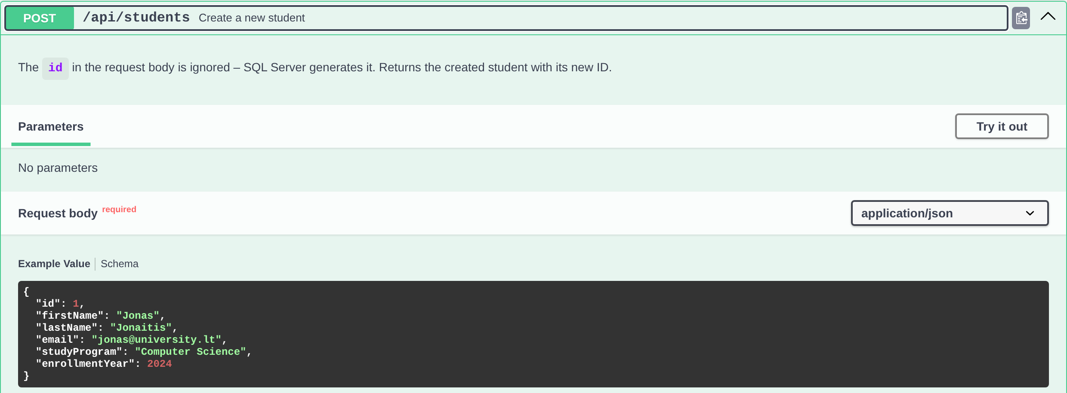
Comments become examples
MODELS
/// <summary> and <example> on the model → schema and example value in Swagger UI
// SimpleStudentApi.csproj
<GenerateDocumentationFile>true</GenerateDocumentationFile>
// Program.cs → inside AddSwaggerGen(o => ...)
o.IncludeXmlComments(xmlFile);
// Models/Student.cs
/// <summary>A student (table Students)</summary>
public class Student
{
/// <example>Jonas</example>
public string FirstName { get; set; } = "";
/// <example>2024</example>
public int EnrollmentYear { get; set; }
}
Result: description and an example request body in Swagger UI
Common mistake: IncludeXmlComments without GenerateDocumentationFile — the XML file does not exist and the API fails at startup.
!
Notes:
Without GenerateDocumentationFile the XML file does not exist and IncludeXmlComments fails at startup — a common mistake.

Slide 9
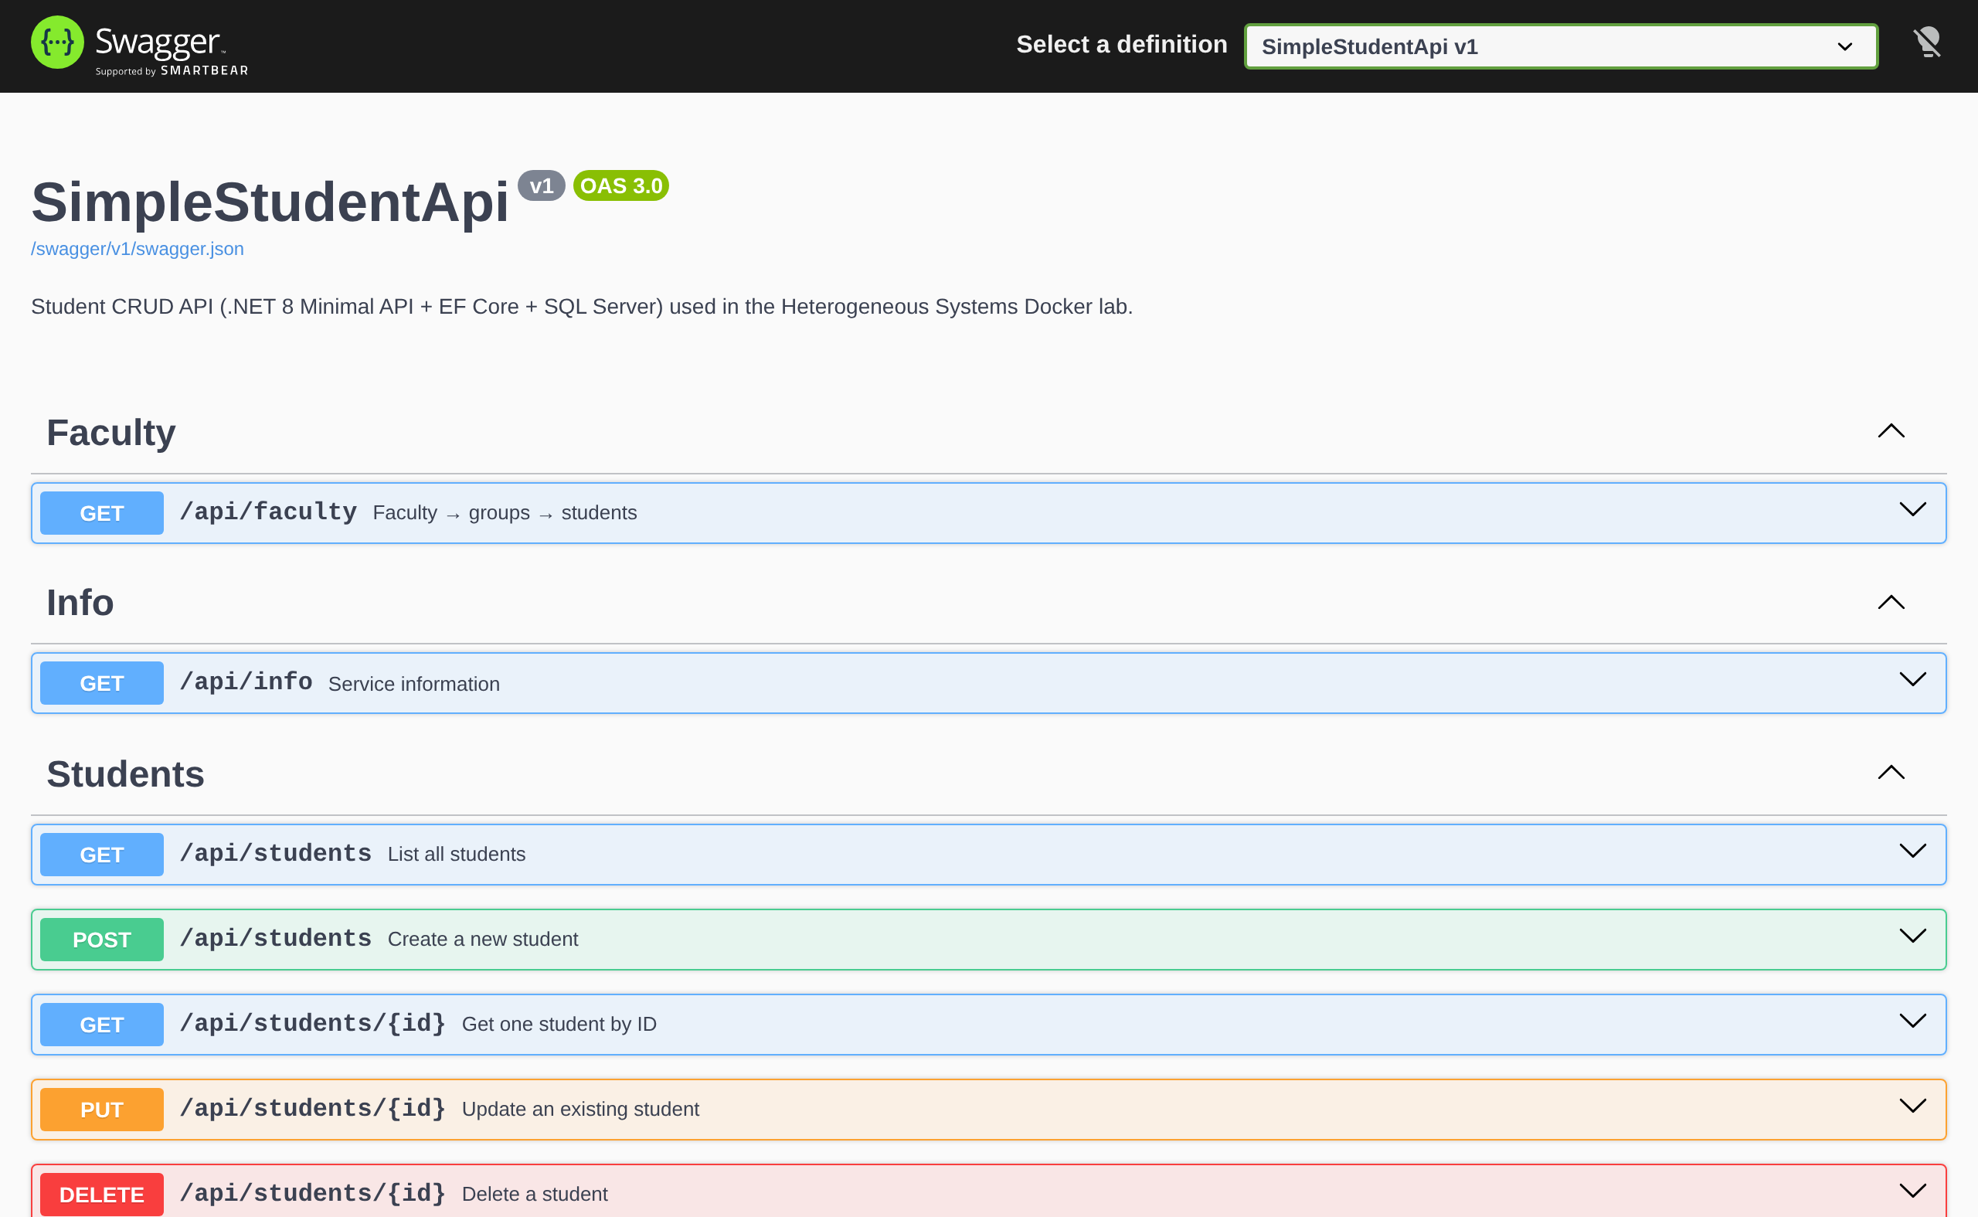
http://localhost:6001/swagger
SWAGGER UI
Every endpoint, grouped by tag, colour-coded by HTTP method
Tags
group endpoints (WithTags)
Colours
GET blue · POST green · PUT orange · DELETE red
Contract link
/swagger/v1/swagger.json — the raw OpenAPI file
Schemas
every request and response model
Notes:
Open it live. Click the swagger.json link to show it is just JSON — this file is the contract.

Slide 10
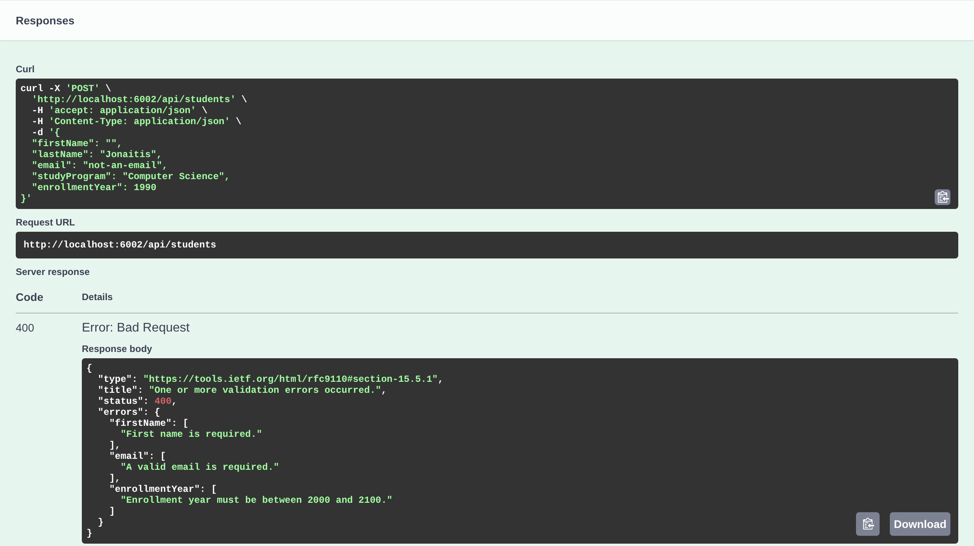
Test the API without writing a client
TRY IT OUT
Expand → Try it out → edit the body → Execute
1
Expand POST /api/students
description, body schema and responses appear
2
Click "Try it out"
the example body becomes editable
3
Send invalid data
empty first name, year 1990 → Execute
4
Read the result
400, field errors, headers and a ready curl command
Swagger UI sends real requests — what you POST is really saved in SQL Server.
Notes:
Then send valid data and show 201 Created with the new id. Copy the curl command into a terminal to show it is the same request.

Slide 11
One document, six uses
WHAT YOU GET
Why the ten minutes of setup pay off
1
Living documentation
2
Manual testing
3
Error contract
Generated from code, so it is never out of date
Try every endpoint in the browser — no Postman needed for the basics
201 / 400 / 404 responses are documented and visible
4
curl and request URL
5
Client generation
6
Interface specification
Copy the exact request into a terminal, a script or a bug report
NSwag or OpenAPI Generator create C#, TypeScript, Java… clients
Attach swagger.json to your project documentation
Notes:
Ask: which of these would have saved you time in a previous project?

Slide 12
Two URLs, two audiences
IN DOCKER
Containers talk by service name; your browser talks through the host port
Inside the Docker network
From your computer
Frontend → API: http://simplestudentapi:8080
Browser → API: http://localhost:6001
Set by ApiSettings__BaseUrl
Set by ApiSettings__PublicUrl
Used by the generated client (server side)
Used for the Swagger link and Swagger UI
Swagger is enabled in every environment here because the containers run as Production. In a real product: Development only, or behind authentication.
Notes:
Same Docker networking lesson as before, now with a visible consequence: a Swagger link pointing to simplestudentapi:8080 would not open in the browser.

Slide 13
Three ways to call the API
FRONTEND INTEGRATION
The two labs show the first two side by side
A
Hand-written HttpClient
B
Generated typed client (NSwag)
C
JavaScript in the browser
GetFromJsonAsync<ApiStudentResponse>("/api/getStudent")
await _api.GetStudentsAsync()
fetch("http://localhost:6001/api/students")
+ simple, no extra tools
– URLs and DTOs typed by hand; typos found at runtime
+ methods and models come from swagger.json; the compiler checks the contract
– regenerate after API changes
+ SPA frameworks (React, Angular) — generate a TypeScript client the same way
– the API must allow CORS
Lab: …with-additional-endpoint-and-page
Lab: …plus-mssql
Not in our labs
Notes:
Option C is what most modern frontends do. The idea is identical: the OpenAPI file drives the client.

Slide 14
Generate the client from swagger.json
FRONTEND — STEP 1
SimpleStudentFrontend/ApiClient/generate-client.sh (Windows: .ps1)
Start the API
docker compose up (or dotnet run)
npx nswag openapi2csclient /runtime:Net80 \
/input:swagger.json \
/output:StudentApiClient.g.cs \
/namespace:SimpleStudentFrontend.ApiClient \
/className:StudentApiClient \
/jsonLibrary:SystemTextJson \
/generateClientInterfaces:true \
/useBaseUrl:false
1
Run generate-client
downloads swagger.json and runs NSwag via npx (needs Node.js)
2
Rebuild the frontend
docker compose up --build
3
Result: IStudentApiClient, StudentApiClient and the models Student, InfoResponse, FacultyResponse, ApiException — about 1 000 lines you never write by hand.
Notes:
The generated file is committed to the repository, so the frontend builds without the API running. Regenerate only when the API changes.

Slide 15
Register once, inject everywhere
FRONTEND — STEP 2
Program.cs, then before vs after in Students.cshtml.cs
// Program.cs
builder.Services.AddHttpClient<IStudentApiClient, StudentApiClient>(c =>
c.BaseAddress = new Uri(apiBaseUrl));
Before (hand-written)
After (generated client)
var client = _httpClientFactory
.CreateClient("StudentApi");
Students = await client
.GetFromJsonAsync<List<StudentDto>>(
"/api/students");
await client.DeleteAsync(
$"/api/students/{id}");
// IStudentApiClient _api is injected
Students = (await _api.GetStudentsAsync())
.ToList();
await _api.DeleteStudentAsync(id);
Wrong URL or field name → compile error instead of a 404 at runtime
Notes:
BaseAddress decides which API the client talks to: simplestudentapi:8080 in Docker, localhost:6001 locally.

Slide 16
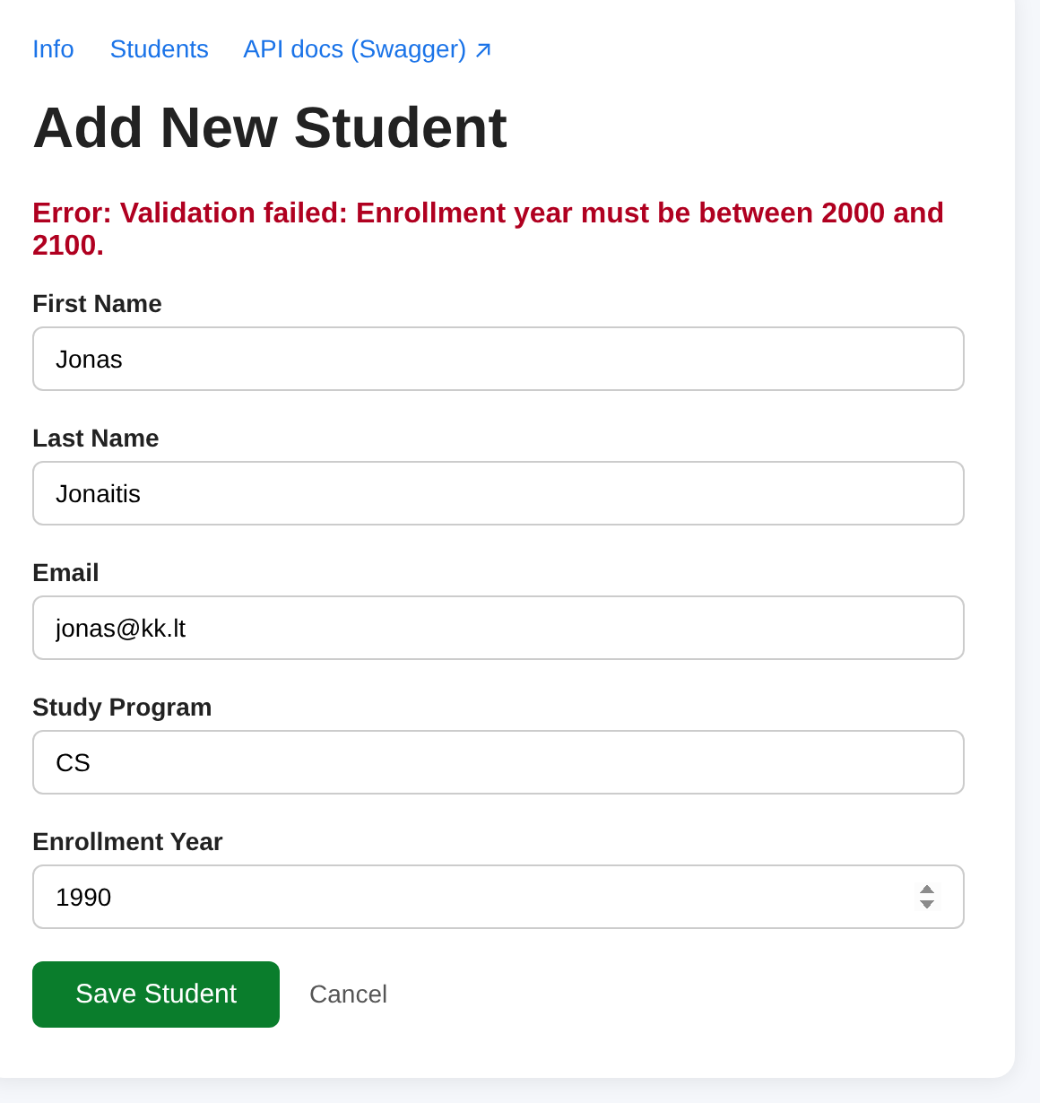
API errors become typed exceptions
ERRORS
The 400 documented in Swagger arrives in C# as ApiException<HttpValidationProblemDetails>
try
{
await _api.CreateStudentAsync(Input.ToApi());
return RedirectToPage("/Students");
}
catch (ApiException<HttpValidationProblemDetails> ex)
{
// 400 – field errors from the API
ErrorMessage = string.Join("; ",
ex.Result.Errors.SelectMany(e => e.Value));
}
catch (ApiException ex) when (ex.StatusCode == 404)
{
ErrorMessage = "Student not found";
}
Simplified — see ApiClient/ApiErrors.cs
Notes:
Show the form with year 1990 (browser validation switched off): the message comes from the API, not from the page.

Slide 17
When the API changes
WORKFLOW
The contract makes breaking changes visible before users see them
1
2
3
4
5
Change the API
Run the API
Regenerate the client
Compile the frontend
Fix and redeploy
e.g. email → emailAddress
swagger.json is updated
generate-client.sh
the compiler lists every broken page
docker compose up --build
Without the generated client, step 4 would be a runtime bug found by a user.
Notes:
Do it live if time allows: rename a property, regenerate, show the compile errors.

Slide 18
Lab tasks (60 min)
PRACTICE
Work in student-docker-lab-plus-mssql
1
Run it and explore
docker compose up; open /swagger; create 3 students with Try it out
2
Break it on purpose
POST invalid data; compare the 400 in Swagger and in the frontend form
3
Add an endpoint
GET /api/students/search?program=… with WithName, WithSummary, Produces
4
Regenerate and use
run generate-client; add a search box to the Students page using SearchStudentsAsync
5
Document it
export swagger.json and add it to your project documentation as the interface specification
Notes:
Task 3 hint: students.MapGet("/search", (string program, AppDbContext db) => …).WithName("SearchStudents"). The query parameter appears in Swagger automatically.

Slide 19
OpenAPI as the interface specification
YOUR DOCUMENTATION
How it maps to the standards from the previous lectures
1
ISO/IEC/IEEE 42010
2
ISO/IEC 25010
3
European Interoperability Framework
Interface / information view: swagger.json is the formal description of the API connector between components.
Compatibility → interoperability: a published contract is evidence that the systems can exchange data.
Technical and semantic interoperability: an open standard (OAS) and a shared data model (schemas).
In your documentation: the OpenAPI file (appendix), a Swagger UI screenshot, and a table of endpoints with status codes.
Notes:
Link back to the standards lecture. The OpenAPI file is concrete evidence for the interoperability section.

Slide 20
Swagger turns your API into a contract you can read, test and compile against.
TAKEAWAYS
Swashbuckle → swagger.json + /swagger
Metadata and XML comments → useful documentation
NSwag → typed client; the compiler checks the contract
Notes:
Questions. Point to the guide in 02-Dalomoji-medziaga and the READMEs in both lab folders.

