Slide 1
Choosing the Correct Regression Model from Types of Variables
AI-05 Yujin Kim

Slide 2
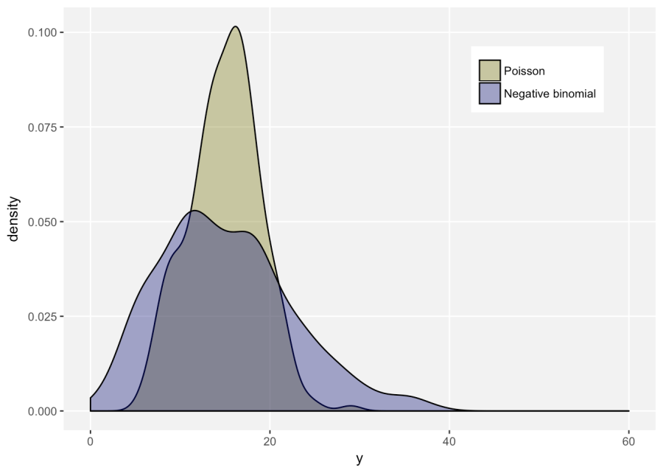
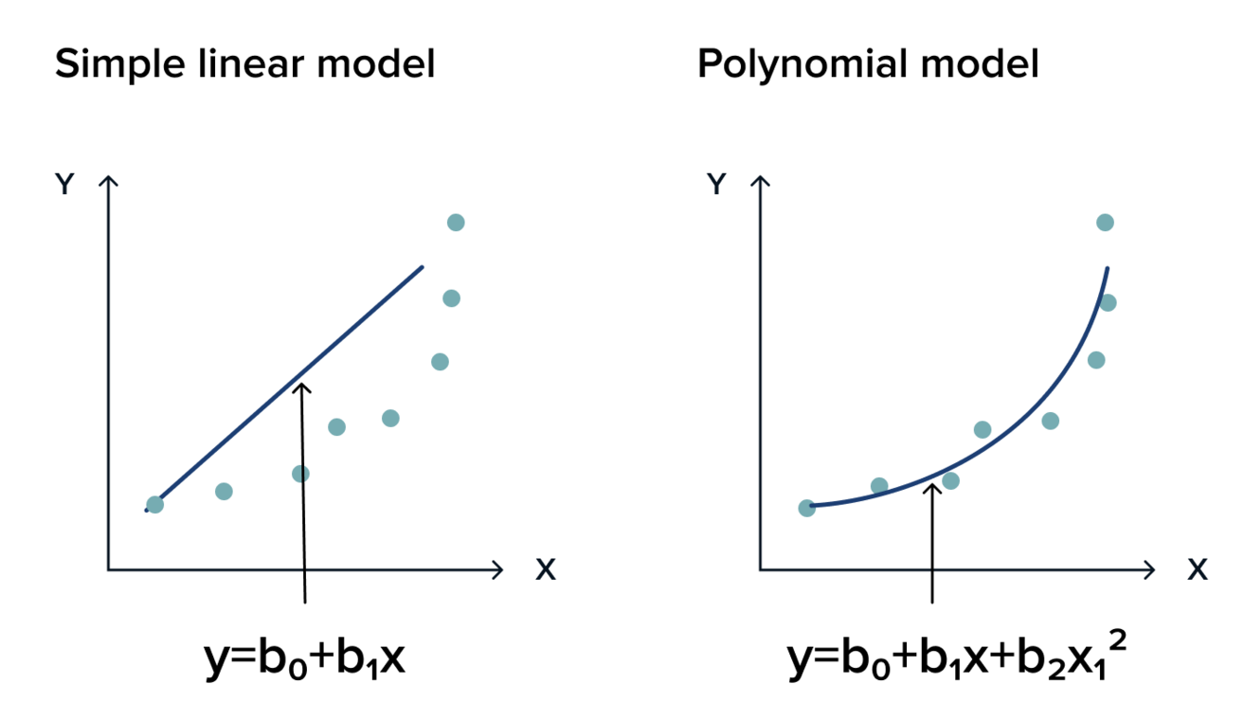
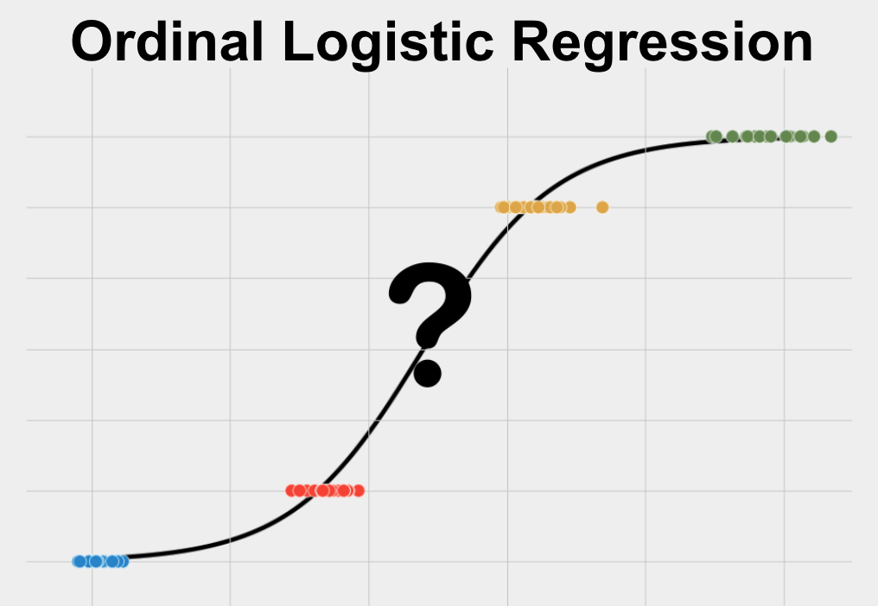
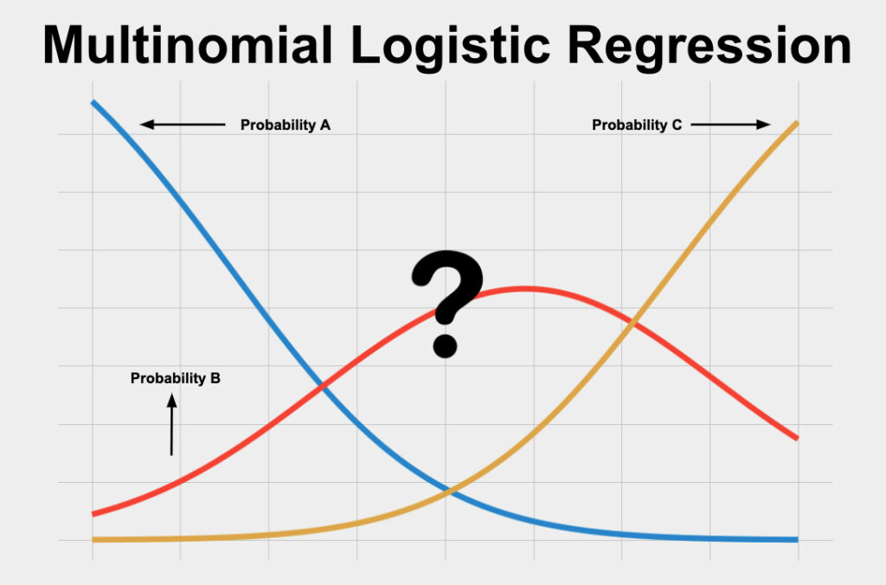
Types of Dependent Variable (DV)
Continuous DV
- continuous scale (e.g., price)
Categorical DV
- categorical scale
Count DV
- discrete, non-negative values
e.g., # of occurrences of an event
model:
Binary logistic regression (a Binomial probability distribution, e.g. pass/fail)
Ordinal logistic regression (an order of outcomes, e.g. movie review)
(multi)nominal logistic regression (no order of preference or ranking, e.g. race)
- do not meet the LM’s assumptions (e.g., the errors follow a normal dist.)
- skewed distribution
model:
Linear regression (simple, multivariate, polynomial)
Ridge, Lasso regression
- most common, straightforward to use
- understand the mean change in a DV given a one-unit change in each IV
- estimate parameters by minimizing the sum of the squared error (SSE)
- apply maximum likelihood estimation which assumes probability distribution given the observed data
model:
Poisson regression (count)
Negative binomial regression (count + overdispersion)
Zero-inflated models (zero-part, regression part)

Slide 3
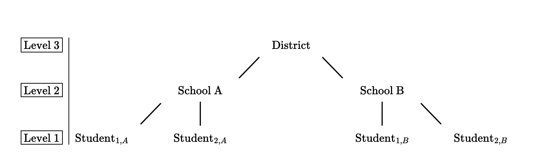
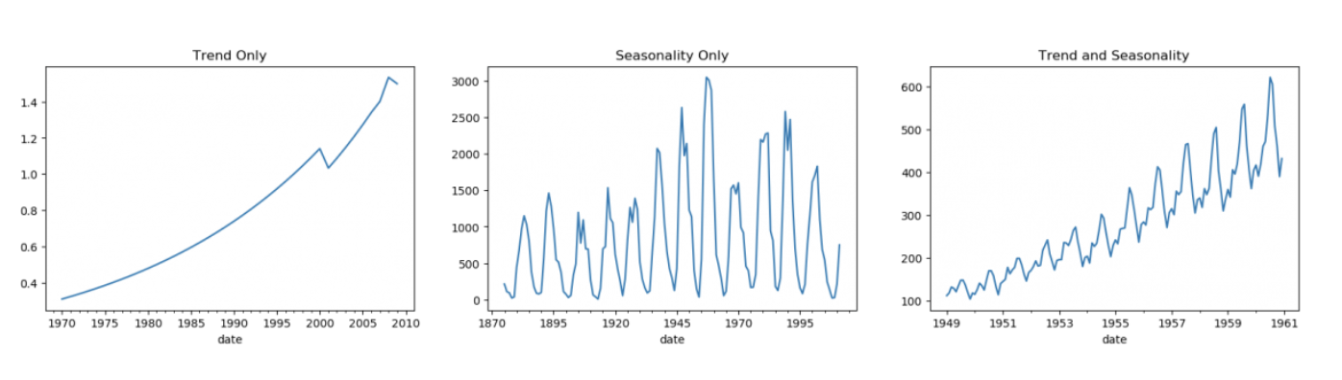
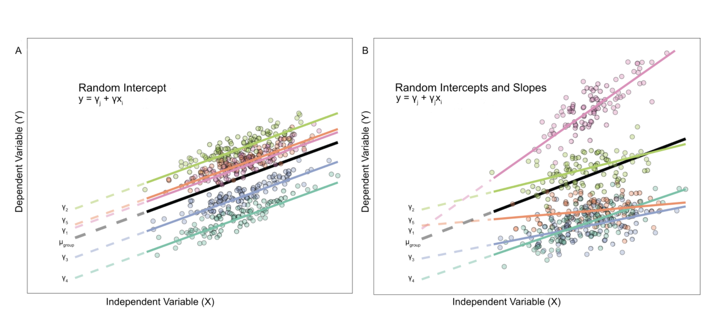
Types of Data Structure
Hierarchical or Multilevel Data (also linear-mixed model)
Time Series Regression
- assumes there is non independence (nested or grouped)
- parameters vary at more than one level
- estimate generalizations of linear models
- must decide fixed and random effects (for intercept or slope)
- DV must be the lowest level of analysis
- assumes evenly spaced time series data (if not, should be in this format using interpolation, aggregation etc.)
- need to decompose patterns of time series
trend: there is a long-term increase or decrease in the data, “changing direction”
seasonality: affected by seasonal factors (of the year, the day of the week, etc), with regularity. e.g., ice cream sales in summer
cycle: patterns of rises and falls that are not a fixed frequency. e.g., socio-economic factors
- also need to remove other components for time series model (e.g.)
stationarity : the values of the series is NOT a function of time
-> should make non-stationary stationary
autocorrelation : the correlation of the series with its previous values
moving average (MA) : removing seasonality and/or trend
ARIMA
Notes:
"Fixed-effect parameters describe the relationships of the covariates to the dependent variable for an entire population,
random effects are specific to clusters of subjects within a population.”
Gelman & Hill (2007) make the case that the classification of a variable as a fixed effect or random effect will vary depending on the objective of the study and the analysis. How a variable is modeled changes what is being measured and what the model is assuming about the variable itself. Using the school study example, if one were to model the categorical school variable as a fixed effect that model would assume the group means (one from each school) are independent from each other; if the categorical school variable is modeled as a random effect (random intercept only) the model would assume that the schools measured are a sample of a larger population of schools.

