Slide 1

My Travel App
Connor Reed
Erik Augenzucker
Josh Dulin
Taddes Korris

Slide 2
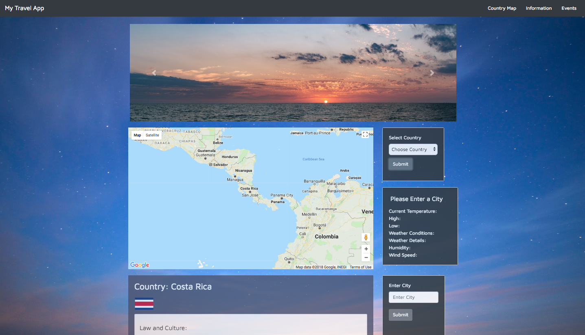

Slide 3
My Travel App
A comprehensive application that gathers helpful information based on the users specified destination.
Creates a better experience for the user when planning for an upcoming trip.
Notes:
Talk about motivation…
Personal experience
Most people love to travel but the hassle of planning a trip can be overwhelming at times
Having an organized source of information can help inform the user, creating a better understanding of where they would like to travel too

Slide 4
Technologies
HTML
CSS
JavaScript
jQuery
APIs and AJAX
Bootstrap Library
jQuery UI Library
Firebase
Notes:
APIs- Tugo, Open Weather, Google Maps, Event Brite
jQuery UI- tooltips and accordion menus
Firebase- stored country name data so dropdown would be populated before return of API call

Slide 5
Design Process
Organization of Methods for Completion
Create Story Map
Designate tasks for specific group members
Researched APIs

Slide 6
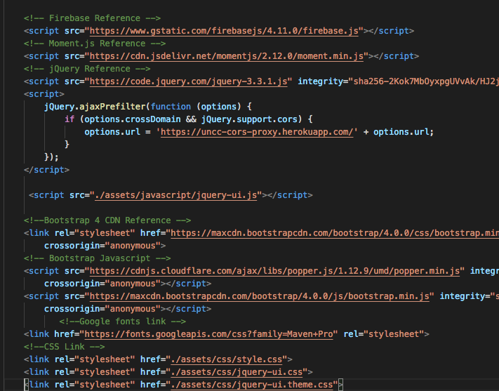
Design Process
Link CDNs

Slide 7
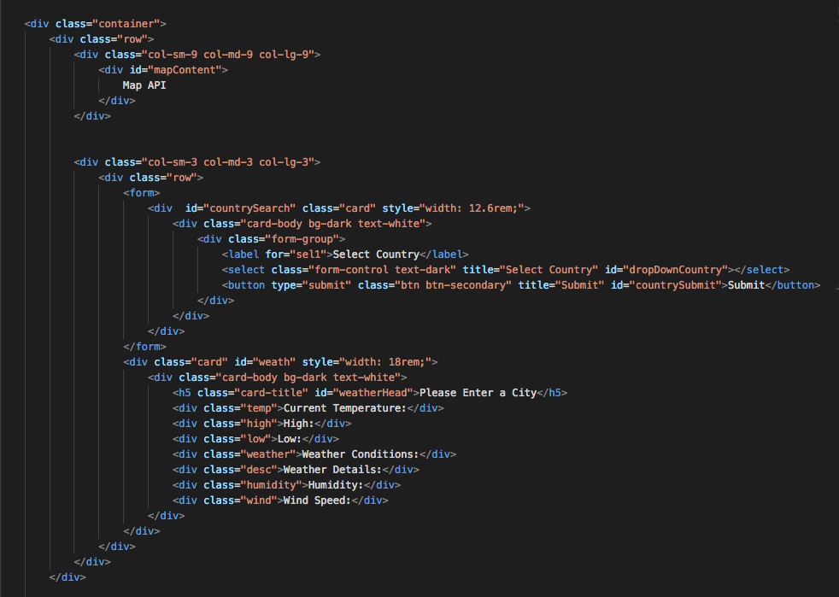
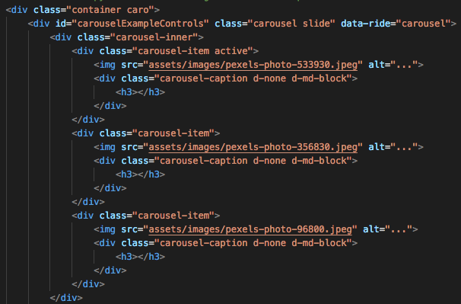
Design Process
Create HTML template for page using Bootstrap
Notes:
Also used navbar

Slide 8
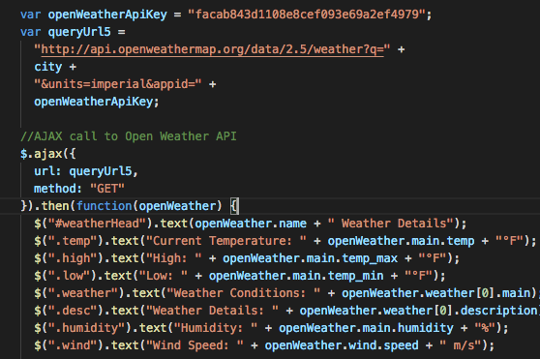
Design Process
Create AJAX calls for each API
Test APIs and determine what parameters to grab

Slide 9
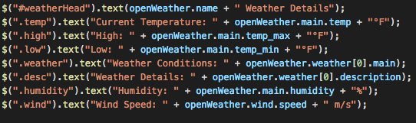
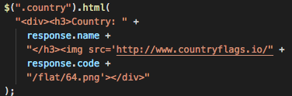
Design Process
Use jQuery to display API data to HTML

Slide 10
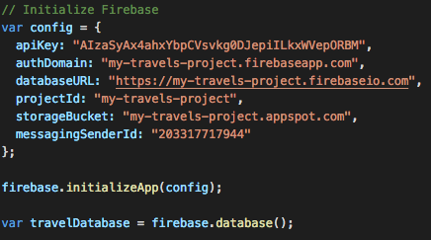
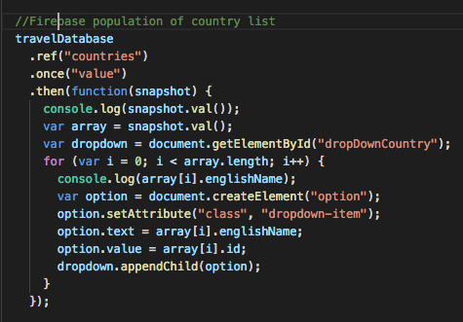
Design Process
Create and link Firebase Database
Pull data

Slide 11
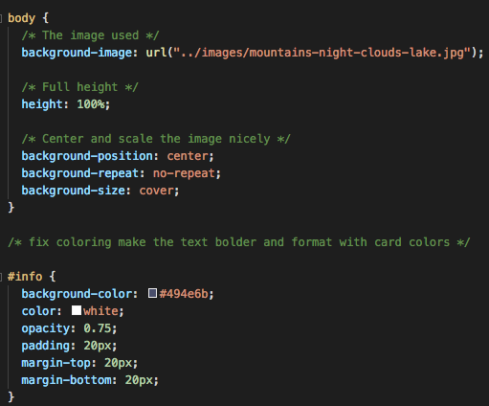
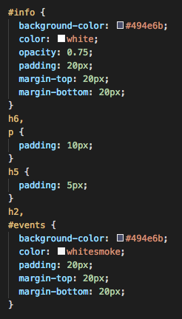
Design Process
Add Styles using CSS to polish

Slide 12
Problems Encountered
Getting started with Git
More accurate latitude and longitude data
jQuery UI bug

Slide 13
Demonstration
https://taddes.github.io/Project-1-Travel-App/
https://github.com/taddes/Project-1-Travel-App
Notes:
https://taddes.github.io/Project-1-Travel-App/

Slide 14
Future Development
More APIs
Open Weather API giving a 5 day forecast
Inform user with lodging options
Inform the user with current flight costs
Creating a map that’s even more interactive.
Access to historical data on flight cost and weather; stored in firebase

