Slide 1
02 cvicenie

Slide 2
Instalacie
kto ma OSX alebo Linux tak instalacia nvm
https://github.com/nvm-sh/nvm
instalacia node
node.js v 11.X + https://nodejs.org/en/
Instalacia editora
atom, VS code, …
kto nema preferovany tak Sublime Text 3.0 https://www.sublimetext.com/
Plugins: https://packagecontrol.io/
HTML-CSS-JS Prettify
SideBarEnhancements
Instalacia Bash konzoly a CMD Line Gitu
OSX a Linux - nic
windows: https://git-scm.com/download/win

Slide 3
Zadanie 01 - Exploratory testing
Setup projektu:
git checkout master
git pull
git checkout –b cviko2
cd 02-cvicenie/ulohy
npm install
npm test
Ciel cvicenia:
Exploratory testing of Java language and API using mocha test framework and node.js assert library
https://mochajs.org/
https://nodejs.org/api/assert.html
Body: 5 bodov
Delivery: commited on forked github
all tests green
new tests created

Slide 4
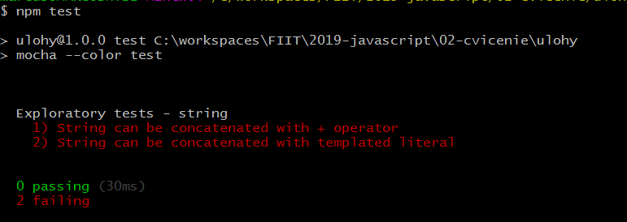
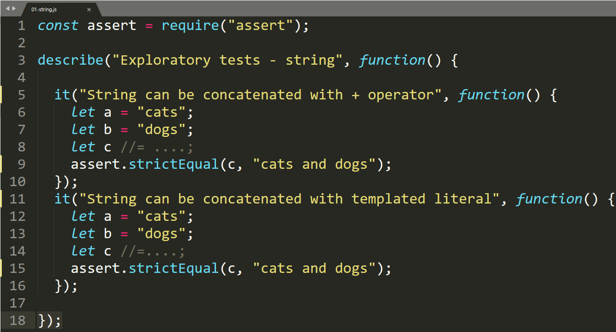
mocha basics

