Slide 1
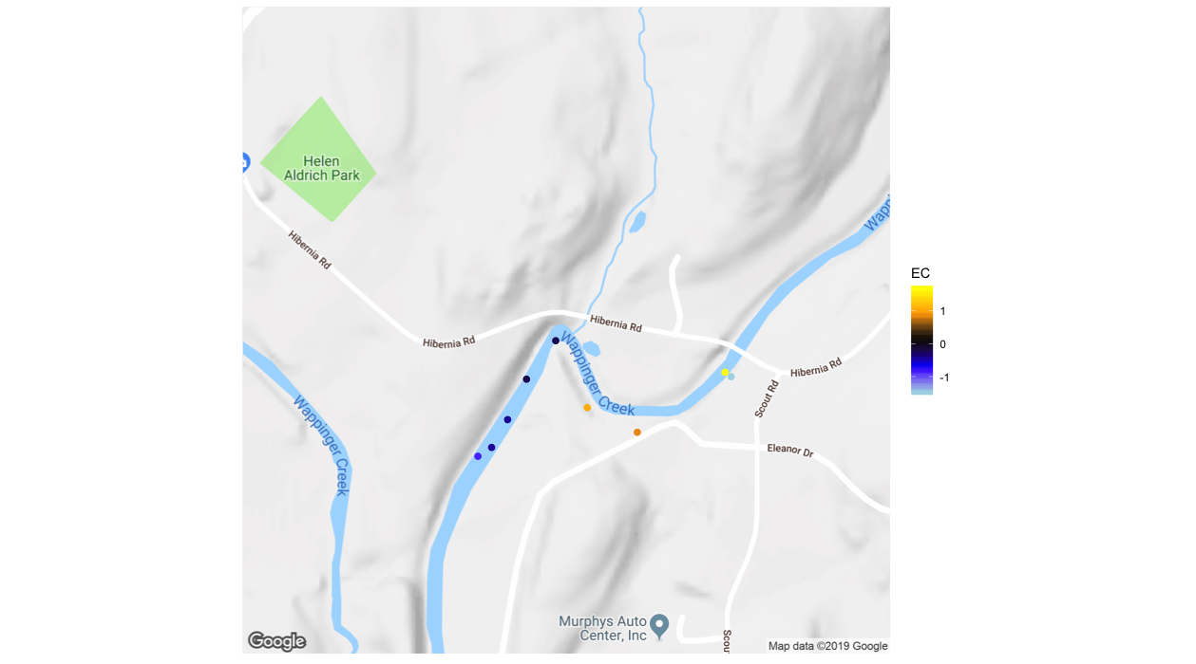

Reach Normalized Electrical Conductivity (μS)
1-2
1-1
High Angle
Fault Zone
A
0.5
1 KM

