Slide 1
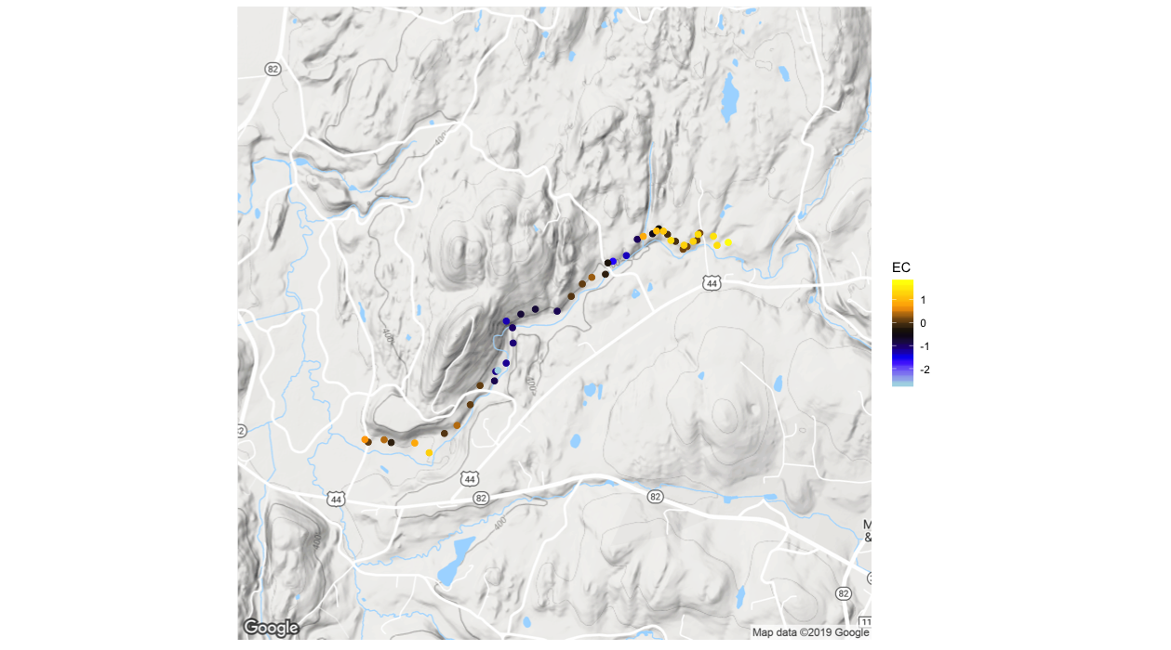

C
= High Angle
Fault
Reach Normalized Electrical Conductivity (μS)
D
3-1
E
Z
3-2
High Angle
Fault Zone
3-3
Z`
3-4
0.5
1.0 KM

