Slide 1
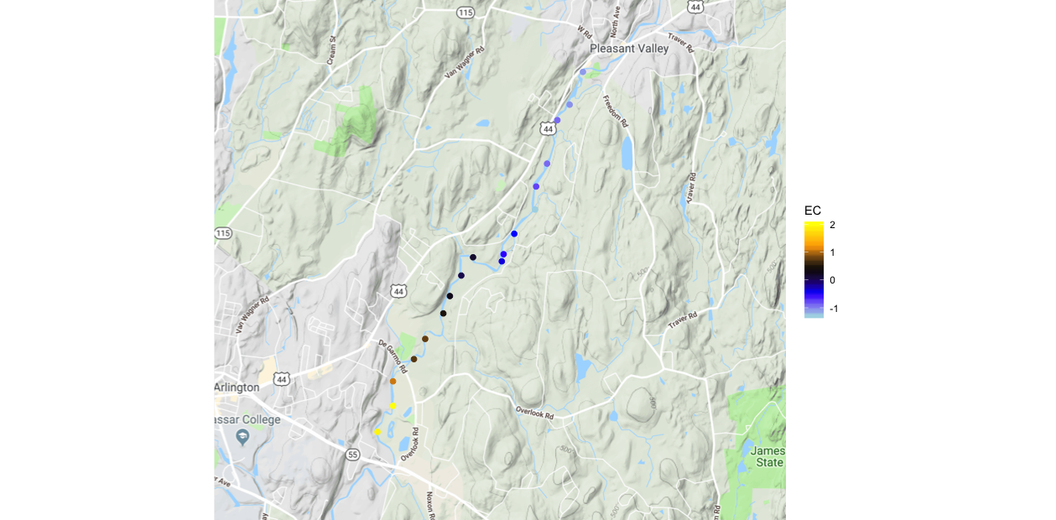

Reach Normalized Electrical Conductivity (μS)
2-1
High Angle
Fault Zone
2-2
B
1.0
2.0 KM

