Slide 1
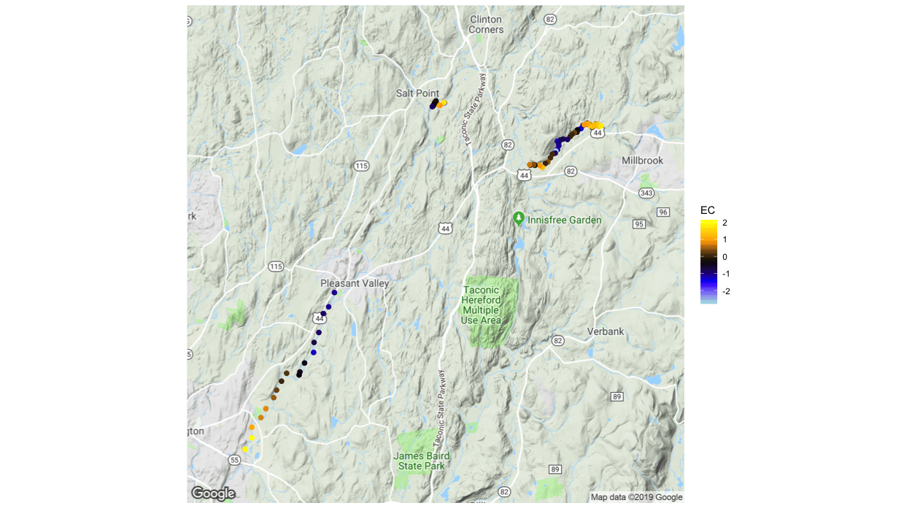
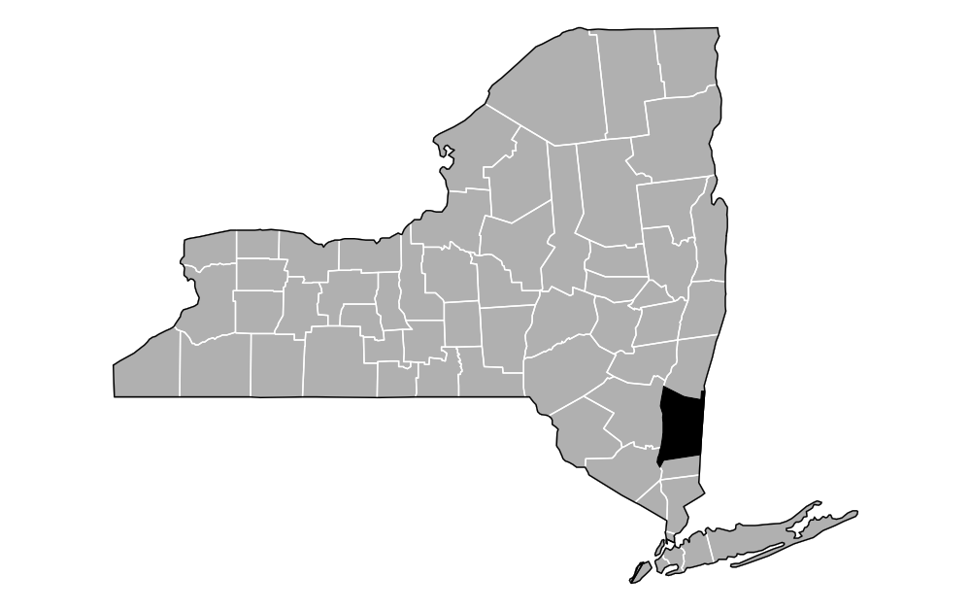

Site 1
Reach Normalized Electrical Conductivity (μS)
Site 3
High Angle
Fault Zone
Site 2
1.0
2.0 KM

Slide 2
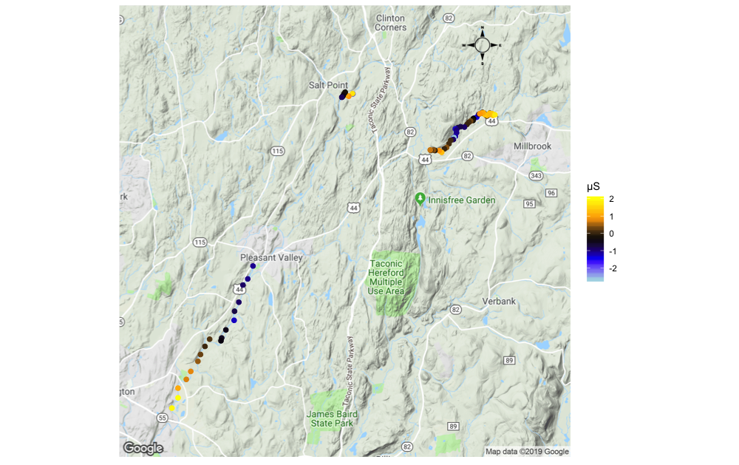
= High Angle
Fault Zone

