Slide 1
Lecture 14
Web Frameworks

Slide 2
Web development continued
Web frameworks are collections of packages or modules which allow developers to write web applications with minimal attention paid to low-level details like protocols, sockets and process management. Common operations implemented by web frameworks:
URL routing
Output format templating.
Database manipulation
Basic security

Slide 3
Web frameworks
Python has a number of web framework options, but the two most popular are:
Django
Follows MVC pattern.
Most popular.
Steeper learning curve.
More features built-in.
Flask
“Micro”-framework: minimal approach.
You can get things up and going much faster.
Less built-in functionality.
Also a popular option.

Slide 4
Intro to flask
We’ll be using Flask due to its ease of use. Django requires a bit more setup and familiarity with the MVC pattern, but once you’re familiar with Flask, you’ll find that learning Django is easier.
So, we have the core logic behind our website completed (namely, ticket_scraper.py). Let’s put this aside for a moment and create our website.

Slide 5
Intro to flask
ticket_app/
app/
static/
templates/
tmp/
The very first thing is to create a directory structure for all of the files and components of our website and set up our virtual env. The root is ticket_app.

Slide 6
Intro to flask
ticket_app/
app/
static/
templates/
tmp/
The very first thing is to create a directory structure for all of the files and components of our website and set up our virtual env. The root is ticket_app.
ticket_app$ virtualenv t_app
ticket_app$ source t_app/bin/activate
(t_app)ticket_app$ pip install flask
For more info on the reasons for this structure, check out this link from the Flask docs.

Slide 7
Intro to flask
ticket_app/
app/ __init__.py
static/
templates/
tmp/
The very first thing we’ll do is create a Flask application object inside of app/__init__.py
from flask import Flask my_app = Flask(__name__) # Create an application object called my_app from app import views # Import the views module from the app package
Import appears at end to avoid circular dependencies: views depends on my_app.

Slide 8
Intro to Flask
ticket_app/
app/ __init__.py
views.py
static/
templates/
tmp/
Now, let’s create our first view. Views are handlers for requests and are mapped to one or more URLs.
from app import my_app @my_app.route('/') @my_app.route('/index') def index(): return "Welcome to the Taylor Swift Concert Ticket-Price Showdown!"
Notice the use of decorators!
We’ve created a view which displays a simple string to the user when they request URLs ‘/’ and ‘/index’

Slide 9
Intro to flask
ticket_app/
run.py
app/ __init__.py
views.py
static/
templates/
tmp/
One last thing we need to do to actually see some stuff. Create the script run.py to start up the development web server with our little application.
#!t_app/bin/python from app import my_app my_app.run(debug=True)
Note the line up top – we’re telling the shell to use our isolated Python interpreter when we run ./run.py.

Slide 10
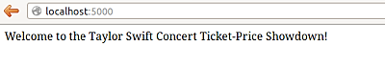
Intro to flask
ticket_app/
run.py
app/ __init__.py
views.py
static/
templates/
tmp/
Now let’s see what we have.
ticket_app$ chmod a+x run.py ticket_app$ ./run.py
After the server initializes, we can check out our site by connecting to localhost:5000.

Slide 11
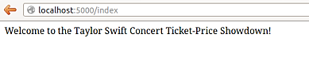
Intro to flask
ticket_app/
run.py
app/ __init__.py
views.py
static/
templates/
tmp/
Now let’s see what we have.
ticket_app$ chmod a+x run.py ticket_app$ ./run.py
We associated both ‘/’ and ‘/index’ with our view function index().

Slide 12
Templating
ticket_app/
run.py
app/ __init__.py
views.py
static/
templates/
tmp/
So far, our only view function merely outputs a single string.
from app import my_app @my_app.route('/') @my_app.route('/index') def index(): return "Welcome to the Taylor Swift Concert Ticket-Price Showdown!"

Slide 13
Templating
ticket_app/
run.py
app/ __init__.py
views.py
static/
templates/
tmp/
We could just as easily return html to be rendered in the browser.
from app import my_app @my_app.route('/') @my_app.route('/index') def index(): return '''<html> <h1>Welcome to the Taylor Swift Concert Ticket-Price Showdown!</h1> </html> '''

Slide 14
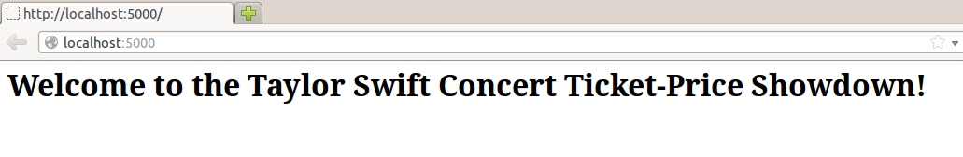
Templating
ticket_app/
run.py
app/ __init__.py
views.py
static/
templates/
tmp/
We could just as easily return html to be rendered in the browser.

Slide 15
Templating
ticket_app/
run.py
app/ __init__.py
views.py
static/
templates/
base.html
tmp/
That method is so ugly though. So let’s separate the presentation from the logic by creating a template base.html inside of templates/.
<html> <head> <title>Taylor Swift Concert Ticket-Price Showdown</title> </head> <body> <h1> Welcome to the Taylor Swift Concert Ticket-Price Showdown! </h1> {% block content %} {% endblock %} </body> </html>
We’re using the Jinja2 templating engine, which is included with Flask.

Slide 16
Templating
Jinja2 templates allow us to do a lot more than just write HTML.
{{ arg }} corresponds to template arguments. I can pass arg=val to my template.
{% %} encompasses control statements (if, for, block, etc).
e.g. {% if arg %} <h1>arg</h1> {% endif %}
{% block content %}{% endblock %} identifies a portion of the html (called “content”) in which more content could be inserted.

Slide 17
Templating
ticket_app/
run.py
app/ __init__.py
views.py
static/
templates/
base.html
tmp/
That method is so ugly though. So let’s separate the presentation from the logic by creating a template base.html inside of templates/.
<html> <head> <title>Taylor Swift Concert Ticket-Price Showdown</title> </head> <body> <h1> Welcome to the Taylor Swift Concert Ticket-Price Showdown! </h1> {% block content %} {% endblock %} </body> </html>
Now we have a template called base.html which has some basic elements but also includes a control statement which allows us to derive and extend the template.

Slide 18
templating
ticket_app/
run.py
app/ __init__.py
views.py
static/
templates/
base.html
index.html
tmp/
We’ve created a basic template which we can extend. So now I’ll create templates/index.html which derives from base.html and adds some more content.
{% extends base.html %} {% block content %} <h2> Find the best ticket prices in town with the Taylor Swift Concert Ticket-Price Showdown! </h2> {% endblock %}
Now we have a template called index.html which inherits from base.html and specifies the matching block statement “content” .

Slide 19
templating
ticket_app/
run.py
app/ __init__.py
views.py
static/
templates/
base.html
index.html
tmp/
One last thing we need to do. Let’s update our views to access our template.
from flask import render_template from app import my_app @my_app.route('/') @my_app.route('/index') def index(): return render_template('index.html')
Invokes Jinja2 templating engine

Slide 20
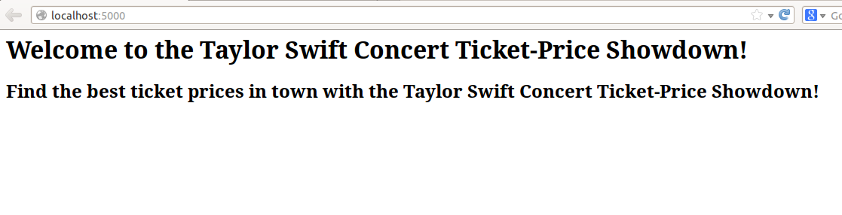
templating

Slide 21
Forms
ticket_app/
run.py
app/ __init__.py
views.py
static/
templates/
base.html
index.html
tmp/
Obviously, we don’t just want to display text to the user, we want to allow them to search for tickets. Naturally, we turn our attention to forms.
(t_app)ticket_app$ pip install flask-wtf
Let’s install the WTForms extension which integrates WTForms, a form validation and rendering library,
with Flask.

Slide 22
Forms
ticket_app/
config.py
run.py
app/ __init__.py
views.py
static/
templates/
base.html
index.html
tmp/
When using extensions with Flask, typically you will have to perform some kind of configuration. This can be done in the “config.py” file at the root of your project.
config.py
WTF_CSRF_ENABLED = True
SECRET_KEY = ‘somesuperdupersecretkey’
For the WTForms extension, we need to specify whether cross-site request forgery protection is enabled and the key to use to validate the form.

Slide 23
forms
ticket_app/
config.py
run.py
app/ __init__.py
views.py
static/
templates/
base.html
index.html
tmp/
Now, we just modify __init__.py to set up our Flask object to use the settings in our config file.
from flask import Flask my_app = Flask(__name__) my_app.config.from_object(config) from app import views

Slide 24
Forms
ticket_app/
config.py
run.py
app/ __init__.py
views.py
forms.py
static/
templates/
base.html
index.html
tmp/
Let’s create our first form. All we want right now is to be able to accept some string which represents the event name and the location. We’ll create a forms.py inside of app/.

Slide 25
Forms
ticket_app/
config.py
run.py
app/ __init__.py
views.py
forms.py
static/
templates/
base.html
index.html
tmp/
Let’s create our first form. All we want right now is to be able to accept some string which represents the event name and the location.
from flask.ext.wtf import Form from wtforms import StringField, SelectField from wtforms.validators import DataRequired class EventSearch(Form): event_name = StringField('event_name', validators=[DataRequired()]) location = SelectField('location', choices=[('tallahassee', 'Tallahassee'), ('orlando', 'Orlando')])

Slide 26
forms
ticket_app/
config.py
run.py
app/ __init__.py
views.py
forms.py
static/
templates/
base.html
index.html
search.html
tmp/
Next, we create a new template for the page on which we will display the form.
{% extends "base.html" %} {% block content %} <h1>{{title}}</h1> <form action="" method="post" name="event_search"> {{form.hidden_tag()}} <p> Please enter the event you’d like to find tickets for: <br>{{form.event_name(size=80)}}<br> </p> <p> Select a location: {{form.location}} </p> <p><input type="submit" value="Find my tickets!"></p> </form> {% endblock %}
For CSRF protection

Slide 27
Forms
ticket_app/
config.py
run.py
app/ __init__.py
views.py
forms.py
static/
templates/
base.html
index.html
search.html
tmp/
Lastly, to see our form in action, we need to create a route for it.
from flask import render_template from app import my_app from app.forms import EventSearch @my_app.route('/') @my_app.route('/index') def index(): return render_template('index.html') @my_app.route('/search', methods=['GET', 'POST']) def search(): form = EventSearch() return render_template('search.html', title='Search for an Event', form=form)

Slide 28
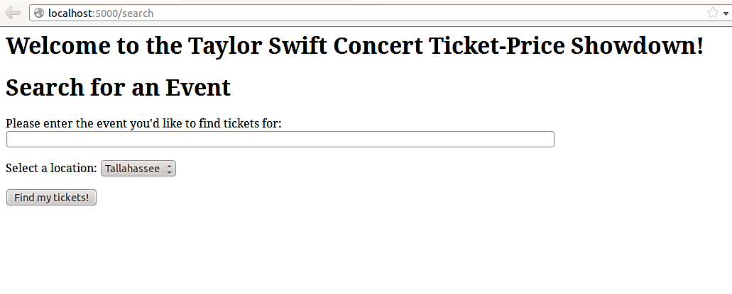
Forms

Slide 29
Forms
ticket_app/
config.py
run.py
app/ __init__.py
views.py
forms.py
static/
templates/
base.html
index.html
search.html
tmp/
Now, we’re displaying a form so let’s actually grab some input.
from flask import render_template ... @my_app.route('/search', methods=['GET', 'POST']) def search(): form = EventSearch() if form.validate_on_submit(): event = form.event_name.data location = form.location.data return render_template('search.html', title='Search for an Event', form=form)
form.validate_on_submit() returns false if the user hasn’t entered data, true if they have and validators are met.

Slide 30
Forms
ticket_app/
config.py
run.py
app/ __init__.py
views.py
forms.py
ticket_scraper.py
static/
templates/
base.html
index.html
search.html
tmp/
If we gather data, and all of the validators are met, we still render search, but with post info.
from flask import render_template from app.ticket_scraper import get_posts … @my_app.route('/search', methods=['GET', 'POST']) def search(): posts = [] form = EventSearch() if form.validate_on_submit(): event = form.event_name.data location = form.location.data posts = get_posts(event, location) return render_template('search.html', title='Search for an Event', form=form, posts=posts)

Slide 31
forms
So here’s what we’re doing:
When a user navigates to /search, they can enter their search criteria.
When a form is submitted, we use the search information to call our scraping module.
Then, we render the search template again with the post information. Now, we need to update the template for search.html to display post information. Note: this is not an ideal setup – we’re mixing backend logic with our application. We’ll call ticket_scraper directly to build our site for now.

Slide 32
Displaying results
To remind ourselves, here’s the contents of search.html.
{% extends "base.html" %} {% block content %} <h1>{{title}}</h1> <form action="" method="post" name="event_search"> {{form.hidden_tag()}} <p> Please enter the event youd like to find tickets for: <br>{{form.event_name(size=80)}}<br> </p> <p> Select a location: {{form.location}} </p> <p><input type="submit" value="Find my tickets!"></p> </form> {% endblock %}

Slide 33
Displaying results
... {% if posts %} <table id="t01"> <thead> <tr> <th>Title</th> <th>Date</th> <th>Venue</th> <th>Number of Tickets</th> <th>Price/Ticket</th> </tr> </thead> <tbody> {% for p in posts %} <tr> <td>{{ p[3] }}</td>
<td>{{ p[0] }}</td> <td>{{ p[1] }}</td> <td>{{ p[2] }}</td> <td>{{ p[4] }}</td> </tr> {% endfor %} </tbody> </table> {% endif %} {% endblock %}
search.html
We enclose our additions to search.html using an if condition – if posts is empty, we don’t display the table of results. This happens when a user first navigates to the search page.

Slide 34
Displaying results
... {% if posts %} <table id="t01"> <thead> <tr> <th>Title</th> <th>Date</th> <th>Venue</th> <th>Number of Tickets</th> <th>Price/Ticket</th> </tr> </thead> <tbody> {% for p in posts %} <tr> <td>{{ p[3] }}</td>
<td>{{ p[0] }}</td> <td>{{ p[1] }}</td> <td>{{ p[2] }}</td> <td>{{ p[4] }}</td> </tr> {% endfor %} </tbody> </table> {% endif %} {% endblock %}
search.html
The post information we gathered using the ticket_scraper module includes:
Title
Date
Venue
Number of Tickets
Price/Ticket

Slide 35
Displaying results
... {% if posts %} <table id="t01"> <thead> <tr> <th>Title</th> <th>Date</th> <th>Venue</th> <th>Number of Tickets</th> <th>Price/Ticket</th> </tr> </thead> <tbody> {% for p in posts %} <tr> <td>{{ p[3] }}</td>
<td>{{ p[0] }}</td> <td>{{ p[1] }}</td> <td>{{ p[2] }}</td> <td>{{ p[4] }}</td> </tr> {% endfor %} </tbody> </table> {% endif %} {% endblock %}
We loop through the posts list, which contains the results of ticket_scraper in the form of tuples. For every row in our results table, we’ll print out the information gathered from a post.

Slide 36
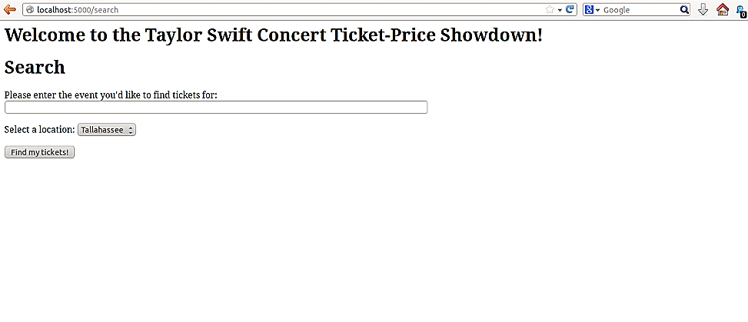
Displaying results

Slide 37
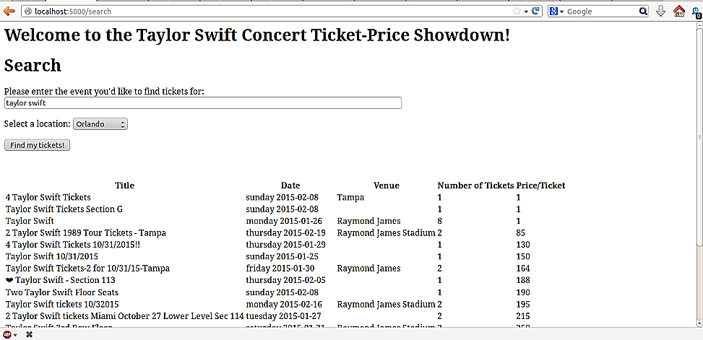
Displaying results

Slide 38
Displaying results
ticket_app/
config.py
run.py
app/ __init__.py
views.py
forms.py
ticket_scraper.py
static/
style.css
templates/
base.html
index.html
search.html
tmp/
Well, that looks…terrible. But at least we’re displaying the data! Let’s make it look nicer. We’ll add an external style sheet to our static folder and update our base.html.
<html> <head> <title>Taylor Swift Concert Ticket-Price Showdown!</title> <link rel="stylesheet" type="text/css" href="{{ url_for('static',filename='style.css') }}"> </head> <body> <h1> Welcome to the Taylor Swift Concert Ticket-Price Showdown! </h1> {% block content %}{% endblock %} </body> </html>

Slide 39
Displaying results
ticket_app/
config.py
run.py
app/ __init__.py
views.py
forms.py
ticket_scraper.py
static/
style.css
templates/
base.html
index.html
search.html
tmp/
We can use a {{ … }} delimeter which will tell Jinja2 to evaluate the expression inside. Inside, we’ll make a call to url_for which generates a URL to the target.
<html> <head> <title>Taylor Swift Concert Ticket-Price Showdown!</title> <link rel="stylesheet" type="text/css" href="{{ url_for('static',filename='style.css') }}"> </head> <body> <h1> Welcome to the Taylor Swift Concert Ticket-Price Showdown! </h1> {% block content %}{% endblock %} </body> </html>

Slide 40
Displaying Results
<html> <head> <title>Taylor Swift Concert Ticket-Price Showdown!</title> <link rel="stylesheet" type="text/css" href="{{ url_for('static',filename='style.css') }}"> </head> <body> <h1> Welcome to the Taylor Swift Concert Ticket-Price Showdown! </h1> <div id="hmenu"> <ul> <li><a href="{{url_for('index')}}">Home</a></li> <li><a href="{{url_for('search')}}">Search</a></li> </ul> </div> {% block content %}{% endblock %} </body> </html>
Let’s add a navigation menu while we’re at it.

Slide 41
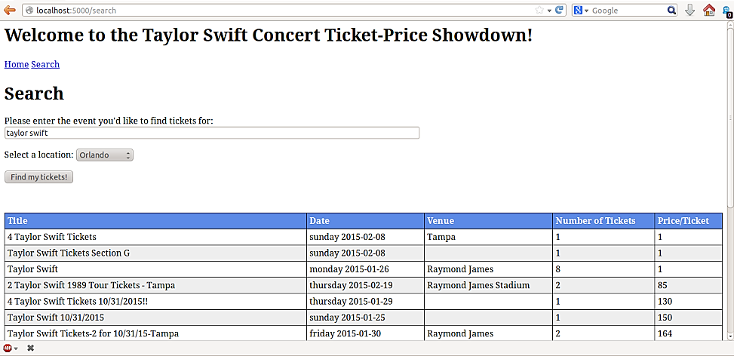
Displaying results

Slide 42
Displaying Results
We’re probably not going to be featured on CSS Zen Garden or anything, but it looks better. So that’s zero to Flask in 40 slides. Some important things to note:
Flask has a TON of extensions: check http://flask.pocoo.org/extensions/.
As I said, we built the “back-end” functionality right into the app here. A smarter way would be to have a reactor loop that picks up scraping requests placed into a queue by the Flask app, and returns the results when it can. This way, we can perform non-blocking scraping in the case of a bunch of users accessing the site at once.
We’ve been serving our site using Flask’s development server (app.run()), which is great for development but you should use a full server for deployment. Let’s explore self-hosting with Gunicorn and Nginx.

