Slide 1
Lecture 15
Web Servers

Slide 2
Deployment
So, we’ve created a little web application which can let users search for tickets on Craigslist, sorted by price per ticket. The steps we’ve taken so far:
Writing the backend functionality of our website – ticket_scraper.py
Using Flask to write our web application, which calls our ticket_scraper module.
We’re going to be terrible software engineers for a moment and assume our web application is ready to be deployed.

Slide 3
Deployment
Even though we’ve been using Flask’s development server to serve our application, this should not be used publicly. Instead, we should set up a production environment.
We could just pick a platform-as-a-service option such as OpenShift, Gondor, CleverCloud, Heroku, etc. That way, we just need to worry about our application and not the server details.
But we’re not going to do that! Let’s create our own server (assuming we obtained a machine we could use as the server).

Slide 4
WSGI
Before we begin setting up our server, let’s discuss WSGI. WSGI is the Web Server Gateway Interface.
WSGI is a Python standard, described in PEP (Python Enhancement Proposals) 3333, that details how web servers should communicate with web applications written in Python. It is not a module or server or package. It’s just a specification.

Slide 5
WSGI
Before WSGI, a traditional web server did not understand or have any way to run Python applications. Eventually, an Apache module called mod_python was created to execute arbitrary Python code. In the late 1990s and early 2000s, most Python web applications were run by Apache configured with mod_python (but also some other custom APIs for specific web servers).
But mod_python was just a small project developed by one person – eventually, a standard method for executing Python code for web applications was necessary.

Slide 6
WSGI
Enter WSGI!
WSGI specifies a uniform standard for invoking Python modules within web applications.
There are two sides to the WSGI specification: “server” and “application”.
The server side provides environment information and a callback function to the application side.
The application processes the request, and returns the response to the server side using the callback function it was provided. If a web framework is WSGI compliant, its applications should be servable by any WSGI-compliant server. This means we can choose our framework and server independently.

Slide 7
WSGI
WSGI-compliant frameworks include Django, Flask, Pylons, Pyramid, etc. (so many choices!) WSGI-compliant web servers include Gunicorn, Tornado, Waitress, etc.
We also have the option of embedding Python into a non-Python based web server by using mod_wsgi (Apache), ModPython (Apache), Nginx WSGI (Nginx), etc.

Slide 8
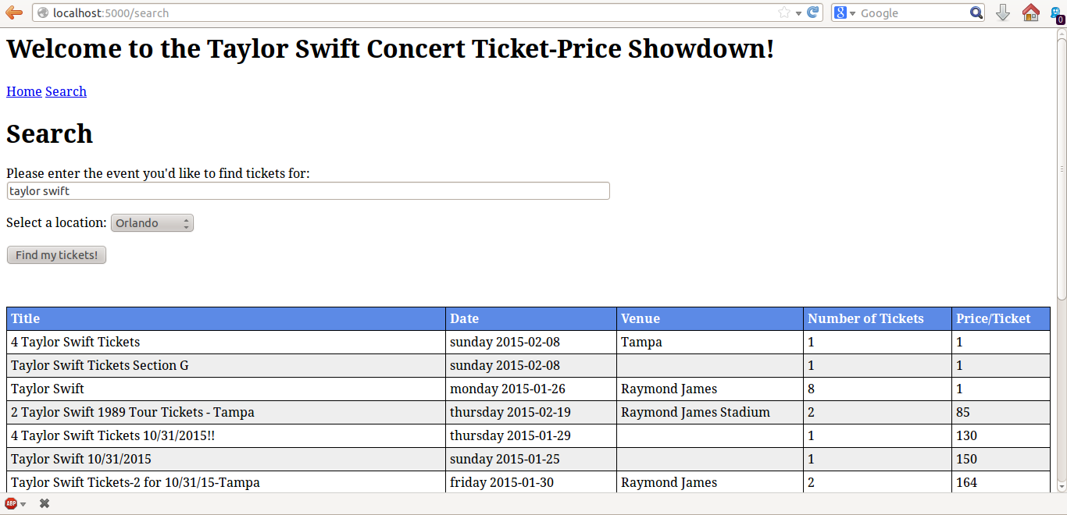
Deployment
We’re going to deploy our little website using Gunicorn fronted by Nginx.
Web Browser
generate search.html
www.whatever.com/search
WSGI Server (Gunicorn)
Web Server (Nginx)
sends search.html, which requires style.css
search.html
GET style.css
style.css

Slide 9
Deployment
Why use Nginx? The simple answer is that even though we need a server that can execute Python (WSGI server), there are features of a non-Python based server that we’d like to utilize: we can distribute requests through Nginx to multiple gunicorn instances, we can perform high-performance static file serving, efficiently handle high connection levels, etc. It’s just better to use Nginx as a reverse proxy so we can take advantage of its features as a powerful HTTP server, but we’re really serving dynamic content from Gunicorn.

Slide 10
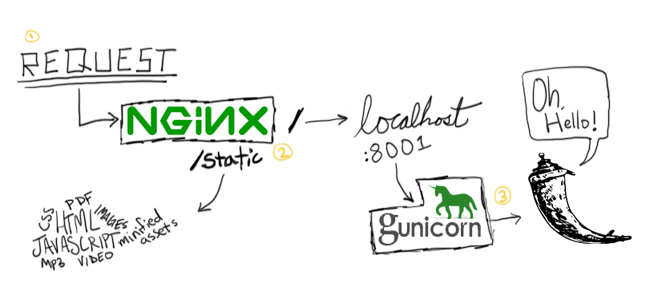
Deployment
An elegant pictorial representation of our setup (from realpython.com)

Slide 11
Getting started
The very first thing we need to get is install nginx and gunicorn of course. This class will temporarily turn into a Unix class for a minute.
$ sudo apt-get install nginx-full gunicorn

Slide 12
Configuring nginx
This is the easy part. Start up nginx. $ sudo /etc/init.d/nginx start Now, /etc/nginx/sites-enabled/ contains symlinks to configuration files in /etc/nginx/sites-available/. Configuration files in sites-available are not active until they are enabled. We’re going to remove the default symlink, create a new site configuration file for our flask application, and create a link for it in sites-enabled.

Slide 13
Configuring nginx
$ sudo rm /etc/nginx/sites-enabled/default $ sudo touch /etc/nginx/sites-available/flask_project $ sudo ln –s /etc/nginx/sites-available/flask_project /etc/nginx/sites-enabled/flask_project The first two are self explanatory, but the last command creates a symbolic link between the two file arguments. Essentially, the sites-enabled file will point sites-available file.

Slide 14
Configuring nginx
Now, we can actually throw some stuff into the configuration file for our Flask project.
/etc/nginx/sites-enabled/flask_project
server {
location / {
proxy_pass http://127.0.0.1:8000;
}
location /static {
alias /path/to/ticket_app/app/static/;
}
}
When an HTTP request hits the ‘/’ endpoint, reverse proxy to port 8000 on localhost, where gunicorn will be listening.

Slide 15
Configuring nginx
Now, we can actually throw some stuff into the configuration file for our Flask project.
/etc/nginx/sites-enabled/flask_project
server {
location / {
proxy_pass http://127.0.0.1:8000;
}
location /static {
alias /path/to/ticket_app/app/static/;
}
}
Do not route requests for static files through the WSGI server. Serve directly.

Slide 16
Configuring nginx
Now, we can actually throw some stuff into the configuration file for our Flask project.
/etc/nginx/sites-enabled/flask_project
server {
location / {
proxy_pass http://127.0.0.1:8000;
}
location /static {
alias /path/to/ticket_app/app/static/;
}
}
Nginx will bind to localhost:80 by default.

Slide 17
Configuring nginx and starting gunicorn
And restart nginx.
Now start up gunicorn inside of the Flask app directory.
What we’re doing is telling gunicorn to serve app.my_app on localhost, port 8000.
$ sudo /etc/init.d/nginx restart Restarting nginx: nginx.
ticket_app$ gunicorn app:my_app –b localhost:8000

Slide 18
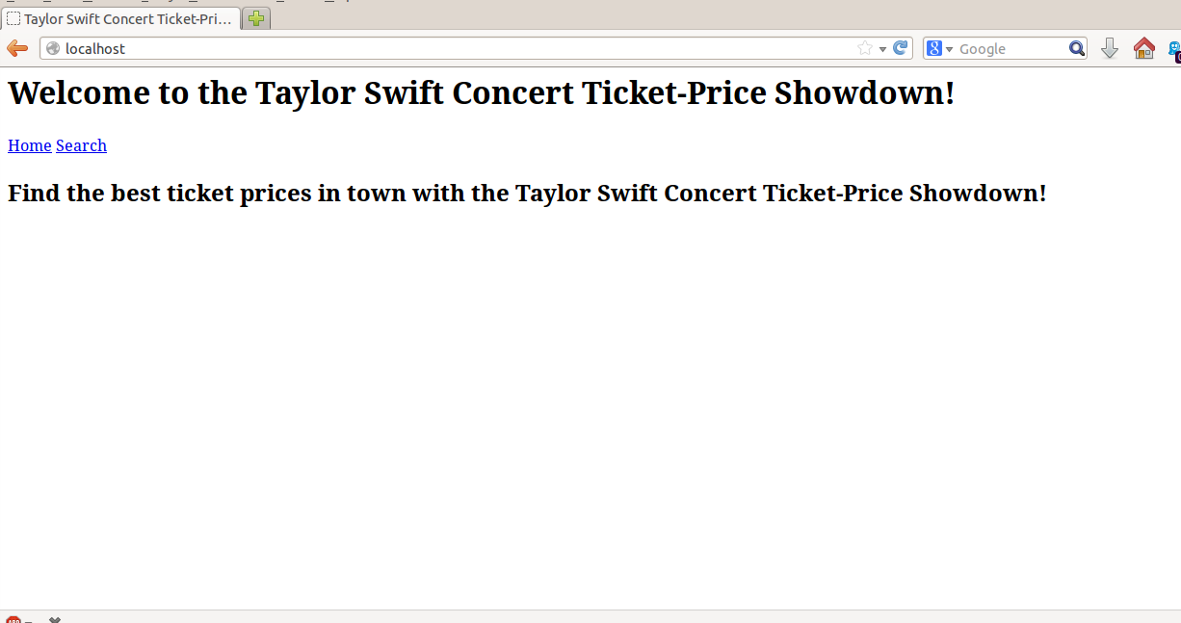
Checking out our site
Yay! Let’s look for Taylor Swift tickets in Tallahassee.

Slide 19
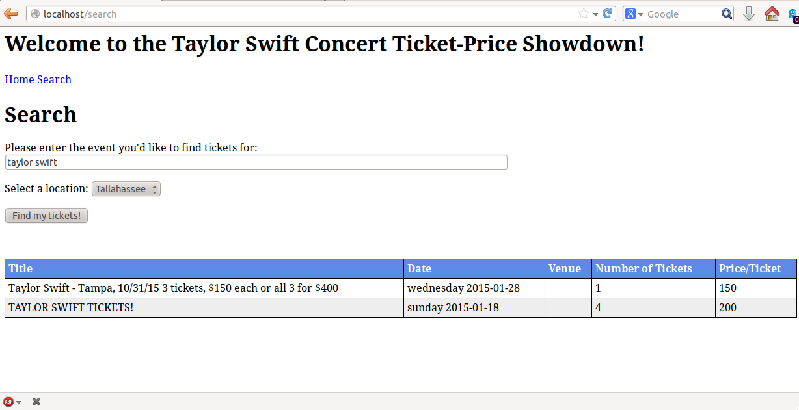
Checking out our site
More yay! Let’s try looking for Taylor Swift tickets in Orlando.

Slide 20
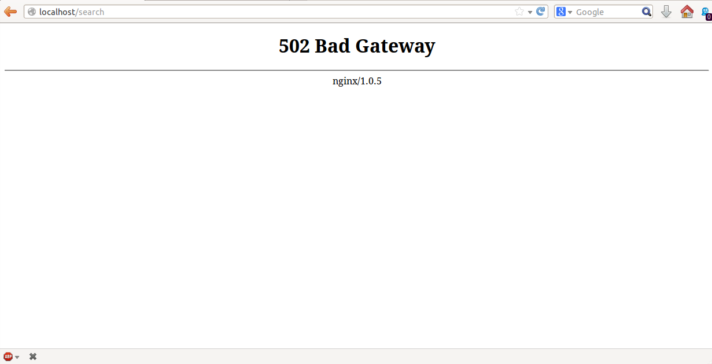
Checking out our site
Noooooo! What’s happening!?

Slide 21
Configuring gunicorn
502 Bad Gateway
The nginx server was acting as a gateway or proxy and received an invalid response from the upstream server. So, it’s Gunicorn’s fault. Let’s check it out. Gunicorn is nice enough to shout the following at us: [2898] [CRITICAL] WORKER TIMEOUT (pid:2903)

Slide 22
Configuring gunicorn
Bottom line: there’s too many Taylor Swift fans in Orlando and Gunicorn is timing out while waiting for the response to be created. Let’s take a step back and learn about how Gunicorn works.

Slide 23
Gunicorn
Gunicorn is a Python-based WSGI-compliant HTTP server for Unix (obviously). Gunicorn is based on the pre-fork worker model. There is a central master process which manages a set of worker processes responsible for handling all requests and responses. There’s only one type of master process and it’s just a reactor loop that listens for signals and responds accordingly. There are, however, a bunch of different worker types.

Slide 24
gunicorn
Sync Workers
Default. Handles a single request at a time.
Async Workers
Called eventlets (requires the eventlet package).
Cooperative multi-threading.
Tornado Workers
Used for writing applications using the Tornado framework.

Slide 25
Gunicorn
Sync workers are alright for most simple web applications that don’t require a lot of resources but they’re easy to DOS, that’s why we use Nginx upfront.
Async workers are required for resource- and time-intensive applications. In our case, our application makes a long blocking call to scrape Craigslist.
So let’s change our Gunicorn configuration. Previously, we just used the default config but now we’ll make our own.

Slide 26
Configuring gunicorn
Let’s create a config file which can be passed to the gunicorn command at start-up.
ticket_app/gunicorn/gunicorn.py
import os
bind = "127.0.0.1:8000"
workers = 2
worker_class = 'eventlet'
logfile = "logs/error.log"
loglevel = 'debug'
According to the Gunicorn docs, 4-12 workers should be able to handle hundreds of thousands of requests per second.
Async Workers

Slide 27
Serving the application
Now, we can issue the following to start up the Gunicorn server: ticket_app$ gunicorn app:my_app –c gunicorn/gunicorn.py

Slide 28
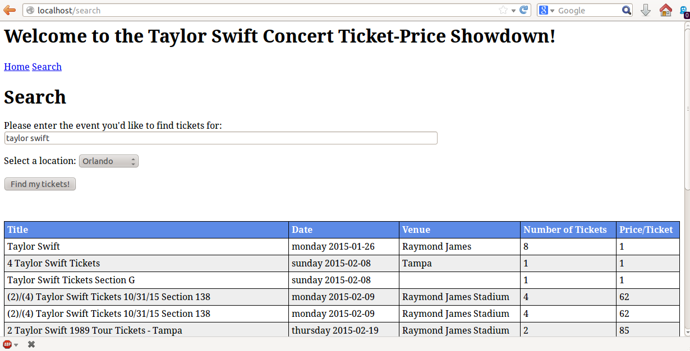
Checking out our site…again
Yay!!!

Slide 29
Configuration options
So that’s basic deployment with Gunicorn and Nginx. Some other considerations:
Explore the Gunicorn and nginx config file settings to see which setup options are available to you.
Create a supervisor so that you don’t have to manually restart your server when changes are made (http://supervisord.org/introduction.html).
Create git/mercurial hooks to automate application updates.
Create a fabfile with Fabric to automate the deployment process.

