Slide 1
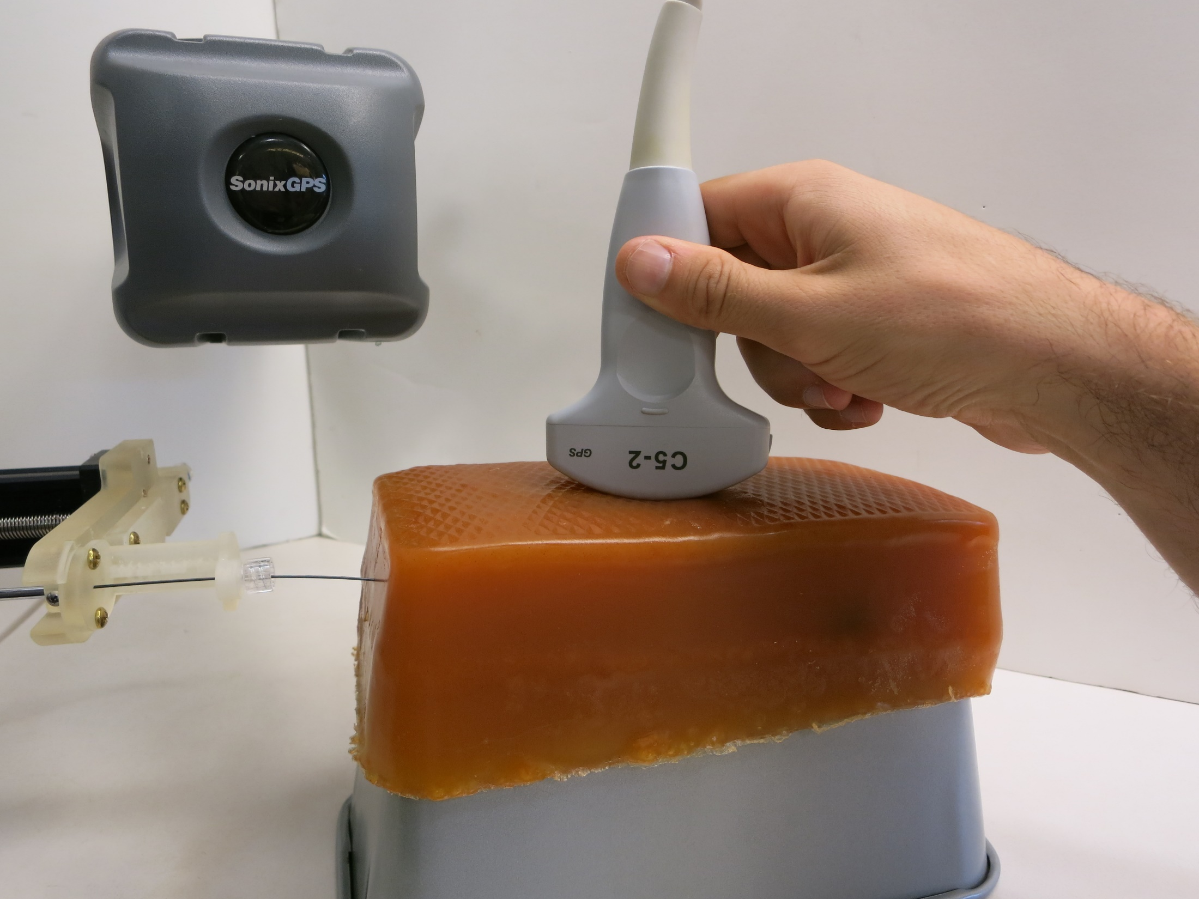
{p_{EM},R_{EM}}
{p_{US},R_{US}}
{p,R}
{p_{robot},R_{robot}}

