Slide 1
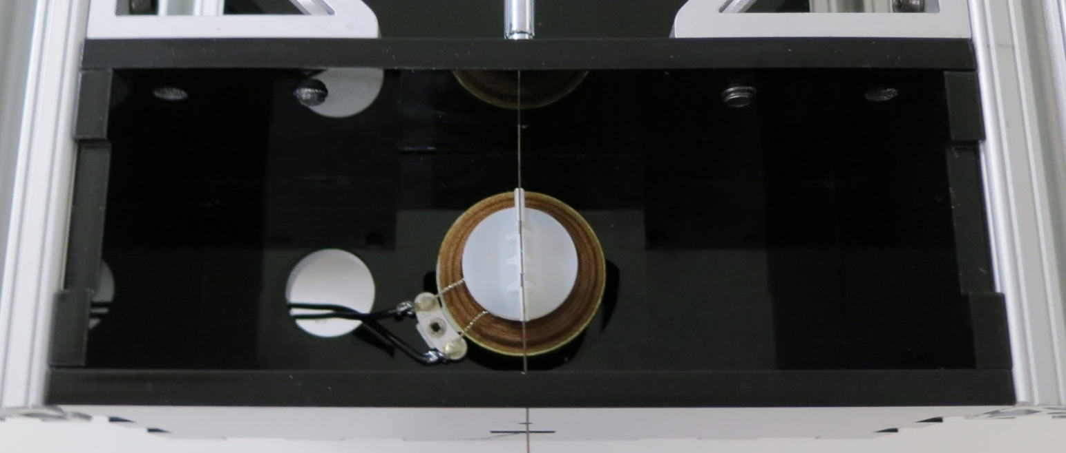
voice coil actuator
needle clip
steerable needle

