Slide 1
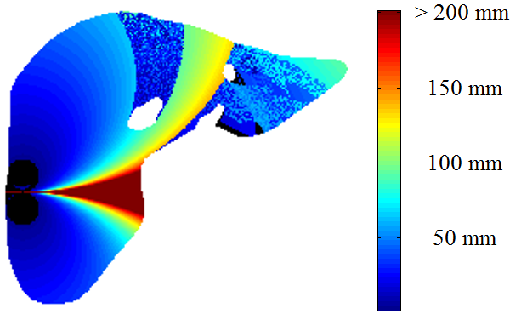

S
R
vessels
L
> 200 mm
I
150 mm
$$v^{\left(1\right)}$$
100 mm
150 mm
unreachable regions

