Slide 1
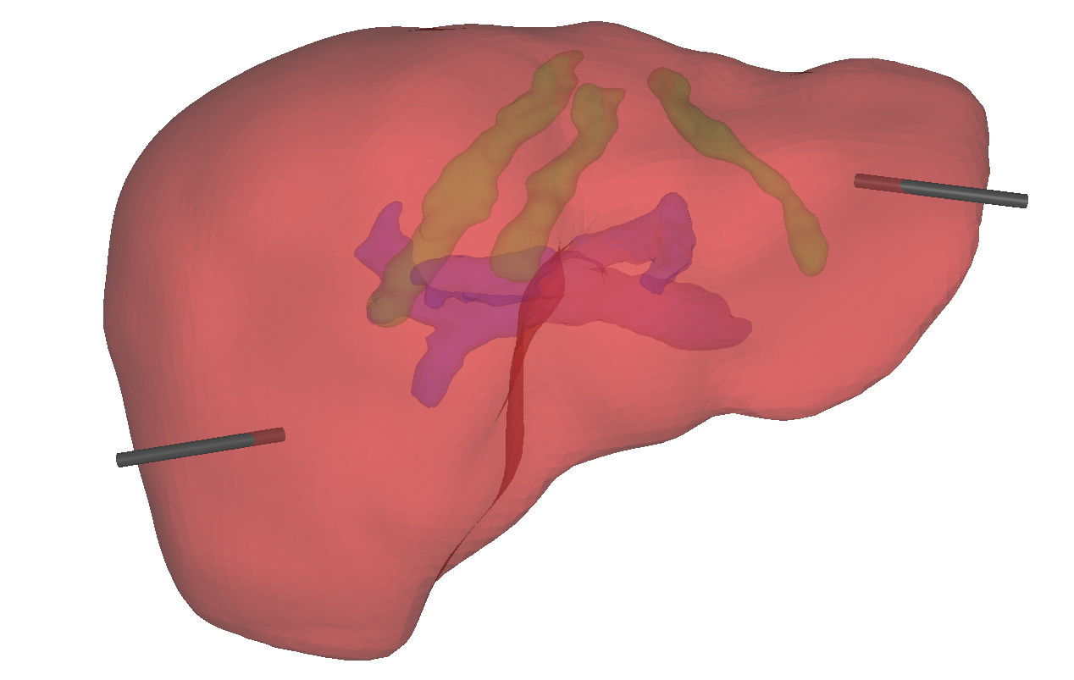


$$v^{\left(2\right)}$$
$$v^{\left(1\right)}$$
SI
ML
AP

