Slide 1
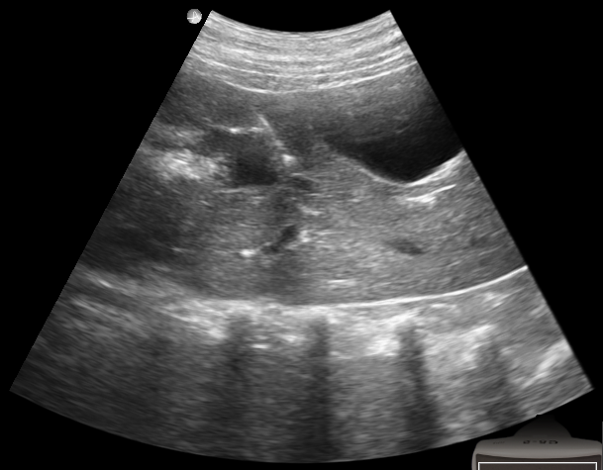
introducer
gallbladder
3
2
1
liver boundary

