Slide 1
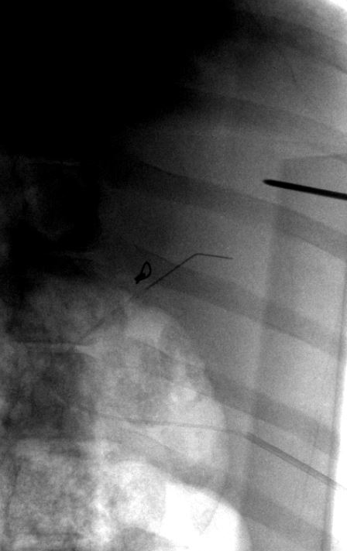
needle tip
buckled needle shaft

