Slide 1

Three-Class Diabetes Status Prediction with Failure-Aware Ensemble Learning and Explainable AI
Health data
ML models
Hybrid
XAI
Dashboard
Project Review-3
Validating methodology and code implementation
Dashboard execution and evaluation
Comparison of baseline, literature-inspired and proposed hybrid models
GitHub repository update
Research paper draft completion
[Student name and roll number]
[Department and University]
[Project guide name]
[Academic year]
Review date: 07 October 2026
Notes:
Welcome. This is Project Review-3 of our B.Tech project. Today we cover five things: methodology and code validation, the dashboard, a fair comparison of baseline models with soft voting, standard stacking and our failure-aware hybrid, the GitHub update, and the status of the research paper draft. Fill in the student, guide and department placeholders before presenting.

Slide 2
PROJECT OVERVIEW AND MOTIVATION
Diabetes is a public-health concern shaped by demographic, lifestyle and health factors.
Early identification of risk patterns supports population-level health analysis.
Machine learning can find patterns in health-indicator data.
Three classes are harder than two: Prediabetes is only 1.83% of records.
High accuracy alone can hide poor minority-class recognition.
We study prediction, model-failure analysis, explainability and public-health analytics.
RESEARCH QUESTION
Can model confidence, prediction disagreement and failure-pattern information improve three-class diabetes classification under severe class imbalance?
Healthcare data
Machine learning
Risk classification
Explainability
Public-health insights
Notes:
Explain why the problem matters, then why three-class prediction is hard: Prediabetes is about 1.83% of respondents, so a model can score well on accuracy while almost never finding Prediabetes. State the research question slowly; the rest of the review is about how we test it honestly.

Slide 3
PROJECT OBJECTIVES
1
Preprocessing, EDA and feature engineering on the BRFSS diabetes health-indicator data
2
Train and compare baseline models for three-class classification
3
Evaluate with Accuracy, Macro-F1, Balanced Accuracy, MCC and class-wise P/R/F1
4
Analyse confidence, disagreement, error overlap and complementary behaviour
5
Build and evaluate a Failure-Aware Hybrid using behaviour-based meta-features
6
Add SHAP and LIME; study calibration and subgroup performance
7
Validate code, dashboard, reproducibility and GitHub organisation
8
Prepare the research paper draft from verified results
The CDC secondary surveillance analysis counts as completed only if usable data and verified results exist (status on Slide 16).
Notes:
Walk through the eight objectives in order. Point out that objective 8 says verified results: we only report numbers that exist in saved result files. The CDC surveillance work is not claimed as complete unless real, usable data are confirmed.

Slide 4
LITERATURE REVIEW: EXISTING APPROACHES
Theme / paper (team library) | Methodology | Main contribution | Limitation | Relevance to our project
1. Traditional ML: assessment of ML models for early diabetes prediction using health indicators (Healthcare Analytics, 2022) | Compares conventional ML models on BRFSS indicators | Benchmark for health-indicator prediction | Conventional comparison; no failure-aware ensemble or XAI | Justifies LR, DT and RF baselines
2. Ensembles: diabetes prediction with an ensemble of multi-classifier models (BMC Bioinformatics, 2023) | Ensemble for diabetic, non-diabetic and prediabetic classes | Three-class ensemble framework | No systematic disagreement or complementarity analysis | Closest task formulation to ours
3. Stacking and boosting: GA-XGBoost with a stacking ensemble (PLOS ONE, 2024) | BRFSS, imbalance handling, optimised XGBoost, stacking, SHAP | Optimised boosting plus stacking | Limited confidence or disagreement-driven failure analysis | Comparator for standard stacking
4. Imbalance: robust diabetic prediction using ensembles with SMOTE (Scientific Reports, 2024) | Preprocessing, feature selection, SMOTE, ensembles | Resampling-based ensemble pipeline | Focus on resampling and performance, not failure complementarity | Motivates imbalance-aware next steps
5. XAI: SHAP, partial dependence and LIME studies (Healthcare Analytics 2025; Engineering Reports 2025; Springer LNNS 2025) | Tuned ML models with SHAP, PDP or LIME | Global and local interpretability | Explanations not linked to ensemble failure analysis | Basis for SHAP and LIME on XGBoost; a 2026 Scientific Reports paper covers calibration and subgroups
Baselines are essential; ensembles combine patterns; weights and resampling address imbalance; SHAP and LIME aid interpretation. Few works relate confidence, disagreement and model failures. Authors, DOIs: [Verified reference to be inserted].
Notes:
These entries come from the team literature survey in Review 1; authors and DOIs were not supplied, so they are marked to be inserted from verified sources before the paper is submitted. Do not quote numerical results from these papers unless you have checked the originals. The old heart-disease table that sits hidden beneath the picture on Review 1 slide 4 should not be reused.

Slide 5
LITERATURE REVIEW: RESEARCH GAP
Gap 1: Severe class imbalance
Gap 2: Limited failure analysis
Prediabetes is far smaller than No Diabetes.
Overall accuracy may not reflect balanced performance.
Comparisons rarely show which models make the same errors.
Error overlap and complementarity need study.
Gap 3: Behaviour-based meta-features
Gap 4: Incomplete evaluation
Probabilities alone may miss confidence, uncertainty and disagreement.
We test whether such information helps meta-learning.
Accuracy-only reporting is not enough.
Add class-wise metrics, calibration, explainability and subgroups.
Proposed direction: evaluate whether confidence- and disagreement-aware stacking offers a useful trade-off against baselines, soft voting and standard stacking.
We do not claim to be the first, or universally superior.
Notes:
Four gaps, each tied to something we measure later. Be careful with wording: prior work already uses confidence and entropy-type information in stacking and in dynamic ensemble selection, so we present our work as a careful, audited comparison, not as a first.

Slide 6
DATASET DESCRIPTION AND PREPROCESSING
253,680
21 + 8 = 29
3 classes
Preprocessing pipeline
respondents (BRFSS 2015)
original + engineered features
target: Diabetes_012
Load and validate the dataset
Inspect missing values, types, class distribution
Exploratory data analysis
Documented preprocessing steps
Engineered features (project implementation)
Stratified 80:20 train/test split
Training-dependent transforms fitted on training data only
Keep the test set locked for final evaluation
23,899 duplicate rows were retained in the production dataset. Possible train/test duplicate overlap [Requires Validation] must be quantified and discussed transparently.
Notes:
Read the key numbers: 253,680 respondents, 21 original plus 8 engineered features, three classes. The chart shows the imbalance directly. The test set is split once and kept locked. Be upfront about the 23,899 duplicate rows: we kept them, and we still need to count how many test rows have an identical twin in the training set.

Slide 7
SYSTEM ARCHITECTURE AND METHODOLOGY
BRFSS dataset
Validation and preprocessing
Exploratory analysis
Feature engineering
Train/test split
Baseline model training
Out-of-fold predictions
Failure and disagreement analysis
Meta-feature construction
Failure-aware hybrid
Locked-test evaluation
SHAP/LIME, calibration, subgroups
Dashboard and reporting
Out-of-fold predictions
Locked test set
Fair comparison
Training meta-features come from folds the base model did not train on.
Same procedure at train and test time.
Never used for model selection.
Never used for threshold tuning.
Used for final evaluation only.
Hybrid vs standalone models.
Hybrid vs soft voting.
Hybrid vs standard stacking.
Notes:
Walk the flow left to right, then the second row. Stress three rules: out-of-fold predictions for meta-feature training, a locked test set that is never used for selection or thresholds, and a fair comparison against standalone models, soft voting and standard stacking.

Slide 8
BASELINE MODELS AND IMPLEMENTATION
Logistic Regression
Decision Tree
Random Forest
SGDClassifier (Modified Huber)
Linear classification baseline
Interpretable nonlinear baseline
Bagged tree ensemble
Linear model, modified Huber loss
Standalone baseline
Standalone baseline
Hybrid base model
Hybrid base model
XGBoost
LightGBM
CatBoost
7 models compared;
5 feed the hybrid
Gradient-boosted trees
Efficient gradient boosting
Ordered-boosting gradient trees
Hybrid base model
Implementation note: SGDClassifier(loss='modified_huber'), a linear model. It is not sklearn.svm.SVC.
Hybrid base model
Hybrid base model
Consistent dataset split for every model; multiple metrics for every model.
Hyperparameter optimisation is documented for the tuned models.
Hybrid components: SGD Modified Huber, Random Forest, XGBoost, LightGBM, CatBoost. [Component list pending code verification]
Notes:
Seven models were evaluated. Say clearly that the model labelled SVM in our code is really SGDClassifier with modified Huber loss, a linear model, and not a kernel SVM. Five models feed the hybrid; Logistic Regression and Decision Tree are standalone baselines. The exact component list must be confirmed from the source code before the paper is finalised.

Slide 9
FAILURE-AWARE HYBRID ARCHITECTURE
1. Base models
2. Out-of-fold predictions
3. Model behaviour
SGD Modified Huber, Random Forest, XGBoost, LightGBM, CatBoost
Cross-validated three-class probabilities; same generation at train and test
Confidence, margins, entropy, agreement and disagreement, error overlap (where validly computed)
4. Meta-features
5. Meta-learner
6. Comparison
Production run reports 50 meta-features. Names and decomposition: verify from source code
Balanced Logistic Regression gives the final three-class prediction
Individual models, soft voting and standard stacking
Five base models
OOF predictions
Verified meta-features
Balanced Logistic Regression
Three-class prediction
Audit item: XGBoost out-of-fold predictions were generated without the sample weights used for the final XGBoost model. The corrected experiment has not yet been verified.
Notes:
Explain the idea in plain words: the meta-learner sees not only what each base model predicts, but how sure each one is and whether they agree. Do not state a breakdown of the 50 meta-features; that has to be reconstructed from the code. Mention the known XGBoost weighting inconsistency as an audit item with correction pending.

Slide 10
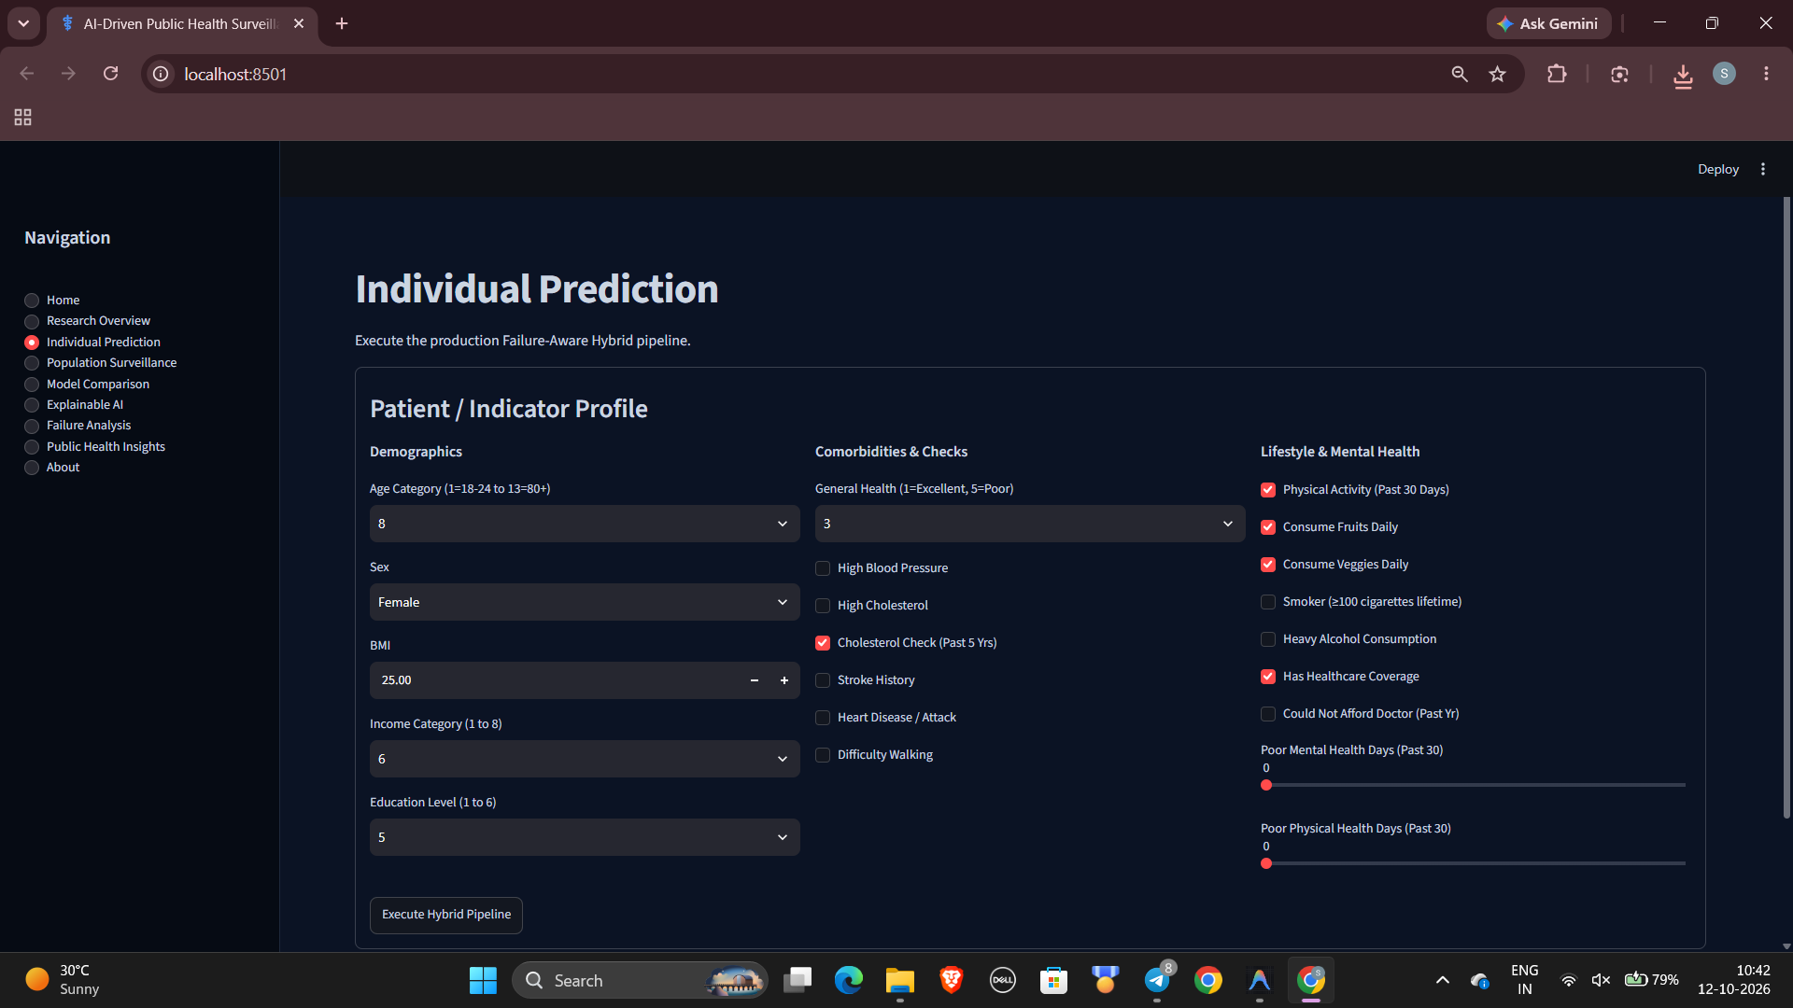
DASHBOARD EXECUTION AND FUNCTIONALITY
Dataset overview, class distribution
Reported in Review 1
[Insert actual dashboard screenshot]
Diabetes status prediction
Reported in Review 1
Model and ensemble comparison
Reported in Review 1
Confusion matrix, class-wise performance
Confirm status
Failure and disagreement analysis
Reported in Review 1
SHAP global and local; LIME local
Reported in Review 1
Calibration visualisation
Confirm status
Subgroup performance
Confirm status
CDC surveillance outputs
Not supported by data
Validation checklist (tick only after a live run)
[ ] Starts without errors
[ ] Dataset loads correctly
[ ] Input validation works
[ ] Predictions match the model pipeline
[ ] Charts render correctly
[ ] SHAP/LIME match the intended model
[ ] Error handling works
[ ] No unsupported surveillance outputs
Notes:
Be honest here. Review 1 listed these dashboard modules as developed, but the status labels are what was reported, not what has been re-verified today. Run the dashboard live, tick the checklist only for what works, and paste a real screenshot in the placeholder. The CDC surveillance module must not show outputs unless real, usable data are confirmed.

Slide 11
COMPARATIVE MODEL RESULTS
Model | Accuracy | Macro-F1 | Bal. Acc. | MCC
Logistic Regression | 0.6414 | 0.4257 | 0.5189 | 0.2920
Decision Tree | 0.5813 | 0.3926 | 0.4902 | 0.2481
Random Forest | 0.7004 | 0.4301 | 0.4983 | 0.3230
SGD Modified Huber | 0.8014 | 0.4472 | 0.4711 | 0.3422
XGBoost | 0.7581 | 0.4347 | 0.4689 | 0.3080
LightGBM | 0.6430 | 0.4234 | 0.5161 | 0.2999
CatBoost | 0.6694 | 0.4300 | 0.5128 | 0.3149
Soft Voting | 0.7477 | 0.4476 | 0.5028 | 0.3533
Standard Stacking | 0.6117 | 0.4199 | 0.5260 | 0.2946
Failure-Aware Hybrid | 0.6387 | 0.4241 | 0.5232 | 0.2983
Highest accuracy: SGD Modified Huber 0.8014
Highest Macro-F1 and MCC: Soft Voting 0.4476 and 0.3533
Highest balanced accuracy: Standard Stacking 0.5260
The Failure-Aware Hybrid has not outperformed all baselines. Current reported locked-test results, pending the corrected audit experiment. Bold red = best in column.
Notes:
Read the table honestly: SGD Modified Huber has the highest accuracy, Soft Voting the highest Macro-F1 and MCC, Standard Stacking the highest balanced accuracy. The hybrid sits in the middle on every metric. The right way to judge it is its minority-class behaviour and what the failure analysis teaches us, not an assumption of superiority. These are the current reported values; they may change after the corrected out-of-fold experiment.

Slide 12
PREDIABETES PERFORMANCE AND FAILURE ANALYSIS
1.83%
0.2959
0.3402
0.0421
0.0560
of records are Prediabetes
Hybrid Prediabetes recall
Standard Stacking recall
Soft Voting recall
Hybrid Prediabetes F1
Why F1 is low
Recall rises only by flagging many non-cases: hybrid precision is 0.0309.
Derived: about 31 false flags per true Prediabetes case.
Failure analysis to deepen
Confusion with neighbouring classes; false-positive burden.
Confidence, disagreement and error overlap by class.
Cost-sensitive learning and class weights; training-only threshold selection; prediabetes-specialist or hierarchical model; precision-recall trade-offs; paired statistics. No clinical usefulness is claimed without external validation.
Next steps
Notes:
Prediabetes is the central scientific challenge. The hybrid finds about 30 percent of Prediabetes cases, but precision is only about 0.03, so F1 stays at 0.056. The false-flag figure is derived from the reported precision and recall. Soft voting looks better on accuracy and MCC but finds only about 4 percent of Prediabetes cases. Next steps must use training or validation data only, never the locked test set.

Slide 13
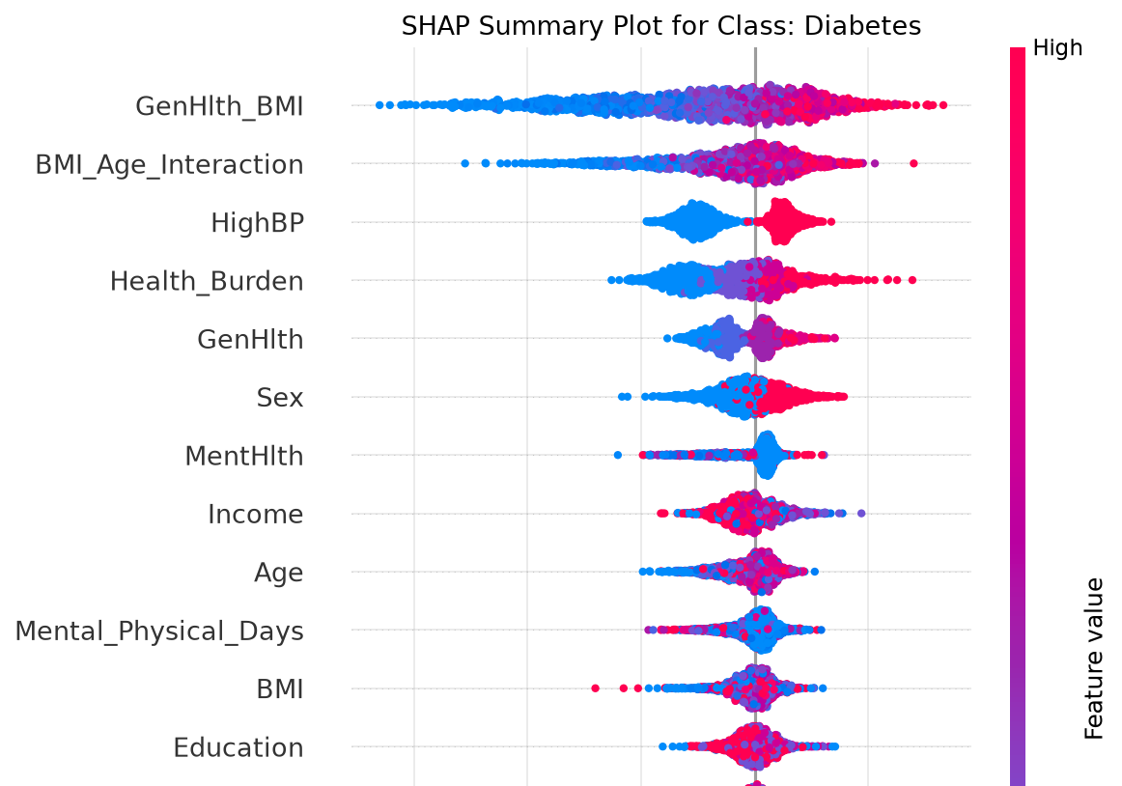
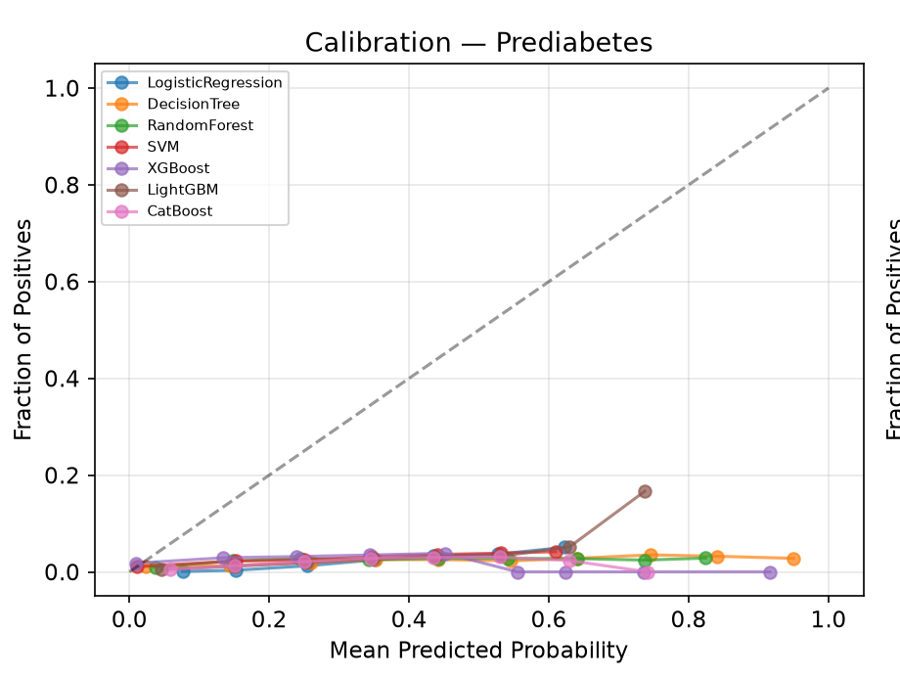
EXPLAINABLE AI, CALIBRATION AND SUBGROUP ANALYSIS
Explainable AI (XGBoost)
Calibration
Subgroups (XGBoost)
Group | Diab. recall
Age 18-39 | 0.1590
Age 65+ | 0.6335
Income low | 0.6705
Income high | 0.4880
Educ. low | 0.6615
Educ. high | 0.4771
SHAP (diabetes class) and LIME explain XGBoost, not the hybrid.
Describes model behaviour, not causes.
Prediabetes probabilities are far above observed frequency (class-weighted models).
Brier and log loss reported; no recalibration; never tune on the locked test set.
Legend label "SVM" = SGD Modified Huber.
Sex, age, income, education, XGBoost only.
Descriptive differences, not fairness conclusions.
Add confidence intervals and class counts.
Notes:
Left: the SHAP beeswarm for the diabetes class of XGBoost shows engineered interaction features such as GenHlth_BMI and BMI_Age_Interaction at the top. Middle: the prediabetes reliability curves sit far below the diagonal, so those probabilities are not literal risks. Right: diabetes recall changes a lot by age, income and education; this is a descriptive observation and not proof of fairness or unfairness. Figures come from the project artifacts; the SHAP waterfall and LIME figures were left out for space.

Slide 14
CODE VALIDATION AND GITHUB REPOSITORY UPDATE
Planned repository organisation
Validation checklist (verify before reporting)
data/ dataset documentation, permitted artifacts
Code runs in a clean environment
Dependencies and versions documented
Random seeds and data splits recorded
Training and evaluation reproducible
Results match saved experiment outputs
Dataset licensing and privacy respected
Commits and repository status verified
notebooks/ exploratory and experiment notebooks
src/ preprocessing, features, training, prediction
models/ model artifacts where permitted
results/ metrics, plots, experiment outputs
dashboard/ dashboard source
configs/ model and experiment configuration
tests/ code and pipeline tests
docs/ methodology, setup, reproducibility
README.md overview and setup
requirements.txt environment specification
Repository URL: [insert] Last verified commit: [insert] Clean-environment run: [Requires Validation]
Notes:
This slide shows the planned structure, not a finished repository. Fill in the real URL and last commit only after checking GitHub. Do not claim a clean-environment run until it has actually been done. Library versions and the Python version must be recorded for reproducibility.

Slide 15
RESEARCH PAPER DRAFT AND PUBLICATION READINESS
Manuscript structure
Issues to address before submission
Title and abstract
Introduction and motivation
Literature review and gap
Dataset and preprocessing
Methodology and hybrid architecture
Experimental setup and metrics
Comparative results
Failure analysis and ablation
Explainable AI
Calibration and subgroup analysis
Discussion and limitations
Conclusion and future work
References and supplement
Verify the exact 50 meta-features from source code
Correct the XGBoost OOF sample-weight inconsistency
Make tables and figures match saved results
Do not claim hybrid superiority
Explain weak Prediabetes performance clearly
Add full hyperparameters and reproducibility details
Add uncertainty analysis if predictions are available
Remove unsupported CDC-dataset claims
Complete author, ethics, funding, conflict and code statements
Status: Draft in progress
Notes:
The paper is a draft in progress, not a finished submission. Use this slide to show you know what is still open. The two most important fixes are the exact meta-feature reconstruction and the corrected out-of-fold predictions.

Slide 16



VALIDATION CHECKLIST AND WORK COMPLETED
Completed (only if verified)
Requires validation
Next actions
Dataset loading and preprocessing
Baseline model implementation
Current comparative evaluation
Initial hybrid implementation
Existing XAI experiments
Initial dashboard implementation
Research paper draft
Corrected XGBoost OOF predictions
Exact 50-feature reconstruction
Train/test duplicate overlap
Saved outputs vs manuscript tables
Full dashboard run and error handling
Clean-environment reproducibility
Final GitHub repository state
Correct the OOF weighting issue
Rebuild the affected hybrid if needed
Targeted Prediabetes improvements
Leakage-safe final validation
Update figures, tables and manuscript
Finalise repository documentation
Mark an item complete only if the corresponding evidence exists.
Notes:
Be strict with the first column: an item belongs there only if you can show the file, output or screenshot. Everything that depends on the corrected out-of-fold run, the exact feature list, the duplicate analysis or a clean-environment run is in the second column.

Slide 17
CONCLUSION AND FUTURE SCOPE
Conclusion
Future scope
Implemented a three-class diabetes classification workflow on BRFSS indicators.
Evaluated seven standalone models and several ensembles.
Investigated a confidence- and disagreement-aware hybrid with a balanced Logistic Regression meta-learner.
A more complex ensemble did not automatically beat simpler ones.
Class imbalance and weak Prediabetes recognition remain central challenges.
Correct and validate OOF generation.
Improve Prediabetes-sensitive learning; cost-sensitive and hierarchical models.
Improve probability calibration.
Statistical uncertainty analysis.
Validate on an independent dataset.
Improve dashboard usability; complete manuscript and repository.
Our objective is not simply to maximise accuracy, but to develop a reproducible, interpretable and rigorously evaluated diabetes classification framework.
Notes:
Summarise: we built the workflow, compared models fairly, and learned that complexity does not guarantee better results. The main open problem is Prediabetes. End with the closing message and invite questions.

Slide 18
Thank You
Notes:
Thank the panel and invite questions. Have the results table, the prediabetes slide and the audit items ready for follow-up questions.

