Slide 1
1. Python Introduction
What is Python?
Why Python is popular
Where Python is used for ?

Slide 2
Programming language
The process of giving instructions to a computer to perform specific tasks.
These instructions are written in a programming language that the computer can understand.
Programming is telling a computer what to do, step by step.

Slide 3
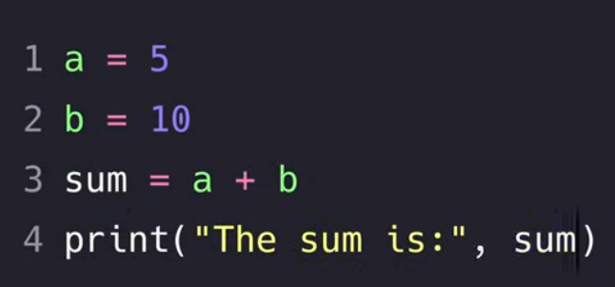
Types of programming languages
1. High-Level Languages
  Easy for humans to read and write.
  Examples: Python, Java, C++
  Uses words and symbols closer to English.
  Example in Python:

Slide 4
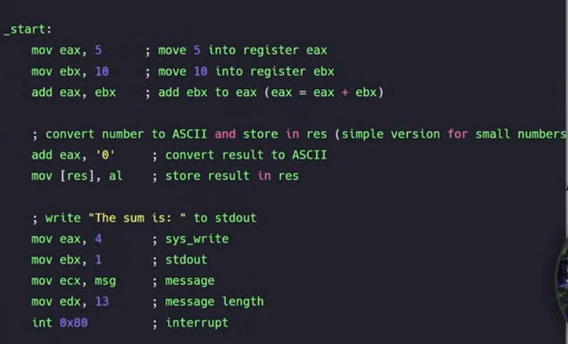
2. Low-Level Languages
  Closer to machine language, harder for humans to read.
  Assembly language
  Often used for hardware control.

Slide 5
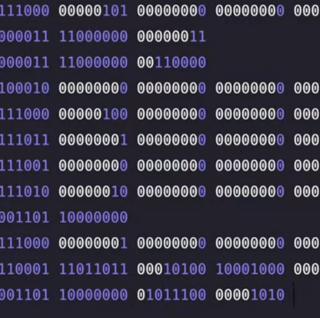
1. Machine Language
  The only language a computer truly understands.
  Made of binary code (0s and 1s).
  Very hard for humans to write or read directly.

Slide 6
What is Python?
  High-level, interpreted, and general-purpose programming language.
  Designed for simplicity, readability, and rapid development.
  Created by Guido van Rossum and first released in 1991.
  Uses clean, English-like syntax → easier to learn and write.

Slide 7
Why Python is Popular
✔ Easy to Learn & Read — beginner-friendly syntax
✔ Large Standard Library — tools for many tasks
✔ Huge Community Support — millions of users worldwide
✔ Cross-platform — runs on Windows, Mac, Linux
✔ Rich Ecosystem — powerful libraries like NumPy, Pandas, TensorFlow
✔ Fast Development — ideal for prototypes and real-world applications

Slide 8
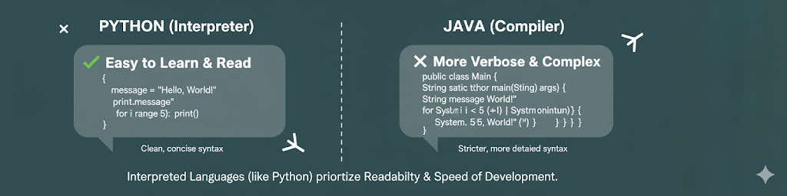

Slide 9
Where Python Is Used
Artificial Intelligence & Machine Learning
– TensorFlow, PyTorch, Scikit-Learn
Data Science & Analytics
– Pandas, NumPy, Matplotlib
Web Development
– Django, Flask, FastAPI
Automation & Scripting
– Automate tasks, system scripts, bots
Software Development & Testing
Cybersecurity, IoT, GIS, and more

Slide 10
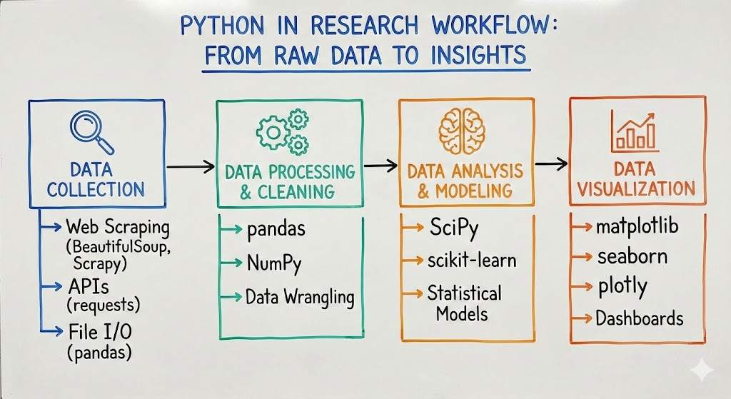

Slide 11
2. Python Setup
    Install Python 3
    Install VS Code + Extensions
    How to run Python files
    Jupyter Notebook basics

