Slide 1

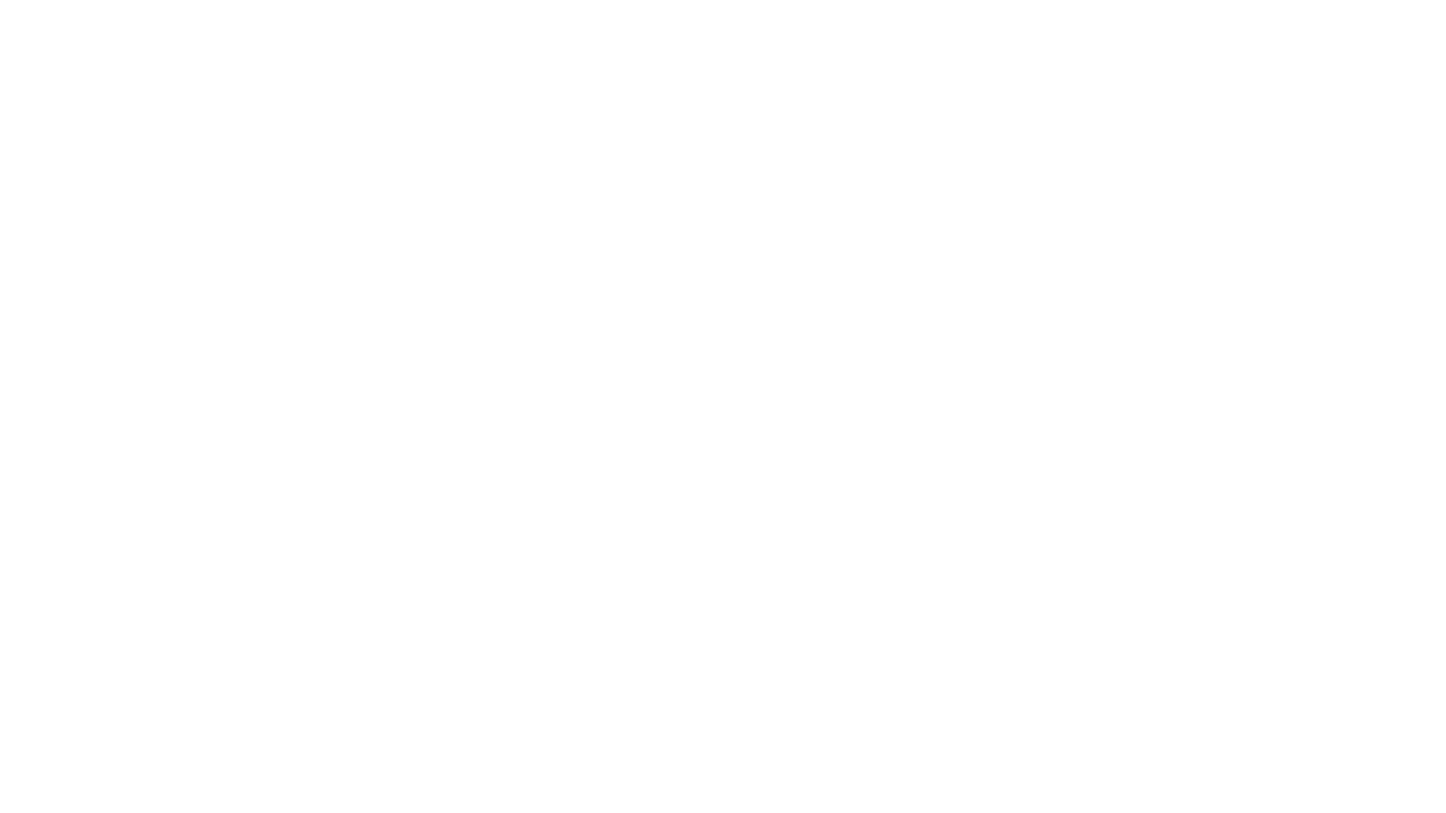

Web systems vulnerabilities
WEB VULNERABILITIES AND COUNTERMEASURES

Slide 2
sql injection
SQL injection is a code injection technique used to target data-driven applications, where malicious SQL statements are inserted into a data entry field for execution.

Slide 3
How to Prevent SQL Injection
• Parameterized Statements
• Object Relational Mapping
• Escaping Inputs
• Sanitizing Inputs

Slide 4
Cross-site scripting (XSS)
Cross-site scripting (XSS) is a type of vulnerability which is usually found in web applications. XSS helps attackers to inject scripts client-side to web pages accessed by other users

Slide 5
How to Prevent Cross-Site Scripting
• Keep Software Updated
• Sanitize Input Fields ( htmlspecialchars(variable_name, ENT_QUOTES, 'UTF-8’) )
• Use Client and Server-Side Form Validation
• Use a Web Application Firewall

Slide 6
CROSS-SITE REQUEST FORGERY
Cross-Site Request Forgery (CSRF) is an attack that causes an end-user to perform unauthorized actions on a web application that they are currently authenticated to. CSRF attacks primarily target state-changing requests, not data theft, because the attacker has no means of knowing the answer to the request fabricated.

Slide 7
How to Prevent Csrf
• REST (Representation State Transfer)
• Anti-Forgery Tokens
• Ensure Cookies are sent with the SameSite Cookie Attribute
• Include Addition Authentication for Sensitive Actions

