Slide 1


Android Architecture and Kotlin
John P. Baugh, Ph.D.

Slide 2
Android Architecture
Ch. 9-10 Android Studio Development Essentials 4.0 (Kotlin Edition)

Slide 3
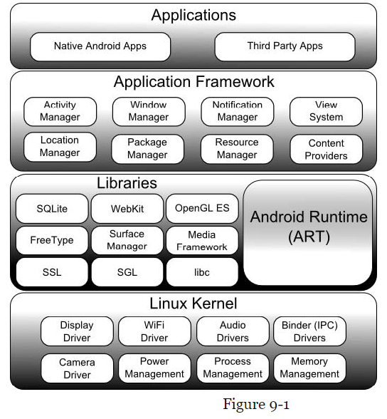
Android Architecture and Anatomy of an Application

Slide 4
The Linux Kernel
This is the core of the OS
Provides the foundation of the Android software stack
Provides many functions, such as
Preemptive multitasking
Low-level core system services
Memory, process, power management, etc.
Network stack
Device drivers for hardware

Slide 5
Android Runtime - ART
Android apps are built in Android Studio and compiled into intermediate bytecode
The format is DEX
The ART uses AOT (ahead-of-time) compilation to translate bytecode down to native instructions required by the device processor
This format is ELF (Executable and Linkable Format)

Slide 6
Android Libraries
The standard Java development libraries are available
Strings, networking, file manipulation
Android libraries
Java-based libraries
Include application framework libraries
Include libraries such as:
android.app – access to application model
android.content – content access, publishing, messaging between applications and application components
android.database – used to access data with content providers, and SQLite database management classes
android.graphics – low-level 2D graphics drawing API
android.hardware – presents an API for accessing hardware such as accelerometer and light sensor
android.opengl – Java interface to OpenGL ES 3D graphics API
android.view – fundamental building blocks of GUIs
android.widget = rich collection of pre-built components, layout managers, radio button, buttons, labels, etc.
And many more!

Slide 7
Application Framework
Provides a set of services that collectively form the environment in which Android apps run and are managed
Consists of many key services such as:
Activity Manager – controls all aspects of app lifecycle and activity stack
Content Providers – allow apps to publish and share data with other apps
Resource Manager – provides access to non-code embedded resources such as strings, color settings, and UI layouts
Notification Manager – allows apps to display alerts and notifications to the user
View System – extensible set of views user to create app UIs
Package Manager – apps use this to find out information about other apps currently installed on the device
Telephony Manager – provides information to the application about telephony services available on the device
Location Manager – provides access to the location services allowing an app to receive updates about location changes

Slide 8
Applications
These are the native applications
E.g., e-mail and web browser apps
These are also third-party apps
Installed by the user after purchasing the device
Made by… you? ☺

Slide 9
Activities and Fragments
Activities make up the Android applications themselves
An activity is a single, standalone module of application functionality that usually correlates directly to a single UI screen and its corresponding functionality
A good design option allows us to break the activity into different sections
These sections are called fragments

Slide 10
Intents
An intent is a mechanism by which one activity is able to launch another and implement the flow through the activities that make up an application
Intents consist of
Description of the operation to be performed
Optionally, data on which it is to be performed
Explicit intent
Request launch of a specific activity by referencing the activity by name
Implicit intent
Stating the type of action or provide data of a specific type
The Android runtime then selects the appropriate activity to launch that most closely matches the criteria specified by the Intent using a process called Intent Resolution

Slide 11
Broadcast Intents and Receivers
Broadcast Intent
A systemwide intent that is sent out to all applications that have registered an interested Broadcast Receiver
The Android system man, for example, send out Broadcast Intents to indicate changes in device status, such as completion of system start-up, connection of external power source, etc.
Broadcast Receivers
Applications use Broadcast Receivers to respond to Broadcast Intents
They are registered by the application and configured with an Intent Filter to indicate types of broadcasts in which it is interested
When a matching intent is broadcast, the receiver is invoked by the Android runtime regardless of whether the app that registered the receiver is currently running

Slide 12
Android Services
Processes that are run the background and do not have a user interface are called Android Services
These are ideal for situations where an app needs to continue performing tasks, but does not necessarily need a UI to be visible the user
Services may still notify the user using notifications and toasts, even though they lack a regular UI

Slide 13
Content Providers
These provide a mechanism for sharing data between applications
Any application can provide other applications with access to underlying data through the implementation of a Content Provider
Including ability to add, remove, and query the data, subject to permissions
Access to the data is provided by a URI (Uniform Resource Identifier)
URIs are generalizations of URLs (Uniform Resource Locators), which we’re familiar with from the Web
Data can be shared in different forms such as
A file
An entire SQLite database

Slide 14
Kotlin
Ch. 11-15 Android Studio Development Essentials 4.0 (Kotlin Edition)

Slide 15
Kotlin Introduction
Invented by JetBrains, which also creates IntelliJ IDE
Is named after an island in the Baltic Sea
Named…. Kotlin ☺
This is to keep in line with how Java is named after the Indonesian island of Java, famous for its coffee
Primary language goals
Make code concise and safe
Concise – easy to read and understand
Safety – Kotlin includes a number of features to improve the chances that potential problems are identified earlier, especially trading potential runtime crashes for syntax errors
Kotlin and Java
Java (1995) is still one of the most popular languages in the world
Until the introduction of Kotlin, essentially all Android apps on the market were written in Java
Kotlin is designed to integrate and work alongside Java
Kotlin first appeared in 2011

Slide 16
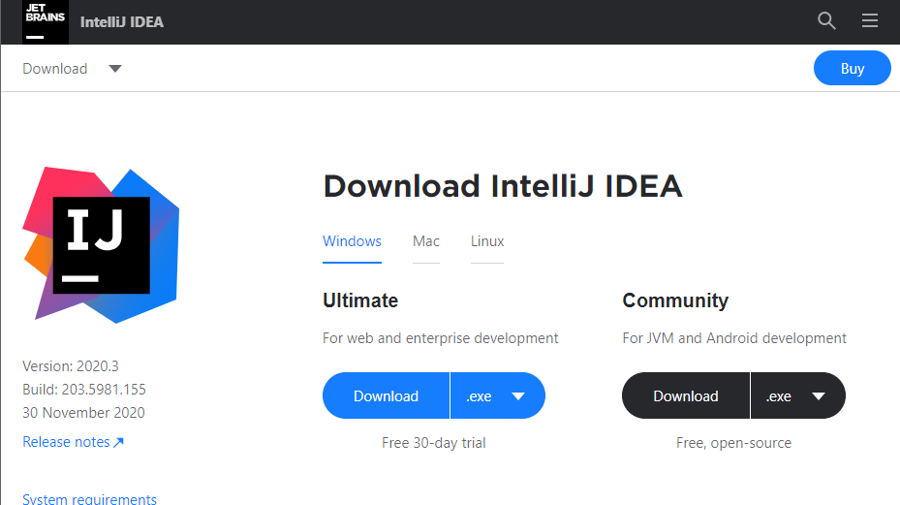
Experimenting with Kotlin
You can use the Kotlin Playground
play.kotlinlang.org
I recommend installing IntelliJ IDEA Community Edition
https://www.jetbrains.com/idea/download
It will automatically detect your platform, but you can change it easily using tabs at the top if you wish

Slide 17
Two IDEs We’ll Use
IntelliJ IDEA
This is a popular IDE for both Java and Kotlin development
Made by JetBrains, who invented Kotlin
We will use this to learn Kotlin more effectively
Android Studio will be used for Android Development
We will use this the most
Android Studio is built on top of IntelliJ

Slide 18
Data Types
Data sits in main memory in our programs in the form of variables (and constants)
The data type determines the type of data (*gasp*) that a variable can hold
Integer types
Byte (8 bits)
Short (16 bits)
Int (32 bits)
Long (64 bits)
Floating Point types
Float (32 bits)
Double (64 bits)
Boolean type
Character type
Char
String types
var someMessage = “My name is John”
var multiLine = “”” Hi I’m John and I love chocolate! “”” //triple quotes means multiline!
You can remove leading spaces of multiple line strings using .trimMargin() method

Slide 19
Variables
Variable types can be inferred implicitly
var myChar = ‘f’ //automatically a character!
var myNum = 10 // Int by default
var num = 1 //Int
var bigNum = 3000000000 //Long
var anotherLong = 5L //prefix L causes automatic Long
Variable types can also be explicit
var someDouble : Double = 3.14
var someFloat : Float = 2.71f //suffix f indicates float
Escape sequences for Strings
\n = new line
\t = horizontal tab
//etc… Just like Java or C++
All the data types in Kotlin are objects automatically
Most have methods (functions) and properties (fields, or data)
myString.toUpperCase() function/method returns uppercase version of myString
myString.length property returns the length of myString, in characters

Slide 20
Mutable vs Immutable Variables
The var keyword allows us to change (or mutate) the value of a variable
var someData = 150 //later… somedata = 200 //OK!
The val keyword means the value cannot be changed
val myVal = 100 //later myVal = 20 //ERROR! myVal is immutable
Immutable variables
Are constants

Slide 21
Nullable Type
Nullable types don’t fundamentally exist in most other programming languages
With the exception of the optional type in Swift
By default, a variable in Kotlin cannot be assigned null
val username : String = null //will NOT compile
To explicitly allow for a variable to be assigned null, you must declare it as nullable
val username : String? = null //this WILL compile because of the ?
However, what if you do the following?
val firstName : String = username //username is nullable, firstName is not, so this is a compiler ERROR
You can only perform this assignment (or method call!) if you somehow ensure the nullable type is NOT in fact, null
if(username != null) { val firstName : String = username //OK since we know username isn’t null }
But, there is a better way – the safe call operator, ?.
val theLength = username?.length

Slide 22
Not-Null Assertion
The not-null assertion removes all compiler restrictions from a nullable type
This is generally discouraged since you can get a NullPointerException
val username : String? = null val length = username!!.length

Slide 23
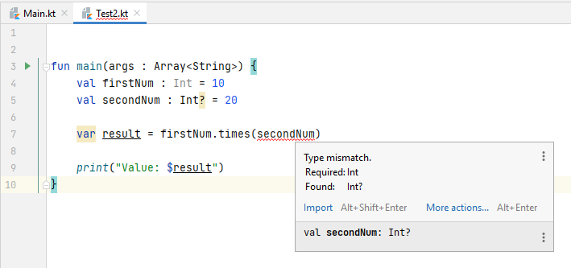
Nullable Types and the let Function
What happens when we pass a nullable type as an argument to a function expecting a non-null parameter
So how do we overcome it?
2 Approaches:
Traditional
Let function lambda statement
Traditional
if(secondNum != null) { val result = firstNum.times(secondNum) print(result) }
The let function is more convenient
secondNum?.let { val result = firstNum.times(it) print(result) }

Slide 24

The Elvis Operators
Yes, it’s literally called the Elvis operator
As a shortcut for the traditional: if(myString != null) { return myString } else { return “String is null” }
This is similar syntactically as the conditional operator (?:) in many languages
return myString ?: “String is null”

Slide 25
Expressions and Arithmetic Operators
Should be familiar from other languages, like Java and C++
But there are some differences
Basic expression consists of:
An operator
Two operands
An assignment
E.g.,
val myResult = 1 + 2
Arithmetic operators in Kotlin
Same as Java or C++
+, -, *, / and %
We also have augmented assignment operators
These are like compound assignment operators in other languages
+=, -=, *=, /=, %=
And, of course, increment and decrement operators
x++ x--

Slide 26
Relational Operators
The relational operators including equality operators are as you’d expect:
if (x == y) { }
Operator | Name | Example
== | Equal to | x == y
!= | Not equal to | x != y
> | Greater than | x > y
>= | Greater than or equal | x >= y
< | Less than | x < y
<= | Less than or equal | x <= y

Slide 27
Logical Operators
&& is AND
|| is OR
! is NOT
AND (&&)
p | q | p && q
T | T | T
T | F | F
F | T | F
F | F | F
OR ( || )
p | q | p || q
T | T | T
T | F | T
F | T | T
F | F | F
NOT (!)
p | !p
T | F
F | T

Slide 28
Range Operator
The .. (range operator) helps us declare and use a range of values
It includes x and y in the statement x .. y
Traditional syntax if(healthPoints >= 90 && healthPoints <= 100) { //... } else if(healthPoints >= 60) { //... } else { /* blah blah */ }
With the range operator, it’s more concise
if(healthPoints in 90 .. 100) { // … } else if(healthPoints in 60 .. 89) { } else { /* blah blah */}

Slide 29
Control Statements
Sequential
The default
Selection
Conditional execution, branching
Repetition
Conditional execution, looping

Slide 30
Selection Control
As expected, most are similar to what we have in C++, Java, or C#
if statement if(someExpression) { }
if-else if(someOtherStatement) { } else { }
We can also treat if-else like an expression with the if-else expression syntax
val largest = if(x > y) x else y
If x is greater than y, return x, otherwise return y
This takes the place of the conditional operator in other languages

Slide 31
The when Statement
Another selection control statement in Kotlin is the when statement
A cleaner alternative to if … else
Is similar to the switch statement in many other languages
General syntax:
when(value) { match1 -> //code to be executed match2 -> //code to be executed }
Example
when(x) { 10 -> println(“x is 10!”) 9 -> println(“x is 9!”) 8 -> println(“x is 8!”)
else -> println(“x is not in range”) }

Slide 32
The when Statement (cont’d)
You can also use it with the range syntax
val myHealthStatus = when(healthPoints) { 100 -> “Excellent condition” in 90 .. 99 -> “has a few scratches” in 75 .. 89 -> “has minor wounds” in 15 .. 74 -> “badly hurt” else -> “is in awful condition!” }
So, for practice, make sure you repeat to yourself and practice with this new syntax, combined, so you become familiar with it
The range operator ..
The when statement with the arrow operator ->

Slide 33
Looping
The for-in loop is used to iterate over a sequence of items
In a collection or a range
Similar to Python
Similar to range-based for (C++) or enhanced for (Java) or foreach in other languages
Syntax: for(index in 1 .. 5) { println(“Value of index is $index”) //use String interpolation with $ }
You can configure for-in with two interesting functions:
downTo
until

Slide 34
downTo and until
downTo
for(index in 100 downTo 90) { //counts down and includes 100 and 90 }
until
for(index in 1 until 10) { //counts up and does NOT include 10 }

Slide 35
The while and do-while loops
As expected… var myCount = 0 //notice var not val
while(myCount < 100) { myCount++ println(myCount) }
And do-while general syntax:
do { } while (someCondition)

Slide 36
Functions and Lambdas
A function is a named block of code that can be called upon to perform a specific task
General Syntax: fun <function name> (<para name> : <para type>, etc.) : <return type> { }
Specific examples
void function
fun sayHello() { println(“Hi there!”) }
Value-returning, parameterized:
fun getResult(num1 : Int, num2 : Int) : Int { return num1 + num2 }

Slide 37
Single Expression Functions
If a function is fairly simple and only has a single expression in it, such as: fun multiply(x : Int, y : Int) : Int { return x * y }
You can use special single-line expression syntax: fun multiply(x : Int, y : Int) : Int = x * y //instead of a return statement

Slide 38
Lambda Expressions
Lambda expressions or lambdas, for short, are self-contained blocks of code, and can be treated like a function
E.g., val sayHello = { println(“Hello”) }
Call the lambda sayHello() //just like a normal function!
Another example
val multiply = {val1 : Int, val2 : Int -> val1 * val2}
Call it:
val result = multiple(10, 20)

