Slide 1


Lifecycle and Activities
John P. Baugh, Ph.D.

Slide 2
Lifecycles
Ch. 19 Android Studio Development Essentials 4.0 (Kotlin Edition)

Slide 3
Resources are Managed
Regardless of the fanfare about how much memory and computing power mobile devices possess, they are considered resource constrained when compared with modern desktops and laptops
Therefore, it is a primary responsibility of the Android system to ensure that the limited resources are managed effectively
This means the OS and applications should always remain responsive to the user
As a result, the Android OS is given full control over the lifecycle and state of both the processes in which apps run, as well as the individual components that comprise those apps

Slide 4
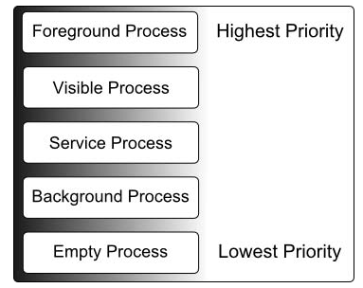
Processes
Each running Android app is viewed by the OS as a separate process
A process can be thought of as a program (app) loaded into memory
A process can be in one of five states at any given time
Foreground – the highest level of priority. There is typically only one or two foreground processes at any given time. To be in this priority level, the process must meet one or more criteria to qualify:
Host an activity with which the user is currently interacting
Host a Service connected to the activity with which the user is interacting
Host a Service that has indicated, via a call to startForeground, that termination would be disruptive to the user experience
Host a Service executing either its onCreate, onResume, or onStart callbacks
Host a Broadcast Receiver that is currently executing its onReceive method
Visible – A process containing an activity that is visible to the user, but with which the user isn’t currently interacting
Service – A process containing a service that has already been started and is currently executing
Background – contains one or more activities that are not currently visible to the user, and doesn’t host a Service that qualifies for Service Process priority
Empty – no longer contain any active applications and are the first to be killed to free up resources

Slide 5
Activity Lifecycle
The process priority level is largely determined by the status of the activities and components that make up the application that it hosts
These activities also transition through different states during execution lifetime of an application
The runtime system maintains, for each application, an Activity Stack
When an application is launched, the first of the app’s activities is pushed onto the top of the stack
When a second activity is started, it is pushed onto the top of the stack (and the first activity is no longer the top)
When the active activity exits, it is popped off of the stack by the runtime and the activity beneath it is made the top of the stack
This can occur when an activity exits because it has nothing else to do, or when the user hits the Back button
The Stack data structure is LIFO (last-in, first-out)
The last item pushed onto the stack will be the first to come off the stack

Slide 6
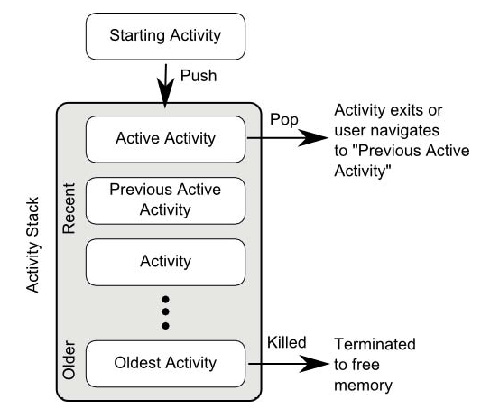
Activity Stack
Visualization of the Activity Stack

Slide 7
Activity States
An activity can be in one of a number of different states during the course of its execution
Active/Running – the activity is at the top of the Activity Stack, is the foreground task visible on the device screen, has focus and is currently interacting with the user. This is the least likely to be terminated in the event of a resource shortage
Paused – the activity is visible to the user but does not have focus currently (typically because this activity is partially obscured by the current activity. The activity is held in memory, remains attached to the window manager, retains all state information and can quickly be restored to active status when moved to the top of the stack
Stopped – the activity is currently not visible to the user (it is totally obscured on the device display by other activities.) As with paused activities, it retains all state and member information, but is at higher risk of termination in low resource situations
Killed – the activity has been terminated by the runtime system in order to free up resources and is no longer present on the Activity Stack. Such activities must be restarted if required by the application

Slide 8
Handling Android Activity State Changes
The traditional techniques for managing the lifecycle will be covered now
The more modern lifecycle handling technique will be covered later in the course
This approach uses the Jetpack Android Architecture Components
The components also come with recommendations for how the handling should be structured

Slide 9
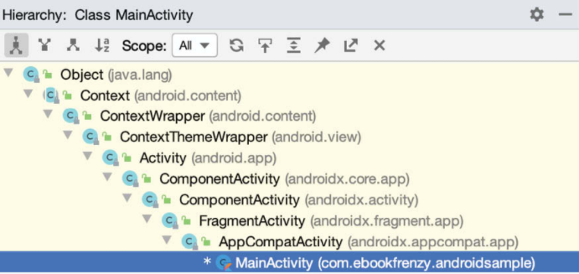
Activity and Fragment Classes
With few exceptions, activities and fragments are created as subclasses of the Android AppCompatActivity and Fragment classes, respectively
You can see that our activity in a sample project inherits from AppCompatActivity: class MainActivity : AppCompatActivity() { //… }
The AppCompatActivity class is ultimately a descendant subclass of the Activity class

Slide 10
Lifecycle Methods
Activity and Fragment contain a range of methods that are intended to be called by the Android runtime to notify the object when its state is changing
These are called lifecycle methods
One such method is the onCreate method
We have, in our sample applications, already overridden and implemented that method in MainActivity class
We will explore onCreate and other relevant lifecycle methods later on

Slide 11
Dynamic State vs Persistent State
A key objective of lifecycle management is ensuring the state of the activity is saved and restored as appropriate
State can be thought of as simply the data (variables) that are currently held within the activity and the UI
Data that persists from one invocation of the application to another is referred to as persistent state
This is typically held in an application’s internal data model, such as a database, content provider or file
The appearance of the UI is an example of dynamic state
E.g., text entered into a text field but not committed to the application’s internal data model
Saving and restoring dynamic state gives the perception of seamless transitions between foreground and background activities, even if the activities are killed and restarted in reality

Slide 12
Android Lifecycle Methods
The Activity and Fragment classes support a set of primary methods as part of their lifecycles:
onCreate – this method is called when the activity is first created
It is the ideal location for most initialization tasks to be performed
The method is passed a (nullable) Bundle object as a parameter, which may contain dynamic state information, typically related to the UI from a prior creation of the activity
onRestart – this method is called when the activity is about to restart after having previously been stopped by the runtime system
onStart - this method is always called immediately after the call to onCreate or onRestart
Followed by onResume if the activity moves to the top of the activity stack
Followed by onStop in the event that the activity is pushed down the stack by another activity
onResume – indicates the activity is now at the top of the activity stack and is the activity with which the user is currently interacting
onPause – indicates that a previous activity is about to become the foreground activity
Call is followed by either onResume or onStop
onStop – the activity is now no longer visible to the user
Call is followed by onRestart or onDestroy
onDestroy – the activity is about to be terminated
onConfigurationChanged – called when a configuration change occurs

Slide 13
Android Activity Lifecycle
Methods only applying to the Fragment class, are as follows:
onAttach – called when the fragment is assigned to an activity
onCreateView – called to create and return the fragment’s UI layout view hierarchy
onActivityCreated – the onCreate of the activity with which this fragment is associated, has completed execution
onViewStatusRestored – the fragment’s saved view hierarchy has been restored
In addition, there are two methods intended specifically for saving and restoring dynamic state of an activity:
onRestoreInstanceState – called immediately after onStart
Is passed a Bundle object containing previous state data
Typically used when it makes sense to restore to a previous state after the initialization of the activity is performed by onCreate and onStart
onSaveInstanceState – called before an activity is destroyed, so the dynamic state can be saved
The method is passed a Bundle object into which the state should be saved
The Bundle is subsequently passed through to onCreate and onRestoreInstanceState when the activity is restarted

Slide 14
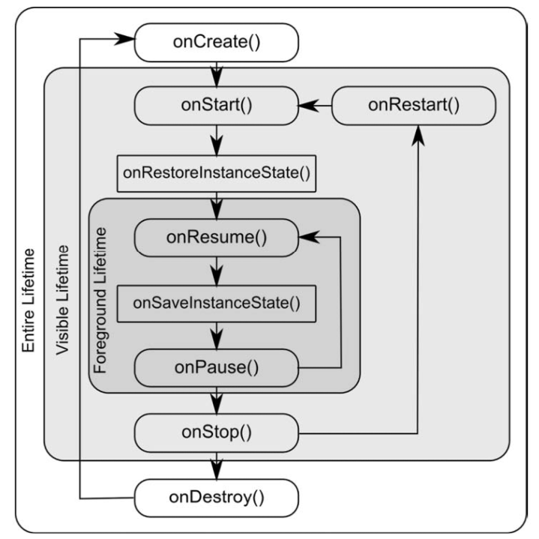
Android Activity Lifecycle

Slide 15
Activities
Ch. 21-22 Android Studio Development Essentials 4.0 (Kotlin Edition)

Slide 16
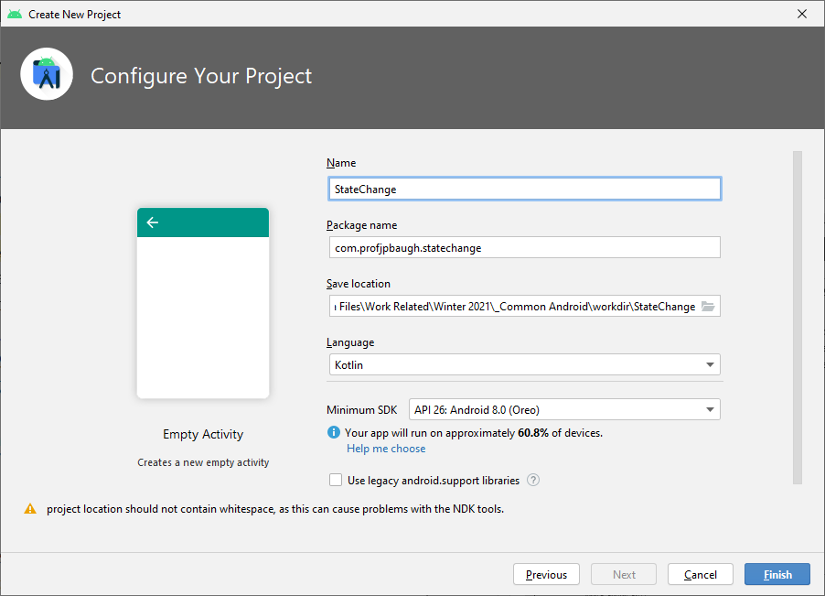
Activity State Changes by Example
Now, we will put the activity state change handling into practice
Create a new project
File -> Close Project if you have a current project open
Start a new Android Studio project from the Welcome Screen
Choose Empty Activity for the template before clicking the Next button
Then, type StateChange as the name of the project, and give it a good project name
Verify that you also have the language set to Kotlin
Also, verify the package name is something meaningful, like mine: com.profjpbaugh.statechange
Click Finish

Slide 17
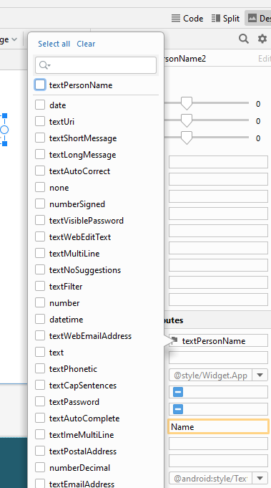
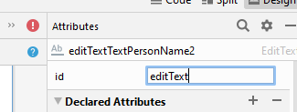
Designing the GUI
The GUI for the MainActivity activity is stored in a layout file named activity_main.xml.
This should already be loaded in the Layout Editor tool
You can always open it in app/res/layout folder within the project
Delete the TextView with “Hello world!” on it
From the Palette to the left, select the Text category, and drag a Plain Text component over to the visual representation of the device screen
This defines a view known as an EditText, which is a text box
You can specify the input type, such as Phone or TextCapCharacters
For our purposes, set the inputType entry and switch off textPersonName and enable text before clicking Apply
Change the id of the view to editText

Slide 18
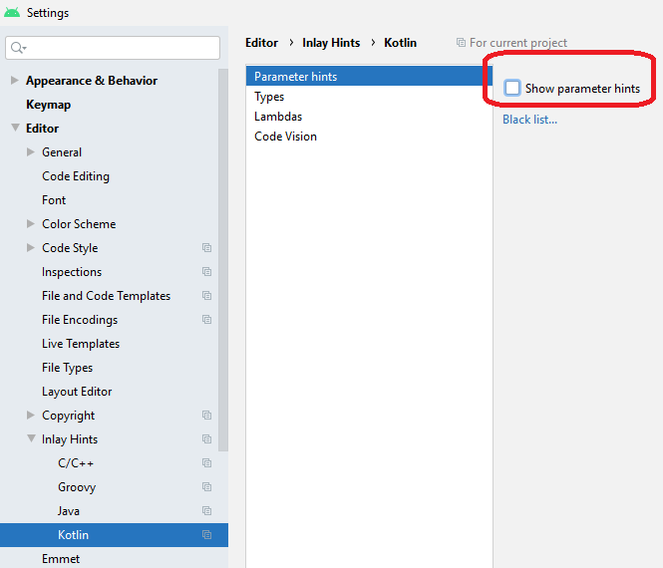
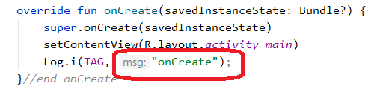
Turning off parameter name hints
If you don’t like inlay hints (such as parameter name hints), you can do so under File → Settings → Editor → Inlay Hints → Kotlin
Then, uncheck the Show parameter hints checkbox for Parameter hints
This is a personal preference, and you can leave them if you’d like
Just note that they are a feature of Android Studio (and IntelliJ) and are not part of the code

Slide 19
Overriding the Activity Lifecycle Methods
class MainActivity : AppCompatActivity() {
private val TAG = "StateChange"
override fun onCreate(savedInstanceState: Bundle?) { super.onCreate(savedInstanceState)
setContentView(R.layout.activity_main)
Log.i(TAG, "onCreate")
}//end onCreate
override fun onStart() {
super.onStart()
Log.i(TAG, "onStart")
}//end onStart
override fun onResume() {
super.onResume()
Log.i(TAG, "onResume")
}//end onResume
override fun onPause() {
super.onPause()
Log.i(TAG, "onPause")
}//end onPause
override fun onStop() {
super.onStop();
Log.i(TAG, "onStop");
}//end onStop
override fun onRestart() {
super.onRestart();
Log.i(TAG, "onRestart");
}//end onRestart
override fun onDestroy() {
super.onDestroy()
Log.i(TAG, "onDestroy")
}//end onDestroy
override fun onSaveInstanceState(outState : Bundle) {
super.onSaveInstanceState(outState)
Log.i(TAG, "onSaveInstanceState")
}
override fun onRestoreInstanceState(savedInstanceState: Bundle) {
super.onRestoreInstanceState(savedInstanceState)
Log.i(TAG, "onRestoreInstanceState")
}
}
MainActivity.kt
Contains the MainActivity class, which inherits from the AppCompatActivity class
Notice that the onCreate lifecycle method is the only one being ovverridden currently
To log output you can use the Logcat diagnostic message system:
Add import android.util.Log at the top of the file
Add a TAG constant (val) at the top of the class as a field
Add Log.i(TAG, “nameOfMethodHere”) to each of the lifecycle methods

Slide 20
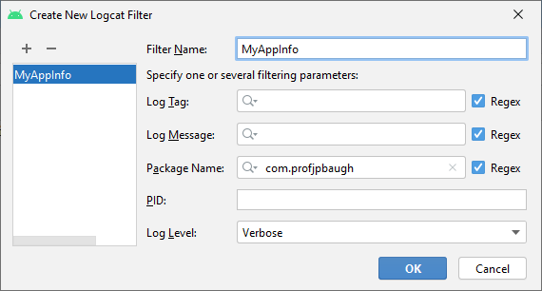
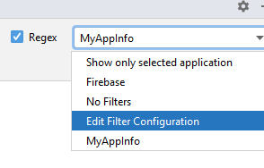
Run the App
Go to Run → Run App
If it says you don’t have an Android Virtual Device (AVD) to emulate the device, you need to create one
I created a Nexus 6P by going to Tools → AVD Manager and selecting the Create Virtual Device option in the lower left corner
Once it’s running, you can expand LogCat at the bottom and see a ton of output from the device
To narrow it down, notice there are filter options
For instance, you can select just Info instead of Verbose
You can create a custom filter by going to the filter type and selecting Edit Filter Configuration, and you can create a new one
Like mine, called MyAppInfo that only shows things from the package com.profjpbaugh, as seen in the image to the right

Slide 21
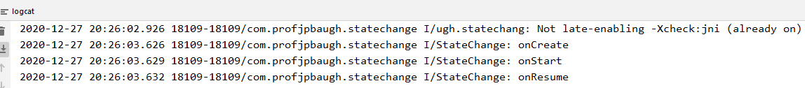
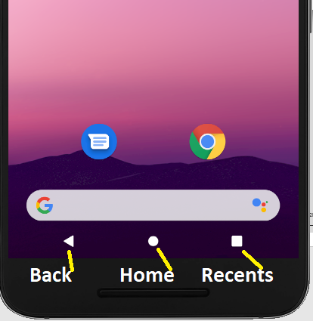
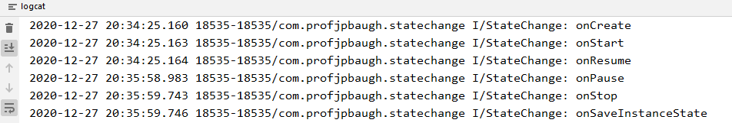
Logcat Output
When you run the app, you only see the startup lifecycle methods:
onCreate
onStart
onResume
Now, click the Home button on the AVD and see what happens in the IDE in Logcat
You now see
onPause
onStop
onSaveInstanceState
onRestoreInstanceState

Slide 22
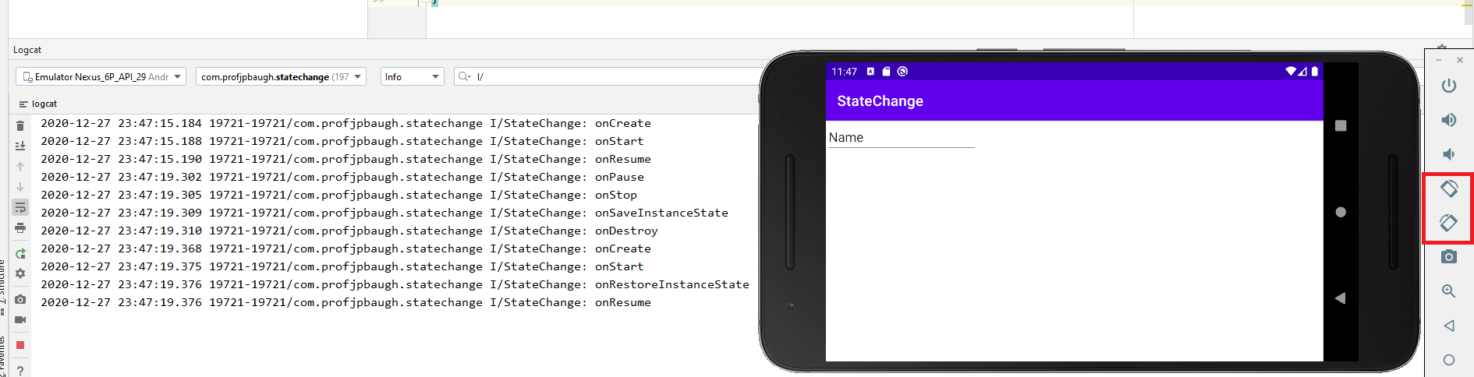
Logcat Output (cont’d)
Now if you rotate the device, it goes through the states, destroying the app and completely recreating it

Slide 23
Saving and Restoring State of an Android Activity
As you can see, the onSaveInstanceState method is called before onDestroy
This means we have an opportunity to save dynamic state information
Recall; dynamic state is the transient data, such as UI state, and persistent state is data that should survive between runs of the application, in structures such as files or databases
Note that the onSaveInstanceState has a reference to a Bundle object passed as a parameter
The Bundle object is where the method will store any dynamic data that needs to be saved
Afterwards, the Bundle object is stored by the runtime system on behalf of the activity, and is subsequently passed through as an argument to the activity’s onCreate and onRestoreInstanceState methods if, and when they are called

Slide 24
Default Saving of UI State
In the StateChange application, enter text into the EditText field and then rotate it
Notice what runs when the device is rotated (look in Logcat)
onPause
onStop
onSaveInstanceState
onDestroy
onCreate
onStart
onRestoreInstanceState
onResume
Given that the data entered into EditText is preserved, but the activity had been destroyed, this may require explanation
The SDK already implements the behavior necessary to automatically save and restore state when an activity is restarted – the onSaveInstanceState and onRestoreInstanceState must each call their super counterparts at the beginning, passing the bundle, for this to work
If you want to disable the automatic saving of this kind, you must set the android:saveEnabled property of a view to false
Set the android:saveEnabled property of the Edit text to false and rerun the app to see what happens when you rotate with data in the EditText

Slide 25
The Bundle class
For situations where state needs to be saved beyond the default functionality provided by the UI view components, the Bundle class provides a container for storing data in key-value pairs
The keys are string values, while the values can be in the form of a primitive value or any object that implements the Android Parceable interface
There are a wide variety of classes that implement this interface
You can even create your own
For purposes of our example, since we disabled the automatic saving of text
We will simply make sure to manually save and restore the data from/to the EditText
This just serves as a demonstration of how to manually save and restore state

Slide 26
Enabling Synthetic Properties
Before we save and restore the instance state, let’s enable synthetic properties so we can make our code cleaner
In order to use synthetic properties, you must do the following:
In your Project, under build.gradle (Module version), make sure the Kotlin Extensions are in the plugins section: plugins {
id 'com.android.application’
id 'kotlin-android’
id "org.jetbrains.kotlin.android.extensions"
}
In the build.grade (Project version), make sure you have the Kotlin Plugin added to the dependencies, as well
dependencies {
classpath "com.android.tools.build:gradle:4.1.1"
classpath "org.jetbrains.kotlin:kotlin-gradle-plugin:$kotlin_version"
}
Make sure to Perform a Gradle Sync Now, which is usually an option when you’re in a Gradle build file

Slide 27
Saving the State
First, import the synthetic properties using the import kotlinx.android.synthetic.main.activity_main.* at the top of the MainActivity class
We need to first modify the onSaveInstanceState method to store the data as a key-value pair into the Bundle object
Notice the use of the safe call operator ( ?. )
override fun onSaveInstanceState(outState : Bundle) {
super.onSaveInstanceState(outState)
Log.i(TAG, "onSaveInstanceState")
val userText = editText.text //synthetic property!
outState?.putCharSequence("savedText", userText)
}

Slide 28
Restoring the State
Then, we need to restore the data from the Bundle object into the EditText inside the onRestoreInstanceState
override fun onRestoreInstanceState(savedInstanceState: Bundle) {
super.onRestoreInstanceState(savedInstanceState)
Log.i(TAG, "onRestoreInstanceState")
val userText = savedInstanceState?.getCharSequence("savedText")
editText.setText(userText)
}
}

Slide 29
Run and test the app!
Run the application again
Notice that if you place test in the EditText, and rotate, it is restored again!
This shows that we can save and restore data manually
For this specific, rather trivial example, we’d typically just rely on the default save and restore process
We just did this to demonstrate how we do this manually
You might want to save data to a database, and restore it from the database on a rotation or close or something of that nature

