Slide 1


Navigation and Menus
John P. Baugh, Ph.D.

Slide 2
Navigation
Ch. 47-48

Slide 3
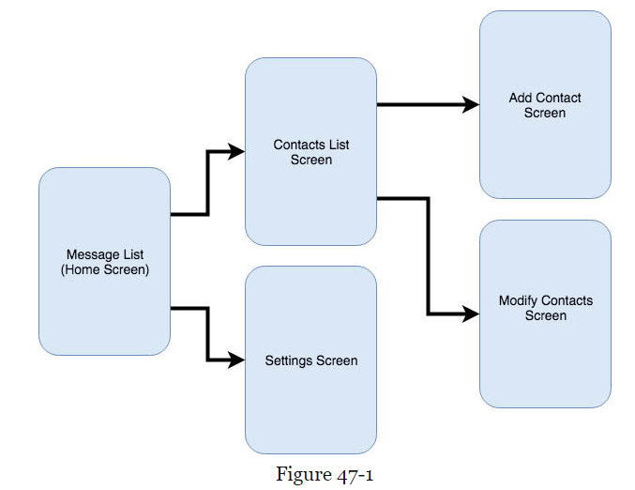
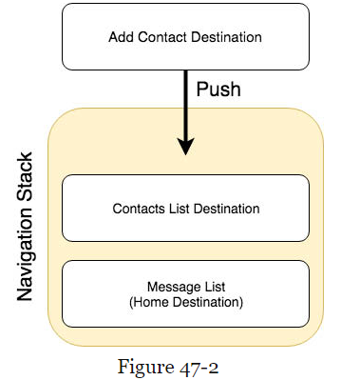
Navigation
For most of its history, when creating navigation, large chunks of manual code were required
Now, with Jetpack, the Android Navigation Architecture Component combined with support for navigation graphs in Android Studio has changed this and made the process much better
Each screen that makes up the app is referred to as a destination and is usually a fragment or activity
Figure 47-1 shows a sample visualized navigation graph
The destinations are tracked on the navigation stack (See Figure 47-2)

Slide 4
Navigation Architecture Component
Adding navigation to an Android project using the Navigation Architecture Component is straightforward, involving:
A navigation host
A navigation graph
Navigation actions
A minimal amount of code, used to obtain a reference to, and interact with, the navigation controller instance
When the app first launches, the home screen is the first destination, and placed onto the stack, and becomes the current destination

Slide 5
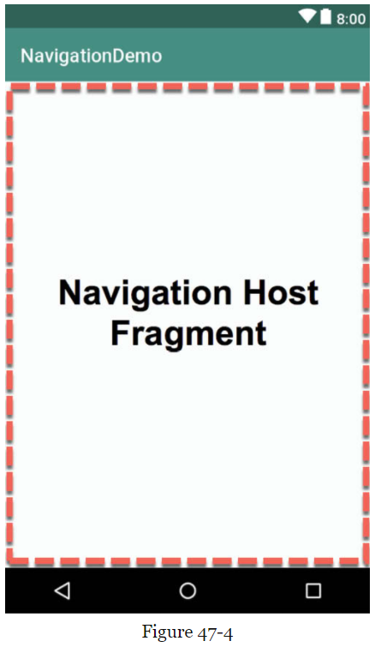
Navigation Host
A navigation host is simply a special fragment, NavHostFragment that is embedded into the user interface layout of an activity
It serves as a placeholder for the destinations through which the user will navigate
A NavHostFragment can be placed into an activity layout within Android Studio layout editor
Either by dragging and dropping an instance from the Containers section of the palette
Or, by manually editing the XML:
<fragment android:id=“@id/demo_nav_host_fragment” android:name=“androidx.navigation.fragment.NavHostFragment” android:layout_width=“match_parent”
android:layout_height=“match_parent” app:defaultNavHost=“true” app:navGraph=“@navigation/navigation_graph” />

Slide 6
Navigation Graph
A navigation graph is an XML file which contains the destinations that will be included in the app navigation.
In addition to the destinations, the file also contains navigation actions that define navigation between destinations and optional arguments for passing data from one destination to another
Android Studio includes a navigation graph editor that can be used to design graphs and implement actions either visually or by manually editing the XML

Slide 7
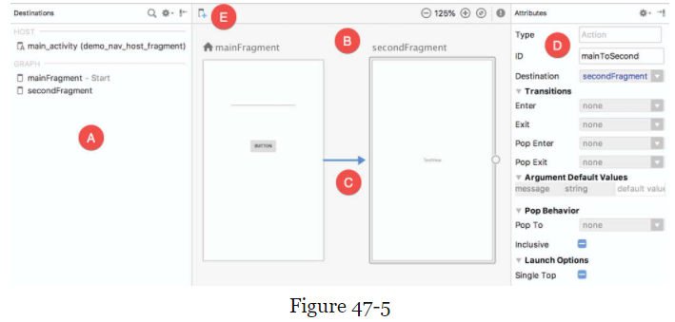
Navigation Graph
A – definitions list: provides a list of all the destinations currently contained within the graph
B – navigation panel: contains a dialog for each destination, showing a representation of the user interface layout
C – arrows between destinations represent the navigation action connections
D – the Attributes panel allows properties of the currently selected destination or action connection to be viewed and modified
E – button that allows you to create new destinations

Slide 8
Accessing the Navigation Controller
Navigating from one destination to another will usually take place in response to an event of some kind
Such as a button click or menu item selection
The code must first obtain a reference to the navigation controller instance
This requires a call to findNavController on the Navigation or NavHostFragment classes
val controller : NavController = Navigation.findNavController(activity, R.id.demo_nav_host_fragment)
Or
val controller: NavController = NavHostFragment.findNavController(fragment)
controller.navigate(R.id.goToContactsList) //use this to perform navigation

Slide 9
Passing Arguments
You can pass data using a Bundle object passed to the destination during an action where it is unbundled and the arguments are extracted, or
Data can be passed between destinations using arguments defined in the navigation graph
E.g.., <fragment … > <argument android:name = “contactsCount” android:defaultValue=“0” app:type=“integer” /> </fragment>

Slide 10
Go through the tutorial in Ch. 48
Chapter 48 introduces the NavigationDemo that is included with the book files available to you

Slide 11
Overflow Menus
Ch. 49

Slide 12
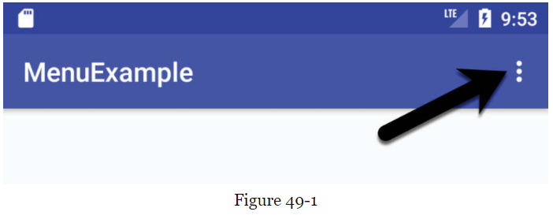
Overflow Menus
One of the most commonly used menus in Android is the Overflow menu
The overflow menu is available typically in the upper right corner on the device display

Slide 13
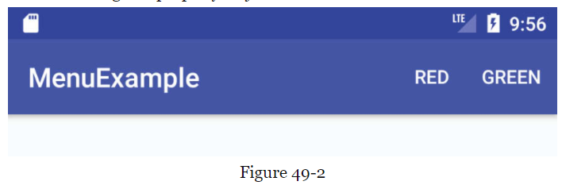
Creating an Overflow Menu
You can declare the items in a menu within an XML file, which can then be inflated and displayed to the user on demand
This involves the use of the <menu> element containing <item> sub-elements for each menu item
The following XML, as an example, defines a menu consisting of two menu items relating to color choices:
<menu …> <item android:id=“@id/menu_red” android:orderInCategory=“1” app:showAsAction=“never” android:title=“@string/red_string” /> <item android:id=“@id/menu_green” android:orderInCategory=“2” app:showAsAction=“never” android:title=“@string/green_string” /> </menu>
Figure 49-2 shows the menu, if the showAsAction is set to ifRoom

Slide 14
Displaying an Overflow Menu
An overflow menu is created by overriding the onCreateOptionsMenu method of the corresponding activity and then inflating the menu’s XML file
For example, if the XML file is named menu_main, then:
override fun onCreateOptionsMenu(menu : Menu) : Boolean { menuInflater.inflate(R.menu.menu_main, menu) return true }

Slide 15
Responding the Menu Item Selections
You can implement onOptionsItemSelected to respond to user interaction
override fun onOptionsItemSelected(item : MenuItem) : Boolean { when(item.itemId) { R.id.menu_red -> { return true }
R.id.menu_green -> { return true } else -> return super.onOptionsItemSelected(item) }//end when }

Slide 16
Example Project
Section 49.7 contains the example project, which can be found in the code for the book as MenuExample

