Slide 1


Jetpack
John P. Baugh, Ph.D.

Slide 2
Jetpack
Ch. 39

Slide 3
Jetpack
Android Jetpack was introduced in 2018, and is now the recommended approach to building Android apps
Jetpack consists of
Android Studio
Android Architecture Components
Android Support Library
Set of Guidelines and recommendations about Android app structure

Slide 4
Architecture and Components
The Android Architecture Components are designed to make it quicker and easier to perform common tasks during app development and conforming to the key principle of architectural guidelines
The Old Architecture style
Typically, up until now, Android projects have consisted of a single activity which contained all of the code for presenting and managing UI and back-end logic of the app
Each activity corresponds roughly to each screen
Modern Android Architecture
Google now advocates for single activity apps where different screens are loaded as content within the same activity
Similar to single-page applications (SPA) which is an architectural approach used frequently in Web applications
Different areas of responsibility are in entirely separate modules
Separation of concerns
The ViewModel component is a key part of this separation of concerns

Slide 5
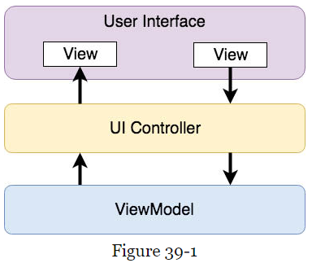
ViewModel Component
The ViewModel’s purpose is to separate UI-related data and logic of an app from the code responsible for displaying and managing UI interaction, and interaction with the OS
An app using this approach uses one or more UI Controllers, such as an activity, with ViewModel instances responsible for handling data needed by the controllers
The ViewModel only knows about the data model and corresponding logic
It doesn’t know about the user interface, and doesn’t try to directly access or respond to events related to views within the UI
Therefore, even if a UI controller is recreated many times during the lifecycle of an app, the ViewModel instances remain in memory and maintain data consistency.

Slide 6
LiveData Component
The LiveData component is used in scenarios where real time data is required.
Although the UI controller could continuously poll (check) the ViewModel for any updated data, this is very inefficient. Picture children in the back seat of a vehicle, during a long drive constantly asking their parents, “Are we there yet?!”
A better solution is for the UI controller to receive a notification when data within the ViewModel changes. So this is more of a signal-based approach rather than a continuous polling approach. LiveData is a data holder that allows value to become observable. An observable object has the ability to notify other objects when there are changes to the data.
A UI controller that is interested in a ViewModel value can set up an observer which will be notified when the value changes. The LiveData object may be declared as being mutable, allowing the observing entity to update the underlying value held within it.
An observer, although frequently used by UI controllers, can be used by any object that conforms to the Jetpack approach to lifecycle management.

Slide 7
ViewModel Saved State
An active app may be placed in the background by the user, or by the system to reclaim resources. If the user restores the app, it should appear in the same state as when it was placed in the background.
As far as the data associated with a ViewModel, this can be implemented by using a ViewModel saved state module, which will save the state of the ViewModel. This can be restored when the app is restored.

Slide 8
LiveData and Data Binding
Android Jetpack includes the Data Binding Library, which allows data in a ViewModel to be mapped directly to specific views within the XML UI layout file. With data binding, the LiveData value stored in the ViewModel can be referenced directly within XML without needing to write code to keep the layout views updated.

Slide 9
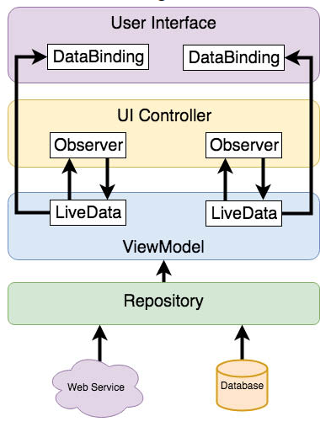
Repository Modules
The code to handle data sources is separate from the code in the ViewModel class itself
Google recommends placing the code for data source functionality in a separate Repository module
Note that a Repository module isn’t some special or magical Android architecture component. It’s simply a POJO (plain ol’ Java object/class- or Kotlin class, for our purposes) to interface with the data sources, It provides a separation of concerns between the ViewModel and the data sources (e.g., databases, Web services)
The image from the book is quite useful in understanding how all of this goes together.

Slide 10
Jetpack ViewModel Tutorial
Ch. 40

Slide 11
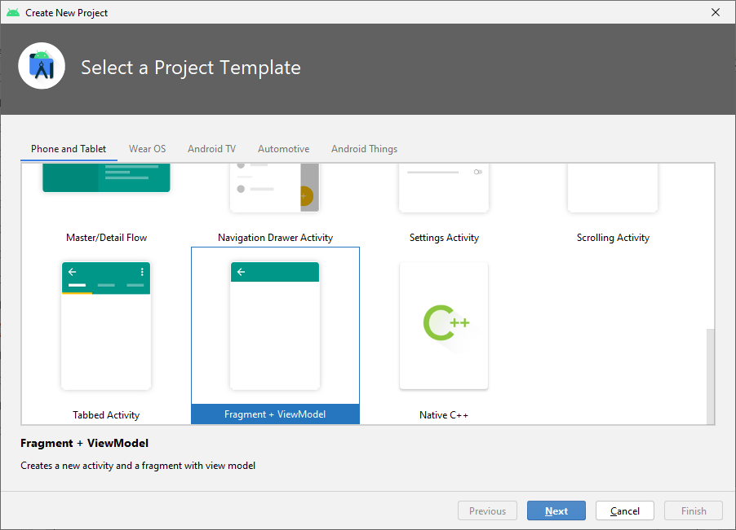
Jetpack ViewModel
The ViewModelDemo project in the book files for the course contains the complete code
Try to go through Ch. 40, step by step to understand, though
You will use the Fragment + ViewModel template instead of the Empty Activity template
Note that the MainActivity layout and Kotlin code are structured to act as a container
The FrameLayout is just a placeholder and is replaced at runtime by the content of the first screen that is to appear when the app launches
The content will typically be a fragment consisting on an XML layout resource file and corresponding class

Slide 12
Further Topics for JetPack
Ch. 41 - 46

Slide 13
Jetpack Topics
Data Binding, Ch. 42-43
ViewModel Saved State, Ch. 44
Lifecycle-Aware Components, Ch. 45-46

