Slide 1


Views and Layouts
John P. Baugh, Ph.D.

Slide 2
Views, View Groups and Layouts
Ch. 23

Slide 3
User Interaction
Except for possibly listening to streaming audio, a user’s interaction with an Android device is primarily visual and tactile in nature
As a result, a key element of developing Android applications involves the design and creation of user interfaces
The primary components that can be brought together to make up a UI:
Views
View Groups
Layouts

Slide 4
Designing for Different Android Devices
What is an Android device?
Smartphones
Tablets
Televisions
Etc.
Therefore, application UIs must now be carefully designed to ensure correct presentation on as wide a variety of display sizes as possible
A major part of this is making sure UI layouts resize correctly when run on different devices
This is largely achieved through careful planning and use of the layout managers, which we will discuss
Also, it’s important to remember that the smartphones and tablets can be held in portrait (long vertically) and landscape (long horizontally) orientations, so a well-designed UI should be able to adapt to such changes and make sensible layout adjustments to utilize the available screen space in each orientation

Slide 5
Views and View Groups
Every item in a UI is a subclass of the Android View class
Precisely: android.view.View
The Android SDK provides a set of pre-built views that can be used to construct an UI
Typical examples of standard views:
Button
CheckBox
ProgressBar
TextView
Views that you can interact with like those mentioned above are referred to as widgets or components
A composite view is a view that can be comprised of multiple other views
These are subclassed from the ViewGroup class
android.view.ViewGroup
An example would be the RadioGroup, which can contain multiple RadioButton widgets

Slide 6
Android Layout Managers
In addition to the widgets, the SDK also includes a set of views called layouts
Layouts are container views, so they are subclassed from ViewGroup
They are designed for the sole purpose of controlling how child views are positioned on the screen
The Android SDK includes the following layout views that may be used within an Android UI:
ConstraintLayout – introduced in Android 7, this is a newer layout recommended for most layout requirements
Allows positioning and behavior of views in a layout to be defined by simple constraint settings assigned to each child view
This layout is very flexible and allows for complex layouts to be quickly and easily created without having to nest other layouts, so it is very efficient
ConstraintLayout is also tightly integrated into the Android Studio Layout Editor tool
Unless otherwise required, this is the layout of choice for the majority of projects you’ll work on
LinearLayout – Positions child views in a single row or column
A weight value can be set on each child to specify how much of the layout space that child should occupy relative to other children
TableLayout – Arranges child views into a grid format of rows and columns
FrameLayout – Allocates an area of the screen and allows for stacking in the z-direction
RelativeLayout – allows positioning of views relative to one another and the parent view
Etc. (see book)

Slide 7
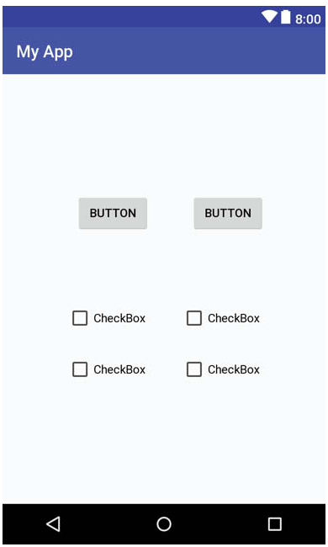
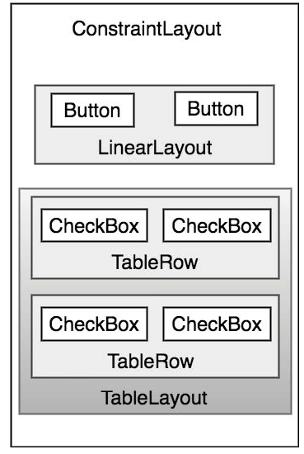
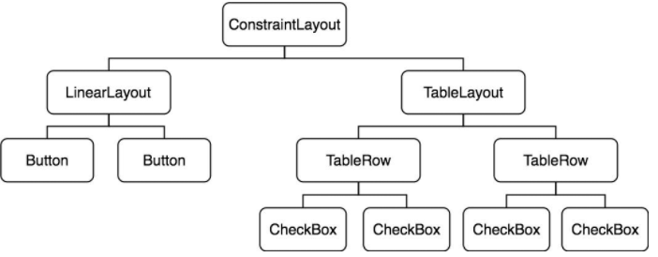
The View Hierarchy
Each view in a UI represents a rectangular area of the display
A UI screen is comprised of a view hierarchy with a root view positioned at the top of the tree and child views positioned on branches (and leaves) below

Slide 8
Creating User Interfaces
There are three different approaches to UI design:
Using the Android Studio Layout Editor tool
Handwriting XML layout resource files
Writing Kotlin code
The Layout Editor generates XML, so those go hand-in-hand, and provide for better separation of concerns
The design of the UI is separated from the behaviors and interaction by the UI being initially created in XML, and the functionality being programmed in Kotlin (or Java)

Slide 9
Using the Android Studio Layout Editor Tool
Ch. 24

Slide 10
Activities and the Android Studio Layout Editor
As we’ve seen, Android applications are typically made of one or more activities
An activity is a standalone module of application functionality that usually correlates directly to a single user interface screen
When using the Android Studio Layout Editor, we are invariably working on the layout for an activity

Slide 11
Empty vs Basic Activity Templates
The Empty Activity template
Creates a single layout file with a ConstraintLayout manager, and a TextView
The Basic Activity template
Creates multiple layout files
The top level layout file is a CoordinatorLayout as the root view
It includes a configurable app bar (action bar) on the top of the device screen
A floating action button is also included
The activity_main.xml contains a reference to a second file named content_main.xml
The purpose of the Basic Activity template is to demonstrate how to implement navigation between multiple screens within an app
If you’d like, create a test project using Basic Activity template, and see how the Next and Previous buttons work
In reality, there is a single activity but multiple fragments, which will be discussed later in the course

Slide 12
The Android Studio Layout Editor
The Layout Editor tool is a WYSIWYG (what you see is what you get) tool
Views can be selected from a palette and placed on to the canvas
A view can the be modified (moved, deleted, resized) subject to the constraints of the parent view
A wide variety of attributes can be accessed using the Attributes tool window
Under the surface, the Layout Editor tool constructs an XML resource file
As we’ve seen, you use three distinct operating modes for the Layout Editor:
Design
Code
Split

Slide 13
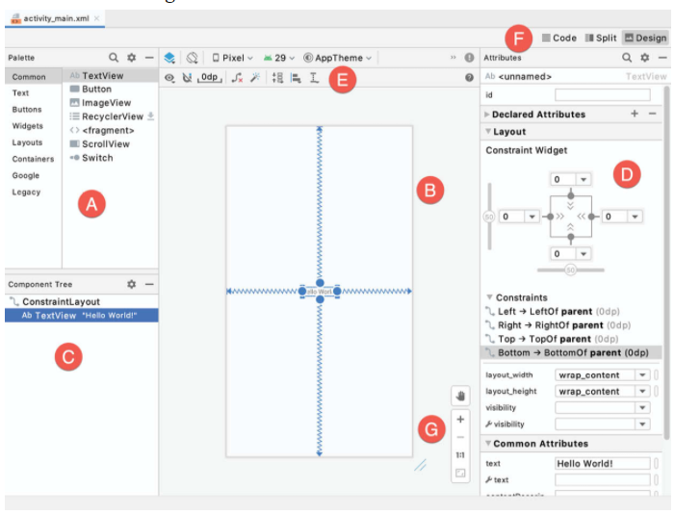
Design Mode
In Design Mode, you can visually manipulate the UI by directly working with the view palette and the graphical representation of the layout
The key areas of the Design Mode are
A – Palette – The palette provides access to a range of view components provided by the Android SDK, which are grouped into categories for easy navigation
B – Device Screen – The device screen provides a visual WYSIWYG representation of the UI layout as it is being designed
C – Component Tree – The component tree provides a visual overview of the hierarchy of the UI design
D – Attributes – All the component views in the palette have attributes associated with them, which can be modified in the attributes panel
E – Toolbar – The toolbar provides quick access to a range of options including, amongst other options, the ability to zoom in and out, change the device model, rotate, etc.
F – Mode Switching Controls – Three buttons providing you with a way to switch back and forth among Design, Code, and Split modes
G – Zoom and Pan Controls – Allows you to zoom in and out and to pan around the canvas

Slide 14
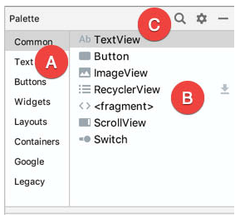
The Palette
The palette is organized into two panels designed to make it easy to locate and preview view components for addition to a layout design
The category panel (A in the lower right figure) lists the different categories of view components that are supported by the Android SDK
The second panel (B in lower right figure) lists the specific components in the selected category
The search button (C in lower right figure) allows us to search for a specific component within the currently selected category
You can also set the category to All to do a full search across all categories

Slide 15
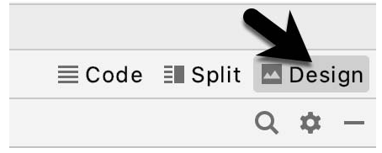
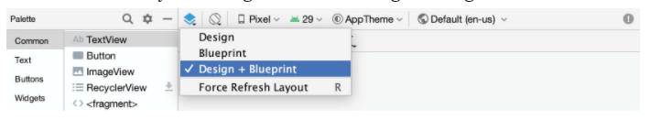
Design Mode and Layout Views
The layout editor is in Design mode by default
You can switch this by clicking one of the other options (Code or Split)
The Blueprint View can be shown either instead of, or concurrently with the Design view
You can also Force Refresh Layout if the layout gets into a weird state in the editor
It causes the layout to rebuild and redraw

Slide 16
Code and Split Modes
The Code Mode allows you to examine and modify the XML code directly
You can switch to it at any time
The Split Mode shows both the Design and Code modes

Slide 17
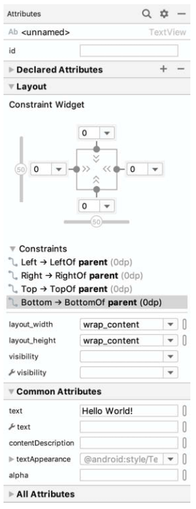
Setting Attributes
The Attributes panel provides access to all of the available settings for the currently selected component
The example to the right shows the attributes of a selected TextView (which is like a label)
There are different sections into which the Attributes tool window is divided
id – Contains the id property which defines the programmatic name that can be referenced in the source code of the app
Declared Attributes – Contains all the properties which have already been assigned a value
Layout – The settings that define how the currently selected view object is positioned and sized in relation to the screen and other objects in the layout
Common Attributes – A list of common attributes… duh!
All Attributes – A complete list of all of the attributes available for the currently selected object
You can also search for an attribute using the search button in the toolbar of the attributes tool window

Slide 18
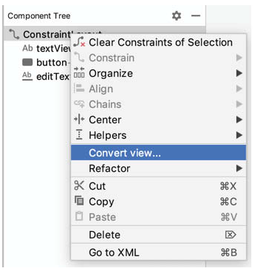
Converting Views
If you want to change the view of a layout from one type to another (e.g., converting a TextView to an EditText) you can do this easily within the layout editor by choosing “Convert view…” after right clicking the component in quesiton

Slide 19
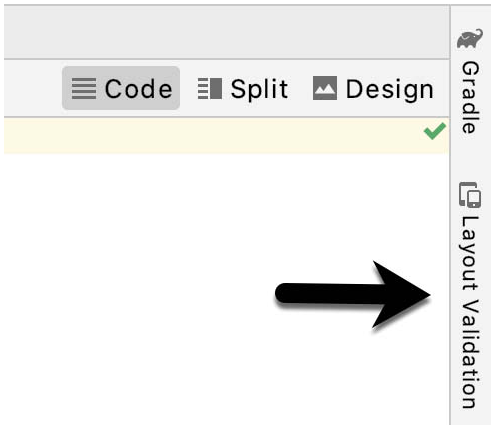
Layout Validation
When you are editing a UI, if you want to preview the UI on a range of Pixel-sized screens simultaneously, then this is the tool for you!

Slide 20
ConstraintLayout
Ch. 25

Slide 21
How ConstraintLayout Works
The ConstraintLayout layout manager is, as the name suggests, constraint-based
In common with all other layouts, ConstraintLayout is responsible for managing the positioning and sizing of the visual components (widgets) that it contains
It does this based on the constraint connections among the child widgets
To full appreciate and understand how to use ConstraintLayout, it’s important to understand the following key concepts:
Constraints
Margins
Opposing Constraints
Constraint Bias
Chains
Chain Styles
Barriers

Slide 22
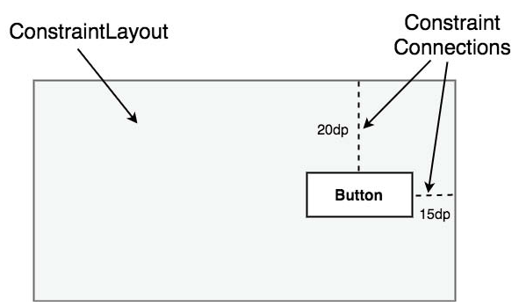
Constraints and Margins
Constraints are sets of rules that dictate the way in which a widget is aligned and distanced in relation to other widgets, the sides of the containing ConstraintLayout, and special elements called guidelines.
Constraints dictate how the UI layout of an activity will respond to change, as well
Changes in device orientation, different screen sizes, etc.
A margin is a form of constraint that specifies a fixed distance
20dp from top, 15 dp from right
Dp = density independent pixels

Slide 23
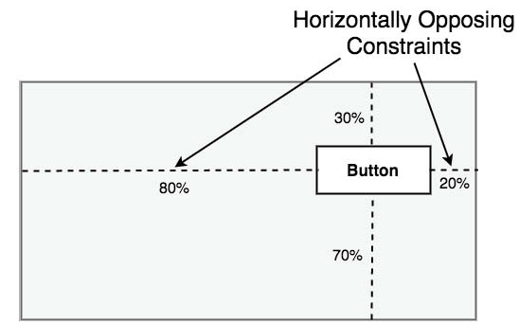
Opposing Constraints
Two constraints operating along the same axis on a single widget are opposing constraints
For example, a widget with constraints on both its left and right-hand sides is considered to have horizontally opposing constraints
When there are opposing constraints, the key idea is that since they are implemented on a particular axis, the position of the widget becomes based on percentage, rather than coordinates

Slide 24
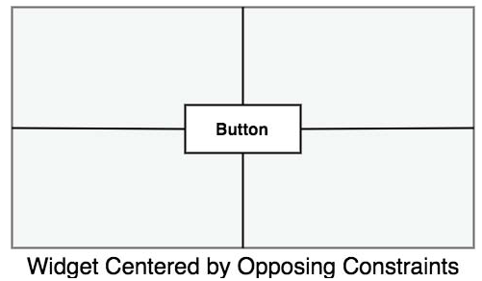
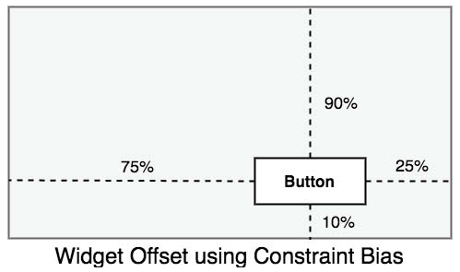
Constraint Bias
As we’ve seen, a widget in a ConstraintLayout can potentially be subject to opposing constraint connections
By default, opposing constraints are equal, resulting in the corresponding widget being centered along the axis of opposition
To allow for the adjustment of widget position in the case of opposing constraints, the ConstraintLayout implements a feature known as constraint bias

Slide 25
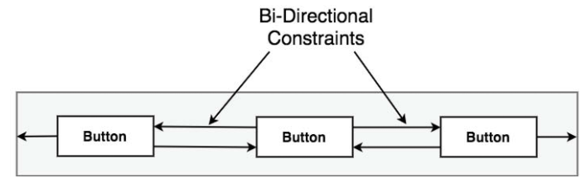
Chains
ConstraintLayout chains provide a way for the layout behavior of two or more widgets to be defined as a group
Chains can be defined in either vertical or horizontal axis
They can also be configured to define how the widgets in the chain are spaced and sized
A chain is formed when widgets are connected by bidirectional constraints
The first element in the chain is the chain head

Slide 26
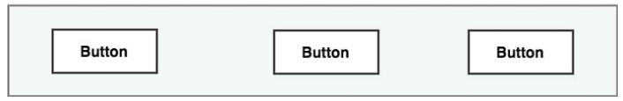
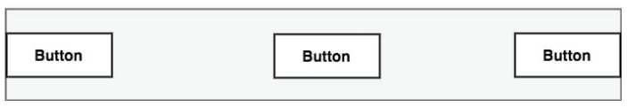
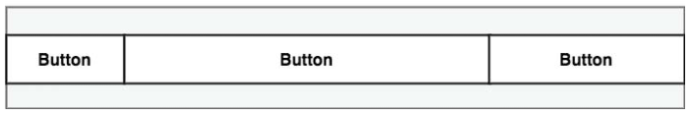
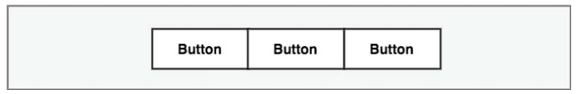
Chain Styles
The layout behavior of a ConstraintLayout chain is dictated by the chain style setting applied to the chain head widget
Currently, the supported chain layout styles include:
Spread Chain – the widgets contained within the chain are distributed evenly across the available space. This is the default behavior for chains.
Spread Inside Chain – the widgets contained within the chain are spread evenly between the chain head and the last widget in the chain. The head and last widgets are not included in the distribution of spacing.
Weighted Chain – Allows the space taken up by each widget in the chain to be defined via weighting properties
Packed Chain – The widgets that make up the chain are packed together without any spacing. A bias may be applied to control the horizontal or vertical positioning of the chain in relation to the parent container.

Slide 27
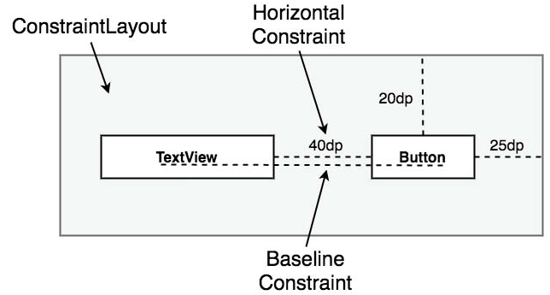
Baseline Alignment
So far, we’ve seen constraints that dictate alignment relative to the sides of a widget
These are side constraints
A common requirement, however, is for a widget to be aligned relative to the content that it displays rather than the boundaries of the widget itself
To address this need, ConstraintLayout provides baseline alignment support

Slide 28
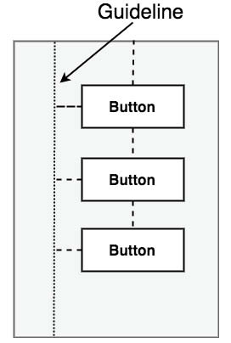
Guidelines
Guidelines are special elements available within ConstraintLayout that provide an additional target to which constraints may be connected
Multiple guidelines may be added to a ConstraintLayout instance which may, in turn, be configured in horizontal or vertical orientations

Slide 29
Using ConstraintLayout in Android Studio
Ch. 26-27

Slide 30
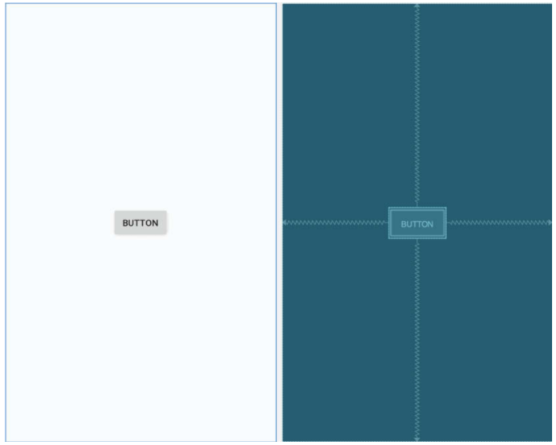
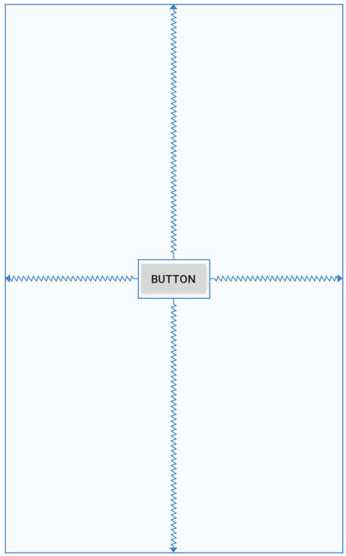
Design and Layout Views
The Design view (left in the figure) presents a WYSIWYG representation of the layout, wherein the layout appears as it will within the running app
The Layout view (right in the figure) displays a blueprint style of view where the widgets are represented by shaded outlines
The Layout view also displays constraint connections
The constraints are also overlaid onto the Design view when a specific widget in the layout is selected or when the mouse pointer hovers over the design area

Slide 31
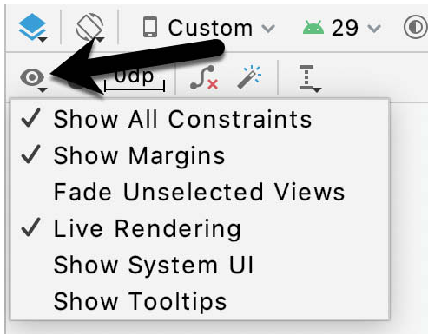
Design and Layout Views (cont’d)
The appearance of constraint connections in both views can be changed using the View Options menu

Slide 32
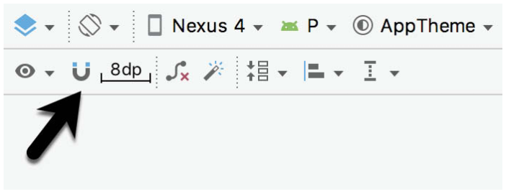
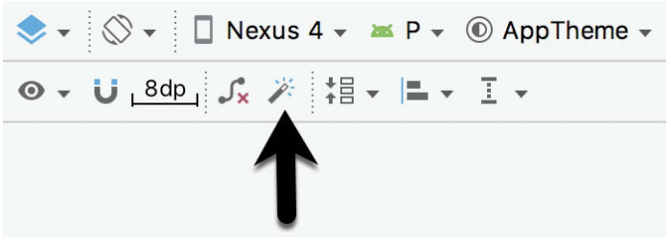
Autoconnect and Inference Modes
Autoconnect mode, as the name suggests, automatically establishes constraint connections as items are added to the layout
Inference mode uses a heuristic approach to automatically implement constraint connections after widgets have already been added to the layout

Slide 33
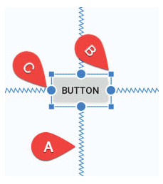
Manipulating Constraints Manually
The third option for implementing constraints is to do so manually
(A) represents the established constraint connections leading from the sides of the widgets to the targets
These are spring-like visibly
(B), the small square markets in each corner of the object are resize handles which, when clicked and dragged, serve to resize the widget
(C), represent the side constraint anchors, which can be used by clicking and dragging the resulting line to the element with which you wish to establish a constraint

Slide 34
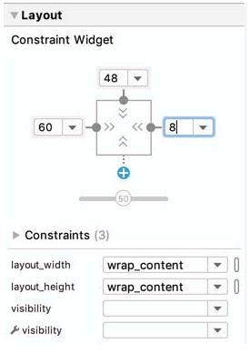
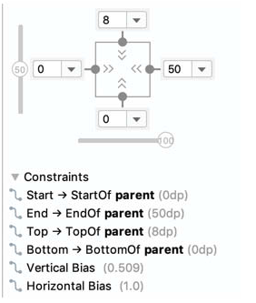
Adding Constraints in the Inspector
Constraints may be added to a view within the Inspector pane located in the Attributes tool window
The square in the center represents the currently selected view and the areas around the square represent the constraints, if any, applied to the corresponding sides of the view
The absence of a constraint is indicated by a dotted line leading to a blue circle containing a plus sign

Slide 35
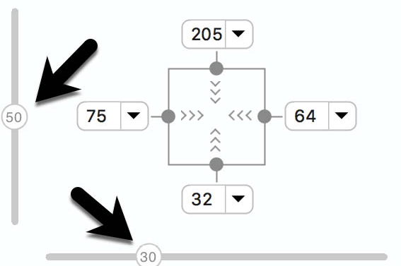
Adjusting Constraint Bias
We previously saw that bias can be set to favor one opposing constraint over another
The two sliders indicated by the arrows in the figure are used control the bias of the vertical and horizontal opposing constraints of the currently selected widget

Slide 36
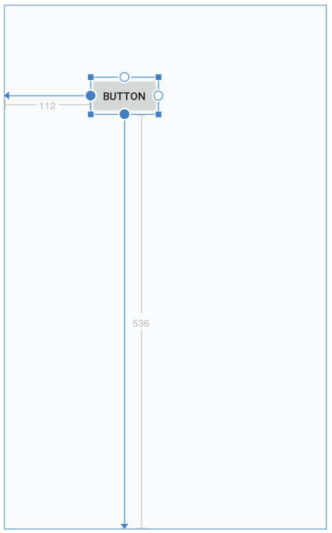
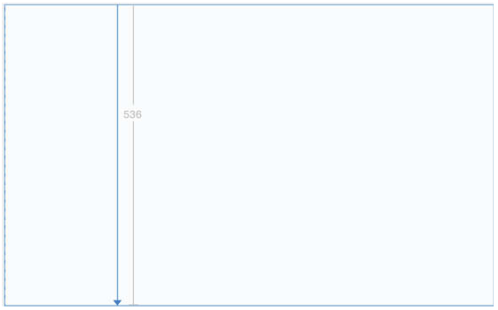
Responsive Layout Design
As review, the following form the cornerstone of responsive layout design using ConstraintLayout:
Opposing constraints
Margins
Bias
When a widget is constrained without opposing constraint connections, those constraints are essentially margin constraints
Using fixed margins is not very flexible, and can lead to undesirable behavior, such as a button disappearing because you rotated the phone and it is fixed outside the boundaries, so margins must be used with care when they provide the entire layout

Slide 37
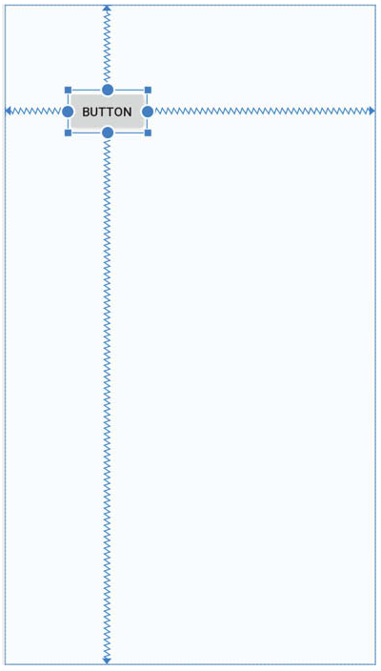
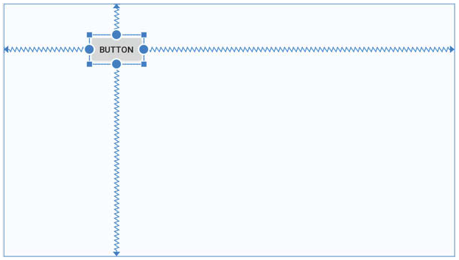
Responsive Layout Design
As review, the following form the cornerstone of responsive layout design using ConstraintLayout:
Opposing constraints
Margins
Bias
When a widget is constrained with opposing constraints and proper bias, widgets automatically respond to layout and orientation changes

Slide 38
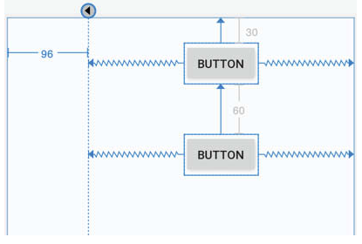
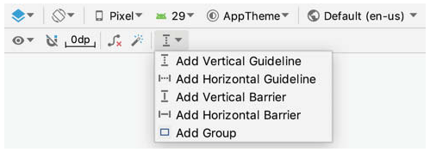
Adding Guidelines or Barriers
You may add guidelines or barriers to provide additional elements to which constraints may be anchored
The major difference is that guideline positions are always fixed (by value or percent), and barrier positions are flexible and always based on the size of one or more UI elements

Slide 39
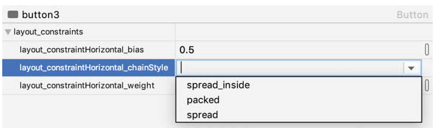
Creating a Chain
Chains may be implemented either by adding a few lines to the XML layout resource file or by using some chain specific features of the Layout Editor
If no chain style is configured, the ConstraintLayout will default to spread chain style
You can alter the chain style by right-clicking any of the widgets in the chain and selecting the Cycle Chain Mode
You can create a packed chain and set the bias (layout_constraintHorizonal_bias and vertical) attributes
You can create a spread or spread inside chain and fill the remaining space by setting one or more views’ layout_width and/or layout_height to “match constraints (0dp)” – default is even spacing (layout_constraintHorizontal_weight, etc.)
layout_constraintHorizontal_weight values are set for each widget in the chain (e.g., 4 for one, 2 for another, etc.)

Slide 40
Ratios (Aspect Ratios)
ConstraintLayout ratios allow one dimension of a widget to be sized relative to the widget’s other dimension
A dimension ratio constraint is configured by setting the constrained dimension to match constraint mode and configuring the layout_constraintDimensionRatio attribute on the widget
The format is width:height
<ImageView
android:layout_width=“0dp”
android:layout_height=“100dp”
android:id=“@id/imageView”
app:layout_constraintDimensionRatio=“2:1” <!– or a float value --> />
So, “2:1” means the width will always be twice the height
Or a float value can be used relative to others

Slide 41
ConstraintLayout Tutorial Using Layout Editor
Ch. 28-32

Slide 42
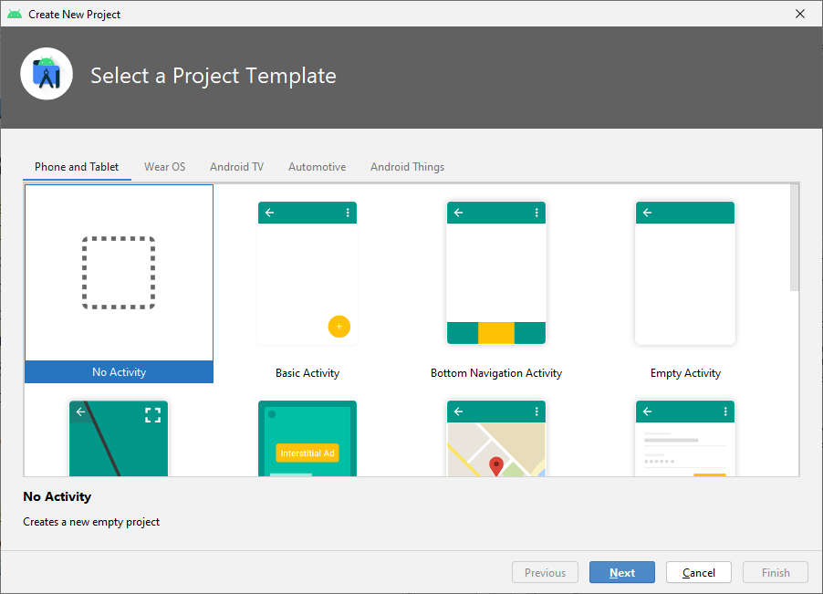
Using Android Studio Layout Editor
Ch. 28 covers using the Android Studio Layout Editor
Subsequent chapters cover different ways of creating the interface, for example, directly using XML, and also how to create the elements programmatically
Note that creating them in Kotlin (or Java) directly is not the best way, unless you need dynamic creation and removal of GUI components
Start a new Android Studio project
We will be creating the new activity and layout resource file manually
So, make sure the No Activity option is selected before clicking on the Next button
Call the Name of the project LayoutSample
Make sure the minimum API is set to 26

Slide 43
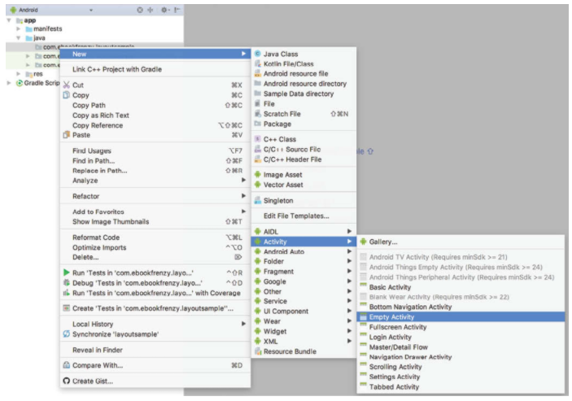
Creating an Activity
The first step in creating a project from scratch is to create a new activity
Expand the hierarchy in the Project window so you can see inside the app/java/… folder in the hierarchy
Once you’ve done so, right-click on it and select the New → Activity → Empty Activity
In the resulting dialog, name the new activity MainActivity and the layout file activity_main
Clearly, the Generate Layout File option must be enabled as well

Slide 44
Designating the Launcher Activity
<?xml version="1.0" encoding="utf-8"?>
<manifest xmlns:android="http://schemas.android.com/apk/res/android"
package="com.profjpbaugh.layoutsample">
<application
android:allowBackup="true"
android:icon="@mipmap/ic_launcher"
android:label="@string/app_name"
android:roundIcon="@mipmap/ic_launcher_round"
android:supportsRtl="true"
android:theme="@style/Theme.LayoutSample">
<activity android:name=".MainActivity">
<intent-filter>
<action android:name="android.intent.action.MAIN" />
<category android:name="android.intent.category.LAUNCHER" />
</intent-filter>
</activity>
</application>
</manifest>
In order for an application to run on a device, it needs to have an activity designated as the launcher activity
This can be seen somewhat like the app/Activity high-level version of having an entry point
You could potentially have multiple activities, so the operating system (Android) will need to know which one is the activity that should be launched first when the application launches
Edit the AndroidManifest (under app/manifests folder in the Projects window)

Slide 45
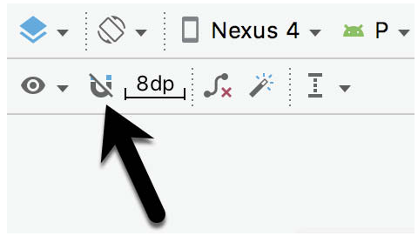
Preparing the Layout Editor Environment
Double-click the activity_main.xml file in app/res/layout to load it into the Layout Editor
Since we want to gain experience with the use of constraints, turn off the Autoconnect feature
Also set the default margin to 8dp, as it is in the image (next to the Autoconnect option)

Slide 46
Import an Image for the ImageView
If you haven’t already, download the book files from the course LMS
Or go to https://www.ebookfrenzy.com/retail/as40kotlin/index.php and download and register yourself
The file that you will be adding to the project, you can find it in the project_icons subfolder
The image will be the galaxy6.png
To do so, do the following:
Display the Resource Manager (View → Tool Windows → Resource Manager)
Locate the galaxys6.png file and drag and drop it into the Resource Manager tool window
In the resulting dialog, click Next and then Import to add the image to the project

Slide 47
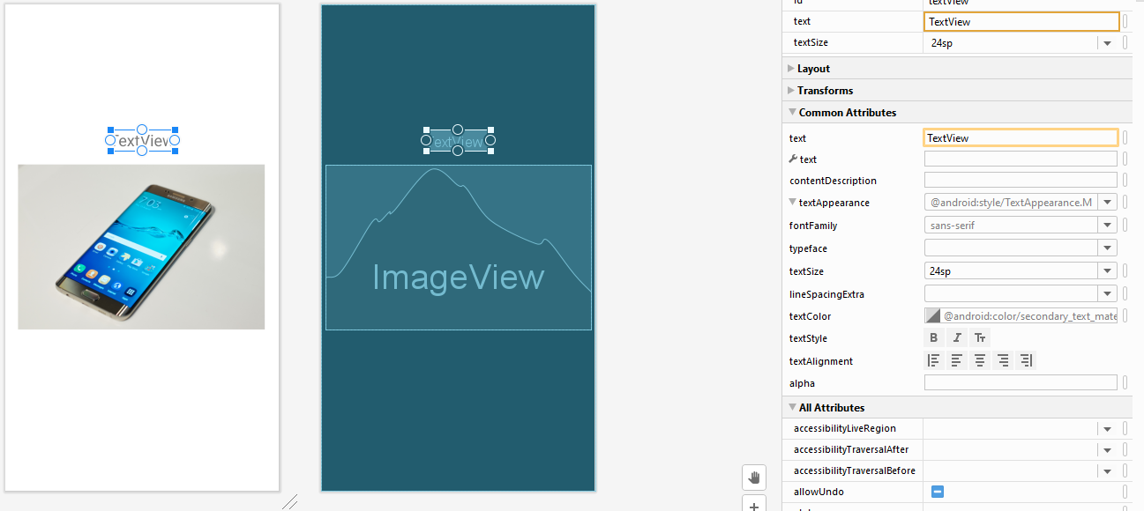
Add Widgets to the UI
From the Common palette category, drag an ImageView object into the center of the display view
Note the horizontal and vertical dashed lines appearing to indicate the center axes of the display
Once you center it, release the mouse button to drop the view into position
Once placed, the Resources dialog will appear seeking the image to be displayed
In the search bar located at the top of the dialog, enter galaxy to locate the galaxys6.png file
Adjust the size of the ImageView and center it again in the layout
Add a TextView object above the ImageView
Unfold the textAppearance attribute in Common Attributes section
Change the textSize to 24sp

Slide 48
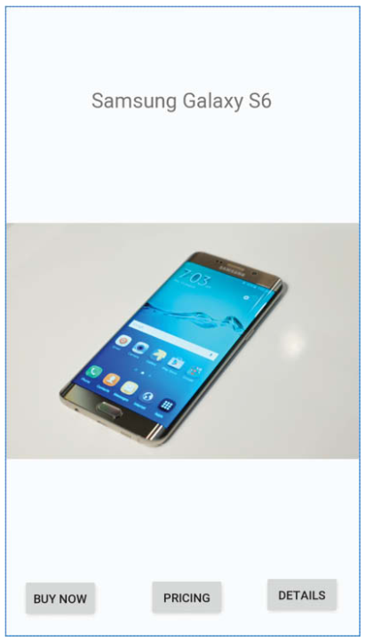
Add Widgets to the UI (cont’d)
Now, add three Button widgets along the bottom of the layout and set the text attributes of these views to “Buy Now”, “Prices”, and “Details”
Also, change the TextView to say “Samsung Galaxy S6”
Re-center it as well

Slide 49
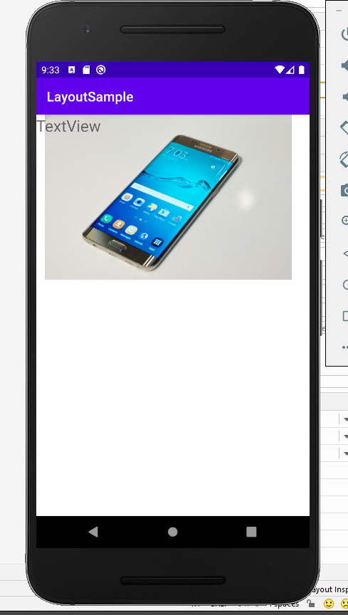
Constraining the Widgets
Run the app
Go ahead! It’s fun to see all the widgets messed up in the upper left corner

Slide 50
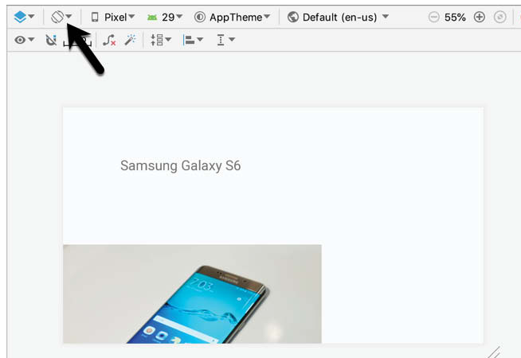
Constraining the Widgets (cont’d)
View the landscape orientation for device rotation in the Layout Editor toolbar
Notice the ImageView gets chopped off
Thus, we see the layout fails to adapt to the change in device orientation

Slide 51

Adding Constraints to the TextView
Constraints are key to creating layouts that can adapt to device orientation changes and different screen sizes
First, rotate the layout back to portrait orientation
Now, select the TextView widget
Establish constraints from the left, right, and top sides of the TextView to the corresponding sides of the parent ConstraintLayout
Make sure the default size of the margins is set to 8dp

Slide 52
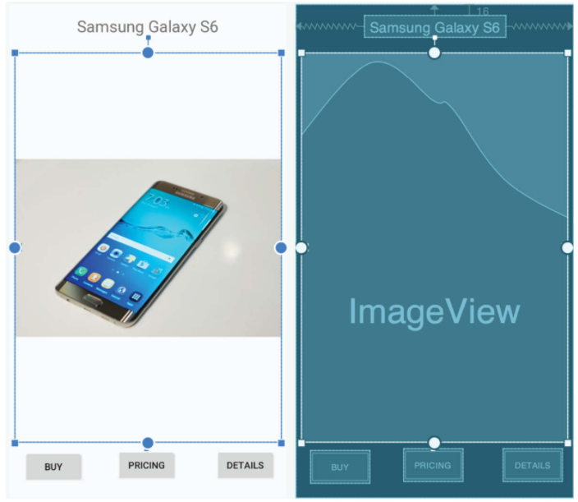
Adding Constraints to the ImageView
Now, select the ImageView and establish opposing constraints on the left and right-hand sides with each connected to the corresponding sides of the parent layout
Next, establish a constraint connection from the top of the ImageView to the bottom of the TextView
Then, do the same from the bottom of the ImageView to the top of the center Button widget
In the Attributes panel, change the top and bottom margins to 24 and 8, respectively
Now, change the height and width dimension properties to match_constraint
The widget will resize to match the constraints

Slide 53
Adding Constraints to the Buttons
The last thing we need to do for now is add constraints to the three Button widgets
For this, we’ll place the buttons in a chain
First, turn on Autoconnect (The magnet / U like image)
Then, shift click to select all three buttons
Right-click on the Buy Now button and select Chains→Create Horizontal Chain
Finally, establish a constraint between the bottom of each of the three buttons (one-by-one) and the bottom of the layout

Slide 54
Testing the Layout
Now, with the constraints added to the layout, rotate the screen into landscape orientation to verify that the layout now adapts to accommodate the new screen dimensions
Now, launch the app on the emulator or a physical device to test out what happens when you rotate it as well

Slide 55
Woohoo!
Great job!
Ch. 29-32 contain additional ways to work with ConstraintLayouts
Ch. 29 focuses on using XML by editing it directly to design the GUI
Ch. 30-31 discuss how to use Kotlin code and the ConstraintSet class to help create Uis, including constraints, from Kotlin code instead of the XML or Layout Editor
Ch. 32 discusses how to apply settings

