Slide 1


Event Handling
John P. Baugh, Ph.D.

Slide 2
Overview of Event Handling
Ch. 33

Slide 3
User Interaction
Event handling is the paradigm by which events occur, often with the user interacting with an application, and the corresponding response of the application
Android maintains an event queue into which events are placed as they occur
Events are then removed from the queue in FIFO order, as expected
When a touch on the screen occurs, the event is passed to the view at that location on the screen
Additionally, the view is also passed a range of information
Coordinates of point of contact between user’s fingertip and screen
The event listener is the class listening for the event, and the event handler is technically the method that responds as a result of the event
Although, the terms are often used in reverse or interchangeably
For example, if a button is clicked, it responds to the click event
In order to respond, there must be a registration between the target’s View.onClickListener via a call to the target’s setOnClickListener method
The onClick method is called on the onClickListener to respond to the event of clicking the button

Slide 4
Using the android:onClick Resource
In addition to using the setOnClickListener, Android allows you to register an onClickListener by setting the android:onClick attribute in the button’s XML code
For example:
<Button android:id=“@+id/button1” android:layout_width=“wrap_content” android:layout_height=“wrap_content” android:onClick=“buttonClick” android:text=“Click me” />
You can also set the attribute in the Attributes panel from the Android Studio Layout Editor

Slide 5
Event Listeners and Callback Methods
There are many callback methods associated with the event listeners, some of which are:
onClickListener – Used to detect click style events whereby the user touches and then releases an area of the device display. It corresponds to the onClick method which is passed a reference to the view that received the event as an argument
onLongClickListener – Used to detect the user’s click for a longer period of time. Corresponds to the onLongClick callback method which is passed as an argument to the view that received the event

Slide 6
Event Handling Example
Ch. 33

Slide 7
Start a new Android Studio project
Start a new Android Studio project
Use the Empty Activity template
Click the Next button
Name this EventExample and give it a package like com.profjpbaugh.eventexample
Minimum API should be 26: Oreo

Slide 8
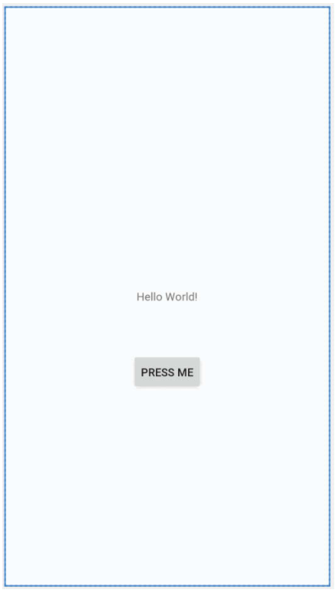
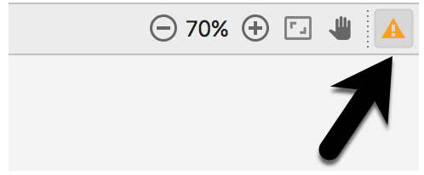
Design the UI
Make sure you enable Autoconnect if not already enabled
The magnet image shouldn’t have a line through it
Drag a Button from the palette and move it so that it’s positioned in the horizontal center of the layout and beneath the existing TextView widget
The default layout gives you the “Hello World” TextView
Select the TextView widget
Using the Attributes pane, set the ID to statusText
Select the Button widget
Set the ID to myButton
Set the text property to Press Me
Click the Infer Constraints button in the layout editor toolbar
It’s the “magic wand” icon
Select the Fix button in the upper right-hand corner of the Layout Editor to extract the text string as a resource named press_me
Now, let’s set up View Bindings so we can use them in our code!

Slide 9
View Bindings
Since Android Studio 3.6, an alternative way of accessing views is available in the form of view bindings
This is now the recommended way of accessing views
Before using them, you must add the following to the build.grade (Module version) : plugins {
id 'com.android.application'
id 'kotlin-android'
id "kotlin-android-extensions"
id "kotlin-kapt"
}
Then, add the following inside the android section of the file:
android {
//... Other subsections here buildFeatures {
viewBinding = true
}
}
Also, add the following to the dependencies section of the file:
kapt 'androidx.databinding:databinding-compiler-common:4.1.2'

Slide 10
Using View Bindings
The first step is to inflate the view binding class so we can access the root view within the layout
Then, the root view will be used as the content view for the layout
The logical place to do this is inside the onCreate method:
To switch to using view binding, the view binding class needs to be imported and the Main activity class modified as follows
Notice the name of the import is because of my project’s package name, and the layout file is activity_main.xml, therefore making the binding class that is automatically generated by Android Studio, ActivityMainBinding:
import com.profjpbaugh.testapp1.databinding.ActivityMainBinding
class MainActivity : AppCompatActivity() {
private lateinit var binding : ActivityMainBinding
override fun onCreate(savedInstanceState: Bundle?) {
super.onCreate(savedInstanceState)
setContentView(R.layout.activity_main)
binding = ActivityMainBinding.inflate(layoutInflater) setContentView(binding.root)
binding.myTV.text = "Howdy!"
}
}

Slide 11
Setting the OnClickListener
The standard style
myButton.setOnClickListener(object : View.OnClickListener { } })
Using lambda notation
myButton.setOnClickListener { }

Slide 12
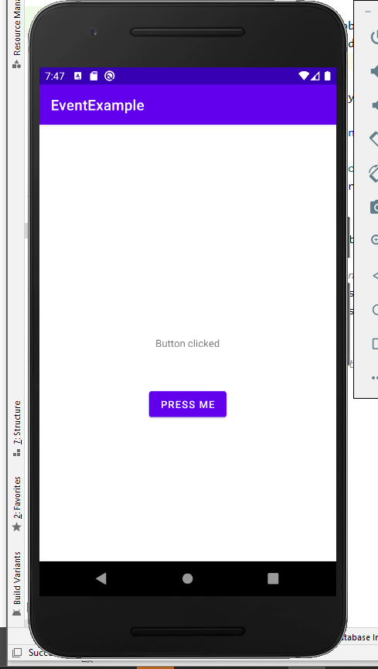
Setting the code and testing
myButton.setOnClickListener {
statusText.text = "Button clicked"
}
Now try running the code in the AVD

Slide 13
Touches and Gestures
Ch. 34

Slide 14
Touch Listeners
A touch listener can be executed from the layout itself
It’s not always about direct view / widget interaction
Many types of gestures: swipes, pinches, etc. exist
The lambda code :
myLayout.setOnTouchListener {v : View, m : MotionEvent -> //tasks go here
true //returns true }
The non-lambda approach:
myLayout.setOnTouchListener(object : View.OnTouchListener { override fun onTouch(v : View, m : MotionEvent) : Boolean { //tasks go here return true } }

Slide 15
The MotionEvent Object
The MotionEvent object passed to onTouch is the key to obtaining information about the event
The type of action associated with an event can be obtained by calling getActionMasked method of the MotionEvent object

Slide 16
Check out the example in Ch. 34!
Multi-touch example in Ch. 34 for your enjoyment, as an exercise for you ☺
In the 4.0 version of the book, page 245-247 are particularly interesting, showing how to determine types of events
There are hundreds of different types of events, so having the basics down helps us to work with these events later on

