Slide 1


Fragments
John P. Baugh, Ph.D.

Slide 2
Introduction to Fragments
Ch. 37

Slide 3
Fragments
A fragment is a self-contained, modular section of an applications’ user interface and corresponding behavior that can be embedded within an activity
Fragments can be created and added to activities during application design, and also added or removed from an activity during an application’s runtime to create dynamically changing UIs
Fragments have their own lifecycle, just like activities
Two components making up a fragment
XML file
Corresponding Kotlin class

Slide 4
XML Example
<?xml version="1.0" encoding="utf-8"?>
<androidx.constraintlayout.widget.ConstraintLayout xmlns:android="http://schemas.android.com/apk/res/android"
xmlns:app="http://schemas.android.com/apk/res-auto"
xmlns:tools="http://schemas.android.com/tools"
android:id="@+id/frameLayout2"
android:layout_width="match_parent"
android:layout_height="match_parent"
tools:context=".TextFragment">
<TextView
android:id="@+id/textView1"
android:layout_width="wrap_content"
android:layout_height="wrap_content"
android:text="Fragment Two"
android:textAppearance="@style/TextAppearance.AppCompat.Large"
app:layout_constraintBottom_toBottomOf="parent"
app:layout_constraintEnd_toEndOf="parent"
app:layout_constraintStart_toStartOf="parent"
app:layout_constraintTop_toTopOf="parent" />
</androidx.constraintlayout.widget.ConstraintLayout>

Slide 5
Fragment Class
import android.os.Bundle import android.view.LayoutInflater import android.view.View import android.view.ViewGroup import androidx.fragment.app.Fragment
class FragmentOne : Fragment() { override fun onCreateView(inflater : LayoutInflater?, container: ViewGroup?, savedInstanceState : Bundle?) : View? { return inflater?.inflate(R.layout.activity_fragment_demo, container, false) }//end function }

Slide 6
Main Activity – Adding the Fragment using the Layout File
import androidx.fragment.app.FragmentActivity import android.os.Bundle class MainActivity : FragmentActivity() { override fun onCreate(savedInstanceState : Bundle?) { super.onCreate(savedInstanceState) setContentView(R.layout.activity_fragment_example) } }

Slide 7
Main Activity – Adding the Fragment using the Layout File
<RelativeLayout …>
<fragment android:id=“@id/fragment_one” android:name=“com.example.myfragmentdemo.myfragmentdemo.FragmentOne tools:layout=“@layout/fragment_one_layout”
…/> </RelativeLayout>

Slide 8
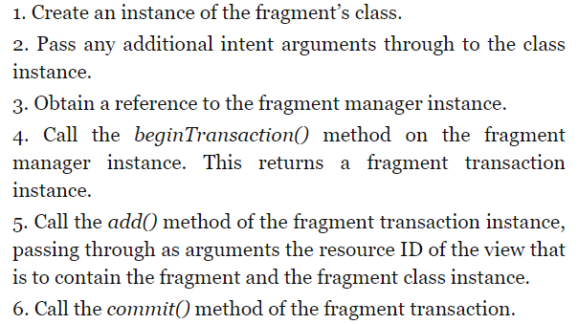
Adding and Managing Fragments in Code
Using the XML approach with the <fragment> tag is easy, but comes at a cost
You cannot dynamically remove the fragment at runtime
To achieve full dynamic control of fragments, you need to add/manage fragments via code
Standard sequence of steps, when working with them:

Slide 9
Code sample
Adding a fragment defined by FragmentOne class so it appears in the container view with an ID of LinearLayout1:
val firstFragment = FragmentOne firstFragment.arguments = intent.extras val transaction = fragmentManager.beginTransaction() transaction.add(R.id.LinearLayout1, firstFragment) transaction.commit()

Slide 10
Handling Fragment Events
Just like with Activities, two major techniques exist:
Register an event-handler in code: button.setOnClickListener { //code performed upon click }
Add an attribute (property) within the XML itself: <Button android:id=“@id/button1” //… android:onClick=“onClickHandler” />

Slide 11
Fragment Communication
Generally good practice dictates that fragments do not communicate directly with one another
All communication should take place via the encapsulating activity
In order for an activity to communicate with a fragment
The activity must identify the fragment object via the ID assigned to it
Once the reference is obtained, the activity can simply call the public methods of the fragment object
Communication in the other direction (fragment to activity) is a little more complicated
The fragment must define a listener interface, which is then implemented within the activity class

Slide 12
Fragment Example
Ch. 38

Slide 13
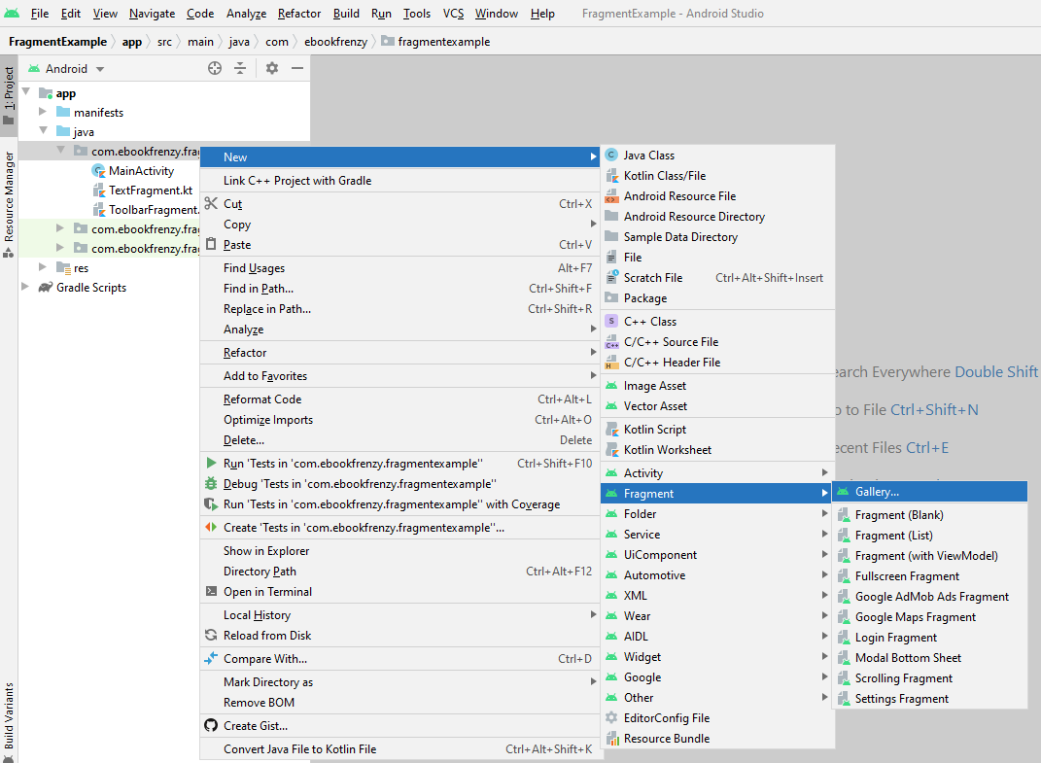
FragmentExample
See the FragmentExample project in the course’s code zip file
Notable information:
You can get to the Fragments Gallery by right-clicking the package and going to New→Fragment→Gallery

Slide 14
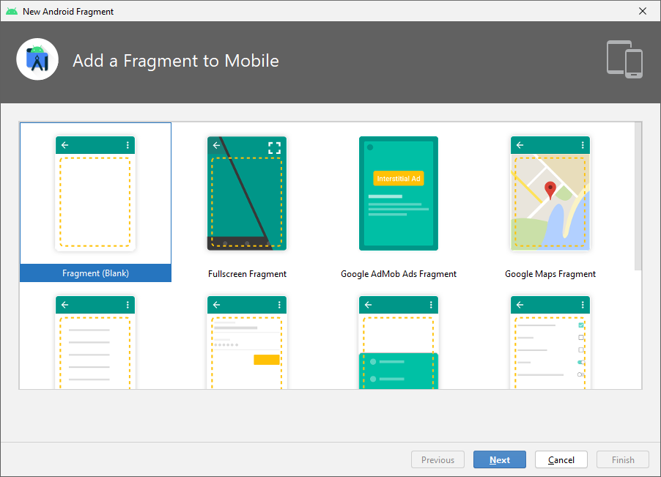
Fragment Gallery
Just like with layouts for Activities, there are pre-made templates for the fragments as well

Slide 15
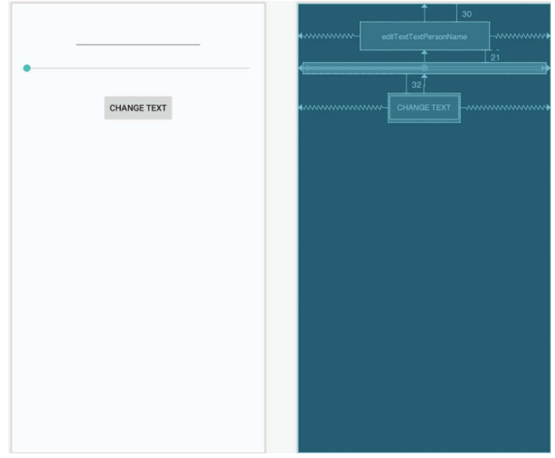
ToolbarFragment
Blank fragment called ToolbarFragment
Corresponding layout is fragment_toolbar
Important: make sure to right-click the FrameLayout in the Component Tree, and convert it to a ConstraintLayout

Slide 16
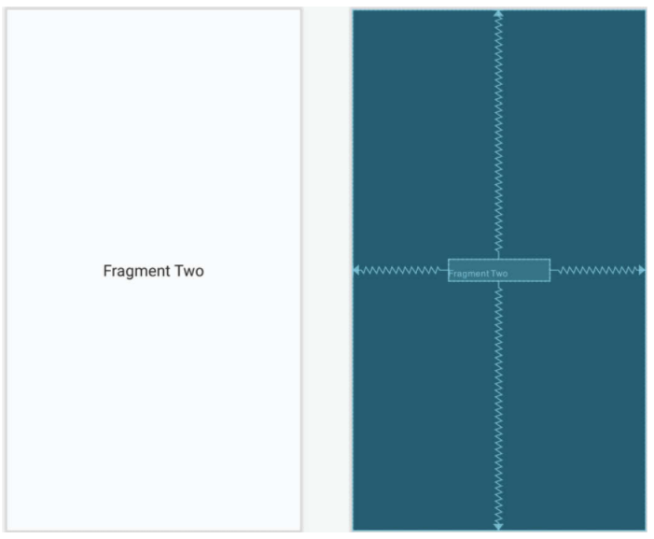
TextFragment
The second fragment
TextFragment class
fragment_text layout
Again, don’t forget to convert the layout to a ConstraintLayout

Slide 17
Let’s look at the code some more
onAttach is called when the fragment is attached to the Activity
Note that fragments have an onClick and an onClickView lifecycle method
Any view-related / UI stuff should go in the onCreateView method
Other initialization should occur in the onCreate method
onActivityCreated
When the Activity to which the fragment is attached is created, the onActivityCreated callback method is called
This is a good place to register event handlers

