Slide 1
Midterm
Programs
© 2021 John Sefcovic and Oakland Community College.

Slide 2
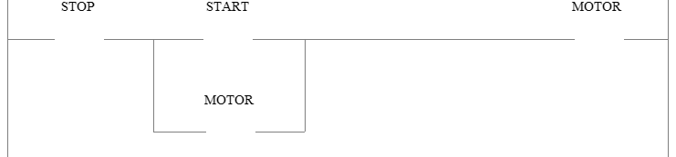
Studio 5000 Program problem No. 1
Start-Stop circuit for Motor control.
1st Rung of lab SS1.
Start: wired Normally Open and pressed when rung is to be True.
Stop: wired Normally Closed and not pressed when rung is to be True.

Slide 3
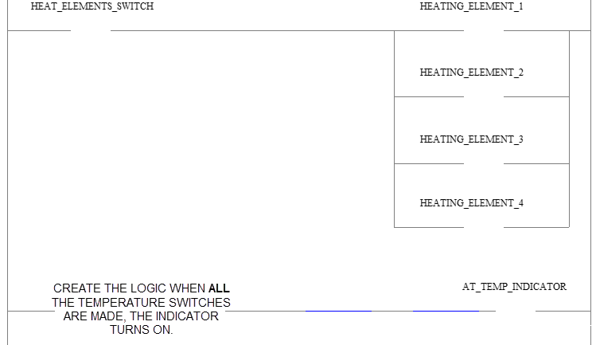
Studio 5000 Program problem No. 2
For a normally open switch, what are the state of the contacts when actuated?
What circuit provides continuity when “all the temperature switches are made,…”
parallel logic circuit,
or series logic?
“Made” contacts are closed or together.

Slide 4


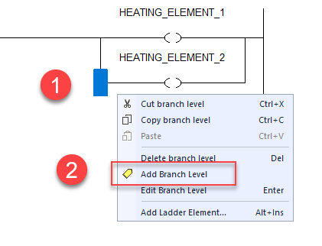
Studio 5000 Program problem No. 2
After first branch, use Add Branch Level to add branches.
Single left on the branch corner and then right click.
Select Add Branch Level.

Slide 5
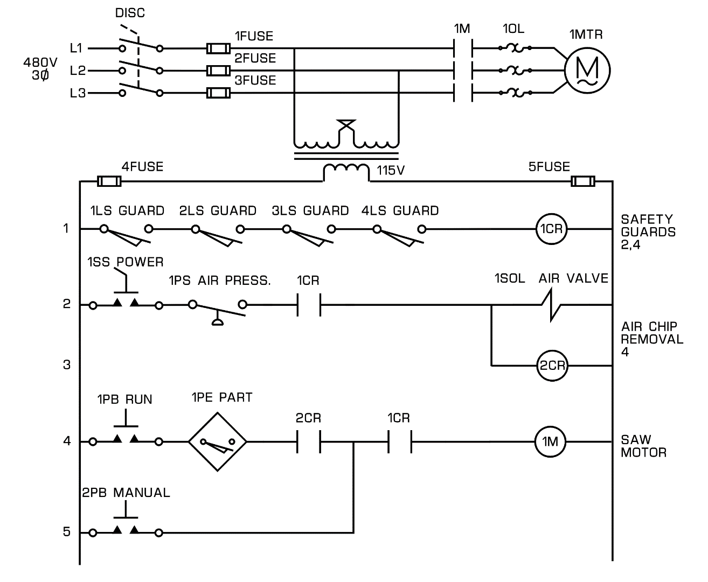
Studio 5000 Program problem No. 3
This is an application using Internal Control Relays (Booleans) to control a Saw Motor.
CR1 (Internal) checks for all Safety Guards closed.
CR2 (Internal) checks for Power to be switched On,
and Air Pressure for the Air Value Chip Removal,
and Safety Gate internal
is On.
All switches and contacts are Normally Open.

Slide 6
Studio 5000 Program problem No. 3
The Saw Motor 1M output will turn On when operator presses the Run Pushbutton, and a part is present 1PE,
…and Air Value for Chip Removal internal is On...
...and the Safety Gate internal is On.
All switches and contacts are Normally Open.

Slide 7
Studio 5000 Program problem No. 3
Or for maintenance the Saw Motor 1M output will turn On when operator presses the Manual Pushbutton...
...and the Safety Gate internal is On.
All switches and contacts are Normally Open.

Slide 8
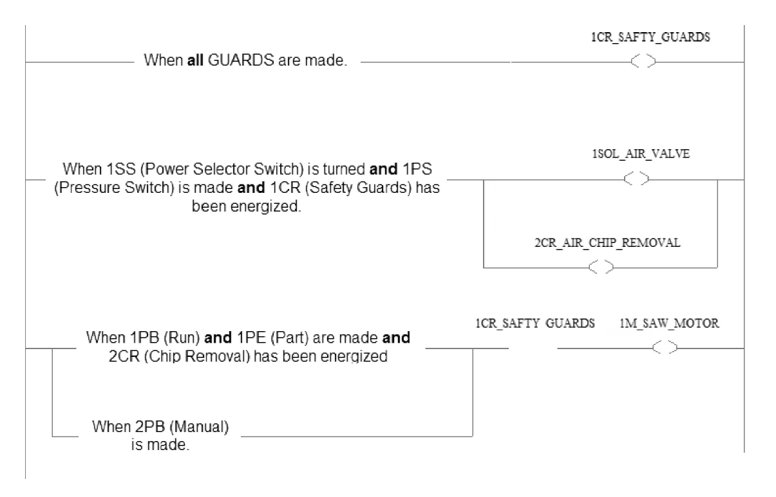
Studio 5000 Program problem No. 3
Program structure.
An and is a series circuit.

Slide 9
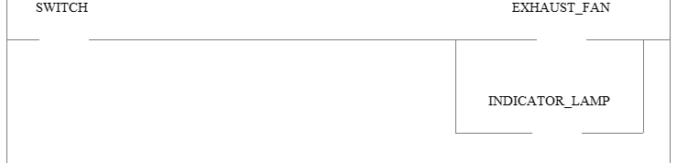
Siemens Program problem No. 1
A Normally Open Switch turn on the Exhaust Fan and Indicator.
For a normally open switch, what are the state of the contacts when actuated?
Parallel outputs, similar to the WASH lab.

Slide 10
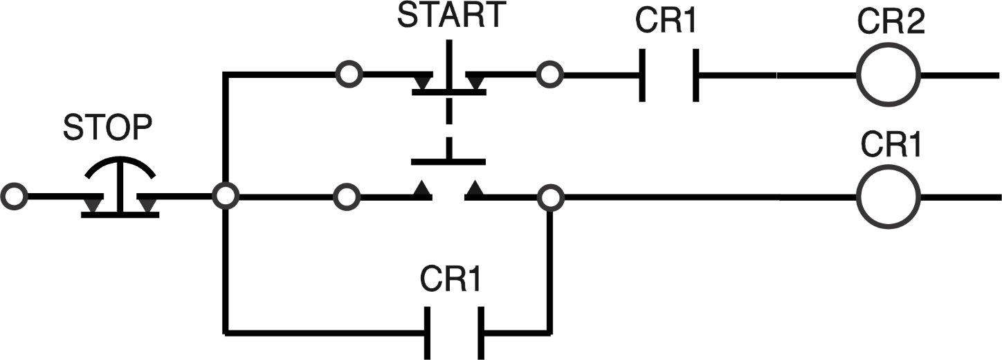
Siemens Program problem No. 2
Pressing START turns on CR1.
Releasing START turns on CR2.
ELECTRICAL CONTINUITY

Slide 11
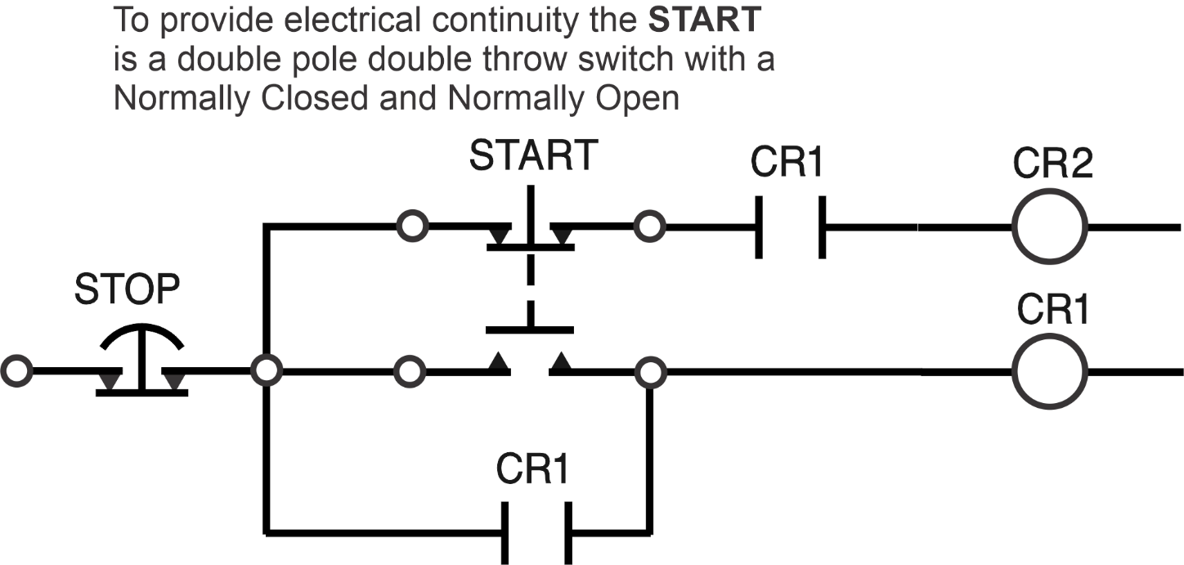
Siemens Program problem No. 2

Slide 12
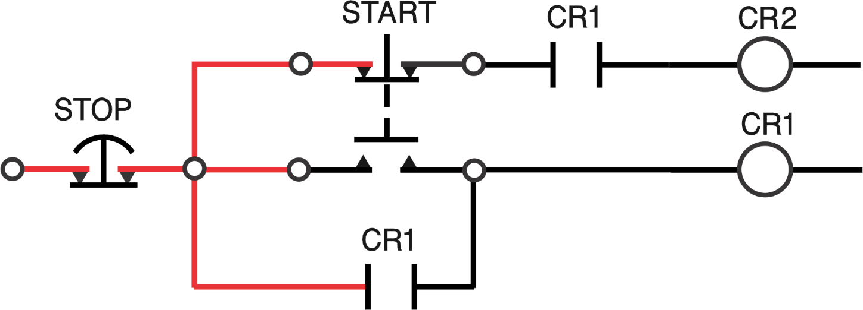
Siemens Program problem No. 2
ELECTRICAL CONTINUITY
CR1 and CR2 are Off.

Slide 13
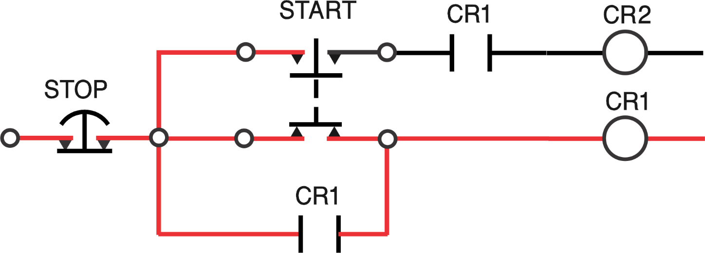
Siemens Program problem No. 2
The START pushbutton is pressed and CR1 turns On.
ELECTRICAL CONTINUITY

Slide 14
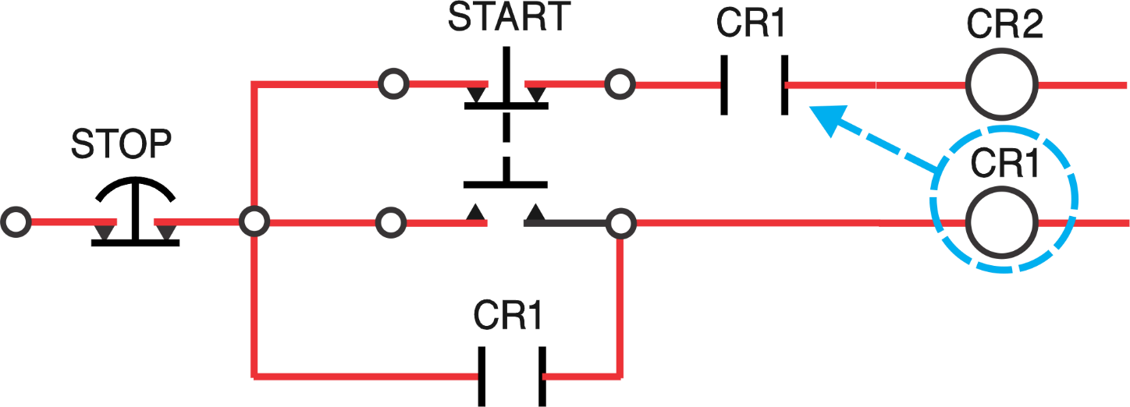
Siemens Program problem No. 2
The START pushbutton is released and CR2 turns On.
ELECTRICAL CONTINUITY
CR1 is On and the contacts allow continuity for the circuit.

Slide 15
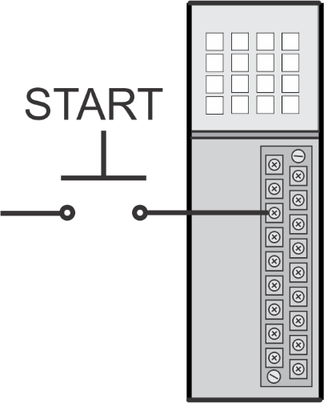
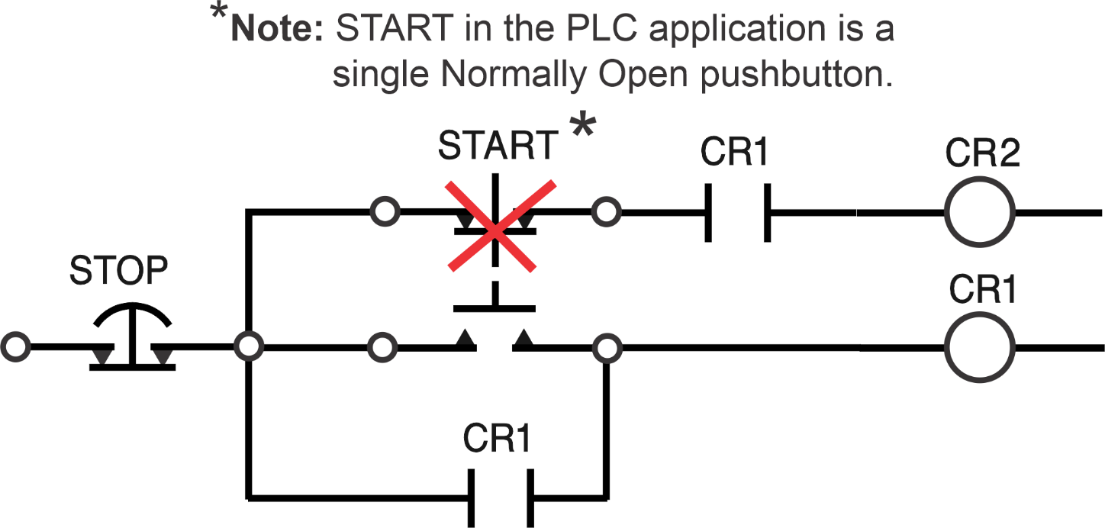
Siemens Program problem No. 2
In the PLC application the START pushbutton is a single Normally Open pushbutton and based on the state of the pushbutton CR1 and then CR2 are turned ON.

Slide 16
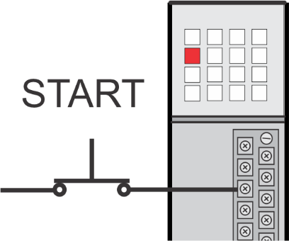
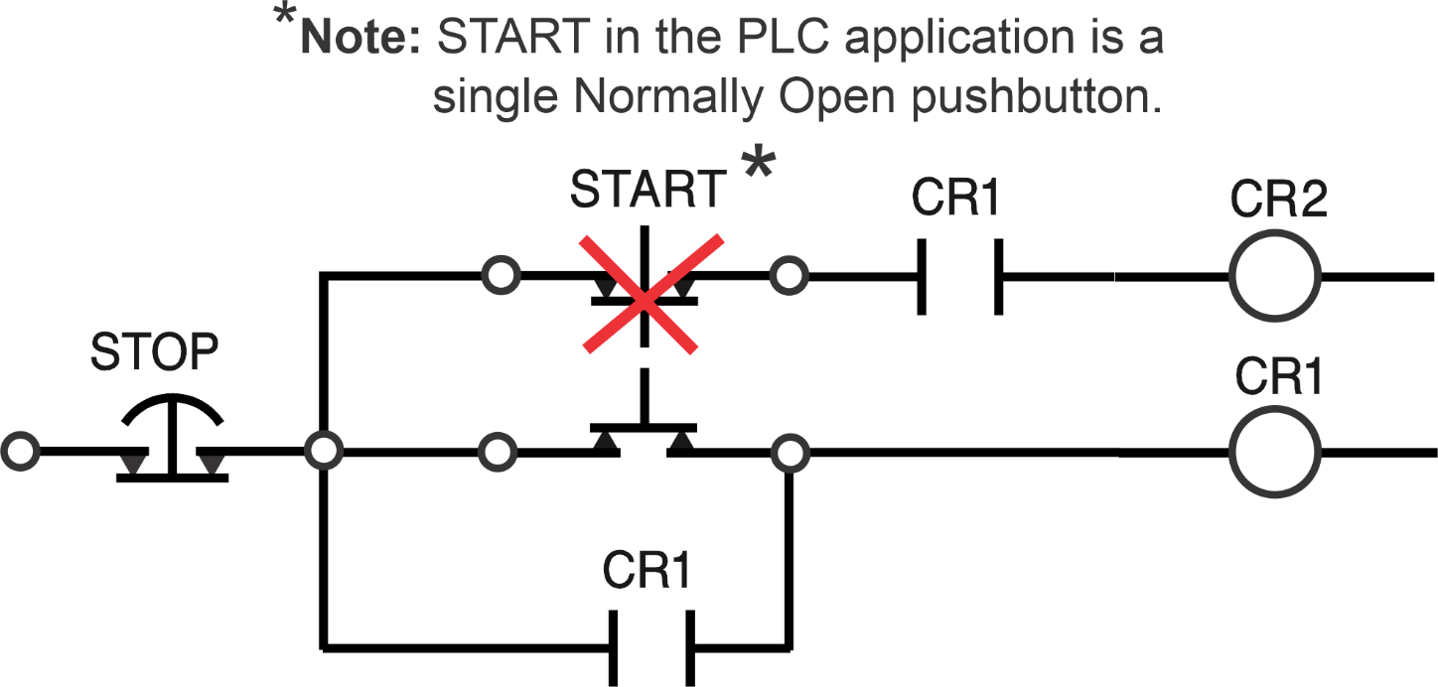
Siemens Program problem No. 2
When the START pushbutton is pressed CR1 turns On.
What is the state of START pushbutton’s contacts?
Drawn in actual state.

Slide 17
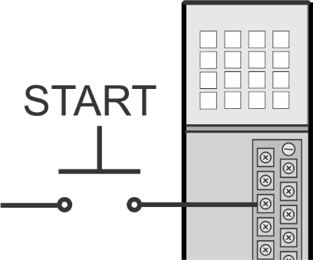
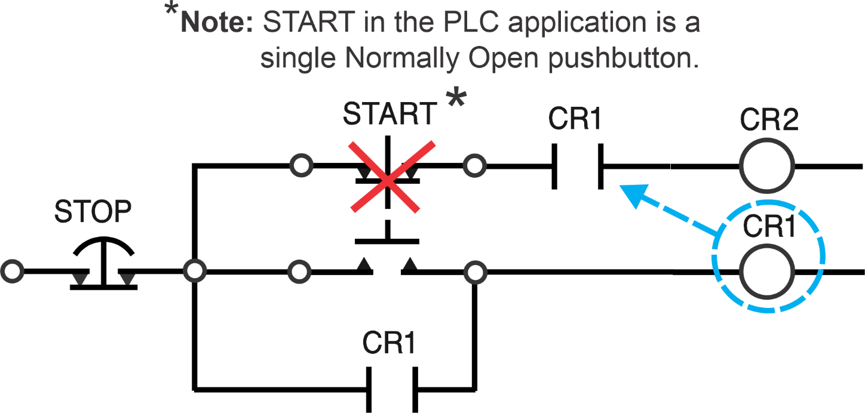
Program problem No. 2
When the START pushbutton is released CR2 turns On.
What is the state of START pushbutton’s contacts?
Drawn in actual state.
CR1 is On.

Slide 18
Siemens Program problem No. 2
Similar in concept to Vat lab; one switch, two different outputs energized by the different state of the input switch’s contacts.

Slide 19
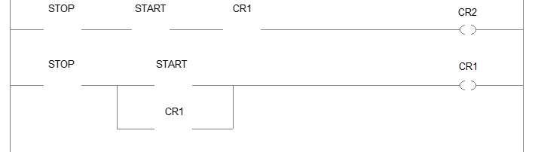
Siemens Program problem No. 2
Program structure.
Circuit broken into two rungs; the STOP is duplicated on each rung.

Slide 20
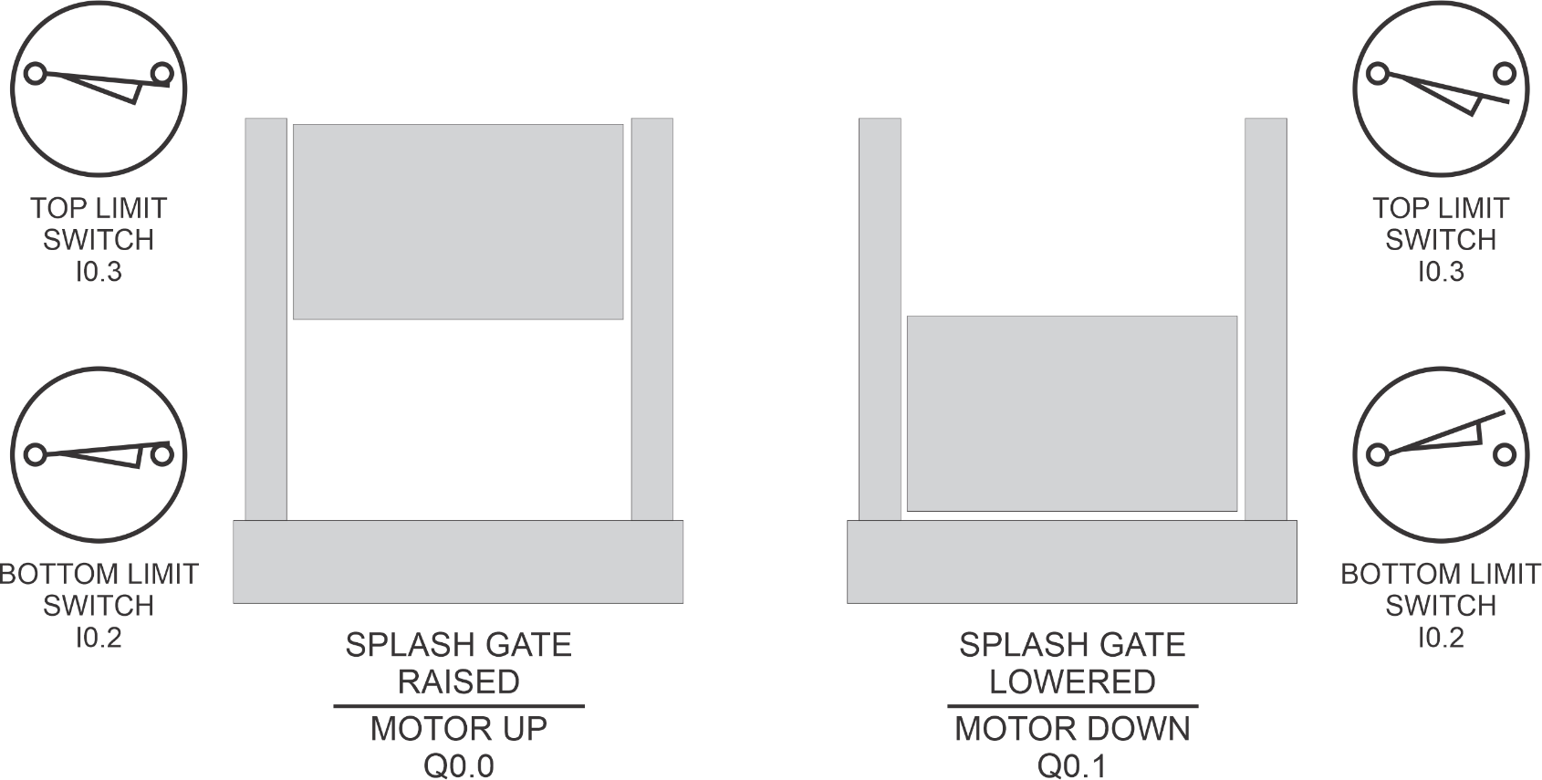
Siemens Program problem No. 3
Top Limit Switch: Normally Open
Bottom Limit Switch: Normally Closed
Note: Switches are shown in their actual positions.

Slide 21
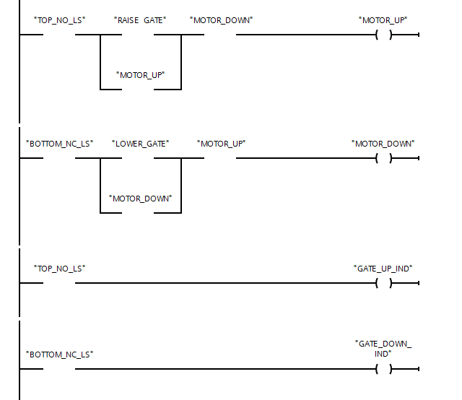
Siemens Program problem No. 3
SIEMENS PLC program structure.

Slide 22
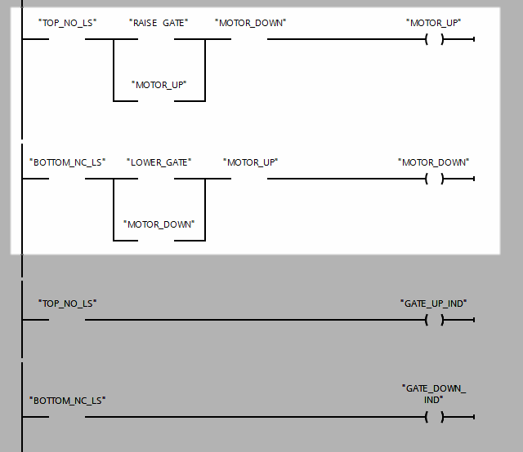
Siemens Program problem No. 3
Similar to lab SS3 for the interlocks.

Slide 23
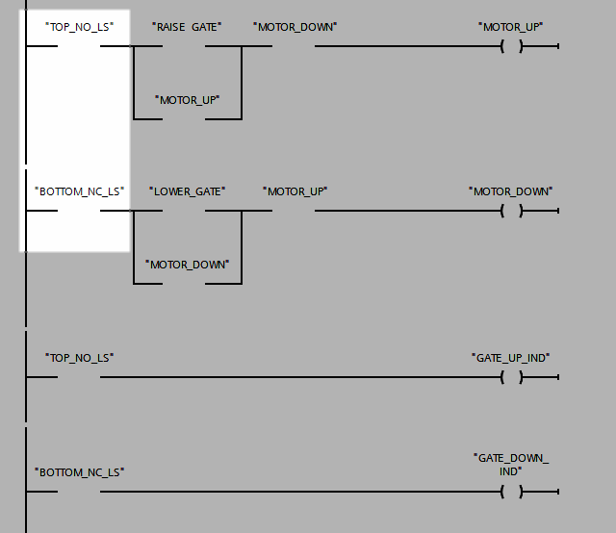
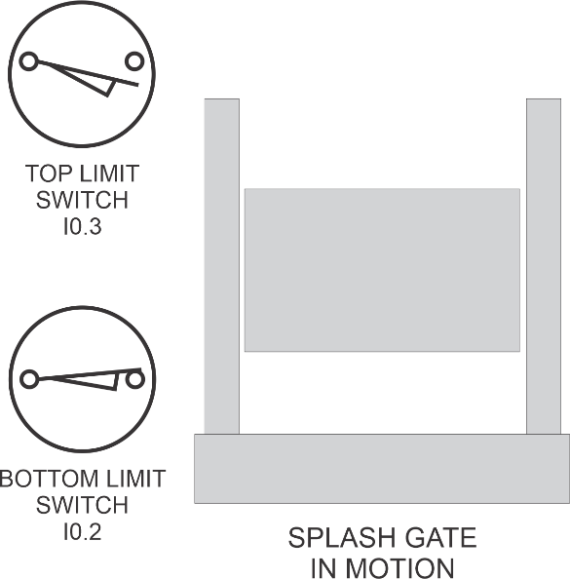
Siemens Program problem No. 3
The TOP and BOTTOM Limit Switches “act” as the “Stop pushbutton.”

Slide 24
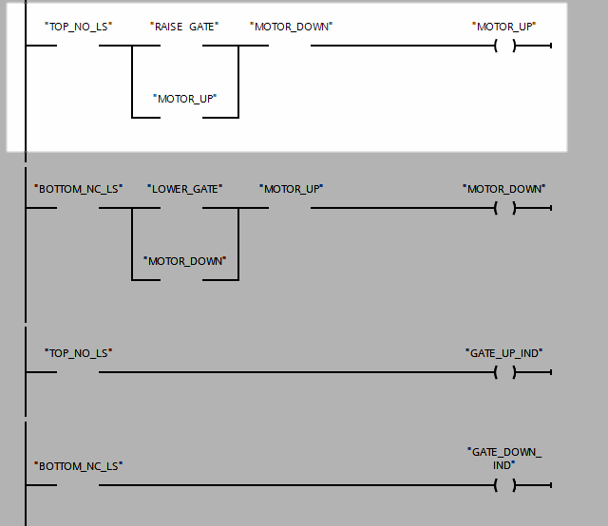
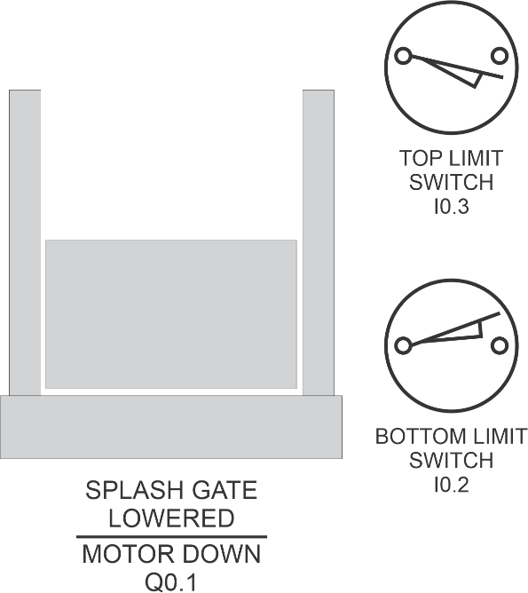
Siemens Program problem No. 3
When the MOTOR_UP is turned on to raise the gate, what is the state of the TOP_NO_LS contacts?

Slide 25
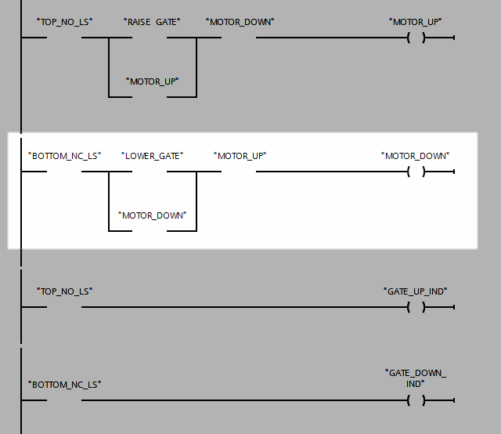
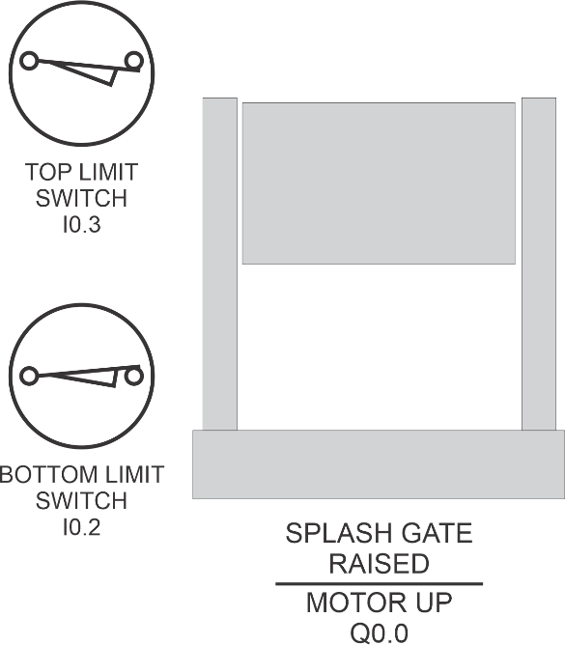
Siemens Program problem No. 3
When the MOTOR_DOWN is turned on to lower the gate, what is the state of the BOTTOM_NC_LS contacts?

Slide 26
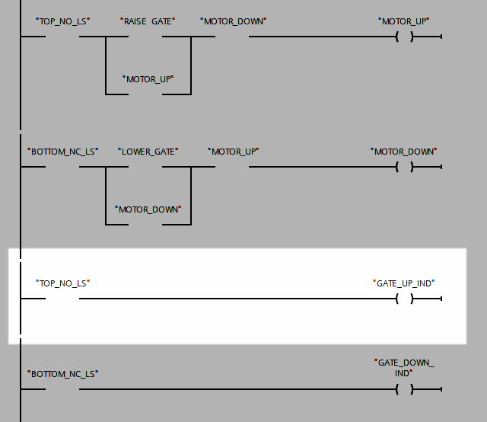
Siemens Program problem No. 3
When the GATE_UP_IND is turned on, what is the state of the TOP_NO_LS contacts?

Slide 27
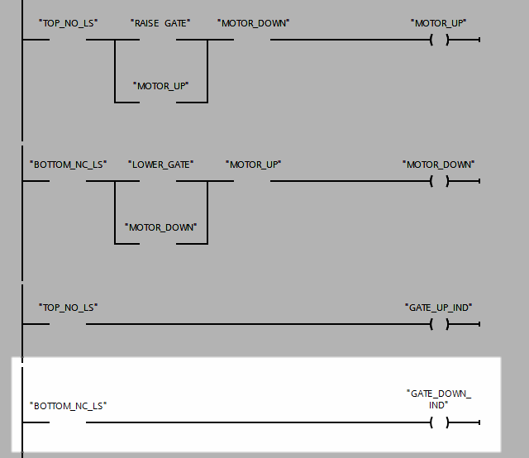
Siemens Program problem No. 3
When the GATE_DOWN_IND is turned on, what is the state of the BOTTOM_NC_LS contacts?

