Slide 1
Relays
© 2010 John Sefcovic and Oakland Community College.

Slide 2

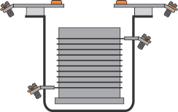
Relay Components
Relays are comprised of two components, the:
Coil
Armature
The COIL is a winding of copper wires when energized produces a magnetic effect.
When the coil is energized the magnetic effect cause the ARMATURE to move. The electrical contact attached to the moving armature then makes or breaks with the mating contact of the electrical circuit.

Slide 3
Relay Circuits
There are two electrical circuits in the relay.
The second circuit is to the contacts
The first circuit is to the coil.

Slide 4


Relay Circuits
Two field components are added to the relay.
A load the relay is controlling is wired into the contact circuit
To energize or de-energize the coil, a switch is wired into the coil circuit.

Slide 5
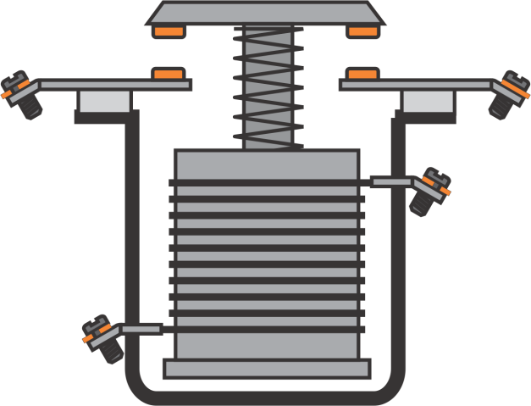
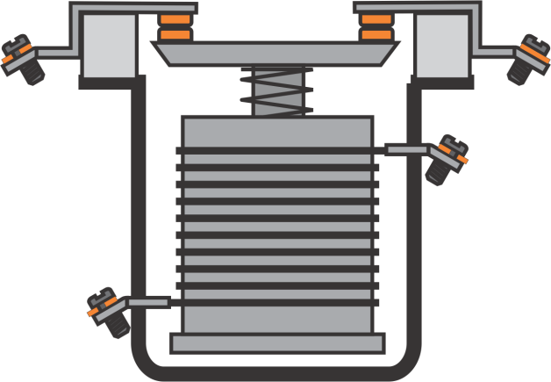
Relay Contacts
The electrical contacts of a relay are also configured Normally Open or Normally Closed.
NORMALLY OPEN
NORMALLY CLOSED
The contacts are apart when the coil is de-energized.
The contacts are together when the coil is de-energized.

Slide 6
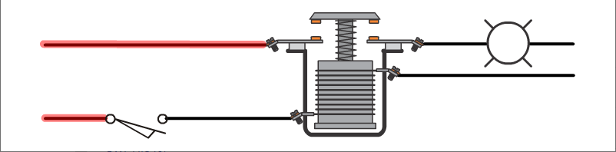
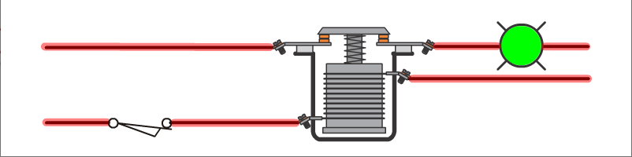
Normally Open Relay
The electrical contacts of a NORMALLY OPEN RELAY are apart when the coil is de-energized.
The energized coil of the relay makes the electrical contacts of the relay, providing continuity to the load.

Slide 7
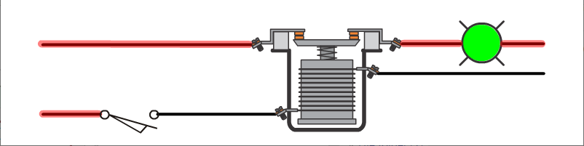
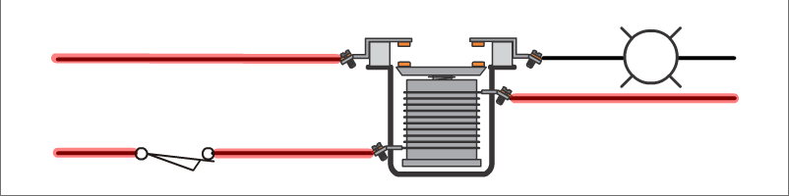
Normally Closed Relay
The electrical contacts of a NORMALLY CLOSED RELAY are together when the coil is de-energized.
The energized coil of the relay breaks the electrical contacts of the relay, causing a lack of continuity to the load.

Slide 8


Relay Switches
In the previous example, the two relay types Normally Open Relay and Normally Closed Relay coils are switched by a Normally Open Limit Switch.
The coil of the relays can also be wired to Normally Closed Limit Switch.

Slide 9
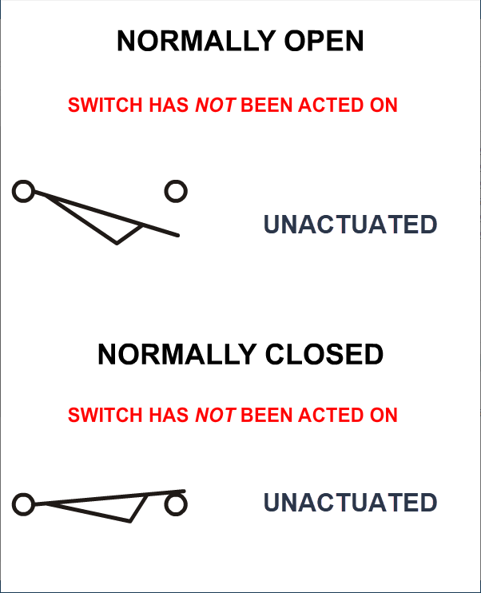
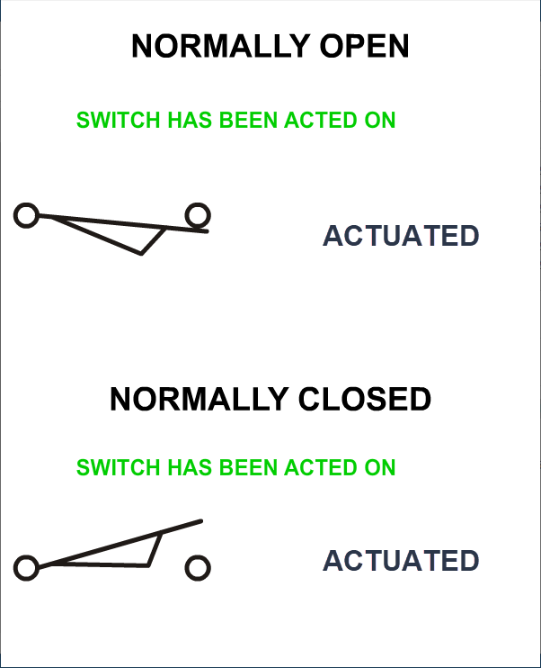
Limit Switches
A common switch to energize or de-energize the coil of a relay is a LIMIT SWITCH.
The electrical contacts of a limit switch are configured Normally Open or Normally Closed.
The state of the switch’s contacts, make or break, depends if the switch is actuated or unactuated.

Slide 10
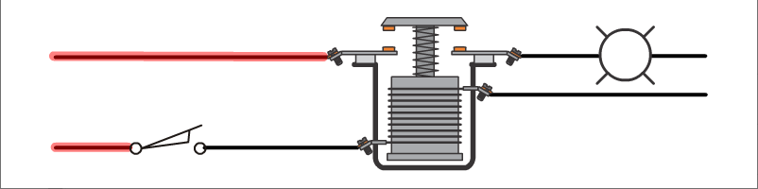
Normally Open Relay
The relay’s contacts MAKE when the Normally Open Switch is actuated.
The relay’s contacts BREAK when the Normally Closed Switch is actuated.

Slide 11
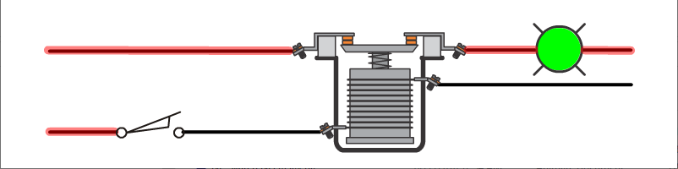
Normally Closed Relay
The relay’s contacts BREAK when the Normally Open Switch is actuated.
The relay’s contacts MAKE when the Normally Closed Switch is actuated.

Slide 12
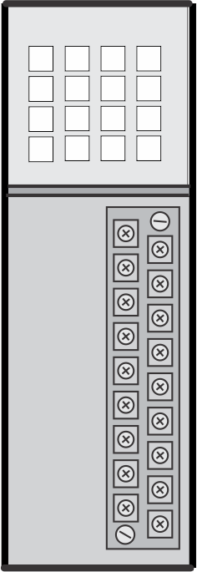
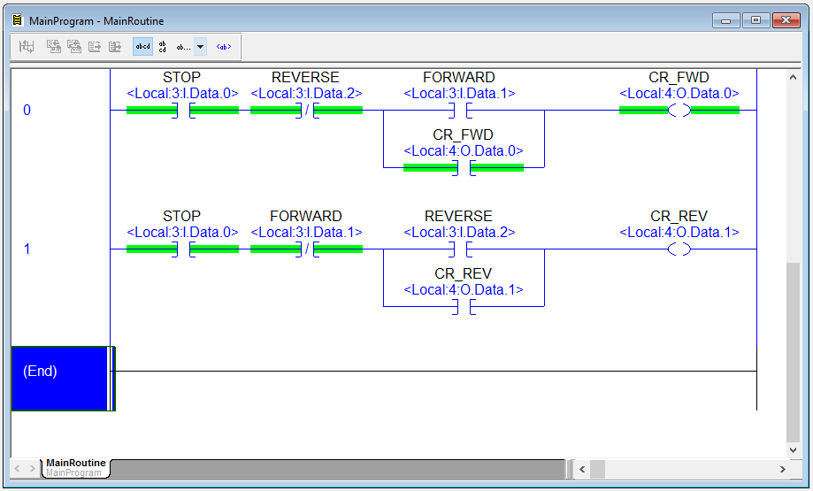
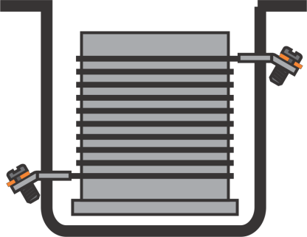
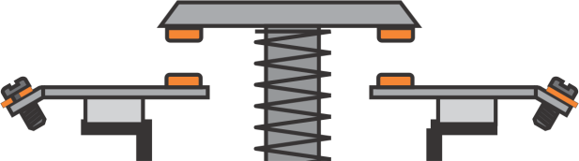
Relay – PLC Relationship
The PLC relates to an electromechanical relay in that:
The Input Module of the PLC acts as the Coil of the relay,
The PLC program Input Instruction acts as the Contacts of the relay.

Slide 13

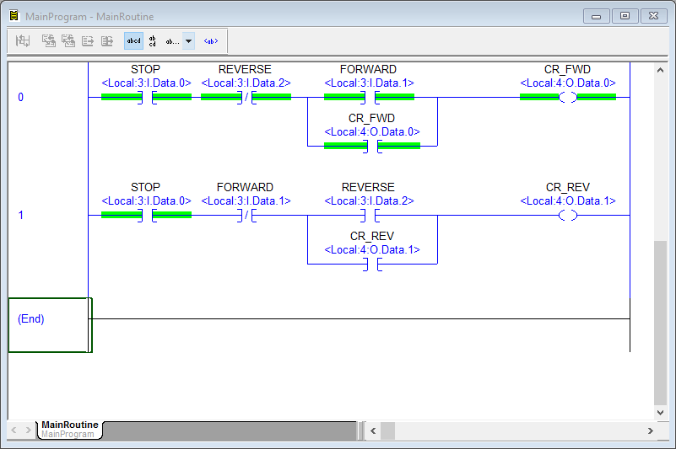
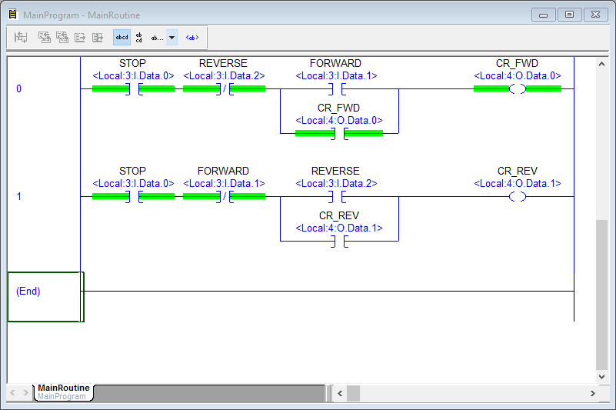
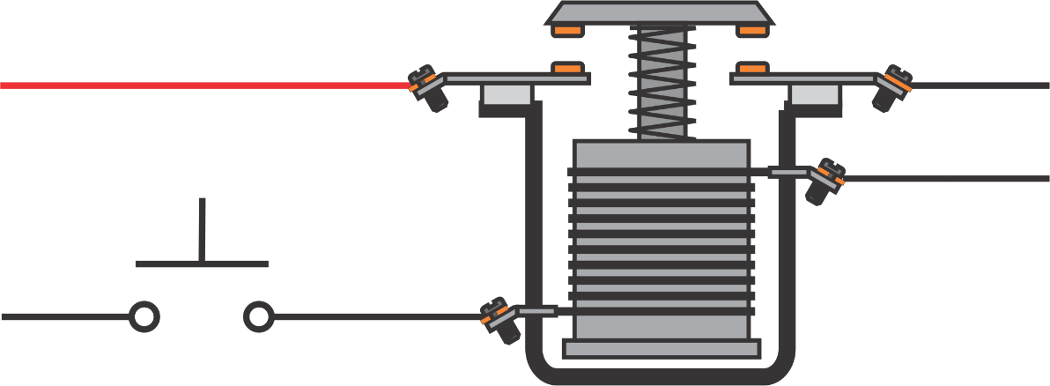
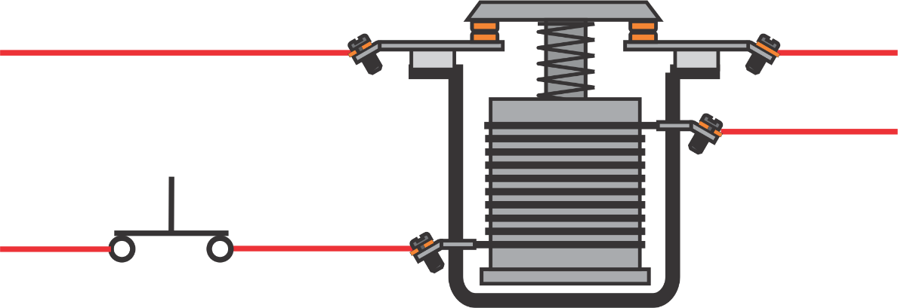

Relay to Instruction Types
NORMALLY OPEN
With a de-energized coil (Input Module), the contact (Program Instruction) does not provide logic continuity.
The contact (Program Instruction) provides the logic continuity.
FORWARD CONTACT
FORWARD
PUSHBUTTON
An energized coil (Input Module) makes the relay contacts.

Slide 14
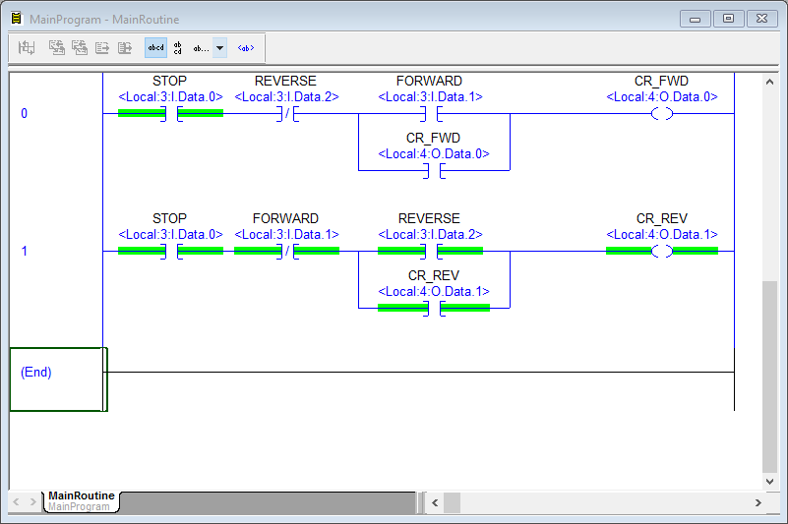
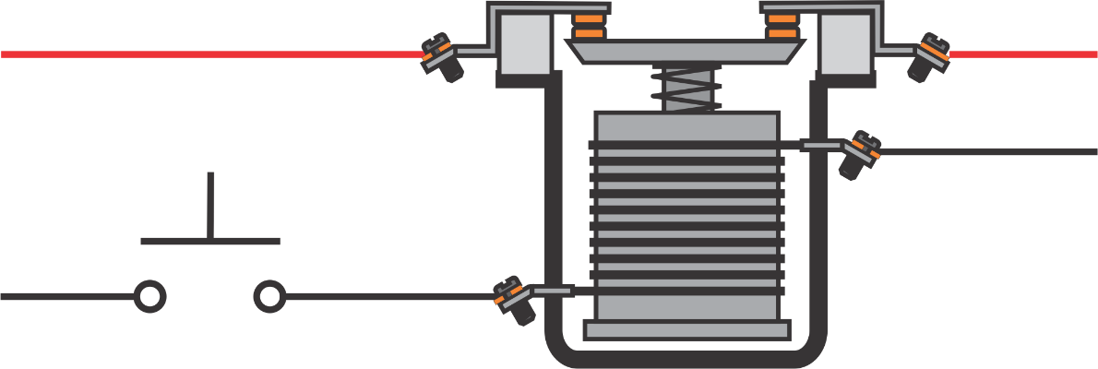
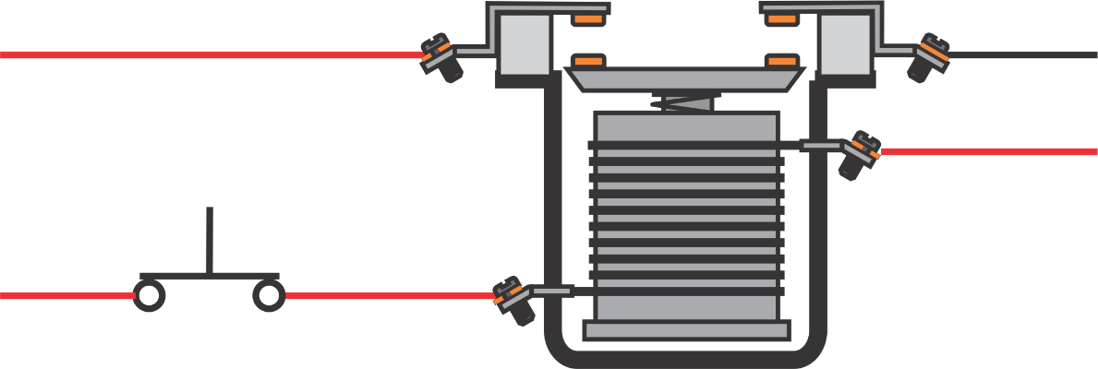
Relay to Instruction Types
NORMALLY CLOSED
With a de-energized coil (Input Module), the contact (Program Instruction) does provide logic continuity.
The contact (Program Instruction) prevents the logic continuity.
An energized coil (Input Module) breaks the relay contacts.

