Slide 1
Binary Coded Decimal
© 2014 John Sefcovic

Slide 2
Binary Coded Decimal - BCD
Binary Coded Decimal
Binary Coded Decimal uses four Binary digits to Code each Decimal number character.
BCD | BINARY
0 | 0000
1 | 0001
2 | 0010
3 | 0011
4 | 0100
5 | 0101
6 | 0110
7 | 0111
8 | 1000
9 | 1001
3
8
4
0011
1000
0100

Slide 3
Binary Coded Decimal - BCD
Binary Coded Decimal
Binary Coded Decimal uses four Binary digits to Code each Decimal number character.
BCD | BINARY
0 | 0000
1 | 0001
2 | 0010
3 | 0011
4 | 0100
5 | 0101
6 | 0110
7 | 0111
8 | 1000
9 | 1001
3
8
4
0011
1000
0100

Slide 4
Binary Coded Decimal - BCD
Binary Coded Decimal
Binary Coded Decimal uses four Binary digits to Code each Decimal number character.
BCD | BINARY
0 | 0000
1 | 0001
2 | 0010
3 | 0011
4 | 0100
5 | 0101
6 | 0110
7 | 0111
8 | 1000
9 | 1001
3
8
4
0011
1000
0100

Slide 5
Binary Coded Decimal - BCD
Binary Coded Decimal
Binary Coded Decimal uses four Binary digits to Code each Decimal number character.
BCD | BINARY
0 | 0000
1 | 0001
2 | 0010
3 | 0011
4 | 0100
5 | 0101
6 | 0110
7 | 0111
8 | 1000
9 | 1001
3
8
4
0011
1000
0100

Slide 6
Binary Coded Decimal - BCD
Binary Coded Decimal
Using three digits, the maximum BCD value.
BCD | BINARY
0 | 0000
1 | 0001
2 | 0010
3 | 0011
4 | 0100
5 | 0101
6 | 0110
7 | 0111
8 | 1000
9 | 1001
9
9
9
1001
1001
1001

Slide 7
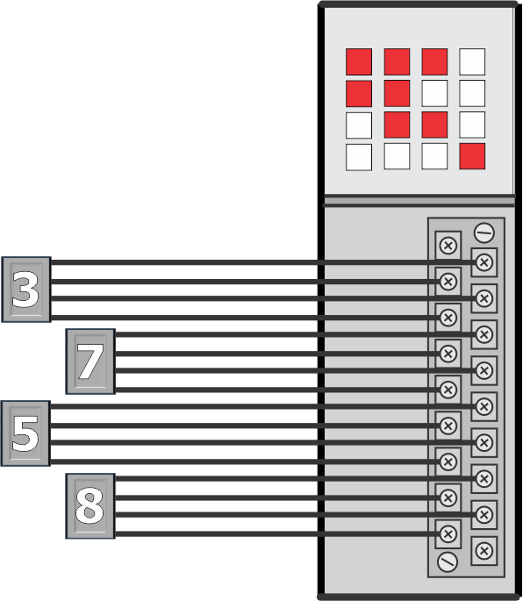
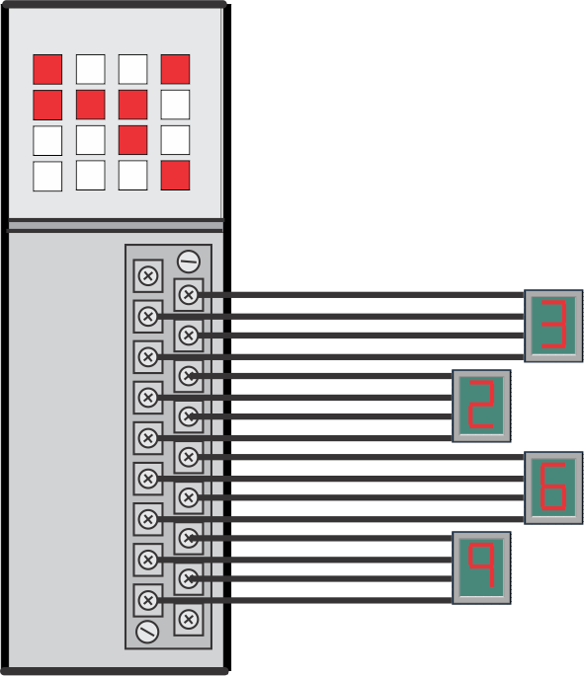
Binary Coded Decimal - BCD
Binary Coded Decimal
By using standard Input and Output modules BCD number values can be sent to/from the processor without using specialized hardware.
INPUT
MODULE
OUTPUT
MODULE

Slide 8
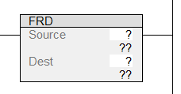
Binary Coded Decimal - BCD
From Binary Coded Decimal
When rung conditions are true, the FRD output instruction converts a BCD value binary pattern in the Source to an equivalent Integer value binary pattern and stores it in the Destination.
You should convert a BCD value to integer before manipulating those values in the ladder program because the processor treats BCD values as integer numbers. Actual BCD may otherwise be lost or distorted.

Slide 9
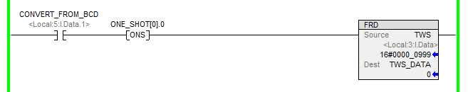
Binary Coded Decimal - BCD
From Binary Coded Decimal
The Source is in BCD.

Slide 10
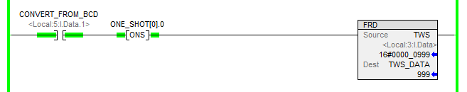
Binary Coded Decimal - BCD
From Binary Coded Decimal
When rung is true, the FRD output instruction converts the BCD value in the Source to the equivalent Integer value at the Destination.

Slide 11

Binary Coded Decimal - BCD
From Binary Coded Decimal
Source displayed as BCD.

Slide 12

Binary Coded Decimal - BCD
From Binary Coded Decimal
Source displayed as BCD.
Source displayed as BCD.
Destination displayed as Integer.
Destination after instruction execution.

Slide 13

Binary Coded Decimal - BCD
From Binary Coded Decimal
Source displayed as BCD.
Source displayed as BCD.
Destination displayed as Integer.
Source and Destination
displayed in number format.
Same value in different number formats.

Slide 14

Binary Coded Decimal - BCD
From Binary Coded Decimal
Notice the difference in the Source Binary pattern and Destination Binary patten.
Source

Slide 15
Binary Coded Decimal - BCD
From Binary Coded Decimal
Notice the difference in the Source Binary pattern and Destination Binary patten.
Source
Destination

Slide 16
Binary Coded Decimal - BCD
From Binary Coded Decimal
The FRD instruction converts the BCD binary pattern to an equivalent binary number pattern for the value. Both the BCD and Decimal number characters are the same,
the bit pattern is converted.
Binary Coded Decimal
Binary BCD Pattern
999
1001 1001 1001
BCD

Slide 17
Binary Coded Decimal - BCD
From Binary Coded Decimal
The FRD instruction converts the BCD binary pattern to an equivalent binary number pattern for the value. Both the BCD and Decimal number characters are the same,
the bit pattern is converted.
Binary Coded Decimal
Binary BCD Pattern
999
1001 1001 1001
BCD
Decimal
Binary Integer Pattern
999
0111 0111 0111
D

Slide 18
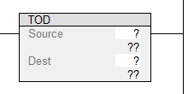
Binary Coded Decimal - BCD
To Binary Coded Decimal
When rung conditions are true, the TOD output instruction converts an Integer value binary pattern in the Source to an equivalent BCD value binary pattern and stores it in the Destination.

Slide 19
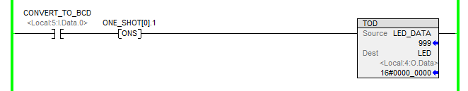
Binary Coded Decimal - BCD
To Binary Coded Decimal
The Source is an Interger.

Slide 20
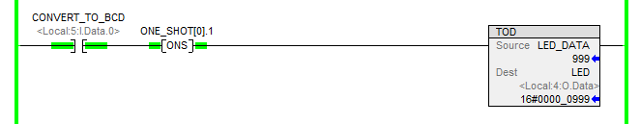
Binary Coded Decimal - BCD
To Binary Coded Decimal
When rung is true, the TOD output instruction converts the Integer value in the Source to the equivalent BCD value at the Destination.

Slide 21

Binary Coded Decimal - BCD
To Binary Coded Decimal
Source displayed as Integer.

Slide 22

Binary Coded Decimal - BCD
To Binary Coded Decimal
Source displayed as Integer.
Source displayed as Integer.
Destination displayed as BCD.
Destination after instruction execution.

Slide 23

Binary Coded Decimal - BCD
To Binary Coded Decimal
Source displayed as Integer.
Source displayed as Integer.
Destination displayed as BCD.
Source and Destination
displayed in number format.
Same value in different number formats.

Slide 24

Binary Coded Decimal - BCD
Binary Coded Decimal
Studio 5000 BCD instructions are on the Math Conversions tab.

