Slide 1
Estimating Parameters of Polya Distribution

Slide 2
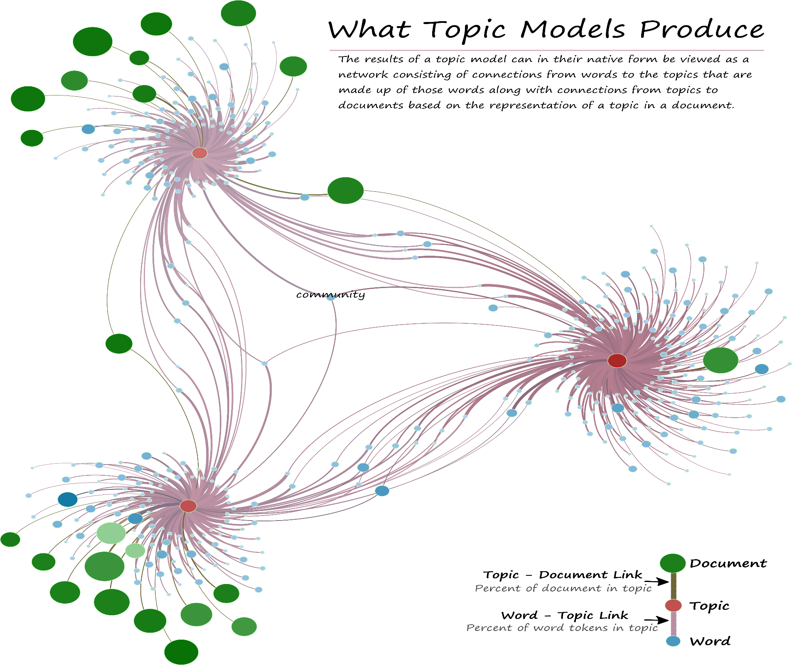

Slide 3
Presentation Outline
Introduction
Problem formulation
Estimation
Cramer Rao Lower Bound (CRLB)
Maximum Likelihood (ML)
Method of Moments (MOM)
Experimental Result
Conclusion

Slide 4

Topic modelling
Methods for automatically organizing, understanding, searching and summarizing large electronic archives.
Uncover hidden topical patterns in collections.
Annotate documents according to topics

Slide 5
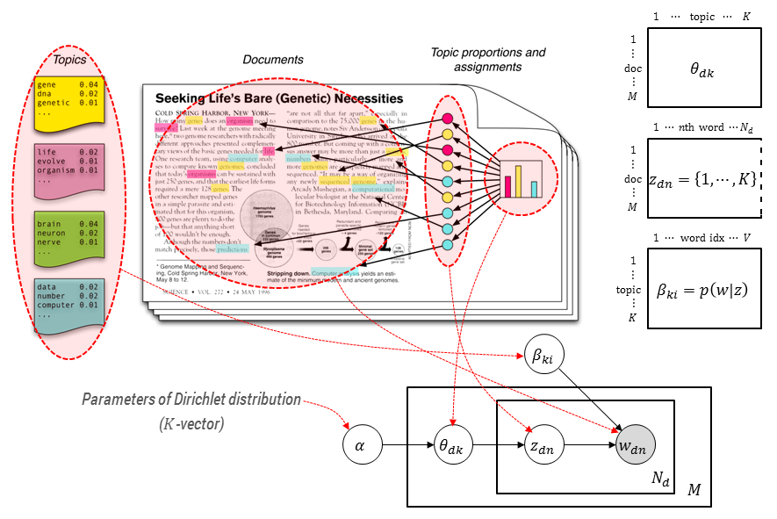
Topic modelling

Slide 6
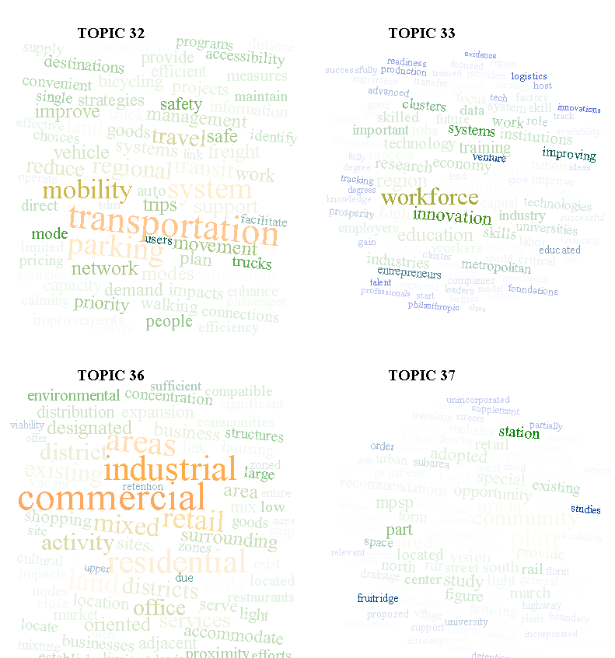

Model used
Dirichlet-multinomial (Polya distribution)
Multinomial distribution k category
Dirichlet conjugate prior for the multinomial
Beta-binomial
Topic a mixture of distribution of words
Documents are mixture of words
Each word is drawn from two topics {0 or 1}

Slide 7
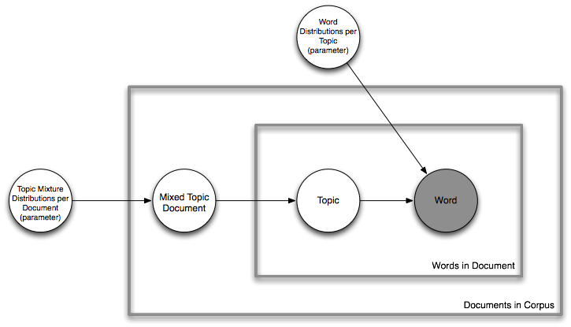
Problem Formulation
Suppose we have m documents: x1, x2, …, xm
Each xi has n words.

Slide 8
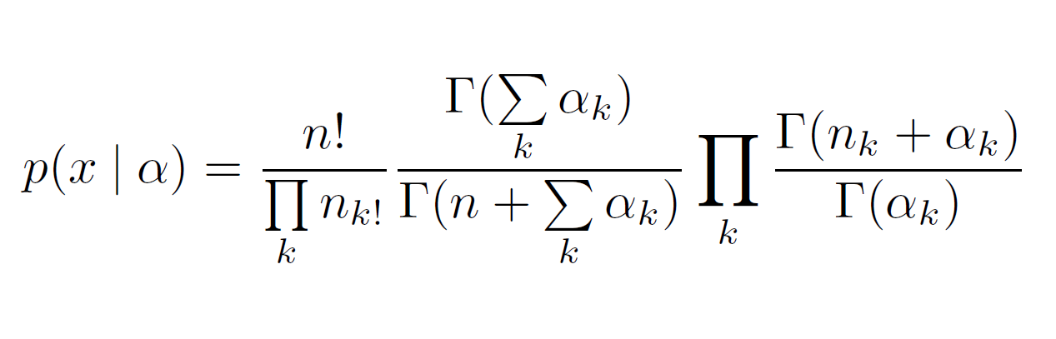
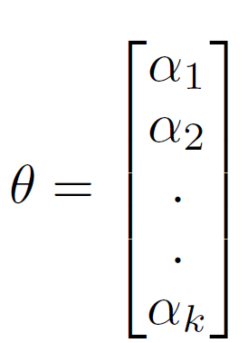
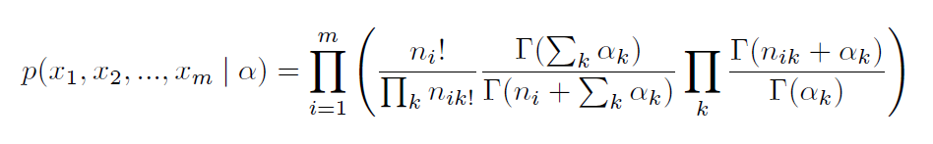

Slide 9
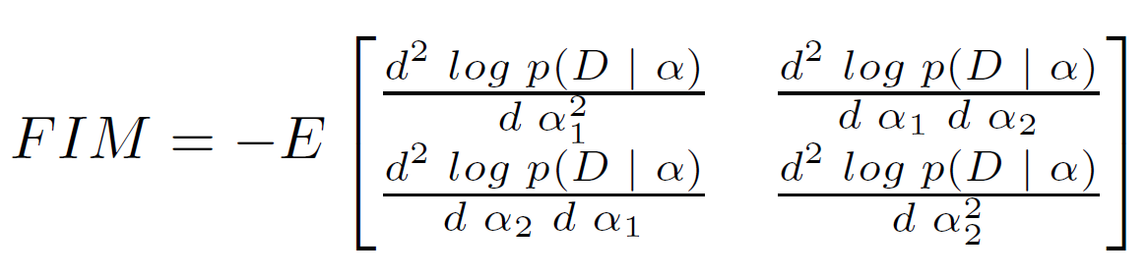
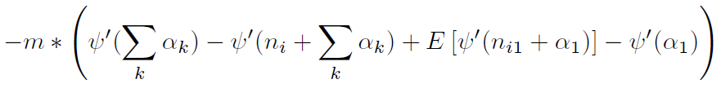
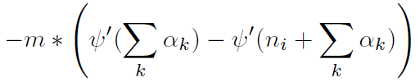
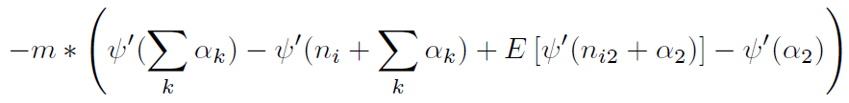
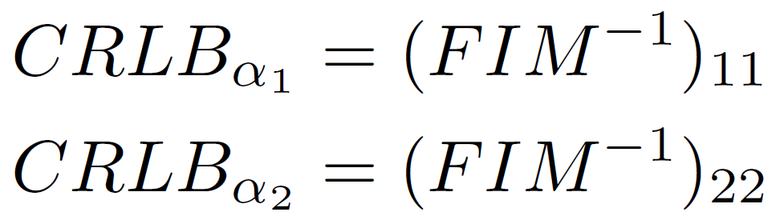
Cramer Rao Lower Bound (CRLB)
FIM₁₁ =
FIM₁₂ = FIM₂₁ =
FIM₂₂ =

Slide 10
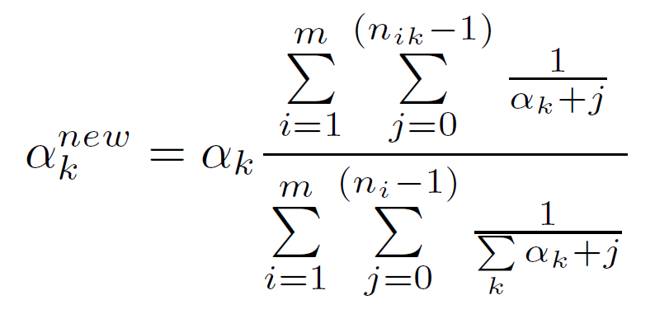
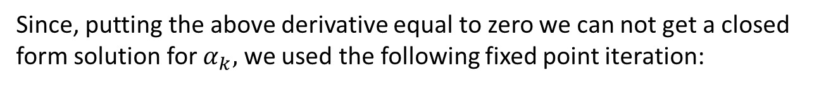
Maximum Likelihood Estimation
Since, putting the above derivative equal to zero we can not get a closed form solution for $α_{k},$ we used the following fixed point iteration:

Slide 11
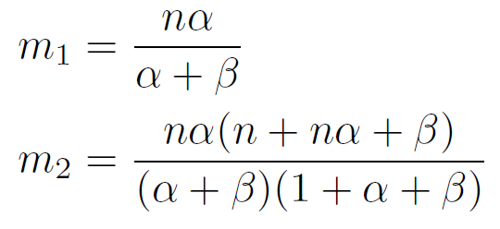
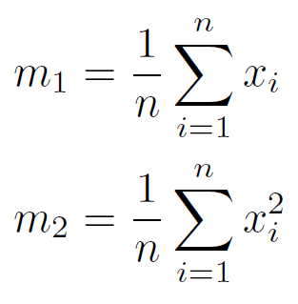
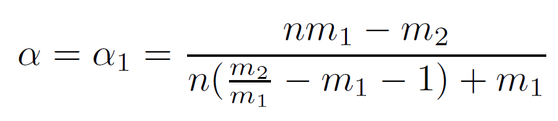
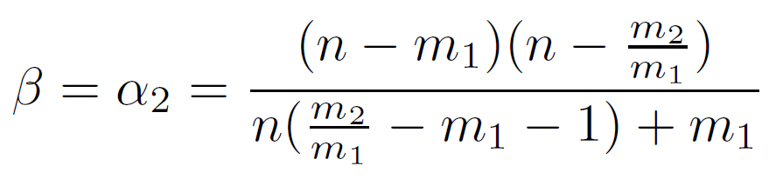
Method of Moments (MOM)
Population moments (Beta-Binomial):
Sample moments from data:
Equating population moments and sample moments and solving for the parameters α and β:

Slide 12
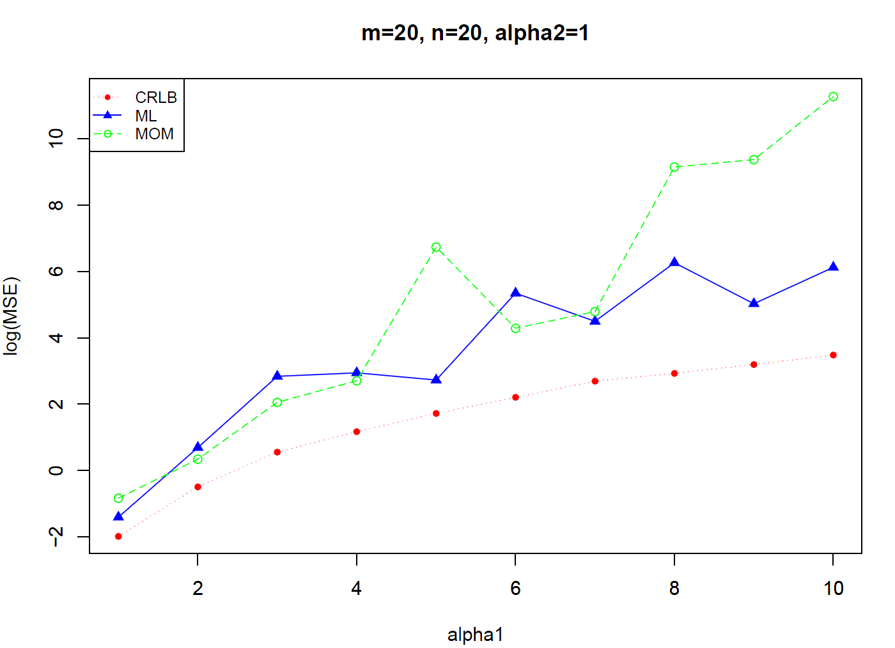
Result

Slide 13
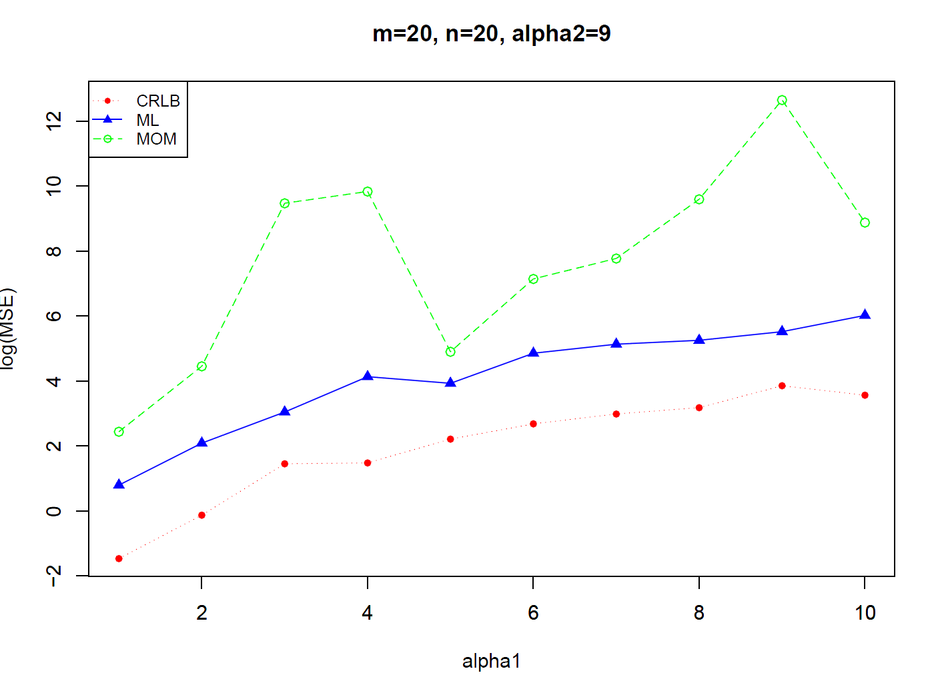

Slide 14
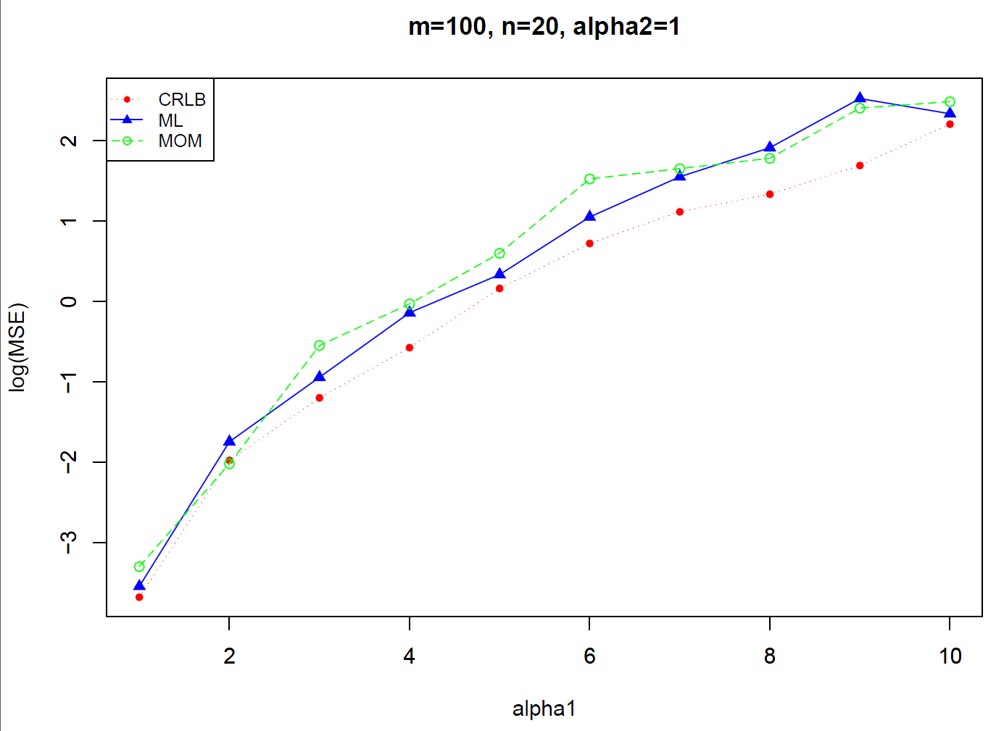

Slide 15
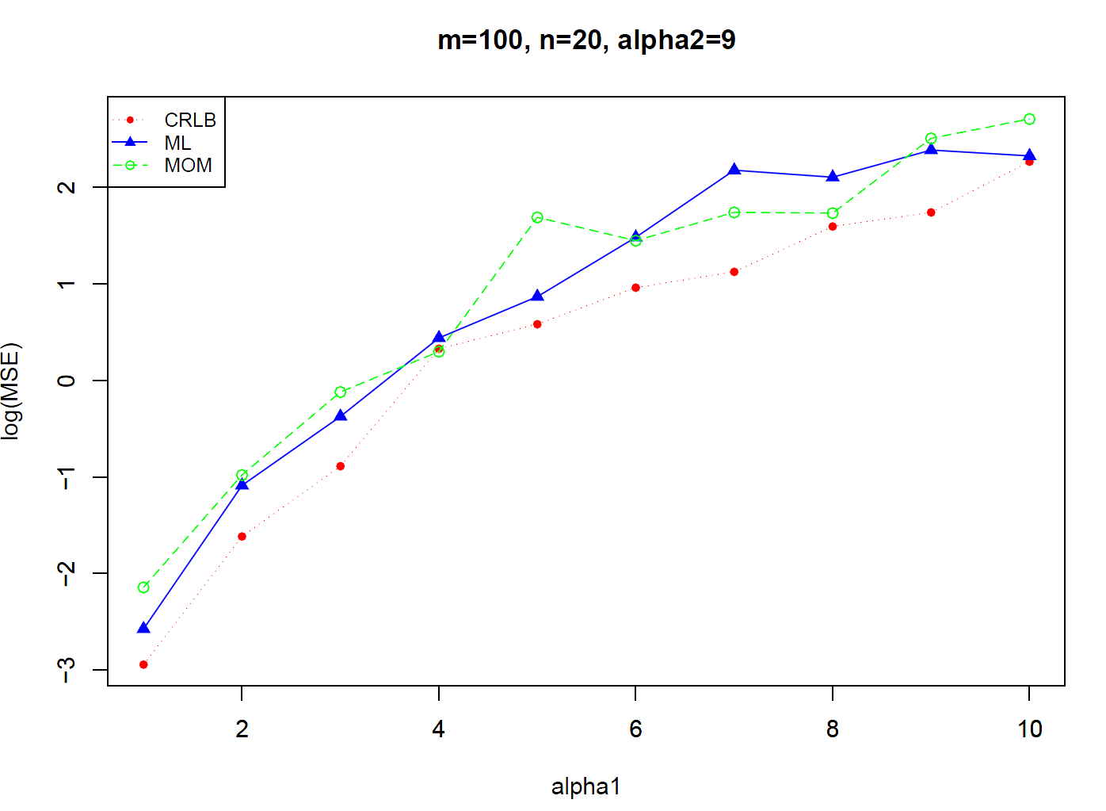

Slide 16
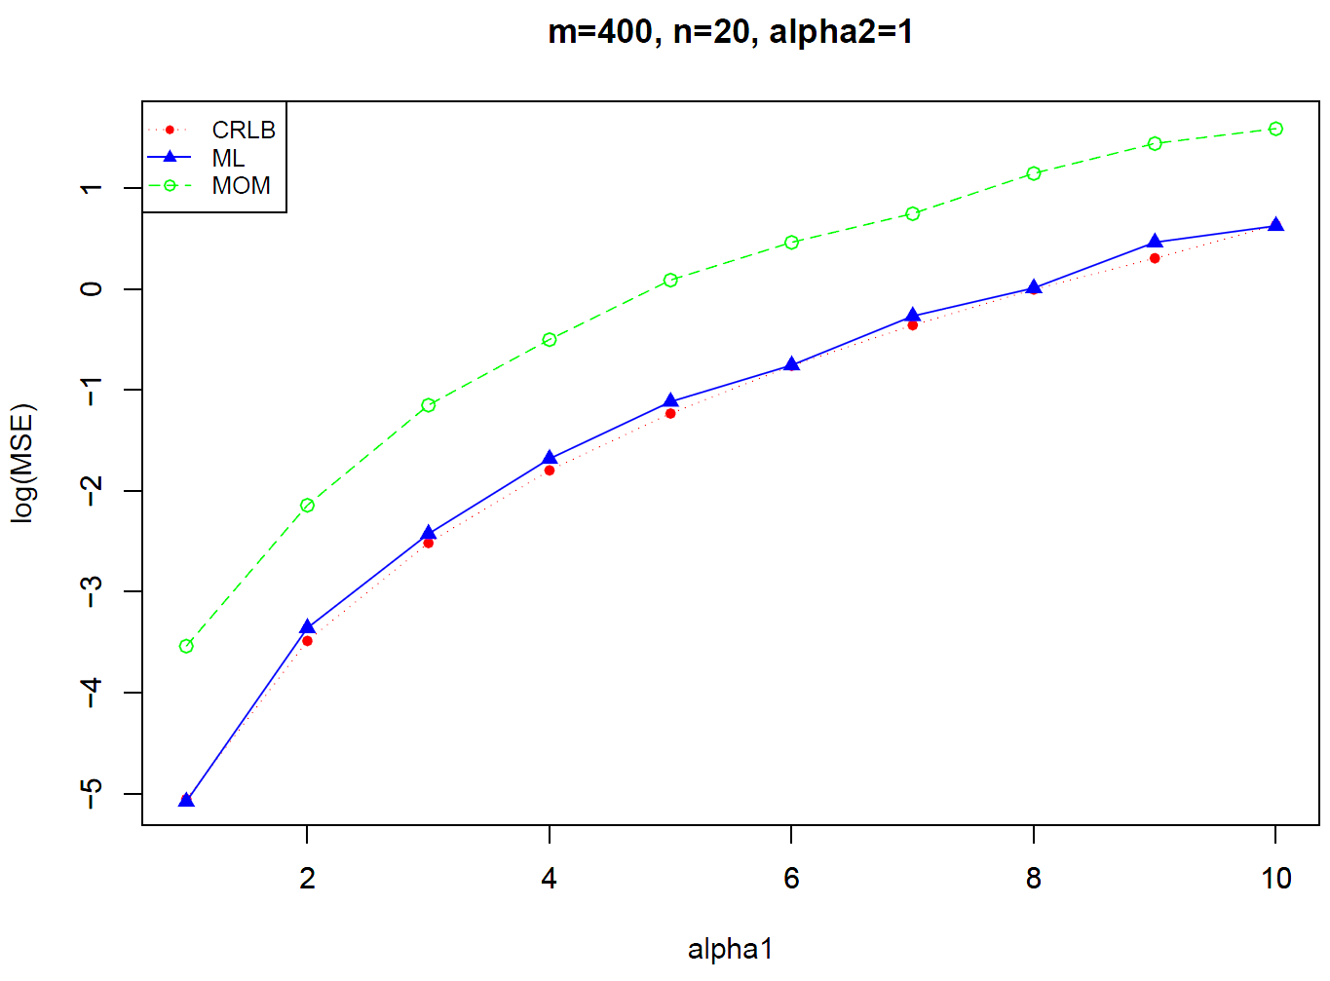

Slide 17
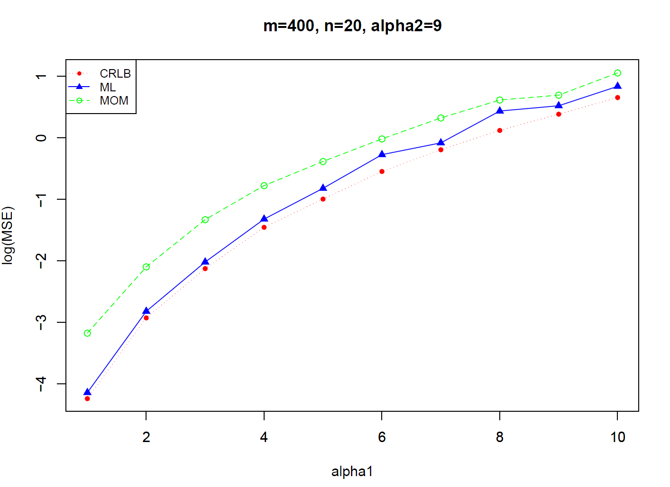

Slide 18
observations
ML computationally expensive, takes hours to complete
MOM computationally efficient
ML is asymptotically efficient and approaches CRLB quicker than MOM.
MSE tends to increase for large parameter sizes.

