Slide 1
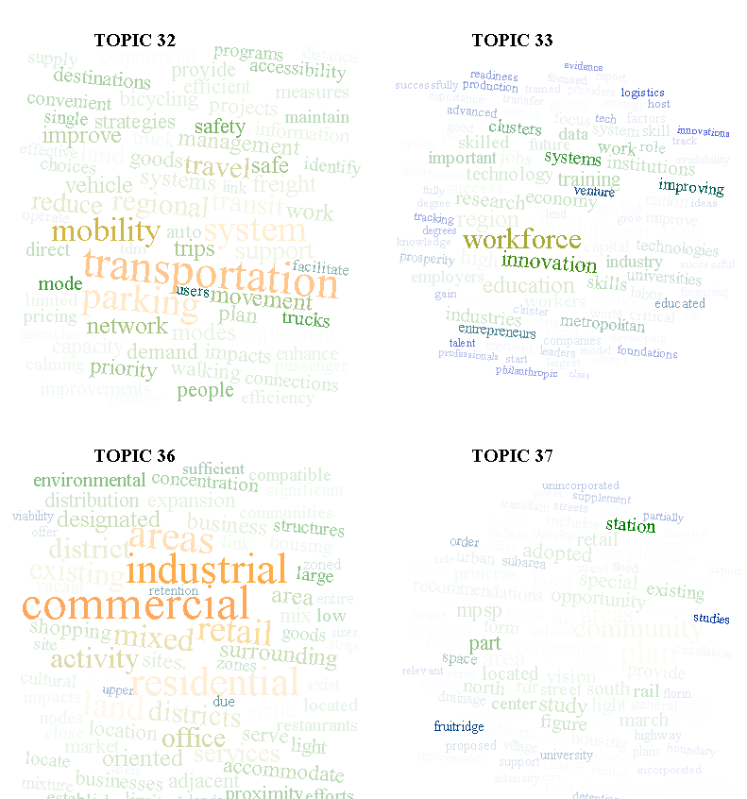
Estimating Parameters of Polya Distribution
Md Amran Siddiqui
Tadesse Zemicheal

Slide 2
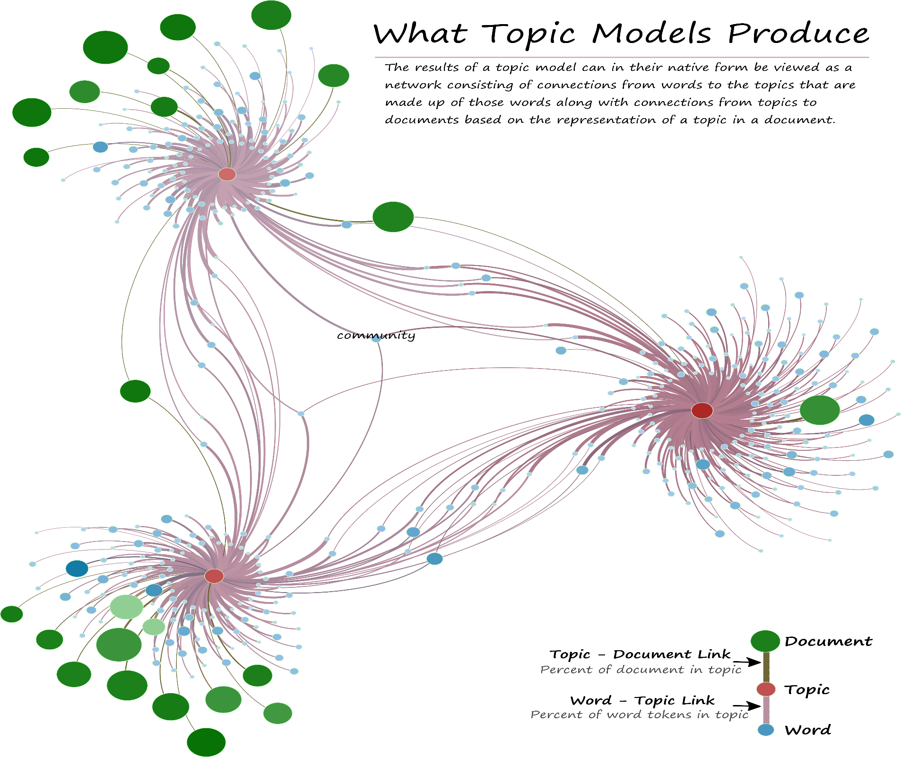

Slide 3
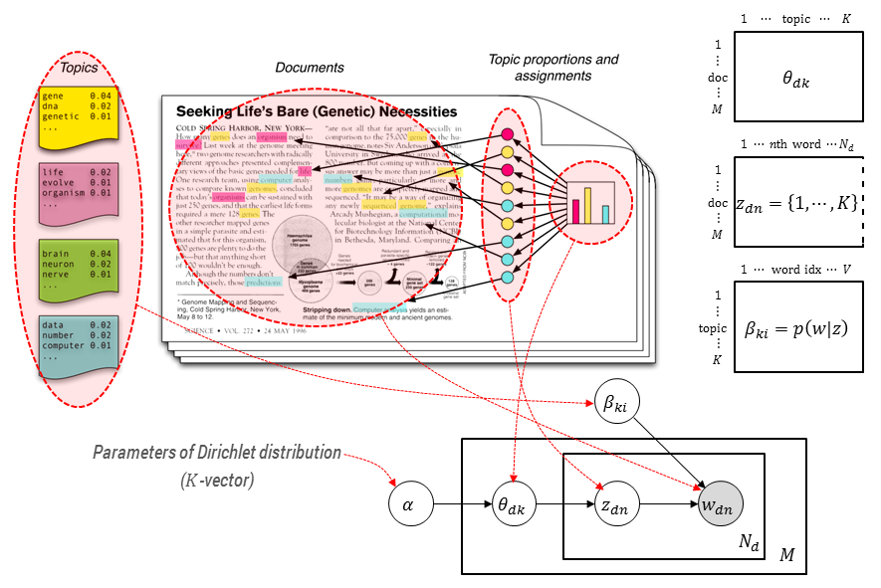
Topic modelling

Slide 4

Topic modelling
Methods for automatically organizing, understanding, searching and summarizing large electronic archives.
Uncover hidden topical patterns in collections.
Annotate documents according to topics

Slide 5

Model used
Dirichlet-multinomial (Polya distribution)
Multinomial distribution k category
Dirichlet conjugate prior for the multinomial
Beta-binomial
Topic: a mixture of distribution of words
Documents: bag of words
Word is drawn from two topics {0 or 1}

Slide 6
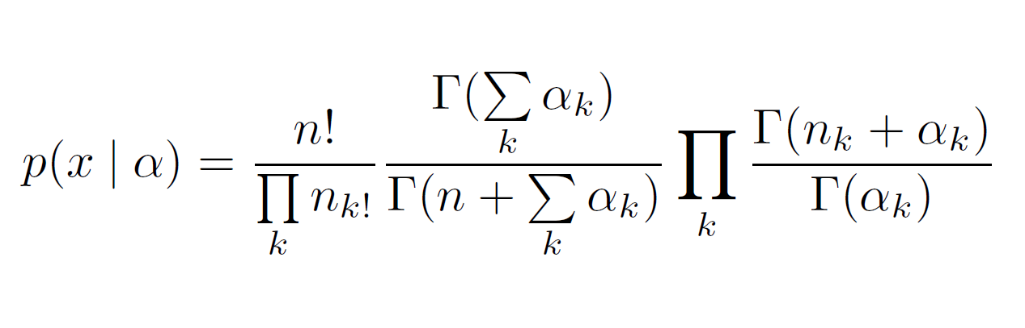
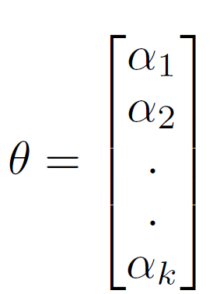
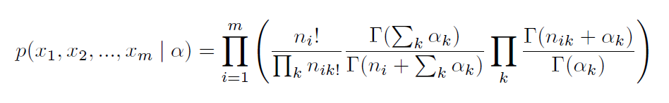
Problem Formulation
Given m documents x1,x2,….xm
Each xi contains n words
PDF is given by
The probability i.e. the likelihood of all documents is given by
We have to estimate parameters from the distribution.

Slide 7
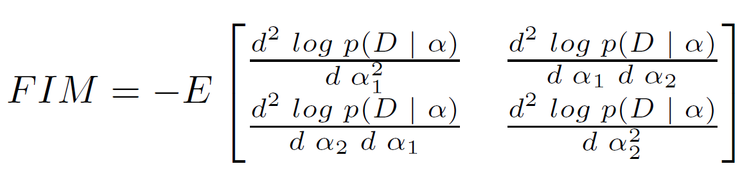
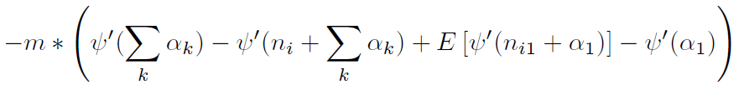
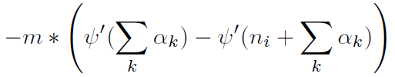
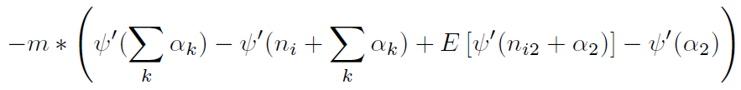
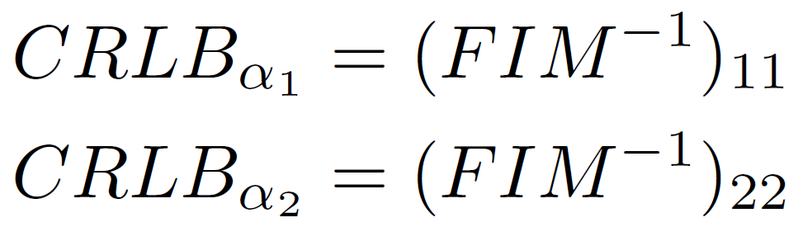
Cramer Rao Lower Bound (CRLB)
FIM₁₁ =
FIM₁₂ = FIM₂₁ =
FIM₂₂ =
CRBL has no closed form in this case
We had to compute numerically with Monte Carlo simulation

Slide 8
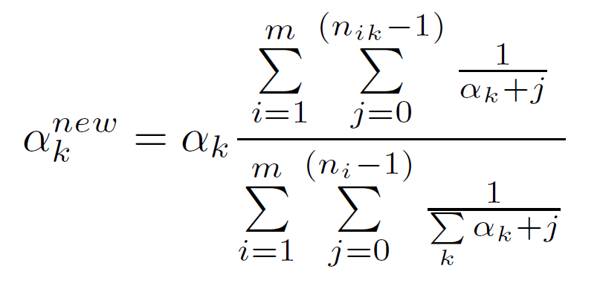
Maximum Likelihood Estimation
No closed form solution exist
Computed using fixed point iteration (Minka 2012)
The final form of iteration is simplified into this form

Slide 9
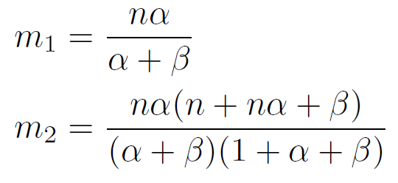
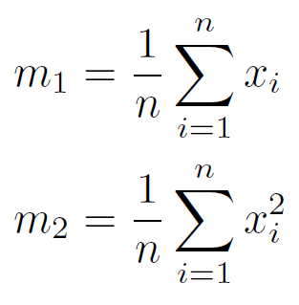
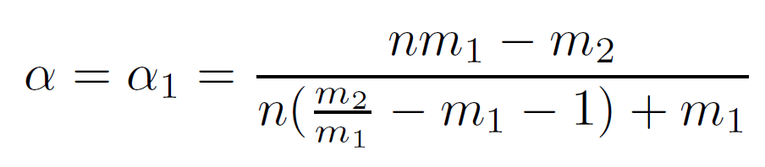
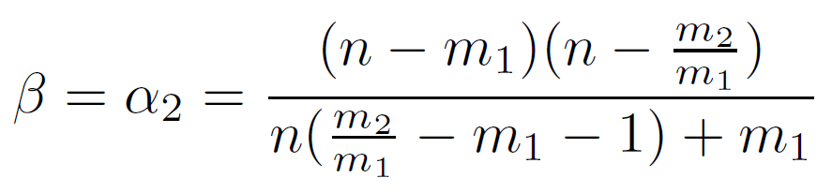
Method of Moments (MOM)
Population moments (Beta-Binomial):
Sample moments from data:
Equating population moments and sample moments and solving for the parameters α and β:

Slide 10
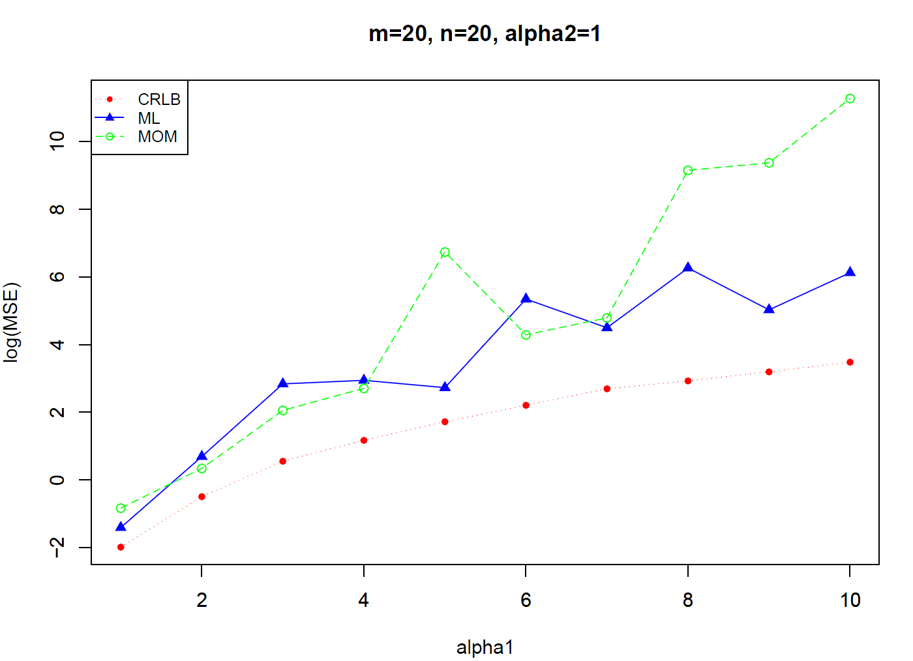
Experimental results
For 200 Monte Carlo iteration

Slide 11
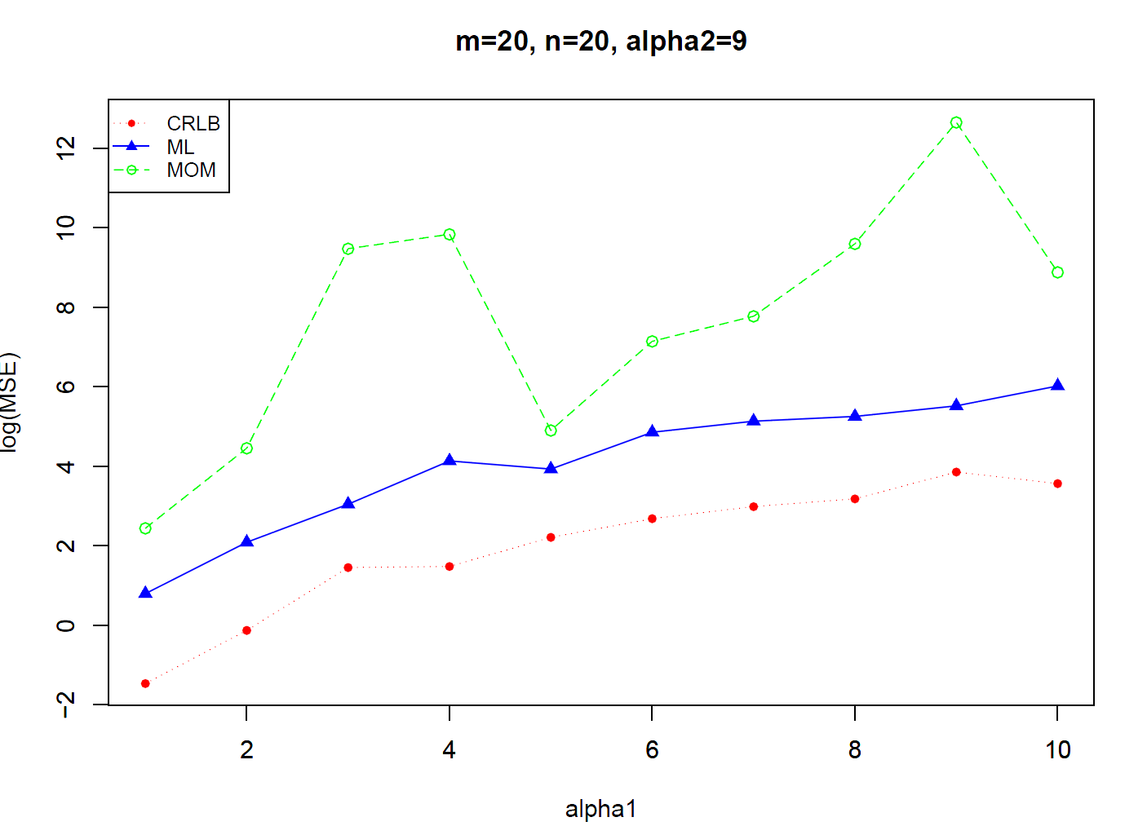
For 200 Monte Carlo iteration

Slide 12
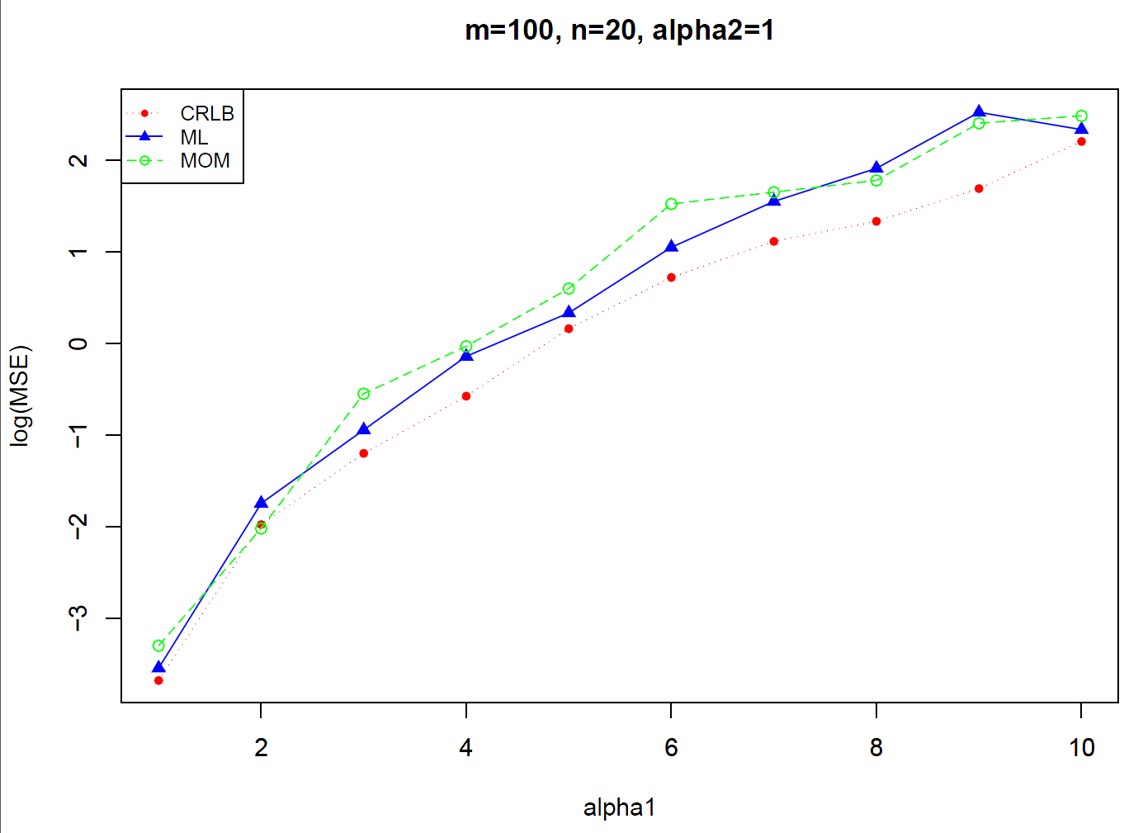
-Increasing number of examples

Slide 13
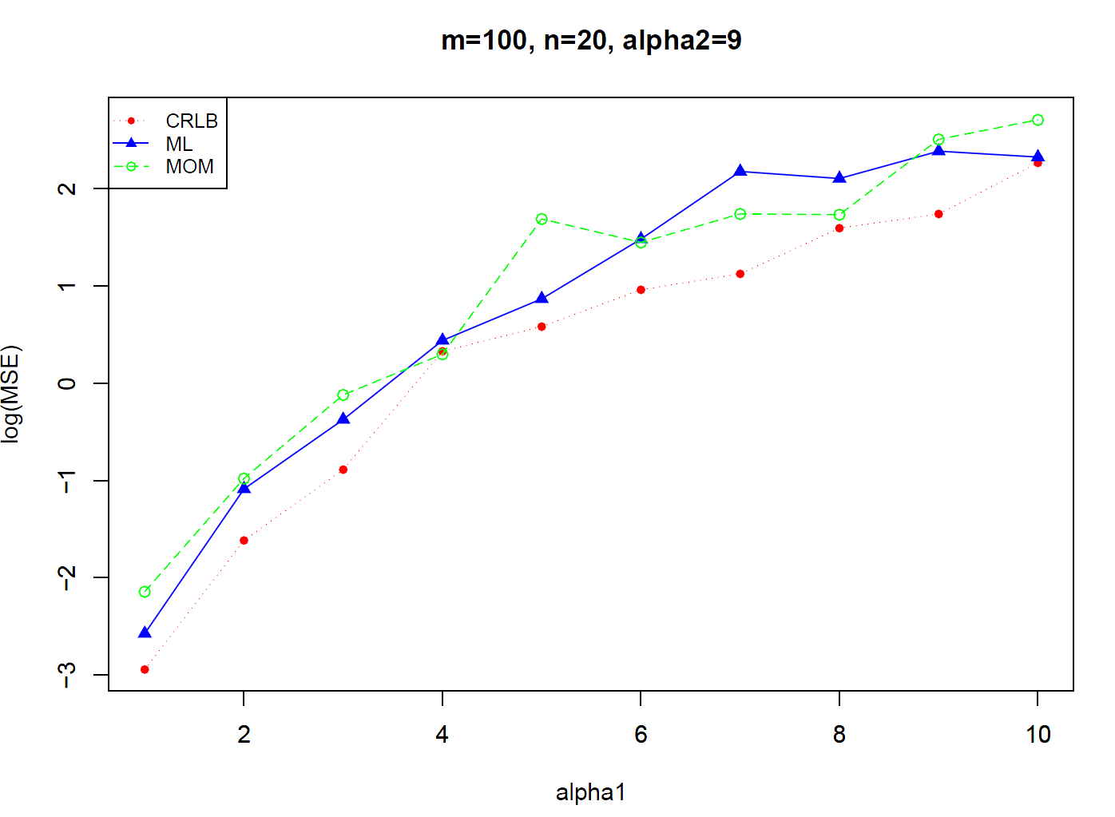
-MSE decreases for all estimators as we increase number of examples

Slide 14
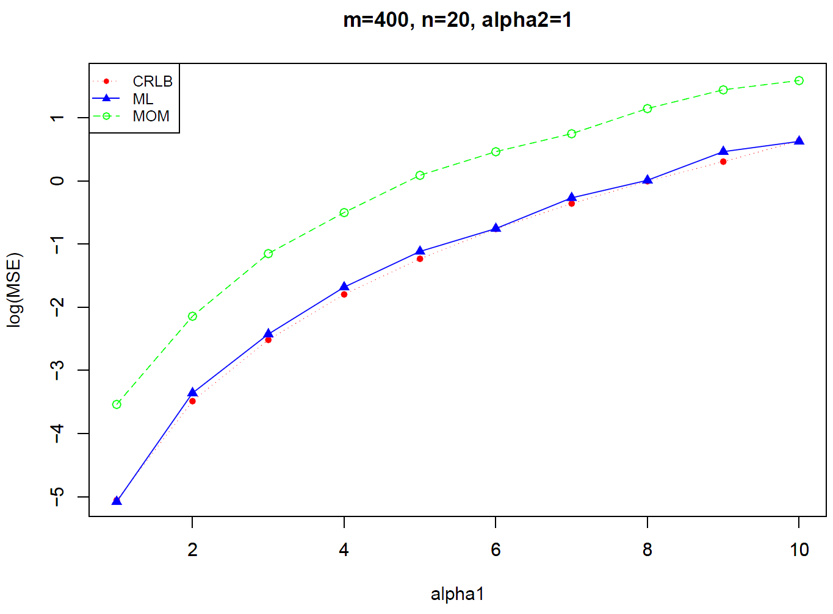
-Increasing Monte Carlo iteration i.e. 1000

Slide 15
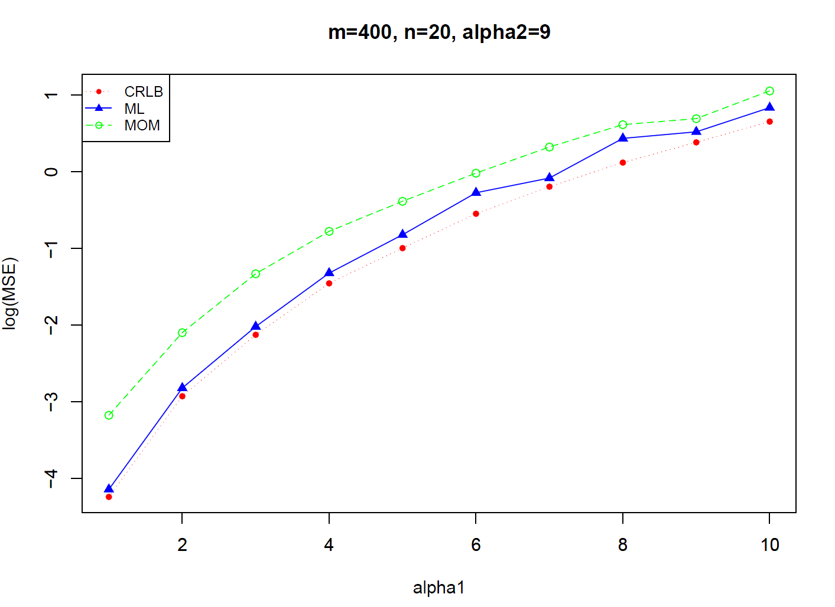
Increasing Monte Carlo iteration i.e. 1000

Slide 16
observations
ML computationally expensive, takes hours to complete
MOM computationally efficient
ML is asymptotically efficient and approaches CRLB quicker than MOM.
MSE tends to increase for large parameter sizes.
Increasing number of examples decreases MSE

Slide 17
Questions?

