Slide 1
GitHub
Simple User Guide

Slide 2
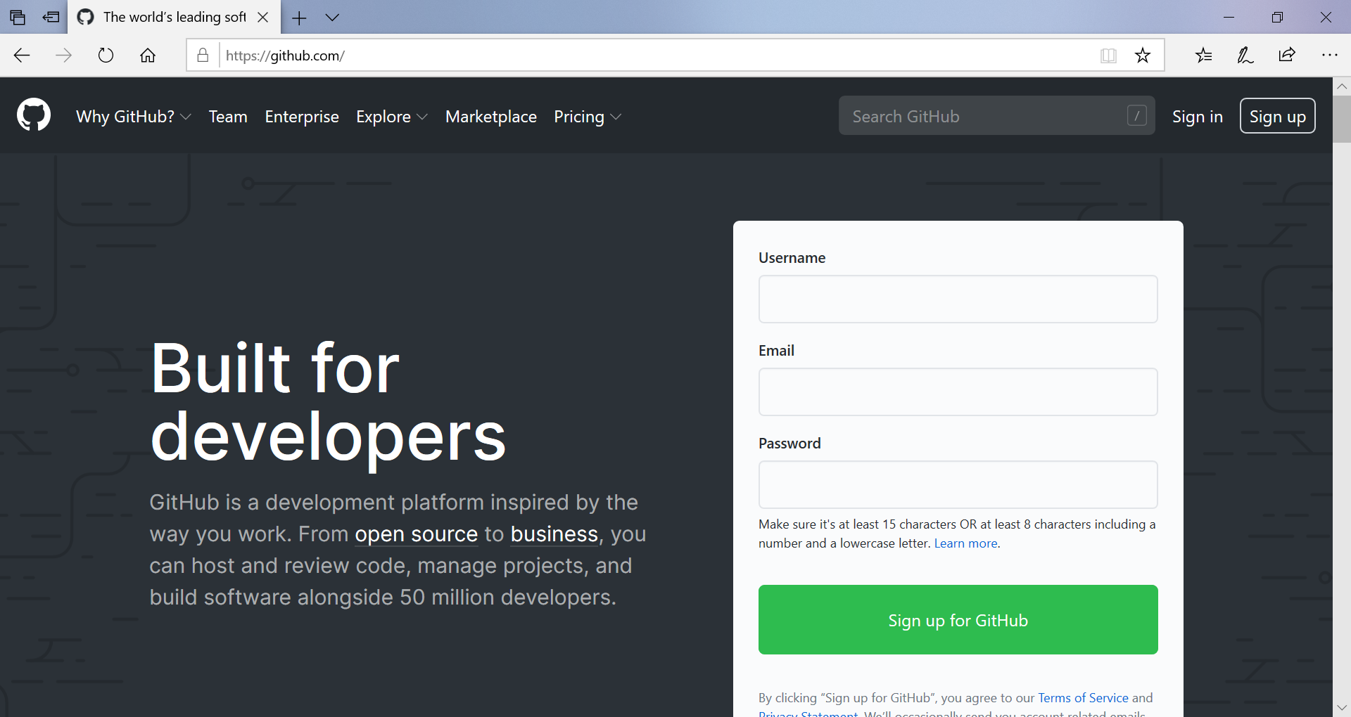
Register (or Sign up) https://github.com/

Slide 3
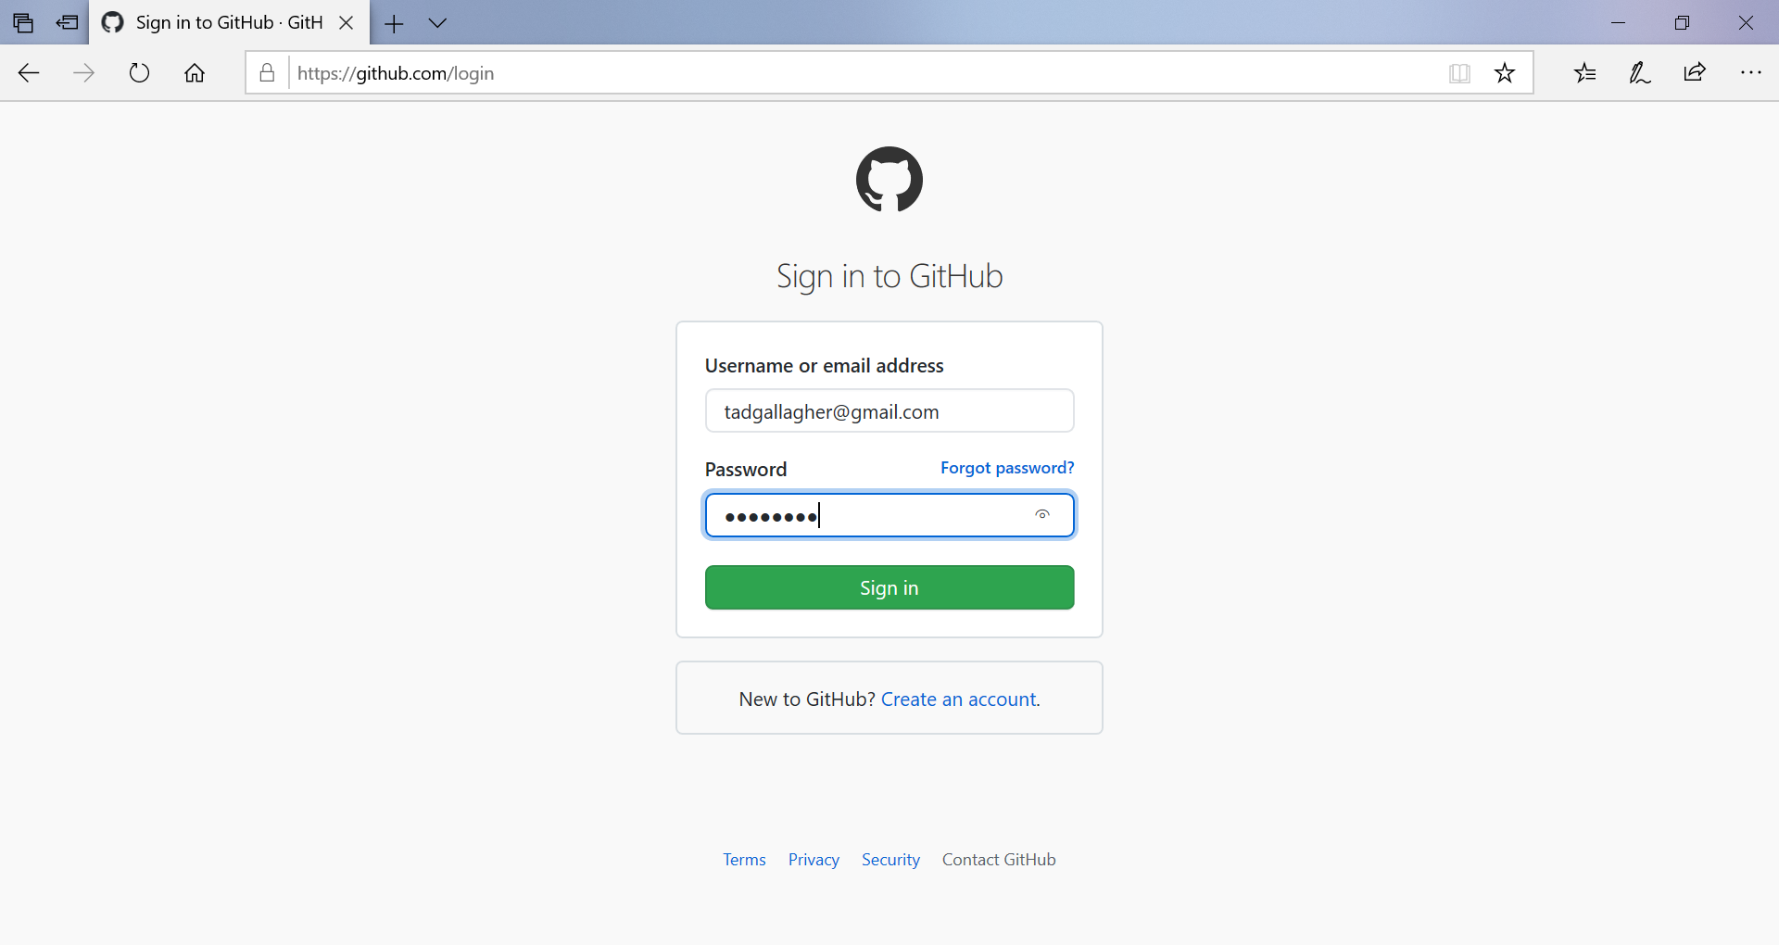
Sign In (may ask for a code)

Slide 4
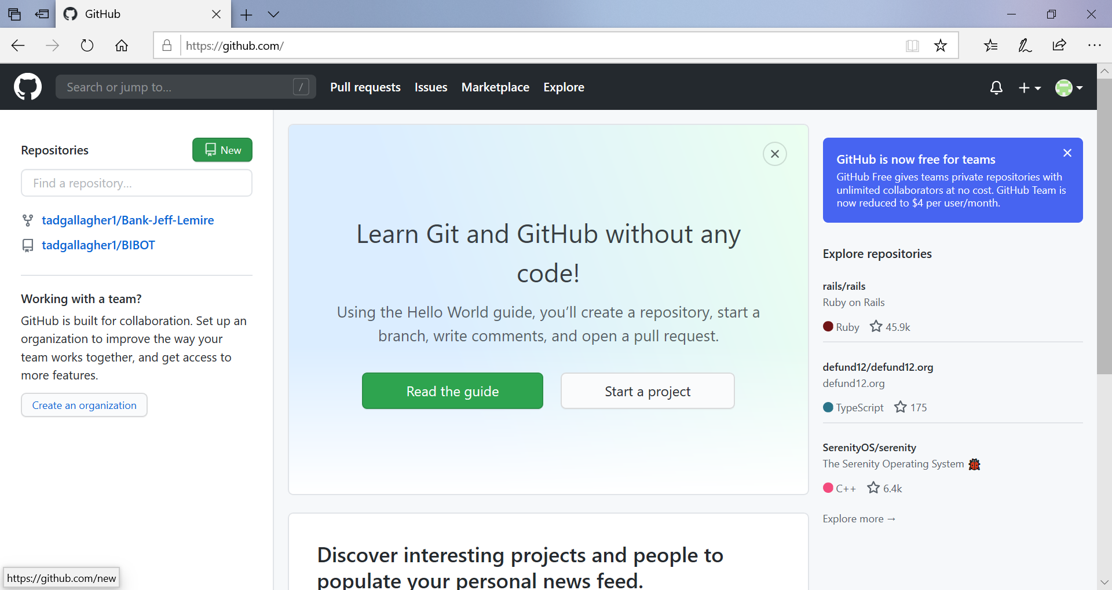
Home Screen

Slide 5
What is GitHub and why do we use it?
GitHub, Inc. is a United States-based global company that provides hosting for software development version control using Git.
In 2018, it became a subsidiary of Microsoft for US$ 7.5 billion. It offers the distributed version control and source code management (SCM) functionality of Git, plus its own features.

Slide 6
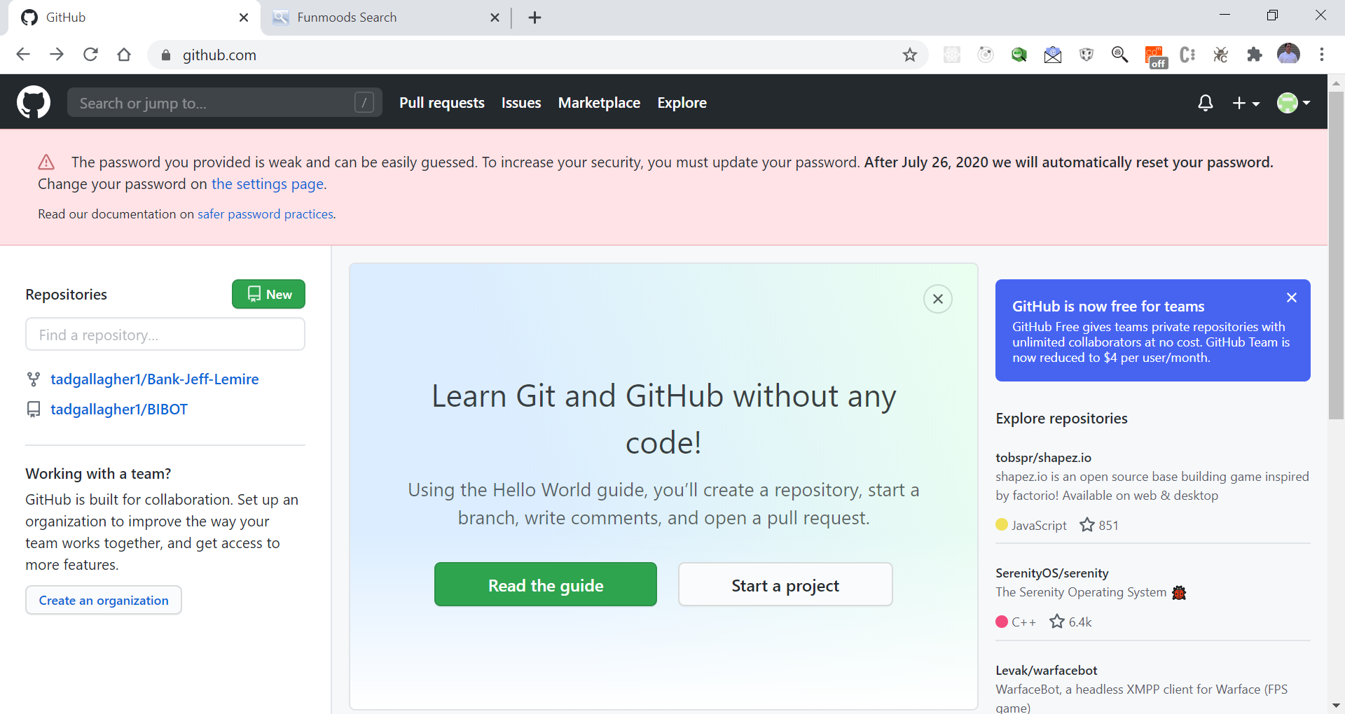
Start a Project

Slide 7
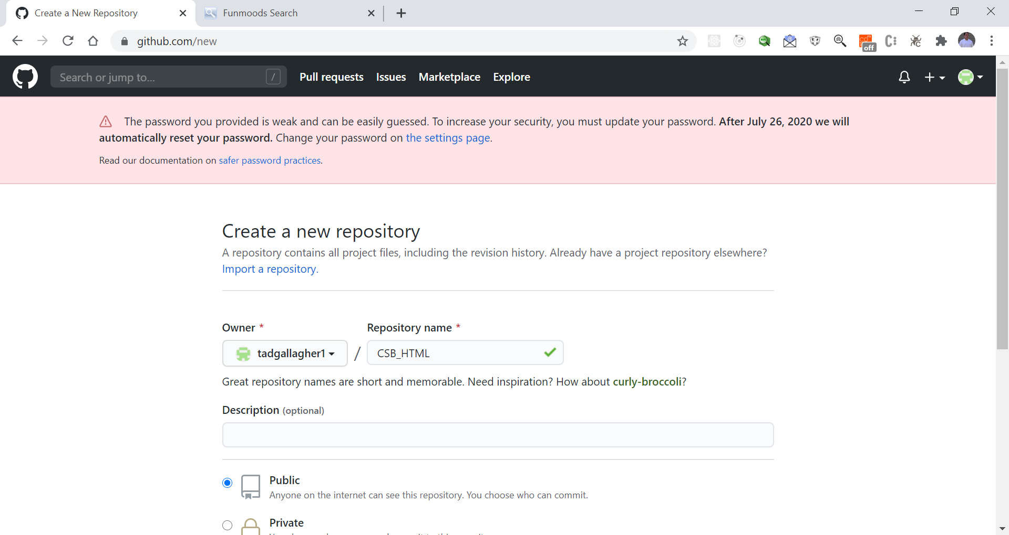
Give it a Name – Make it Public or Private

Slide 8
Other Settings
Git Ignore
Licenses

Slide 9
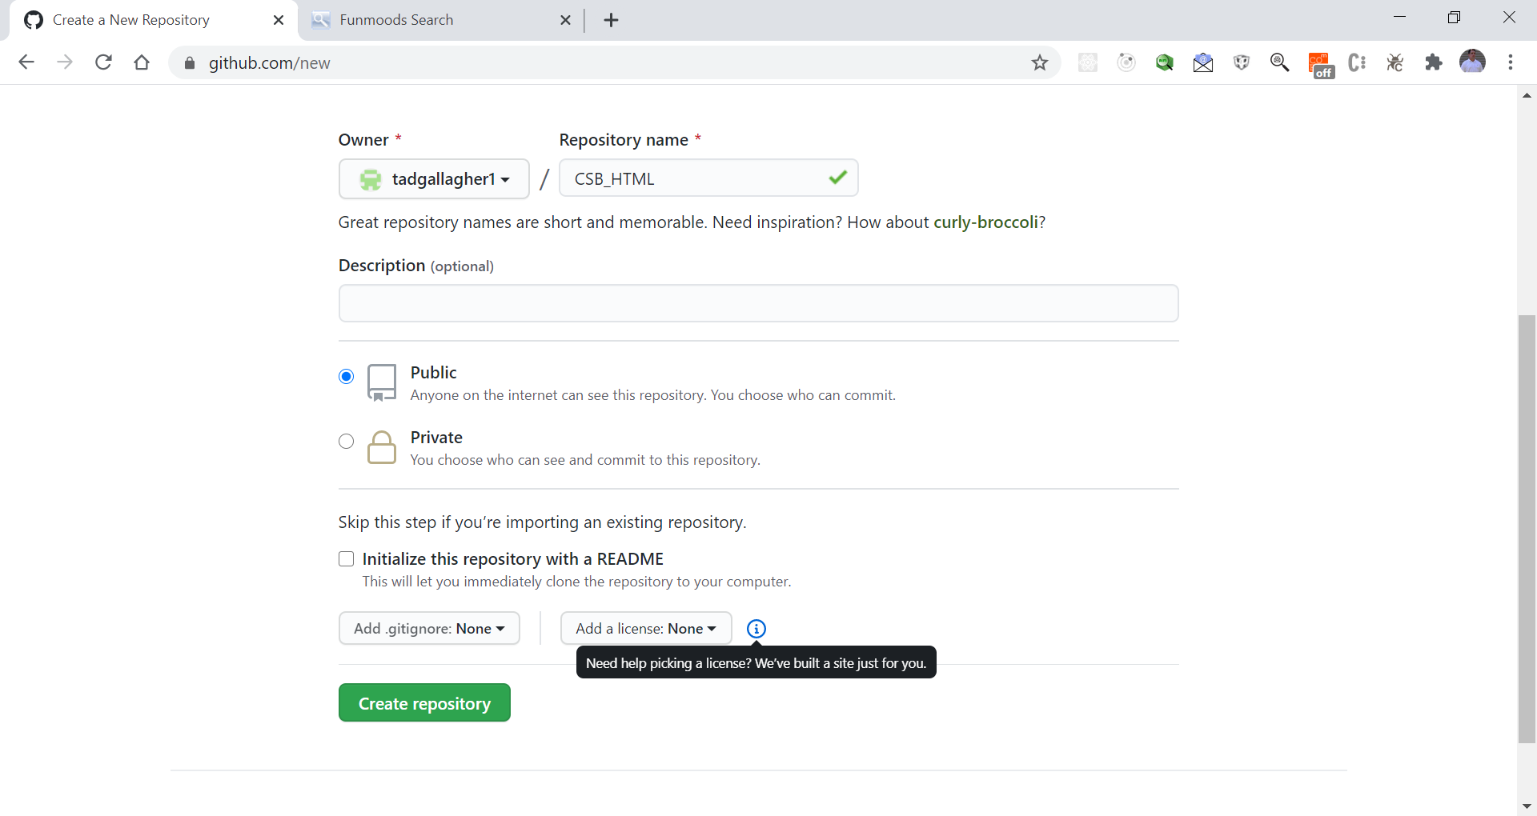
Create Repository

Slide 10
Within GitHub you have the option of using the command line (this is know as Git)
In Terminal or Command Window you can enter command directly to perform the previous steps.
git init
git add README.md
git commit -m "first commit"
git remote add origin https://github.com/tadgallagher1/CSB_HTML.git
git push -u origin master

Slide 11
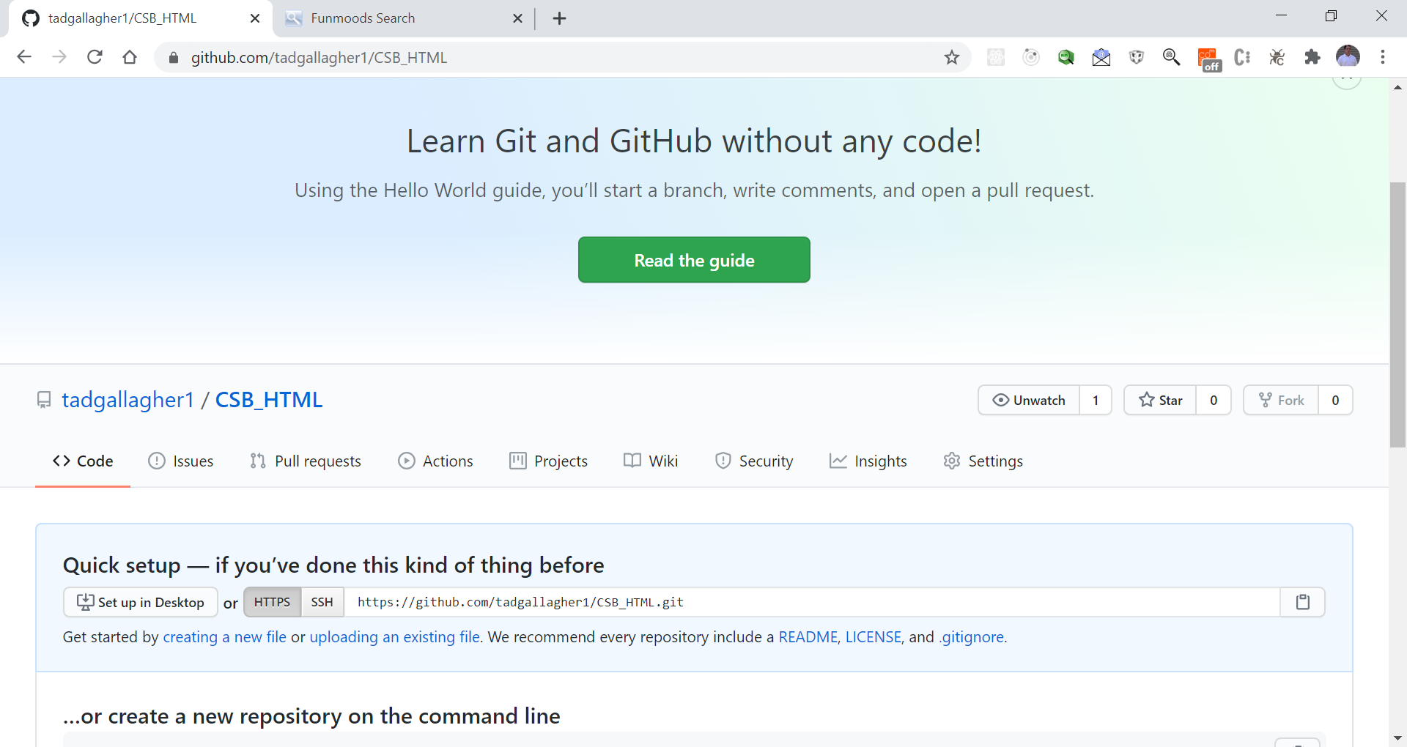
This is your repository https://github.com/tadgallagher1/CSB_HTML.git

Slide 12

Load your work – Example

Slide 13
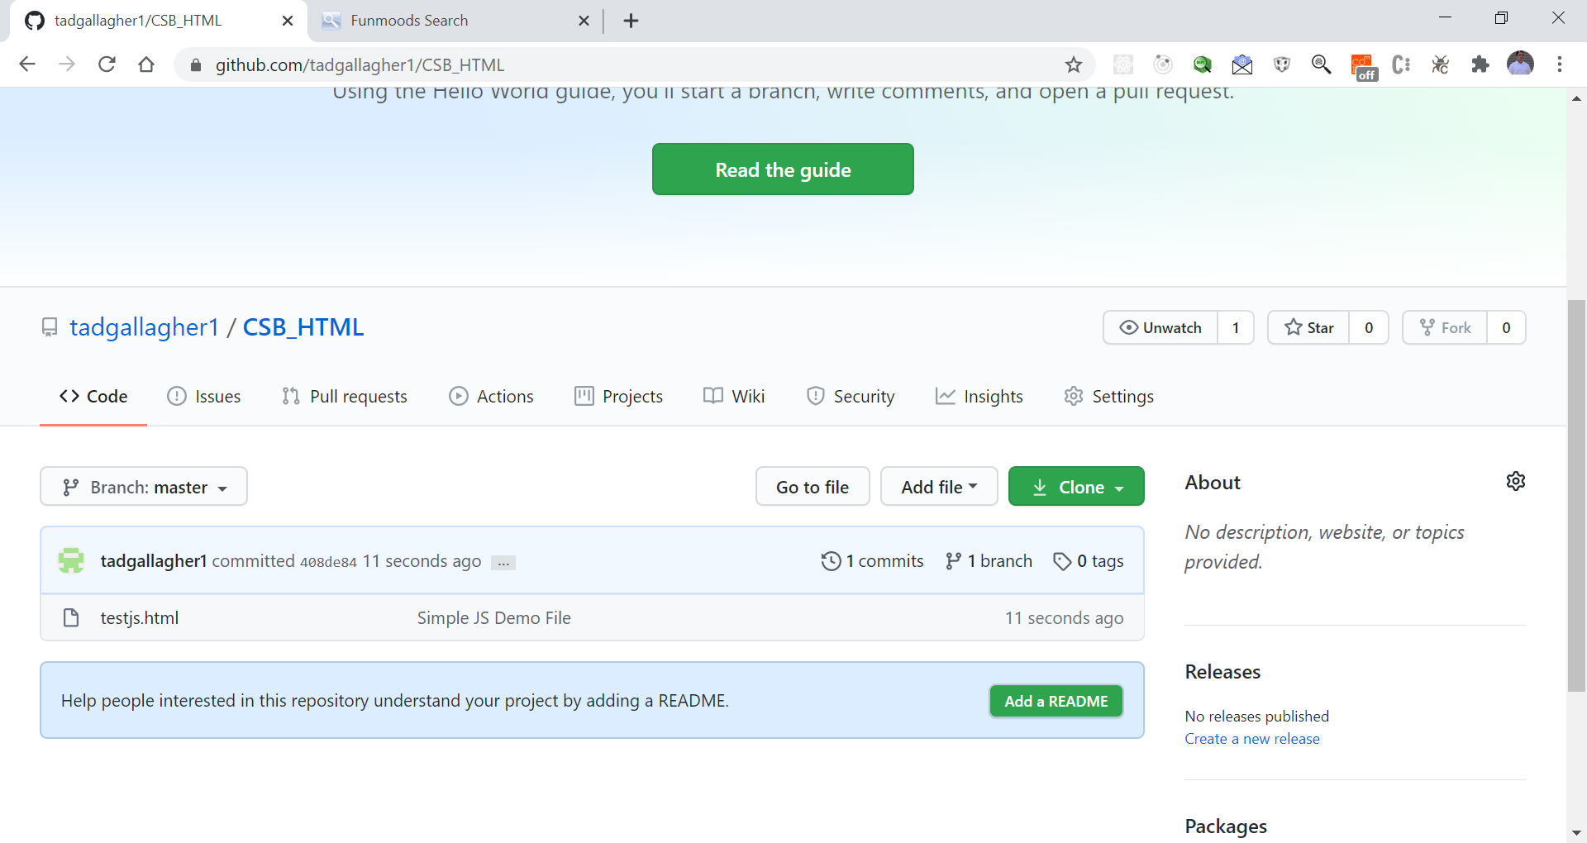
Uploaded File

Slide 14
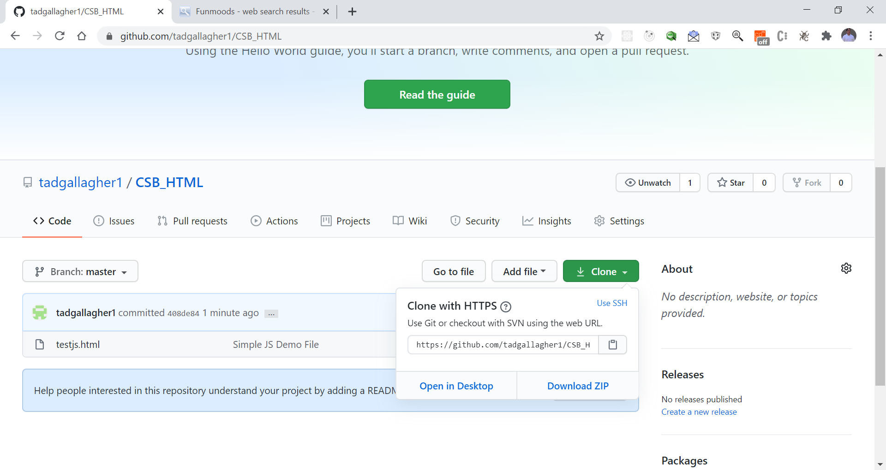
Getting your code (Clone)

Slide 15
GitHub Terms
Branching
Push
Pull
Merge
Ignore Files

Slide 16
More Resources on GitHub
What is GitHub?
https://www.youtube.com/watch?v=w3jLJU7DT5E
Learn GitHub in 20 Mins
https://www.youtube.com/watch?v=0fKg7e37bQE
Git and GitHub – What is it?
https://www.youtube.com/watch?v=fJtyf62yAb8

