Slide 1
HTML 1

Slide 2
Prep Work
Prep Work
Finish Fitness and/or Photoshop Exercises
Watch YouTube Video on Photoshop
Do Treehouse lessons:
HTML Basics [183 min] https://teamtreehouse.com/library/html-basics-2
Introduction to HTML and CSS [134 min] https://teamtreehouse.com/library/introduction-to-html-and-css
Practice Photoshop Tools

Slide 3
HTML 1
Today’s Class
Project Review from Last Class
Intro To HTML Syntax and Concepts
Headings, Text Formatting, and Page Layouts
HTML Lists
Inserting Comments, Links, and Images
Tables Continued
Grouping -HTML 5 and Divs
Recreate the HTML structure of some sample pages

Slide 4

HTML 1
Photoshop/ Web Exercise

Slide 5
HTML 1
Terms and Info
HTML is Hyper Text Markup Language
HTML is the building block of all web sites
The Mark up provides meaning to the text (structure, formatting, layouts)
Web browsers read HTML and display your website content
Made up of tags which format the content of your web page
Saved as .html or .htm files and viewed through a browser
Where you place files matters (Folder and File Names/Locations)
Notes:
Think of HTML is the skeleton of your website. It’s the structure and the content of your site.

Slide 6
Table Summary
Previous In-Class Exercises
The <table> tag is used to add data to a web page.
A table is drawn out row by row. Each row is created with the <tr> tag.
Inside each row there are a number of cells represented by the <td> tag (or <th> if it is a heading for a column).
You can make cells of a table span more than one row or column using the rowspan and colspan attributes.
You can split the table into a <thead>, <tbody>, and <tfoot>for longer tables. This allows you to style each section differently through CSS.
Notes:
Tables are defined with the <table> tag.
Tables are divided into table rows with the <tr> tag.
Table rows are divided into table data with the <td> tag.
A table row can also be divided into table headings with the <th> tag.
To make a cell span more than one column, use the colspan attribute.
To add a caption to a table, use the <caption> tag.
A border can be added using the border attribute.

Slide 7
HTML Tables
Syntax
Table 1
<table border="1">
<tr>
<td>Jill</td>
<td>Smith</td>
<td>50</td>
</tr>
<tr>
<td>Eve</td>
<td>Jackson</td>
<td>94</td>
</tr>
</table>
Table 3 - With Caption and Heading
<table border="1">
<caption>Monthly savings</caption>
<tr>
<th colspan="2">Month</th>
</tr>
<tr>
<td>January</td>
<td>$100</td>
</tr>
<tr>
<td>February</td>
<td>$50</td>
</tr>
</table>
Table 2 - With Heading
<table border="1">
<caption>Monthly savings</caption>
<tr>
<th>Month</th>
<th>Cost</th>
</tr>
<tr>
<td>January</td>
<td>$100</td>
</tr>
<tr>
<td>February</td>
<td>$50</td>
</tr>
</table>
Notes:
Tables are defined with the <table> tag.
Tables are divided into table rows with the <tr> tag.
Table rows are divided into table data with the <td> tag.
A table row can also be divided into table headings with the <th> tag.
To make a cell span more than one column, use the colspan attribute.
To add a caption to a table, use the <caption> tag.
A border can be added using the border attribute.

Slide 8
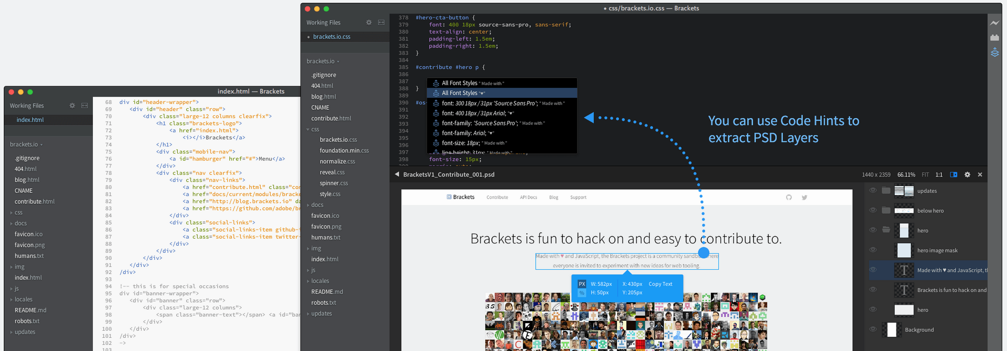
HTML 1
Tools of the Trade (Review)
Developers usually write code in an IDE (integrated development environment)
Sublime Text
Brackets
Visual Studio Code
You need a way to get the code to and from the server
FTP-Filezilla, CPANEL
SSH
Version Control

Slide 9
HTML

Slide 10
HTML 1
Terminology and Syntax
HTML elements - An element usually consists of an opening tag (<element_name>), a closing tag (</element_name>), which contain the element's name surrounded by angle brackets, and the content in between:
<element_name>...content...</element_name>
HTML tags label pieces of content such as "heading", "paragraph", "table", and so on
Browsers do not display the HTML tags, but use them to render the content of the page
Examples:
The <!doctype html> declaration defines this document to be HTML5
The <html> element is the root element of an HTML page
The <head> element contains meta information about the document and links to css/js
The <title> element specifies a title for the document
The <body> element contains the visible page content
The <h1> element defines a large sub heading
The <p> element defines a paragraph
Notes:
The DOCTYPE declaration defines the document type to be HTML
The text between <html> and </html> describes an HTML document
The text between <head> and </head> provides information about the document
The text between <title> and </title> provides a title for the document
The text between <body> and </body> describes the visible page content
The text between <h1> and </h1> describes a heading

Slide 11
HTML 1
Doctype and Other Beginning Page Declarations:
Starts a document opening and declares it is an HTML document
Previously used to define language, markup, type of HTML etc.
HTML 5 has streamlined it to one declaration for doctype
<!doctype html>
<html lang="en"> Defines the native language of the document. Declaring a language is important for accessibility applications (screen readers) and search engines:
<meta charset="utf-8"> Defines the encoding type for the document and is placed in between the <head></head> tags. To display an HTML page correctly, a web browser must know the character set used in the page.
Other:
Another item that can go between the <head></head> and <script></script> tags is pointing to a library that will allow HTML5 support for older browsers like Internet Explorer
<script src="http://html5shim.googlecode.com/svn/trunk/html5.js"></script>
This link will be sure that older browsers will render the HTML 5 properly if it is not supported
Notes:
The DOCTYPE declaration defines the document type to be HTML
The text between <html> and </html> describes an HTML document
The text between <head> and </head> provides information about the document
The text between <title> and </title> provides a title for the document
The text between <body> and </body> describes the visible page content
The text between <h1> and </h1> describes a heading

Slide 12
HTML 1
Basic Page Layout
"Hello World"
<!doctype html>
<html lang="en">
<head>
<title>Page Title</title>
</head>
<body>
<h1>Hello World!</h1>
</body>
</html>
Notes:
The DOCTYPE declaration defines the document type to be HTML
The text between <html> and </html> describes an HTML document
The text between <head> and </head> provides information about the document
The text between <title> and </title> provides a title for the document
The text between <body> and </body> describes the visible page content
The text between <h1> and </h1> describes a heading

Slide 13
HTML 1
Syntax
HTML Identifies Types of Content, Meaning, and Groups it Semantically
<blockquote></blockquote>More specific way to represent group of content
<h1></h1>-Section Heading, creates a new section of a page but do not group content and is used to describe the topic they precede.
<p></p>- Paragraph information - most basic element to group content
Structure of an HTML document can be viewed as a series of sections and subsections, like a document outline. This sectioning helps with searching and rendering of the page.
Notes:
The DOCTYPE declaration defines the document type to be HTML
The text between <html> and </html> describes an HTML document
The text between <head> and </head> provides information about the document
The text between <title> and </title> provides a title for the document
The text between <body> and </body> describes the visible page content
The text between <h1> and </h1> describes a heading

Slide 14
HTML Headings, Paragraphs, hr
Block-level Elements
A block-level element always starts on a new line and takes up the full width available (stretches out to the left and right as far as it can).
The <div> element is a block-level element.
Examples of block-level elements:
<div></div>
<h1></h1> - <h6></h6>
<p></p>
<form></form> tag is used to create an HTML form for user input.
Inline Elements
An inline element does not start on a new line and only takes up as much width as necessary.
Examples of inline elements:
<span></span> used for grouping and applying CSS styles to inline elements.
<a></a>
<img />
<em></em>
http://www.htmlhelp.com/reference/wilbur/overview.html
Notes:
Headings are defined with the <h1> to <h6> tags.
<h1> defines the most important heading. <h6> defines the least important heading.
The <hr> tag creates a horizontal line in an HTML page.
The hr element can be used to separate content.
With HTML, you cannot change the output by adding extra spaces or extra lines in your HTML code.
The browser will remove extra spaces and extra lines when the page is displayed.
Any number of spaces, and any number of new lines, count as only one space.

Slide 15
HTML Headings, Paragraphs, hr
HTML
Block Level Elements
Headings, Paragraphs, Page, and Line Breaks
Headings can be used to describe the topic they precede and they are defined with the <h1> to <h6> tags.
<h1>This is a Level 1 Heading or Headline</h1>
<h2>This is a Level 2 heading or Headline</h2>
<h3>This is a Level 3 heading or Headline</h3>
<h4>This is a Level 4 Heading or Headline</h4>
<h5>This is a Level 5 Heading or Headline</h5>
<h6>This is a Level 6 Heading or Headline</h6>
<p>This is a paragraph.</p>
<hr /> Horizontal Rule, Section Break or Line
<br />Break to Next Line
<p>
This paragraph
contains a lot of lines
in the source code,
but the browser
ignores it.
</p>
<p>
This paragraph
contains a lot of spaces
in the source code,
but the browser
ignores it.
</p>
Notes:
Headings are defined with the <h1> to <h6> tags.
<h1> defines the most important heading. <h6> defines the least important heading.
The <hr> tag creates a horizontal line in an HTML page.
The hr element can be used to separate content.
With HTML, you cannot change the output by adding extra spaces or extra lines in your HTML code.
The browser will remove extra spaces and extra lines when the page is displayed.
Any number of spaces, and any number of new lines, count as only one space.

Slide 16
HTML Text Formatting
HTML
Formatting Quotes and Abbreviations
<q>Quote</q>
<blockquote cite="http://www.yahoo.com">
This is a quote from Yahoo!...indented
</blockquote>
<p>
Text below the block quote...
</p>
<p>
<cite>
A Brief History in Time...
</cite></p>
<p><abbr title="Professor">Prof</abbr>Abbreviated title
</p>
<p><acronym title="National Aeronautics and Space Administration">NASA</acronym>does space stuff.
</p>
The <acronym> tag is not supported in HTML5 must use <abbr></abbr>.
Notes:
Headings are defined with the <h1> to <h6> tags.
<h1> defines the most important heading. <h6> defines the least important heading.
The <hr> tag creates a horizontal line in an HTML page.
The hr element can be used to separate content.
With HTML, you cannot change the output by adding extra spaces or extra lines in your HTML code.
The browser will remove extra spaces and extra lines when the page is displayed.
Any number of spaces, and any number of new lines, count as only one space.

Slide 17
HTML Text Formatting
HTML
Text-Level Elements
HTML Formatting
<b>Bold-Does not stress importance</b>
<i>Italics</i>
On the 4<sup>th</sup>of the month!
Amount of CO<sub>2</sub> in the air!
Whitespace is irrelevant and the browser adds spacing before and after then removes any extra spacing when displaying the page.
<p>This is a paragraph.</p>
Semantic Elements and Emphasis
<strong>Used to stress importance</strong>
<em>emphasized text</em>
<small>Reduces Text Size</small>
Note: Browsers display <strong> as <b>, and <em> as <i>. However, there is a difference in the meaning of these tags: <b> and <i> defines bold and italic text, but <strong> and <em> means that the text is "important".
Notes:
Headings are defined with the <h1> to <h6> tags.
<h1> defines the most important heading. <h6> defines the least important heading.
The <hr> tag creates a horizontal line in an HTML page.
The hr element can be used to separate content.
With HTML, you cannot change the output by adding extra spaces or extra lines in your HTML code.
The browser will remove extra spaces and extra lines when the page is displayed.
Any number of spaces, and any number of new lines, count as only one space.

Slide 18
HTML Text Formatting
HTML
Formatting Addresses: (Block Level Element)
<address>
<p>
8995 N Military Trail, Suite 303B<br />
Palm Beach Gardens, FL
</p>
</address>
Strikethrough and Insert Text:
<p>This is the<del>worst</del><ins>best</ins> idea!</p>
<p>can also use<s>strike-through</s></p>
Notes:
Headings are defined with the <h1> to <h6> tags.
<h1> defines the most important heading. <h6> defines the least important heading.
The <hr> tag creates a horizontal line in an HTML page.
The hr element can be used to separate content.
With HTML, you cannot change the output by adding extra spaces or extra lines in your HTML code.
The browser will remove extra spaces and extra lines when the page is displayed.
Any number of spaces, and any number of new lines, count as only one space.

Slide 19
HTML Lists
HTML
Listing Items on a page
Ordered lists use numbers
Unordered lists use bullets
Definition lists are used to define terminology
Lists can be nested inside one another
Block Level Elements
Notes:
Comments are not displayed by the browser, but they can help document your HTML.
With comments you can place notifications and reminders in your HTML.
Comments are also great for debugging HTML, because you can comment out HTML lines of code, one at a time, to search for errors.
Conditional comments defines HTML tags to be executed by Internet Explorer only.

Slide 20
HTML Lists
HTML
Definition Lists
<dl>
<dt>Sushi</dt>
<dd>Sliced raw fish served on rice</dd>
<dt>Sashimi</dt>
<dd>Sliced raw fish that is served with condiments such as shredded daikon radish or ginger root, wasabi and soy sauce</dd>
</dl>
Unordered Lists Nested Lists
<ul>
<li>Coffee</li>
<li>Tea</li>
<li>Milk</li>
</ul>
Ordered Lists
<ol>
<li>Coffee</li>
<li>Tea</li>
<li>Milk</li>
</ol>
Roman Numerals:
<ol type="I">
<li>Caesar</li>
<li>Brutus</li>
<li>Octavius</li>
</ol>
<ul>
<li>Coffee</li>
<li>Tea
<ul>
<li>Black tea</li>
<li>Green tea</li>
</ul>
</li>
<li>Milk</li>
</ul>
Notes:
An unordered list starts with the <ul> tag. Each list item starts with the <li> tag.
The list items will be marked with bullets (small black circles).
A style attribute can be added to an unordered list, to define the style of the marker:
An ordered list starts with the <ol> tag. Each list item starts with the <li> tag.
The list items will be marked with numbers.
List can be nested (lists inside lists).

Slide 21
HTML Comments
HTML
Comments: can be used to leave notes to yourself or other developers about a specific point in code.
General Comment:
<!-- This is a comment -->
Surrounding Content
<!-- Begin Main Content-->
<!-- End Main Content -->
Comment out code for debugging:
<!-- <img border="0" src="pic_mountain.jpg" alt="Mountain"> -->
Comment version support:
<!--[if IE 8-->
.... some HTML here ....
<![endif]-->
Notes:
Comments are not displayed by the browser, but they can help document your HTML.
With comments you can place notifications and reminders in your HTML.
Comments are also great for debugging HTML, because you can comment out HTML lines of code, one at a time, to search for errors.
Conditional comments defines HTML tags to be executed by Internet Explorer only.

Slide 22
HTML Links
HTML
Anchor and Hyperlinks
You will commonly come across the following types of links:
Links from one page to another on the same website (Relative)
Links from one website to another out on the internet (External)
Links that start up your email program and address a new email to someone (Mail client)
Links from image in a web page (Image)
Links from one part of the web page to another part of the same page (Inside the same page) Uses ID <a href="#idname">Top of Page</a>
Links that open in a new browser window (Target) target="_blank"
Notes:
HTML links are hyperlinks.
A hyperlink is a text or an image you can click on, and jump to another document.
The target attribute specifies where to open the linked document.
It is common to use images as links. Think company logo (ex. Palm Beach Code School Website)

Slide 23
Links Summary
HTML
Links are created using the <a> tag.
The <a> tag uses the href attribute to indicate the location, page or destination you are linking to.
If you are linking to a page within your own site, it is best to use relative links rather than fully qualified/absolute URLs.
You use the id attribute to target elements within a single page that can be linked to.
You can create links to open email programs with an email address in the "to" field.
Notes:
HTML links are hyperlinks.
A hyperlink is a text or an image you can click on, and jump to another document.
The target attribute specifies where to open the linked document.
It is common to use images as links. Think company logo (ex. Palm Beach Code School Website)

Slide 24
HTML Links
HTML
Relative Link- (Uses File Name)
<a href="about.html">About Us Page</a>
External (Absolute) -Link & Opening A New Window- (Uses URL)
<a href="http://www.w3schools.com/" target="_blank">Visit W3Schools!</a>
Target specifies where to open the link (window, tab, etc)
Linking an Image- (Uses image instead of text to click on)
<a href="default.html">
<img src="smiley.gif" alt="HTML tutorial"/>
</a>
Mail To Link- (Uses Mail Client)
<a href="mailto:jon@example.com">Email Jon</a>
Link Inside A Page- (Scrolls Content to top)
<h1 id="top">This is my Top line</h1>
Other HTML headings, content, and Paragraphs here, ...lots of content!
<a href="#top">Top of Page</a>
Notes:
HTML links are hyperlinks.
A hyperlink is a text or an image you can click on, and jump to another document.
The target attribute specifies where to open the linked document.
It is common to use images as links. Think company logo (ex. Palm Beach Code School Website)

Slide 25
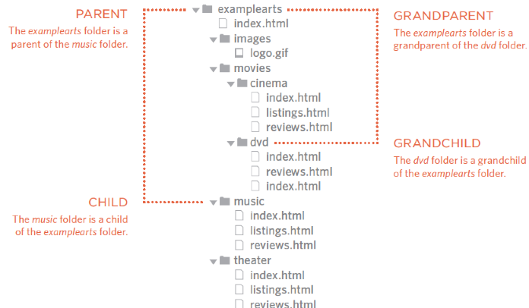
HTML Links
Folder Paths
"Pay attention to folder/file paths"
<a href="images/default.html"> Drill down one folder (images)
<a href="css/icons/default.html"> Drill down two folders (css -> icons)
<a href="../index.html"> Up one directory
<a href="../../index.html"> Up two directories
Notes:
HTML links are hyperlinks.
A hyperlink is a text or an image you can click on, and jump to another document.
The target attribute specifies where to open the linked document.
It is common to use images as links. Think company logo (ex. Palm Beach Code School Website)

Slide 26
HTML Images
HTML
Images
<img> attributes
src - Location (URL) or (path) of image (required)
alt - Description of the image if it doesn’t display (optional but recommended)
title - tooltip (mouseover) with more information about the image
height - specifies height in pixels by default
width - specifies width in pixels by default
Note: Always specify the width and height of an image. If width and height are not specified, the page will flicker while the image loads.
Notes:
HTML links are hyperlinks.
A hyperlink is a text or an image you can click on, and jump to another document.
The target attribute specifies where to open the linked document.
It is common to use images as links. Think company logo (ex. Palm Beach Code School Website)

Slide 27
HTML Images
HTML
WIDTH AND HEIGHT
<img src="images/smiley.gif" alt="HTML tutorial" width="600" height="400" />
ALIGN RIGHT
<img src="images/smiley.gif" alt="HTML tutorial" width="600" height="400" align="right" />
TOP ALIGN
<img src="images/smiley.gif" alt="HTML tutorial" width="600" height="400" align="top" />
EXTERNAL
<img src="http://www.w3schools.com/images/w3schools_green.jpg" alt="W3Schools.com"/>
Image with Caption
<figure>
<img src="images/smiley.gif" alt="HTML tutorial" width="600" height="400" align="top" />
<br />
<figcaption>This is a smiley face</figcaption>
</figure>
Notes:
HTML links are hyperlinks.
A hyperlink is a text or an image you can click on, and jump to another document.
The target attribute specifies where to open the linked document.
It is common to use images as links. Think company logo (ex. Palm Beach Code School Website)

Slide 28
HTML Tables
HTML
Maps
An image map is an image with clickable areas that usually act as hyperlinks.
The image is defined by the <img> tag, and the map is defined by a <map> tag with <area> tags to denote each clickable area. Use the usemap and name attributes to bind the image and the map.
<img src="images/circle.gif" usemap="#shapes">
<map name="shapes">
<area shape="polygon" coords="79,6,5,134,153,134">
<area shape="circle" coords="79,6,115">
<area shape="rectangle" coords="79,6,115,234">
</map>
Notes:
HTML links are hyperlinks.
A hyperlink is a text or an image you can click on, and jump to another document.
The target attribute specifies where to open the linked document.
It is common to use images as links. Think company logo (ex. Palm Beach Code School Website)

Slide 29
HTML Layouts
HTML
3 Methods For Front End Layouts
HTML Tables (older method uses cells for grouping data elements together )
Divs (boxes used for grouping HTML elements together)
HTML5 Semantic Grouping /Sectioning (larger boxes used for grouping HTML elements together)
Notes:
Tables are defined with the <table> tag.
Tables are divided into table rows with the <tr> tag.
Table rows are divided into table data with the <td> tag.
A table row can also be divided into table headings with the <th> tag.
To make a cell span more than one column, use the colspan attribute.
To add a caption to a table, use the <caption> tag.
A border can be added using the border attribute.

Slide 30
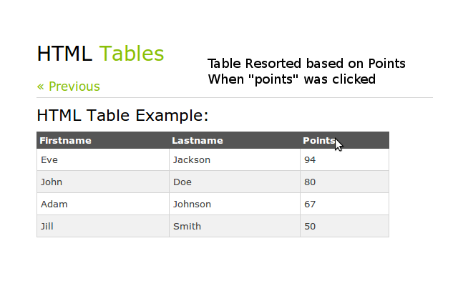
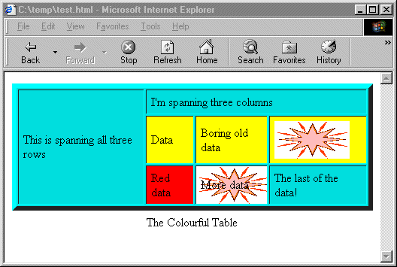
HTML Layouts
HTML
Tables
Tabular Data Layout
Text and Image Layout
Notes:
Tables are defined with the <table> tag.
Tables are divided into table rows with the <tr> tag.
Table rows are divided into table data with the <td> tag.
A table row can also be divided into table headings with the <th> tag.
To make a cell span more than one column, use the colspan attribute.
To add a caption to a table, use the <caption> tag.
A border can be added using the border attribute.

Slide 31
HTML Tables
Would be located in the body <body></body>
<table width="400" border="1" cellspacing="0" cellpadding="0">
<tr>
<td valign="top">Cell 1 </td>
<td>Cell 2 </td>
</tr>
<tr>
<td colspan="2">Cell 1 spanning 2 columns</td>
</tr>
</table>
HTML
Tables and their Properties
Examples:
The border creates gridlines when set to a value = 1 no gridlines value = 0
The width declares the width in pixels of the overall table or column
The height declares the height in pixels of the overall table, column or row
cellspacing specifies the space between the cells.
cellpadding specifies the space between the cell content and its borders.
colspan makes a cell span more than one column
The colspan makes a cell span more than one column
The valign makes items in a cell align (top, middle, bottom) vertically halign makes items in a cell align horizontally
Note Other Table Tag Examples:
<th>Firstname</th> -Table Header -centers in the cell and bolds contents
<thead>Groups the header content in a table
<tbody>Groups the body content in a table
<tfoot>Groups the footer content in a table
Notes:
HTML links are hyperlinks.
A hyperlink is a text or an image you can click on, and jump to another document.
The target attribute specifies where to open the linked document.
It is common to use images as links. Think company logo (ex. Palm Beach Code School Website)

Slide 32
HTML Tables
HTML Layout 1
Table/Nesting
<table border="1">
<tr>
<td>
<table width="400" border="1">
<tr>
<td>Cell 1 Row 1 of second Table</td>
<td>Cell 2 Row 1 of second Table</td>
</tr>
<tr>
<td>Cell 1 Row 2 of second Table</td>
<td>Cell 2 Row 2 of second Table</td>
</tr>
</table>
</td>
</tr>
<tr>
<td>Bottom Row</td>
</tr>
</table>
Notes:
HTML links are hyperlinks.
A hyperlink is a text or an image you can click on, and jump to another document.
The target attribute specifies where to open the linked document.
It is common to use images as links. Think company logo (ex. Palm Beach Code School Website)

Slide 33
HTML Divs
HTML Layout 2
Divs (Block Level Element)
The div element in HTML is a container element that encapsulates other elements and can be used to group and separate parts of a webpage.
A div by itself does not inherently represent anything but is a powerful tool in web design.
The <div> element usually has no specific semantic meaning by itself, simply representing a division, and is typically used for grouping and encapsulating other elements within an HTML document and separating those from other
groups of content. As such, each <div> is best described by its contents.
<div>
<p>Hello! This is a paragraph.</p>
</div>
The div element is typically a block-level element, meaning that it separates a block of an HTML document and occupying the maximum width of the page.
Notes:
Tables are defined with the <table> tag.
Tables are divided into table rows with the <tr> tag.
Table rows are divided into table data with the <td> tag.
A table row can also be divided into table headings with the <th> tag.
To make a cell span more than one column, use the colspan attribute.
To add a caption to a table, use the <caption> tag.
A border can be added using the border attribute.

Slide 34
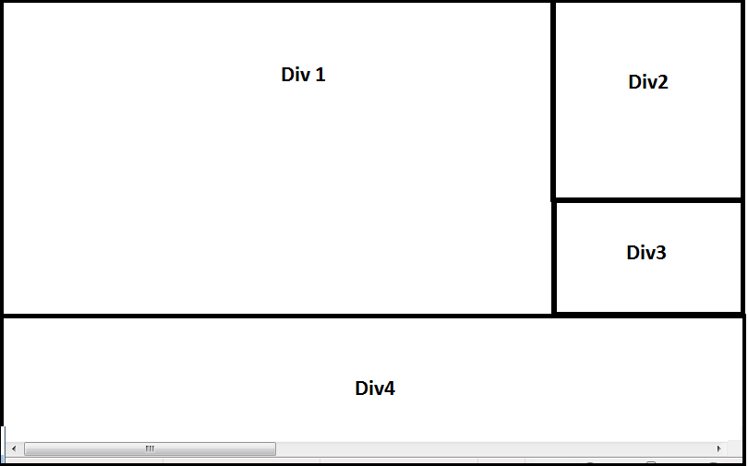
HTML Divs
HTML Layout 2
Divs- were used in the past to group content but have been further broken into sectioning elements using HTML5. Both Divs and HTML5 use CSS to size, position, and present content.
<div class=“leftcol”>
Div 1
</div>
<div class=“rightcol1”>
Div 2
</div>
<div class=“rightcol2>
Div 3
</div>
<div class=“bottom”>
Div 4
</div>
Notes:
Tables are defined with the <table> tag.
Tables are divided into table rows with the <tr> tag.
Table rows are divided into table data with the <td> tag.
A table row can also be divided into table headings with the <th> tag.
To make a cell span more than one column, use the colspan attribute.
To add a caption to a table, use the <caption> tag.
A border can be added using the border attribute.

Slide 35
HTML Grouping and Sectioning
HTML Layout 3
HTML 5 Introduced additional sectioning for elements
<article></article> -self contained content like articles, blogs,widgets
<aside></aside> things related to content aside of it like ads, quotes, video, social media, blogs
<nav></nav> contain lists and hyperlinks
<section></section> contains articles which contain headings
HTML 5 Also introduced semantic grouping elements
<header></header> contains logos, page/site titles,introductory content
<main></main> the main content of the page can contain articles and sections (use only once)
<footer></footer> contains text links, copyrights and sometimes addresses
Notes:
Tables are defined with the <table> tag.
Tables are divided into table rows with the <tr> tag.
Table rows are divided into table data with the <td> tag.
A table row can also be divided into table headings with the <th> tag.
To make a cell span more than one column, use the colspan attribute.
To add a caption to a table, use the <caption> tag.
A border can be added using the border attribute.

Slide 36
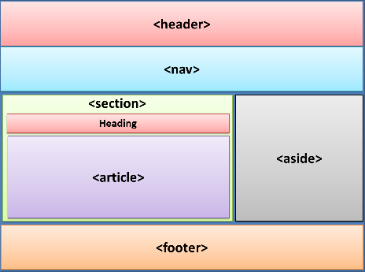
HTML Grouping and Sectioning
HTML
<header>
Header info
</header>
<nav>
Navigation links
</nav>
<section>
<h1>heading</h1>
<article>
article
</article>
</section>
<aside>
aside
</aside>
<footer>
aside
</footer>
Notes:
Tables are defined with the <table> tag.
Tables are divided into table rows with the <tr> tag.
Table rows are divided into table data with the <td> tag.
A table row can also be divided into table headings with the <th> tag.
To make a cell span more than one column, use the colspan attribute.
To add a caption to a table, use the <caption> tag.
A border can be added using the border attribute.

Slide 37
CSS Inline Styling
CSS
INLINE CSS RECAP
CSS Uses Selectors, Attributes and Values
(inline CSS goes inside the HTML tag<> with style= “attribute:value;”)
Background Color:
<html tag/selector style="background-color:black;"> changes background color for the inline HTML element
Text Color:
<html tag/selector style="color:white;"> changes text color for the inline HTML element
Notes:
Tables are defined with the <table> tag.
Tables are divided into table rows with the <tr> tag.
Table rows are divided into table data with the <td> tag.
A table row can also be divided into table headings with the <th> tag.
To make a cell span more than one column, use the colspan attribute.
To add a caption to a table, use the <caption> tag.
A border can be added using the border attribute.

Slide 38
HTML 1
Exercise 1
Notes:
If you haven’t already done so, sign up on codecademy and start working the HTML & CSS track. http://www.codecademy.com/tracks/web

Slide 39
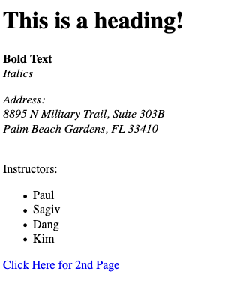
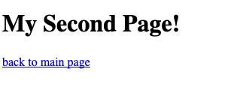
HTML Exercise 1
HTML
1- Create a web page that looks like this name it (formatting.html) save the file in the public_html/class-samples/ folder:
2- Create a web page that looks like the “My Second Page” name it (formatting2.html) save the file in the public_html/class-samples/ folder:
Page 1
Page 2

Slide 40
HTML 1
Exercise 2
Notes:
If you haven’t already done so, sign up on codecademy and start working the HTML & CSS track. http://www.codecademy.com/tracks/web

Slide 41
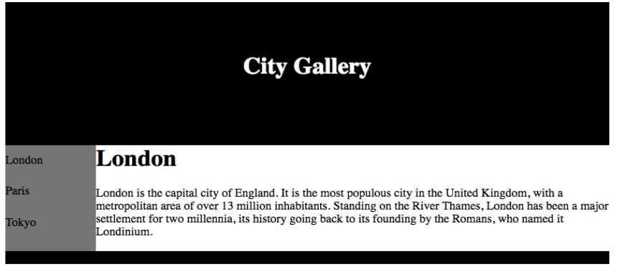
HTML Exercise 2
HTML
Create the City Gallery web page with tables so that it looks like this and uses the text sent in your email: (use inline css styling for the colors) Upload the page to the webserver public_html/class-samples/city.html

Slide 42
HTML 1
Exercise 3 (Time Permitting)
Notes:
If you haven’t already done so, sign up on codecademy and start working the HTML & CSS track. http://www.codecademy.com/tracks/web

Slide 43
HTML 5 Exercise 3
HTML 5
Create a portfolio structure web page using HTML 5 semantic grouping (header, footer, nav, section, article, aside) so that it looks like the slide and uses the text/images sent in your email name it (index.html): Save the page to public_html folder
Group the items for the page based on their content type (header, nav, etc.)
Save the images to public_html/images
Upload the page to the web server public_html/index.html

Slide 44
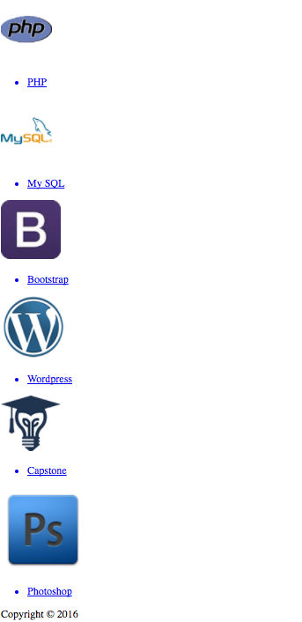
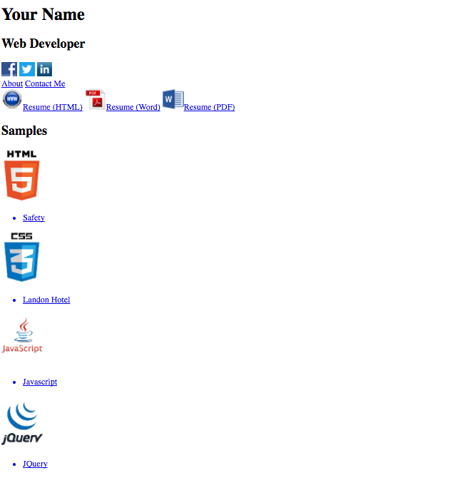
HTML 5 Exercise
Top Half of Page
Bottom half of Page

Slide 45
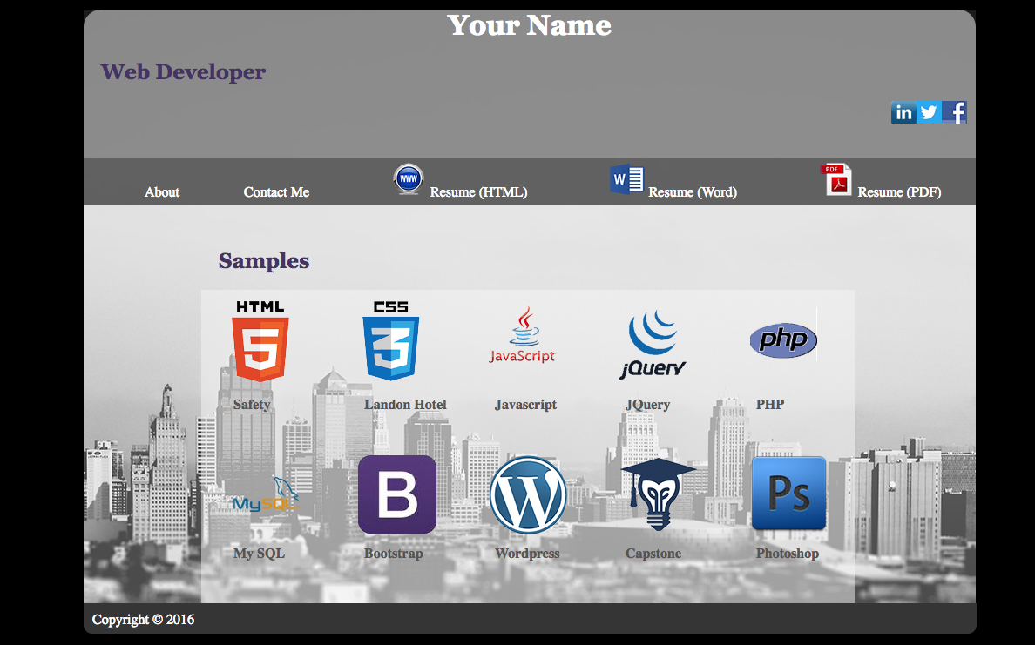
Homework
Final Result Will be completed after CSS3 Class

Slide 46
Homework
Homework
If you have not already done so: Finish Fitness in class exercise and upload to the web server in public_html/class-projects/photoshop directory (Send Instructor the link)
i.e http://pbcs.us/~firstinitallastname/class-projects/photoshop
Finish in-class exercises for Formatting, City Gallery, and Portfolio Page and upload them to the web server
3. HTML Basics [183 min] https://teamtreehouse.com/library/html-basics-2
Introduction to HTML and CSS [134 min] https://teamtreehouse.com/library/introduction-to-html-and-css

Slide 47
End
Notes:
If you haven’t already done so, sign up on codecademy and start working the HTML & CSS track. http://www.codecademy.com/tracks/web

