Slide 1
Platforms
Six Part Series (1a of 6)

Slide 2
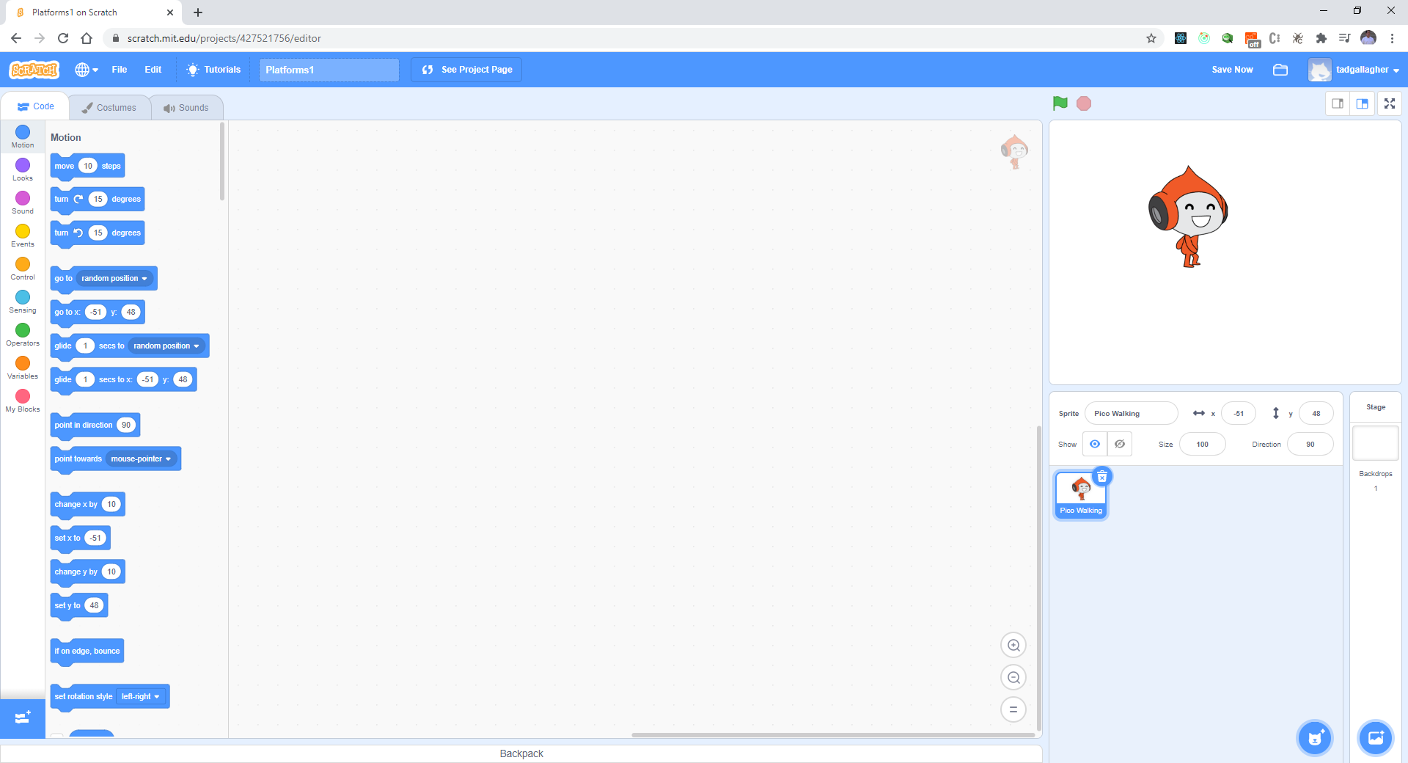
Pick a new Sprite (Pico), Delete Scratchy

Slide 4
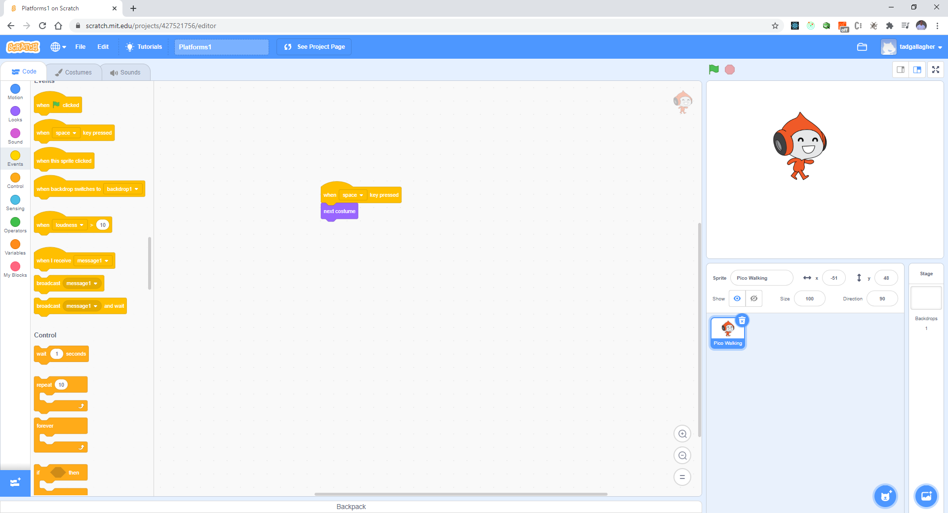
For testing – Create a Walk Cycle Test your work – space bar

Slide 5
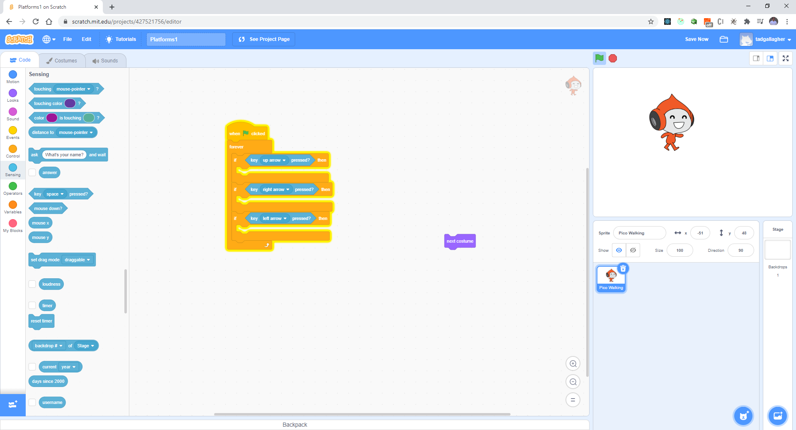
Let’s make this better with a loop

Slide 6
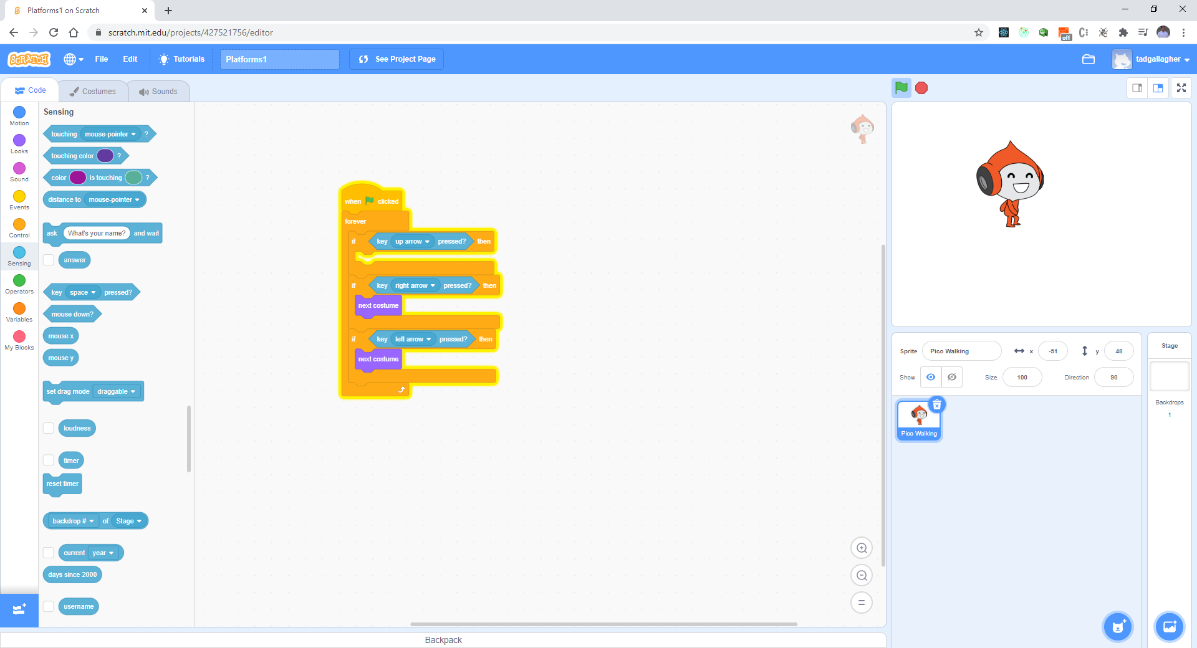
Add functionality below

Slide 7
Test your work
Press the left arrow – what happens?
Press the right arrow – what happens?

Slide 8
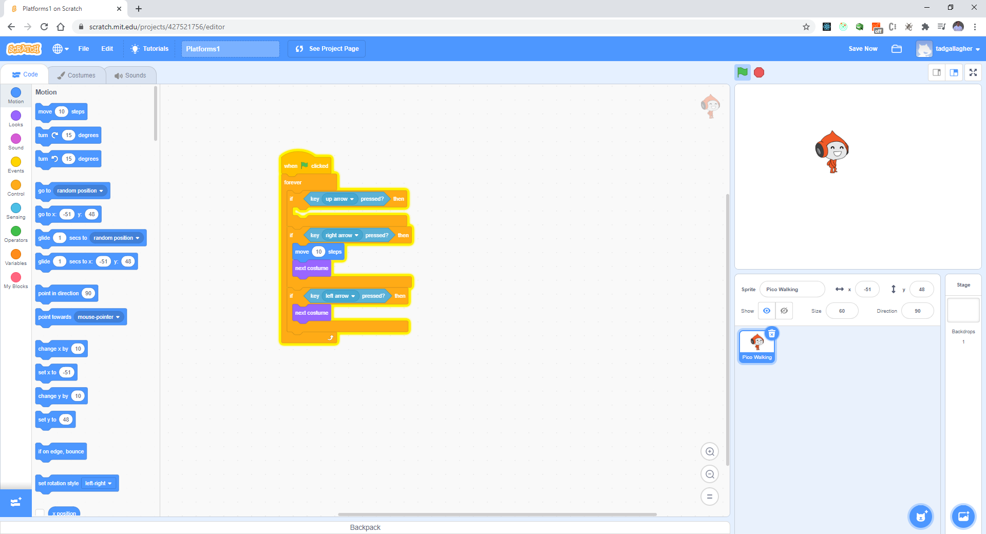
We want to do more, we need steps

Slide 9
Make Pico smaller – 60%

Slide 10
Test your work
What happens when you press the right arrow?
Does Pico move 10 steps?

Slide 11
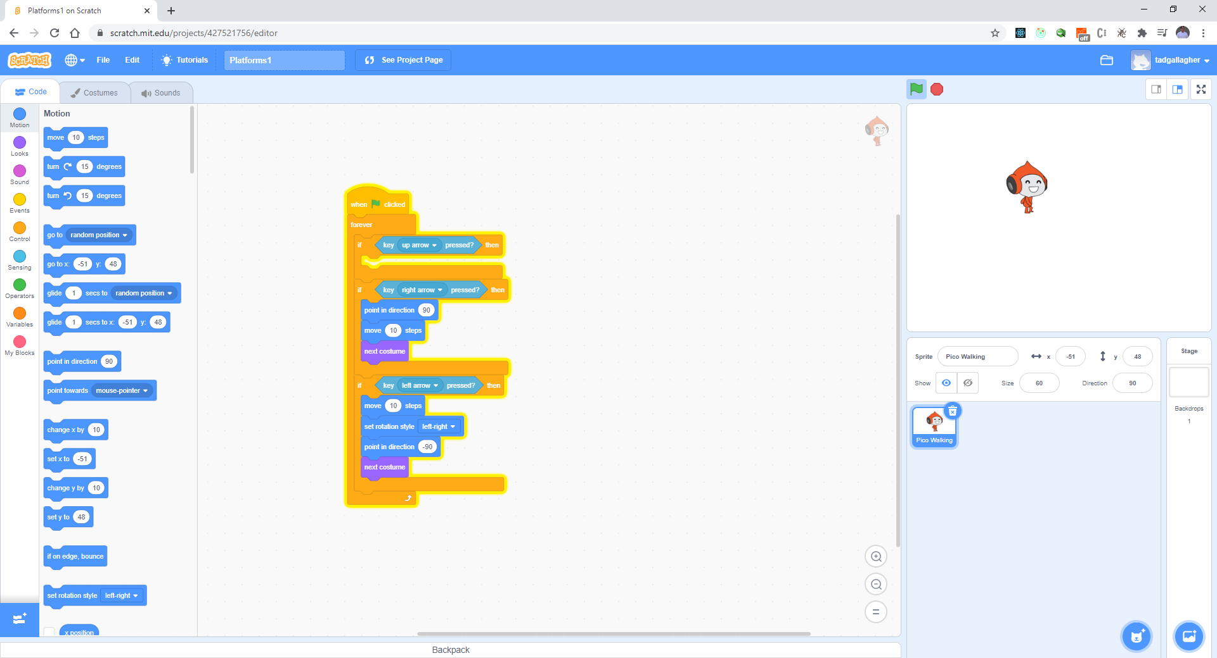
Now for the left arrow

Slide 12
Test your work
Press the left arrow – what happens?
Press the right arrow – what happens?
He should move smoothly.

Slide 13
Now for the up arrow?
Why should it go up?
We need to keep track of where Pico is – this is the ground level.

Slide 14
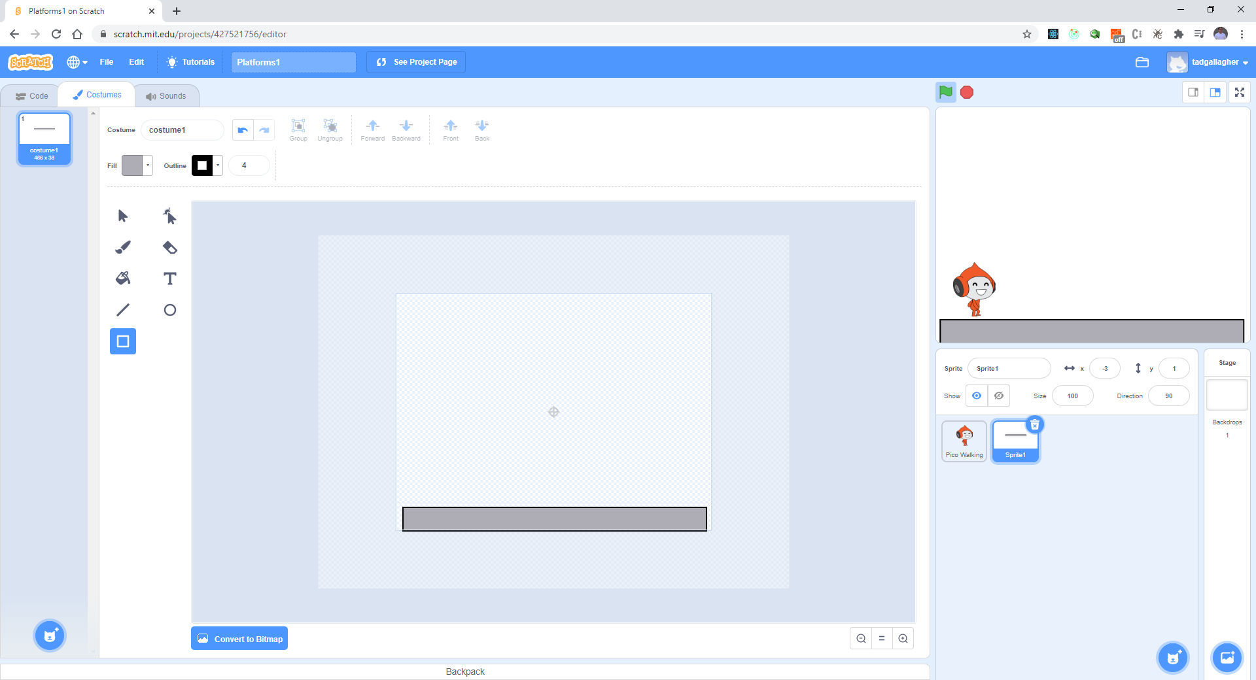
Make a ground level – new Sprite

Slide 15
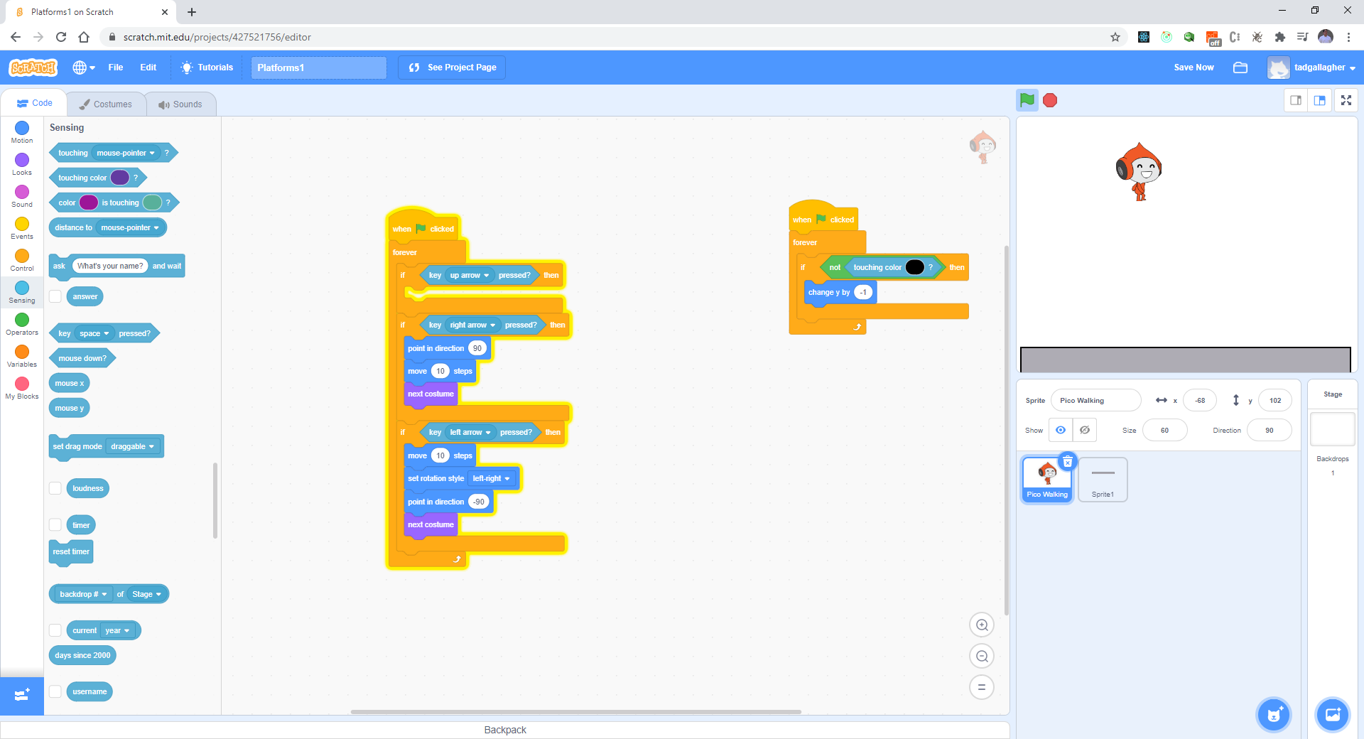
Next - Keep track of touching the ground

