Slide 1
Platforms
Six Part Series (1b of 6)

Slide 2
Test your code – Move Pico to top and test
Pico should stop when he hits ground level.
Retest right and left arrows also.

Slide 3
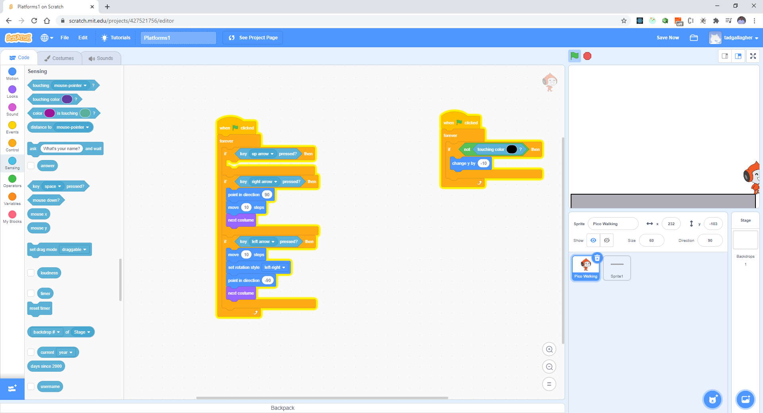
Change to -10 to speed up

Slide 4
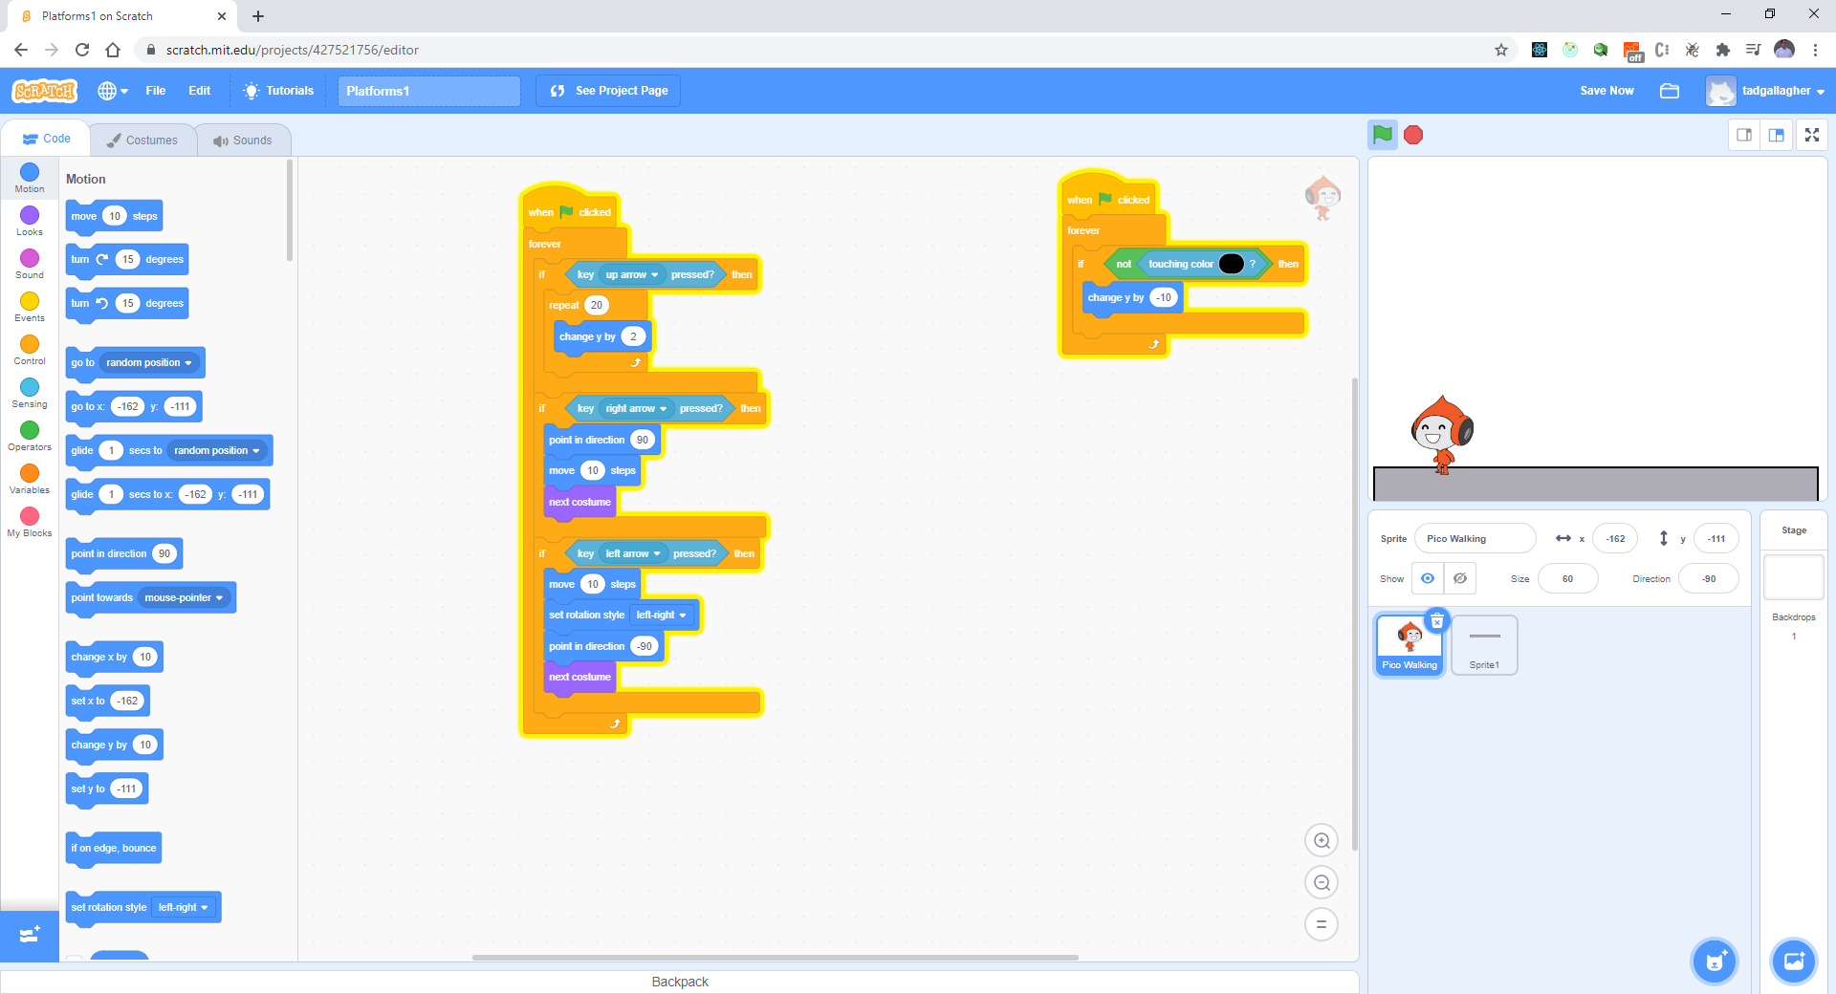
Finish the Up Button

Slide 5
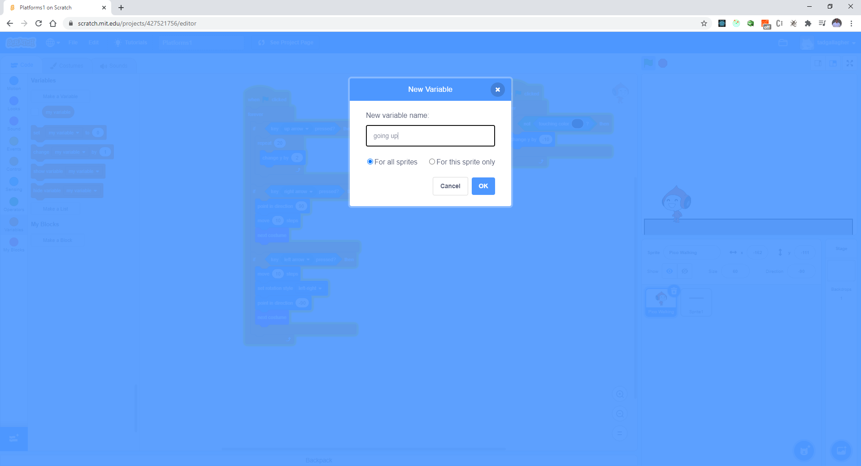
Let fix up the up arrow – add a variable

Slide 6
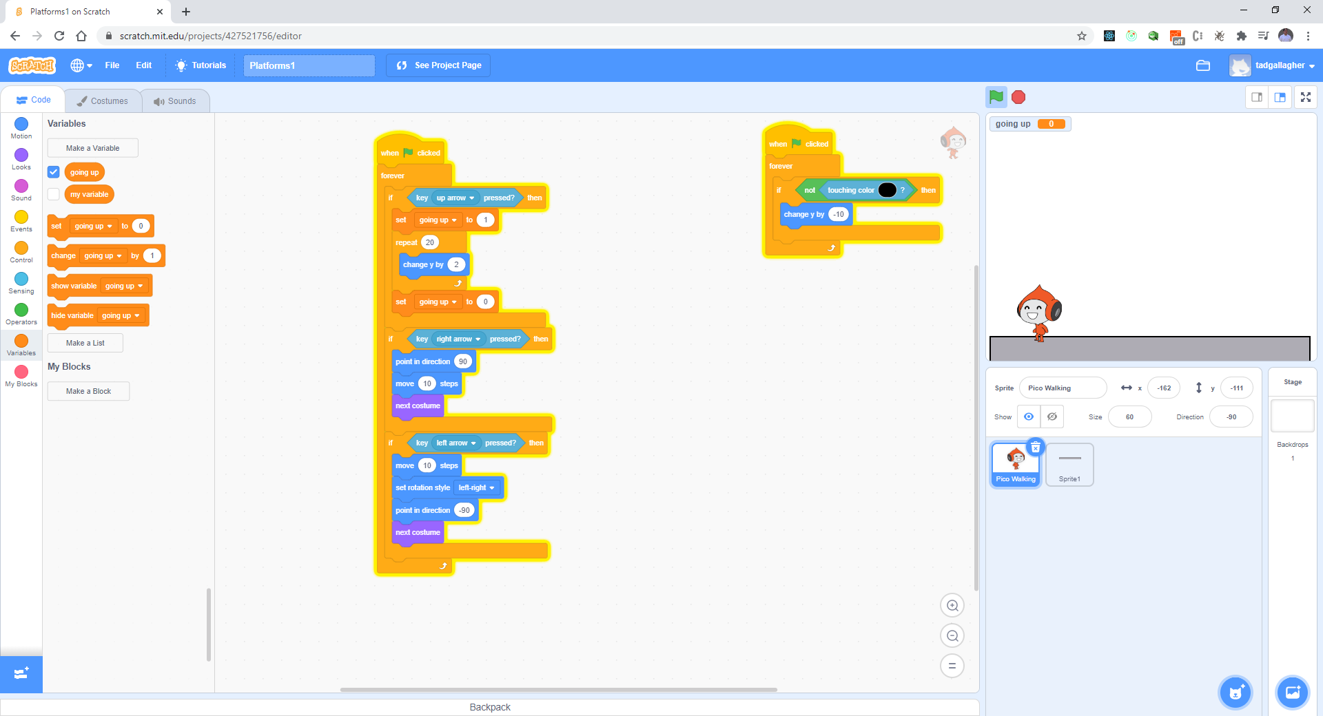
Initialize and Set

Slide 7
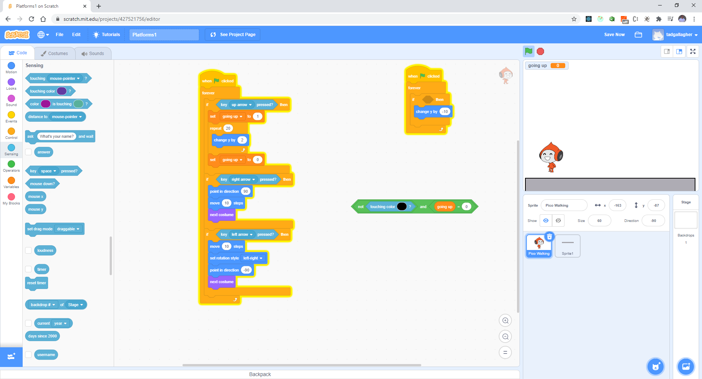
Update as follows:

Slide 8
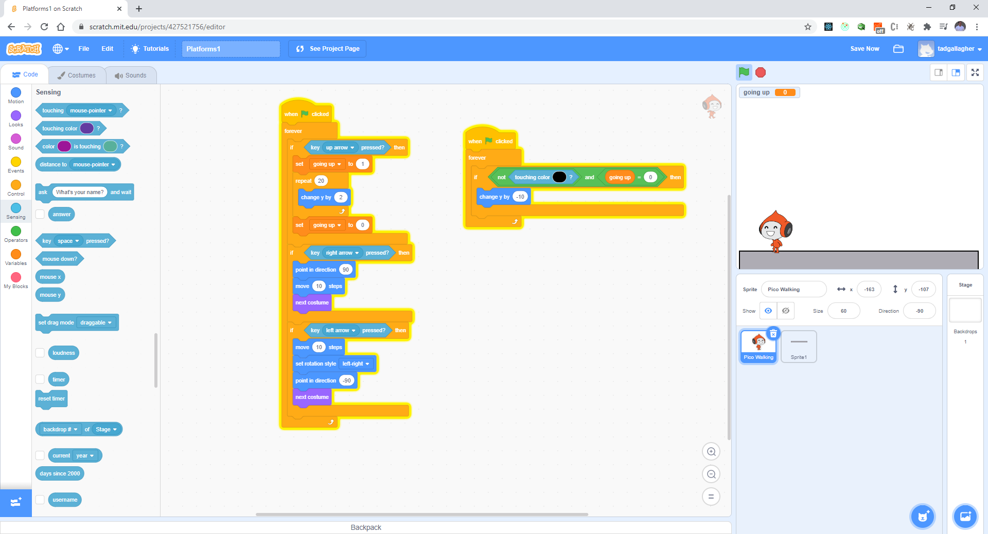
Completed code looks as follows:

Slide 9
Test your code
Pico should stop when he hits ground level.
Retest right and left arrows also.

Slide 10
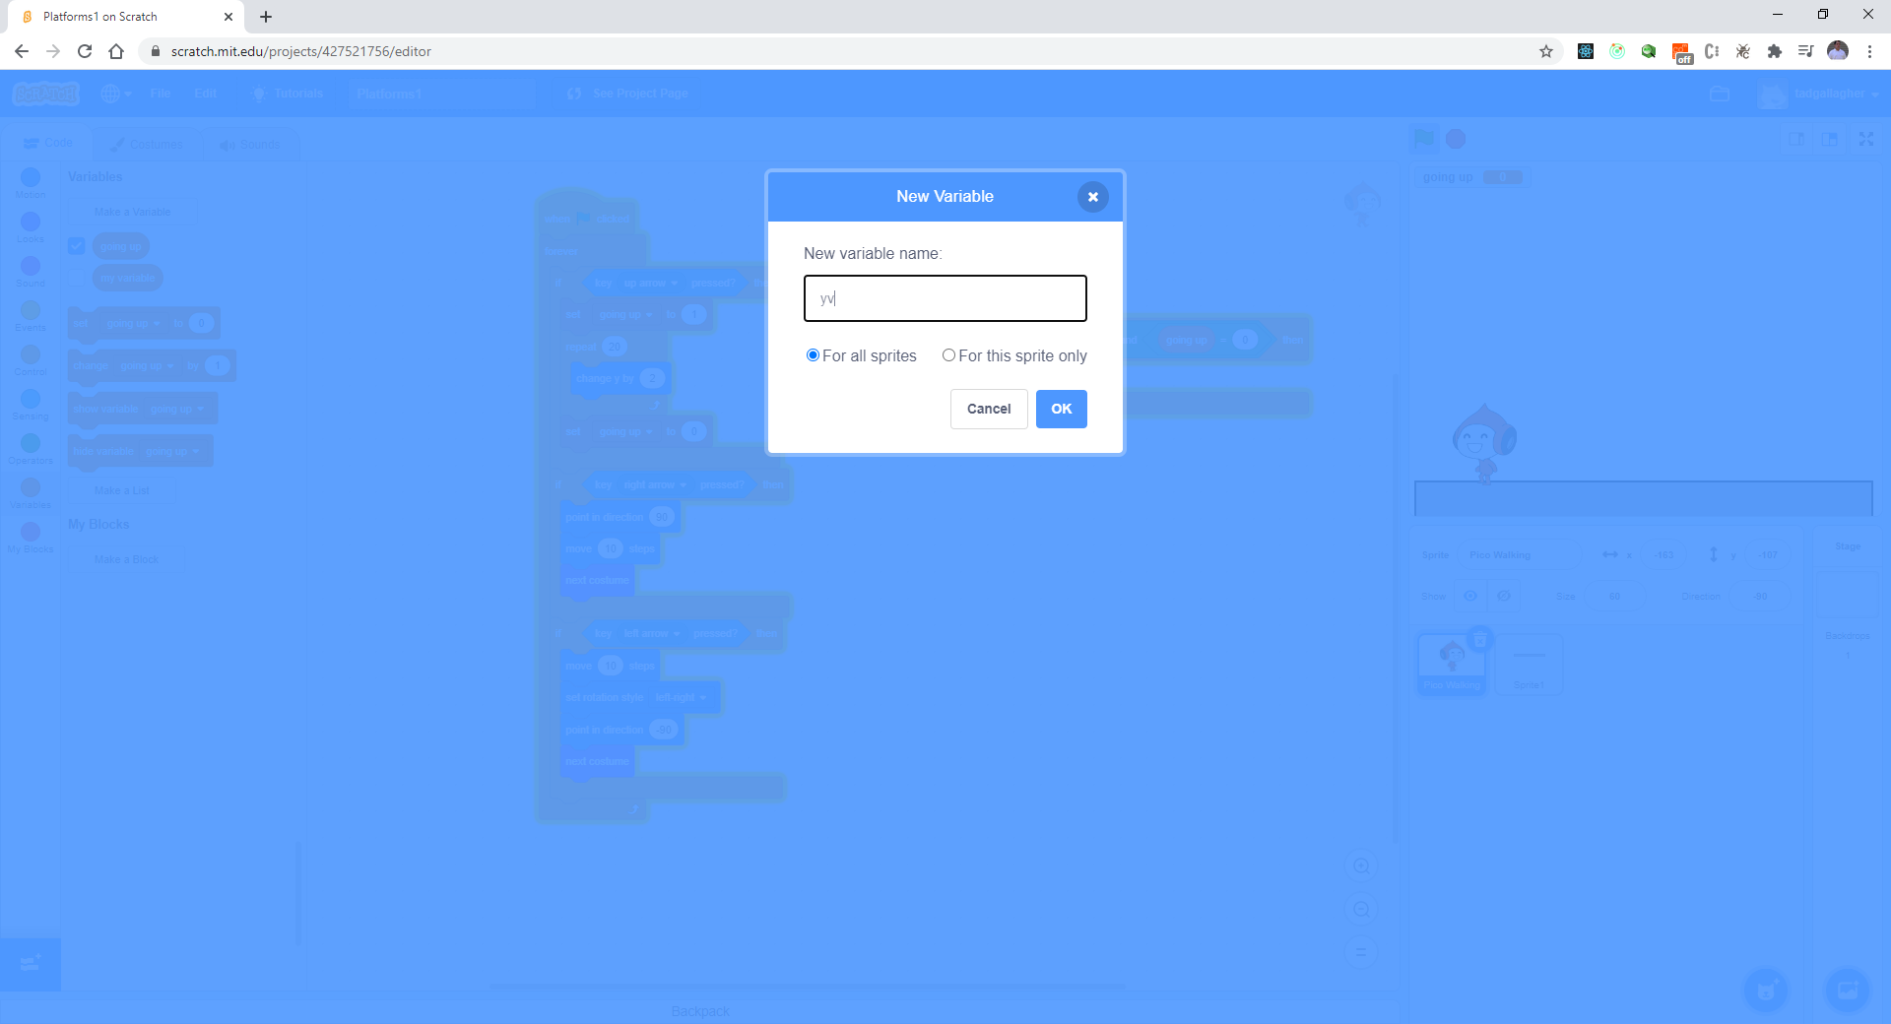
Let’s fix the velocity, so the jump improves Create a variable

Slide 11
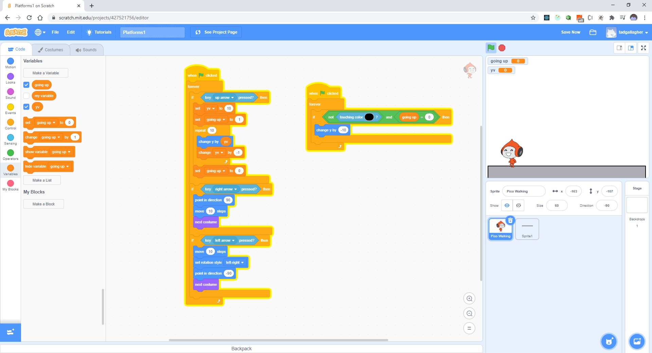
Initialize YV and few changes

Slide 12
Retest your UP Arrow
How does the movement look?

Slide 13
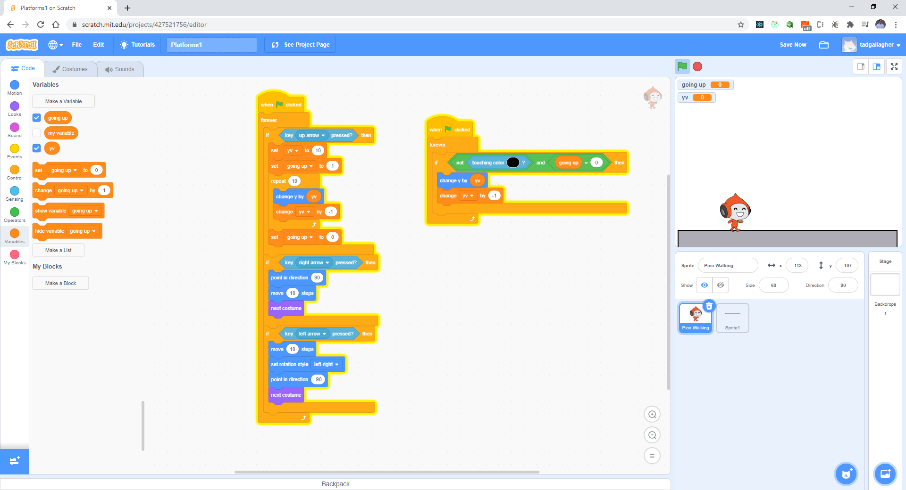
Few more changes

Slide 14
Test your code again
Verify all keys

Slide 15
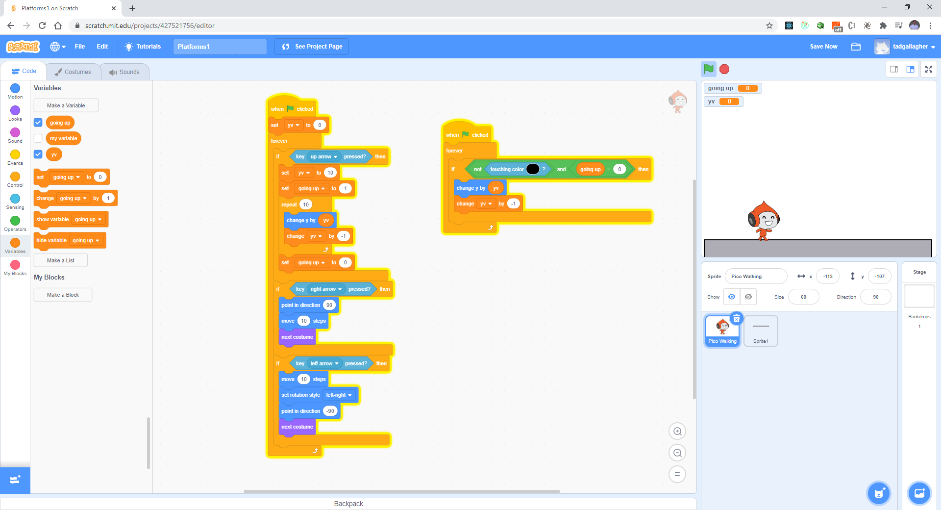
One bug – need to initialize YV to 10 on start

Slide 16
Test the movement
Any problems?

