Slide 1
Platforms
Six Part Series (2 of 6)

Slide 2
We should only allow 1 jump – let’s fix this
Also need to move properly when in air.
Let’s solve these problems.

Slide 3
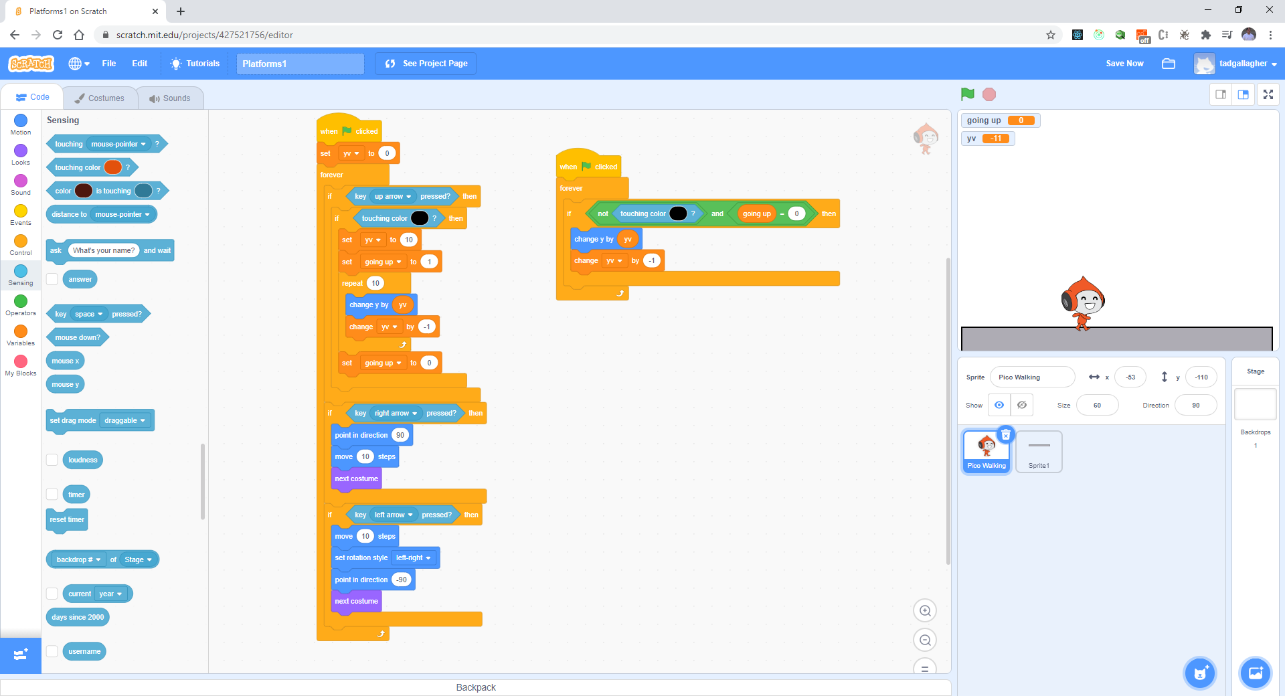
Limit Jumping – How is the issue happening?

Slide 4
Test your work
Does it jump multiple now?

Slide 5
Let’s fix the next problem – Moving in air
Where does the movement happen in the code?

Slide 6
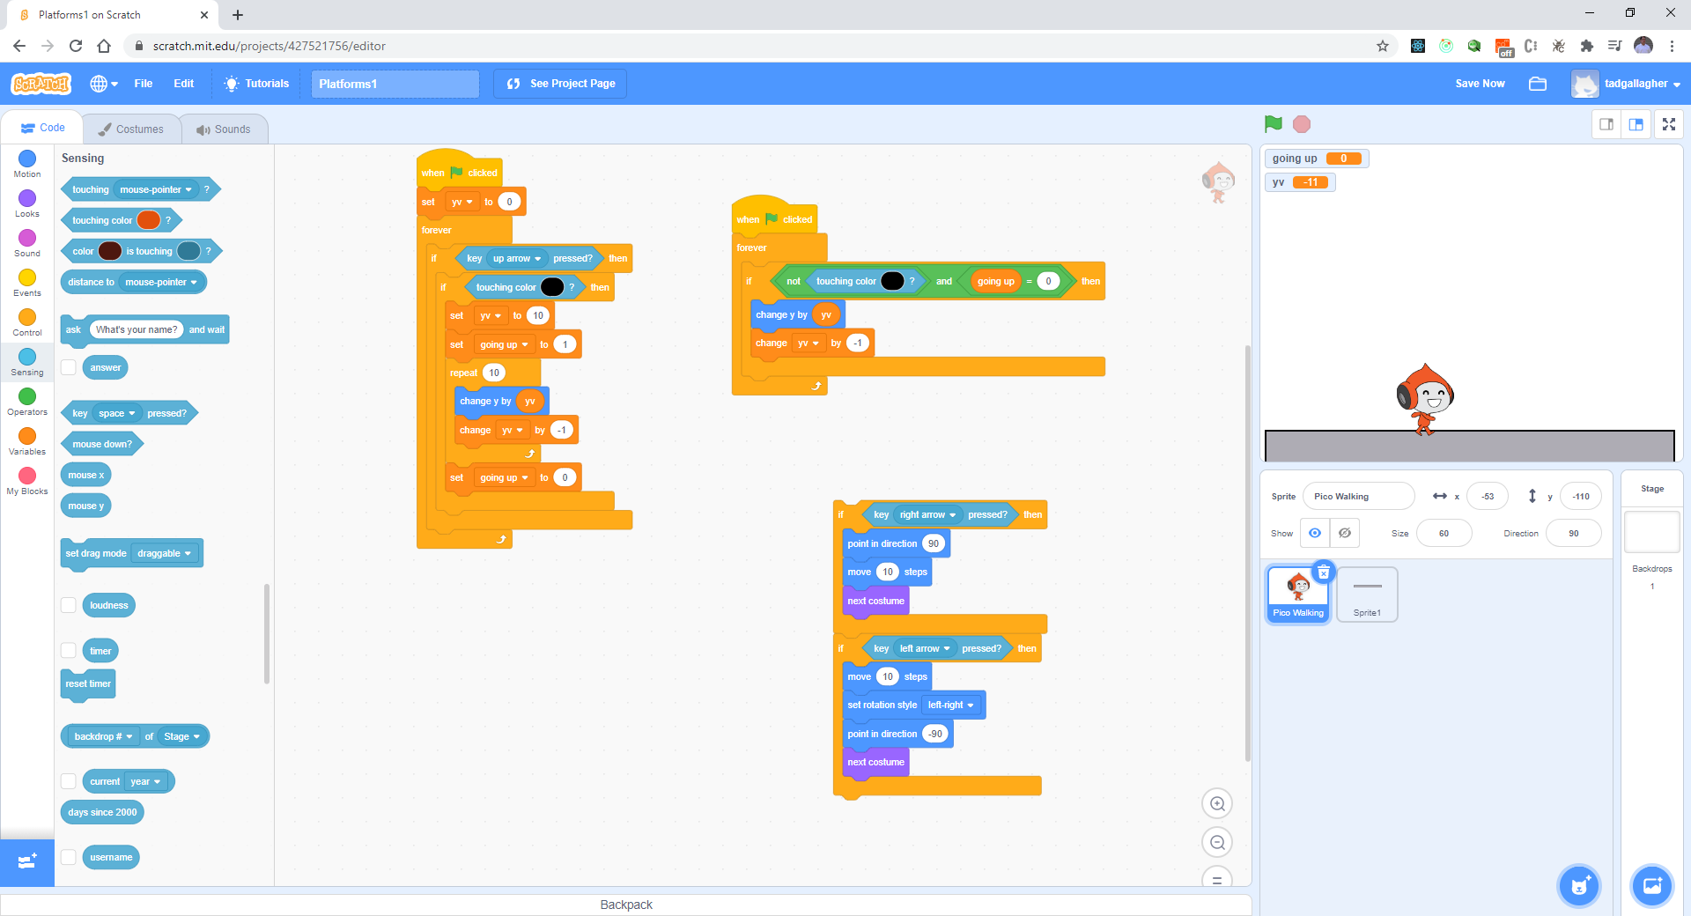
Let’s separate the movement

Slide 7
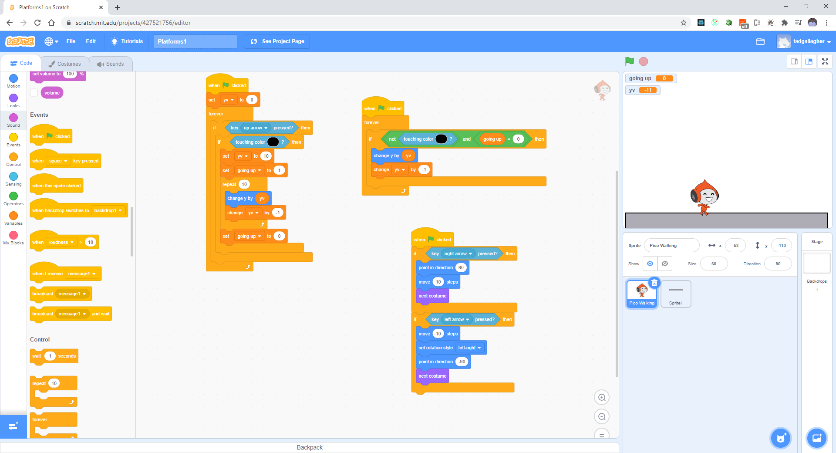
Kick it off with an Green Flag and Test

Slide 8

Let’s make the Jump Higher – 15, 10

Slide 9
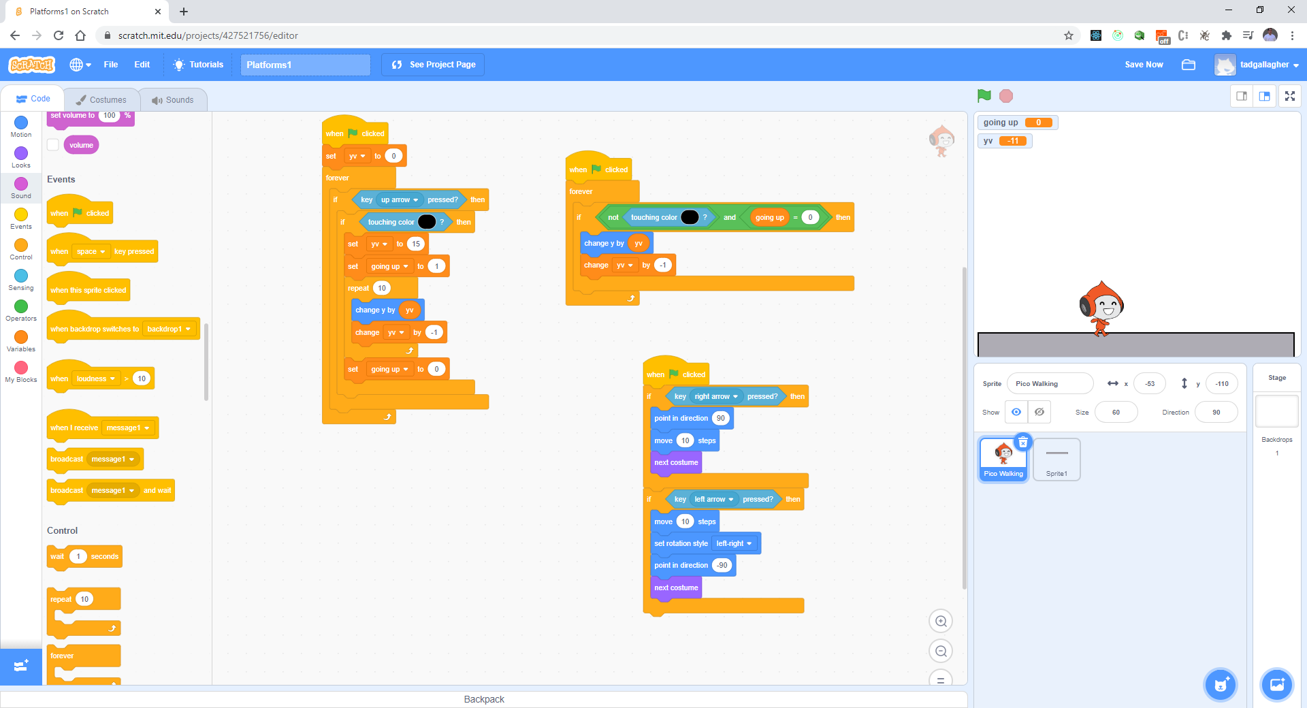
Should look like this:

Slide 10
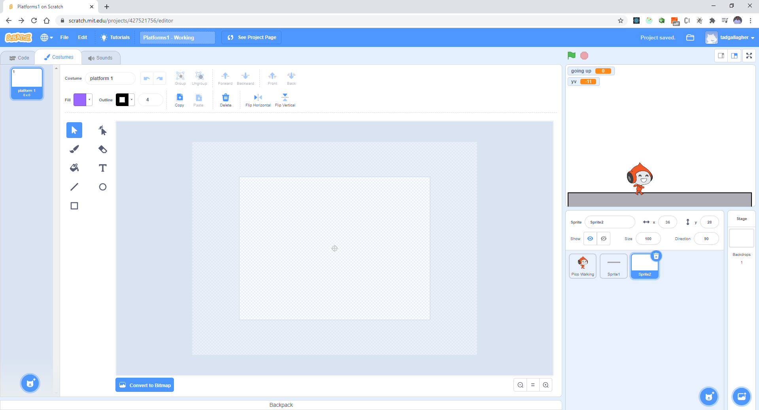
Let’s create several platforms in one Sprite

Slide 11
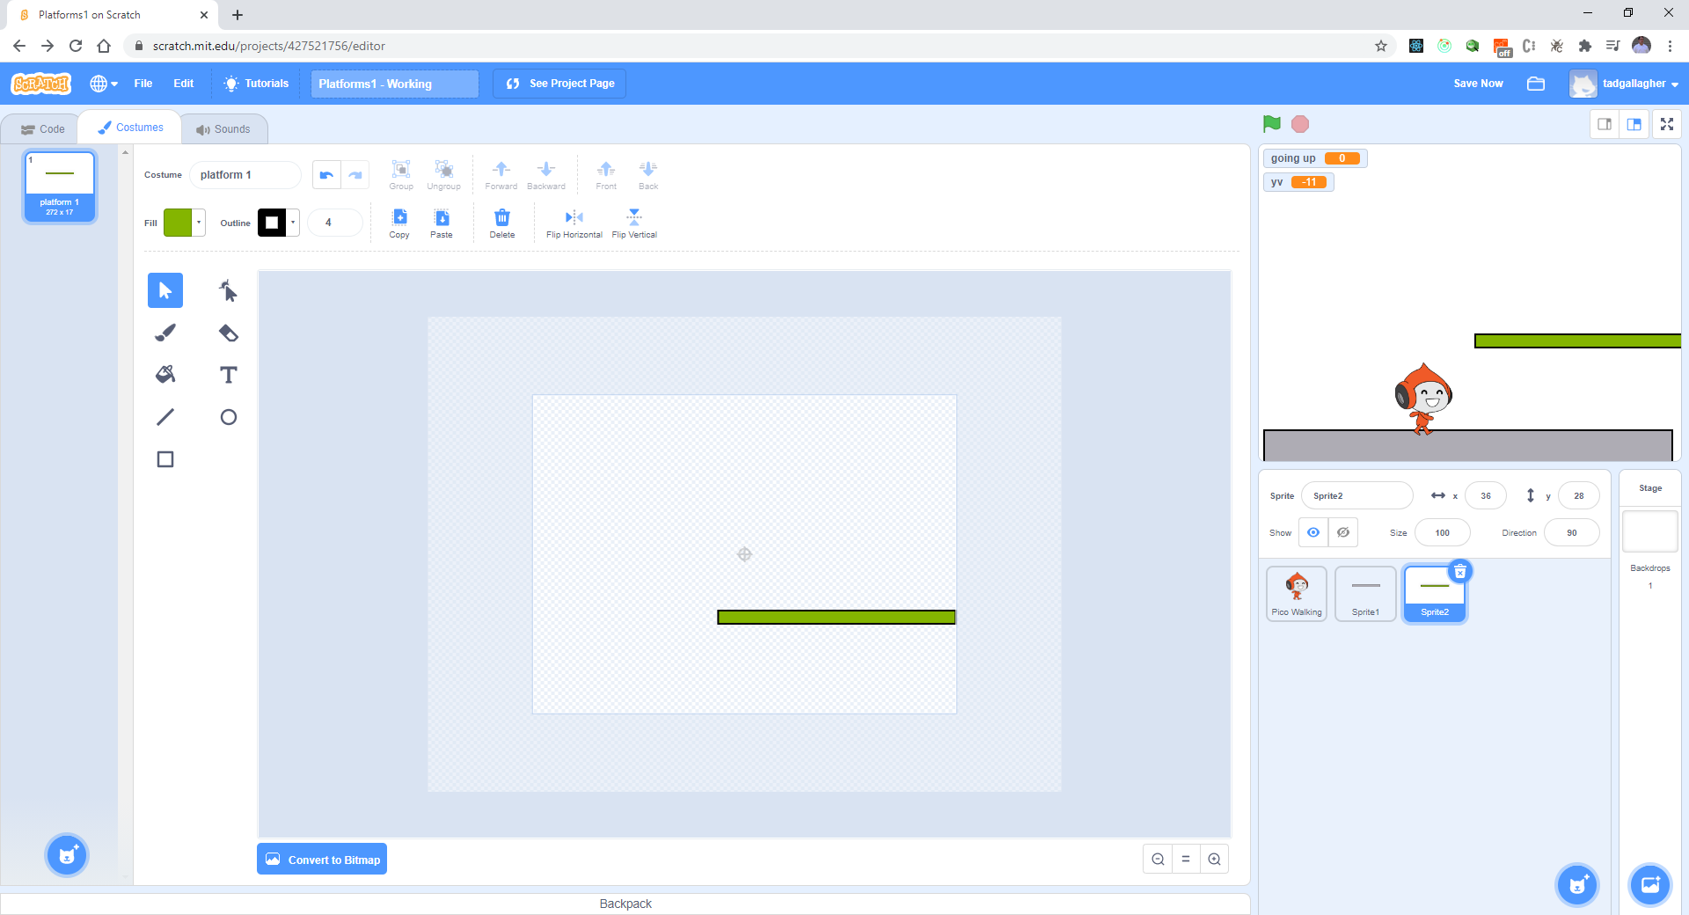
Copy Sprite1, paste to new Sprite, change color

Slide 12
Test your code
Try to jump to the platform.
What happens – it should be working.
Ut Oh – is it missing the platform a little?

Slide 13
Test your code
Try to jump to the platform.
What happens – it should be working.
How’s the 2nd platform working?

Slide 14
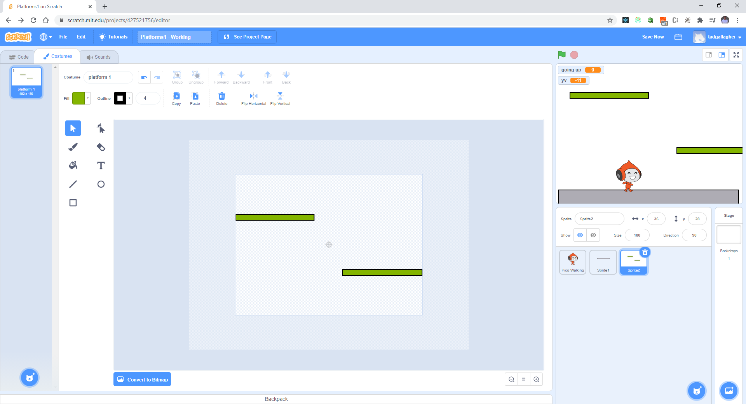
Copy the Platform. Should look like this:

Slide 15
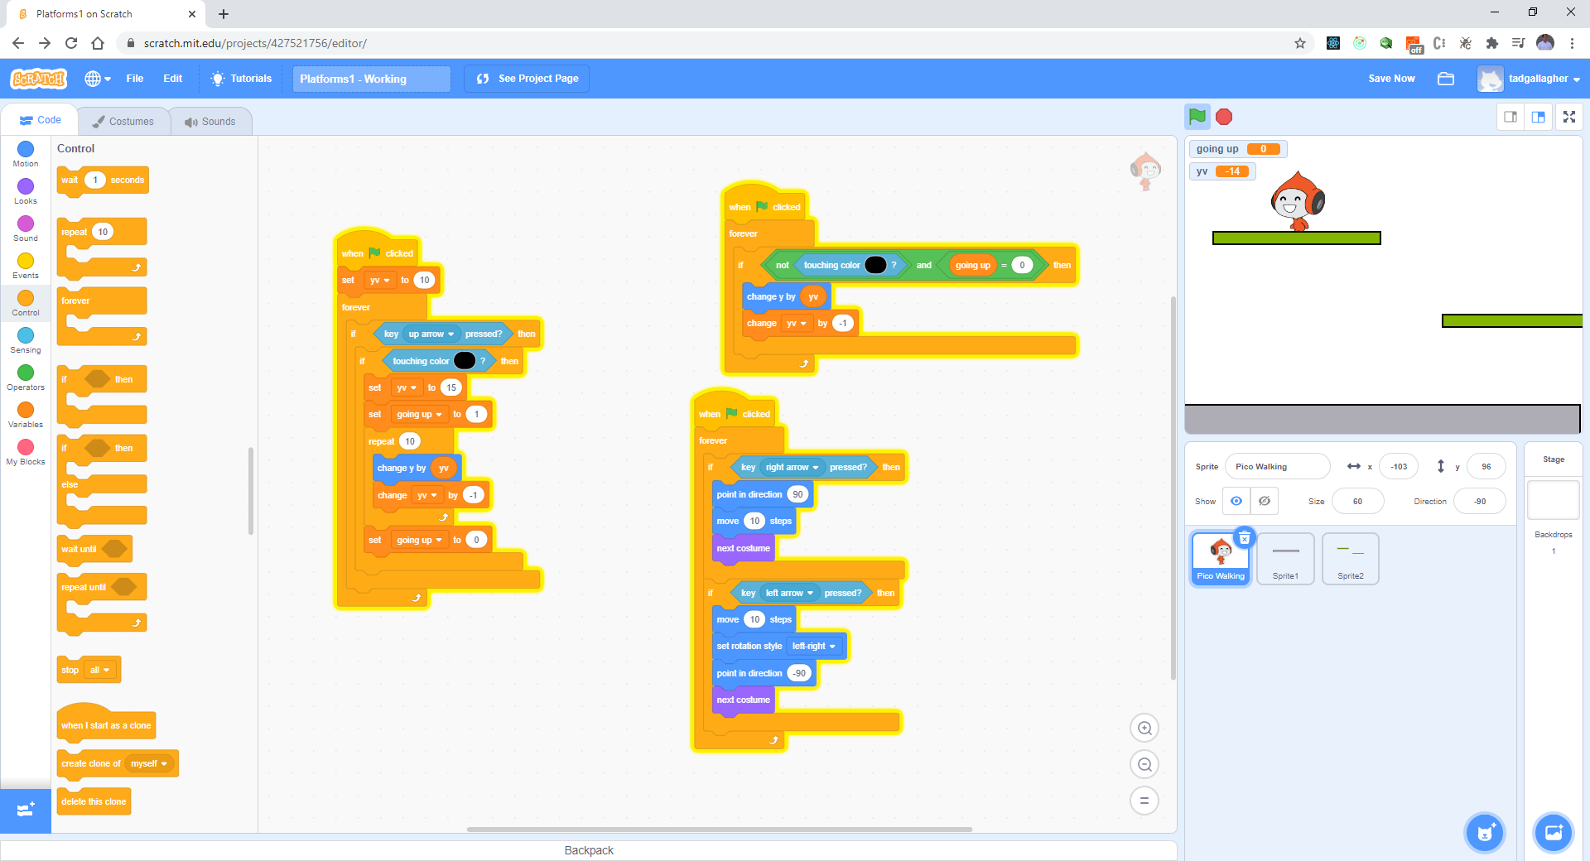
Couple things we forgot – loop and set yv

Slide 16
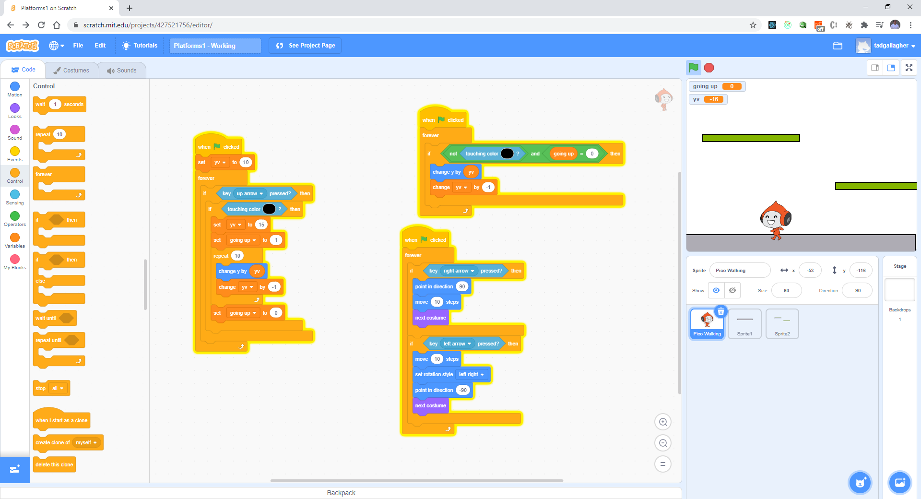
Problem – can’t jump thru platform

Slide 17
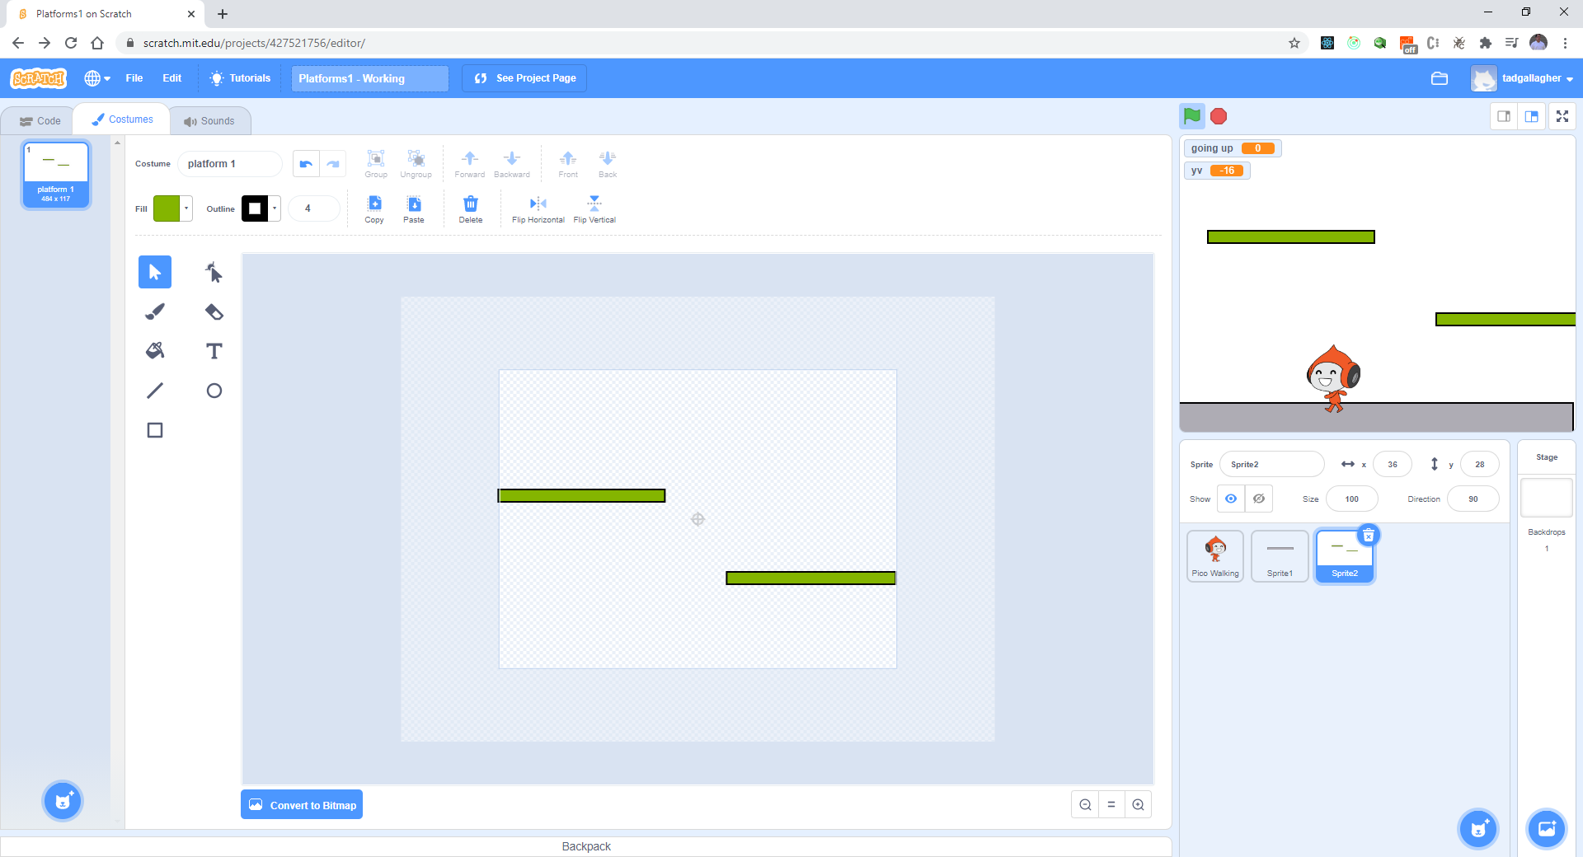
Convert to BitMap

Slide 18
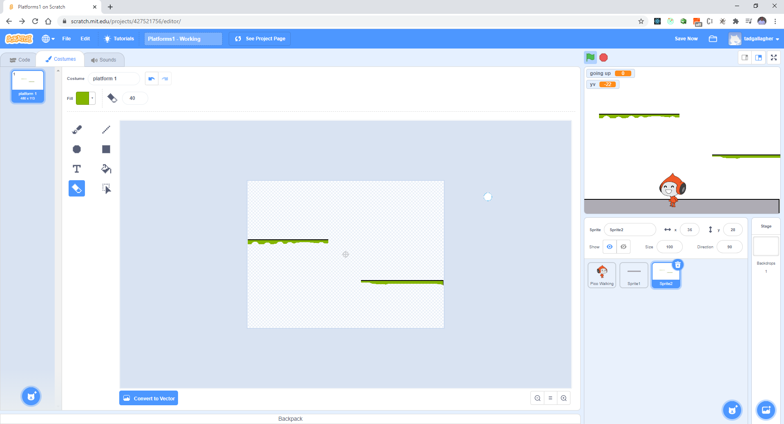
Erase black edge on side and bottom

