Slide 1
Snake Game

Slide 2
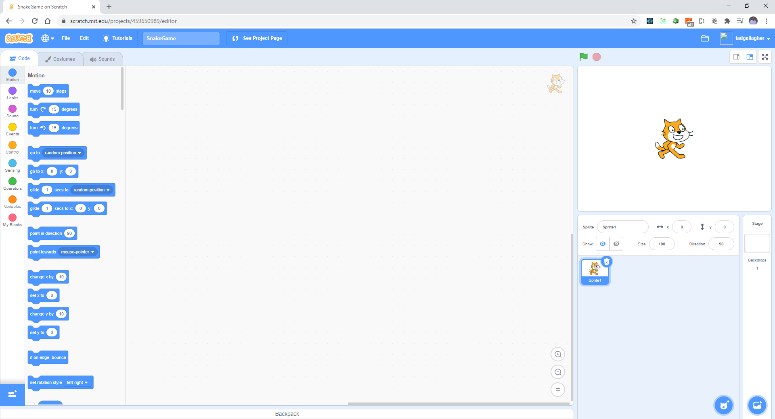
Create a new Game - SnakeGame

Slide 3
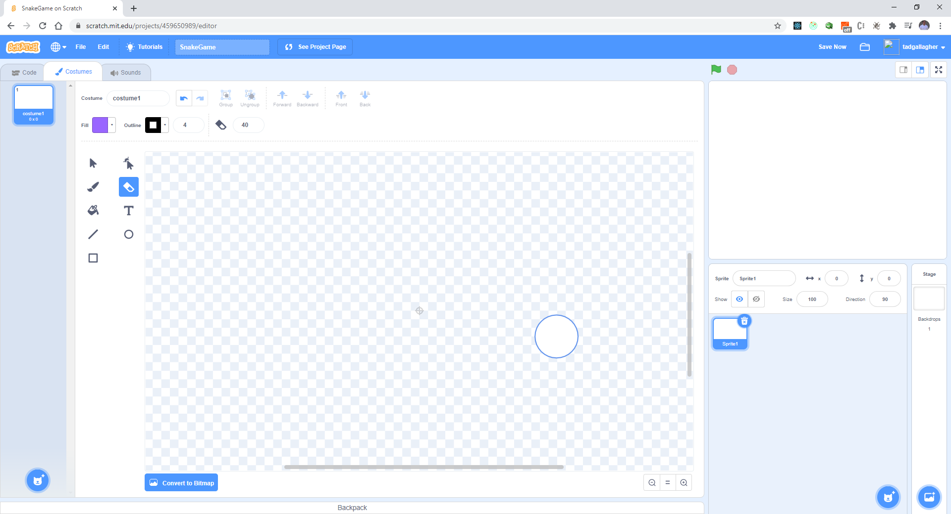
Erase Scratchy

Slide 4
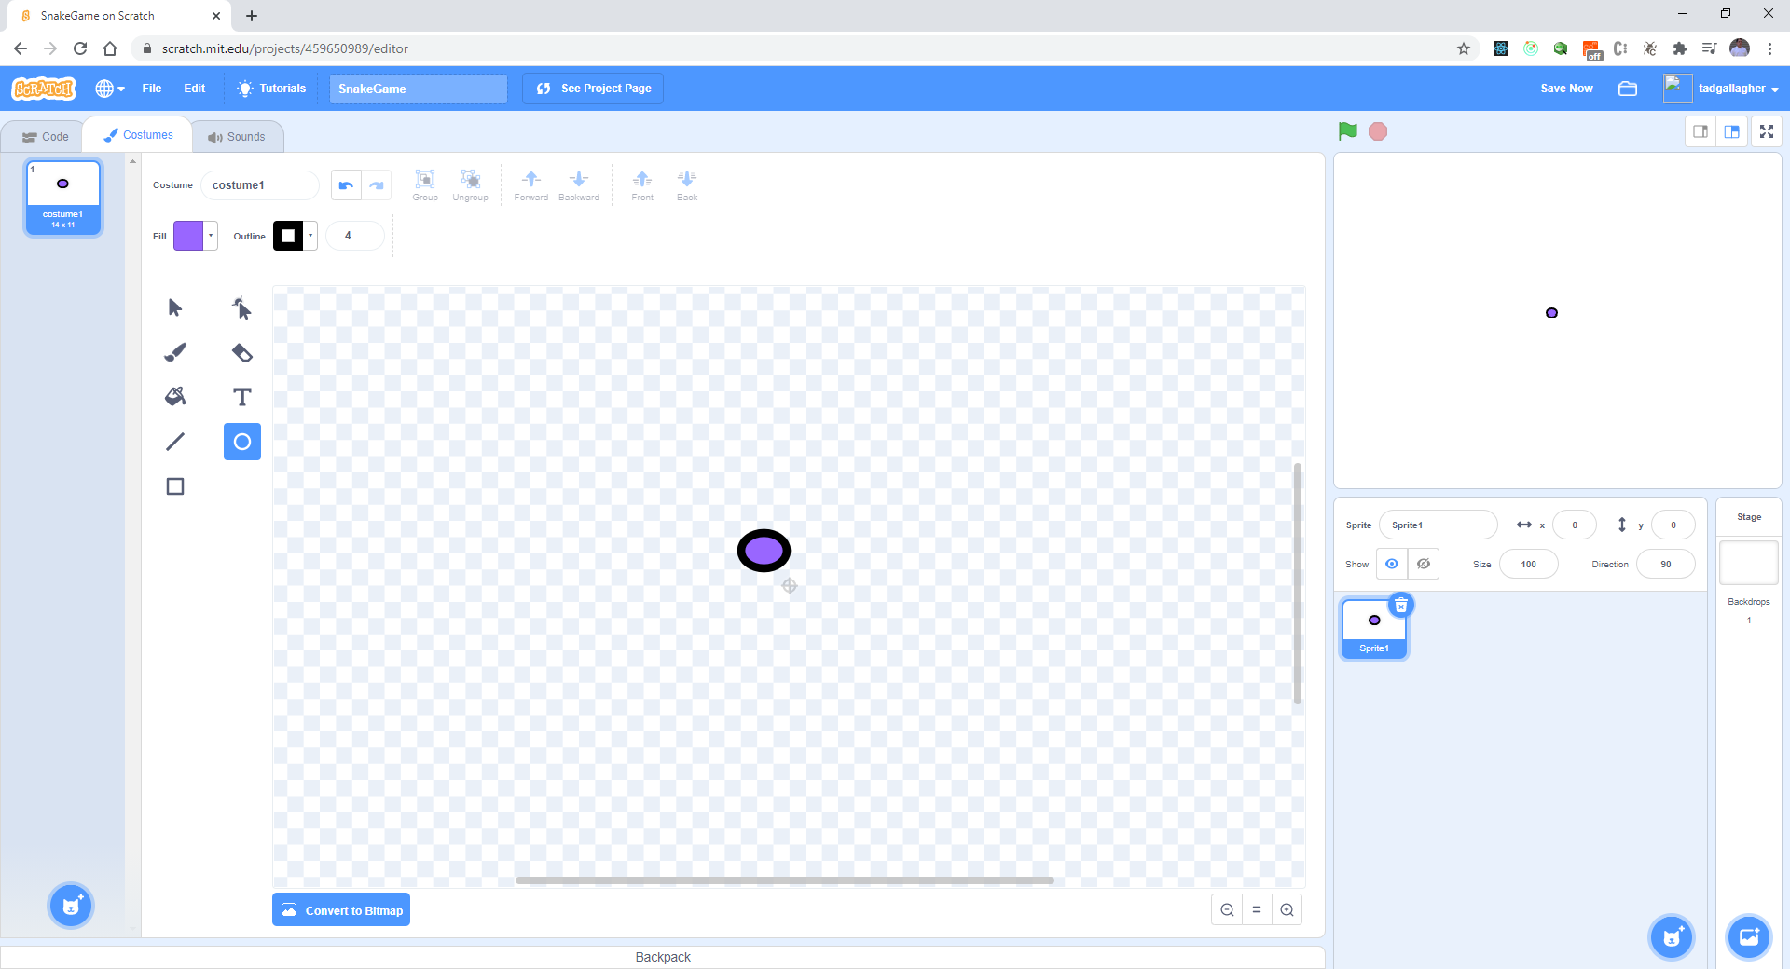
Create a little purple circle

Slide 5
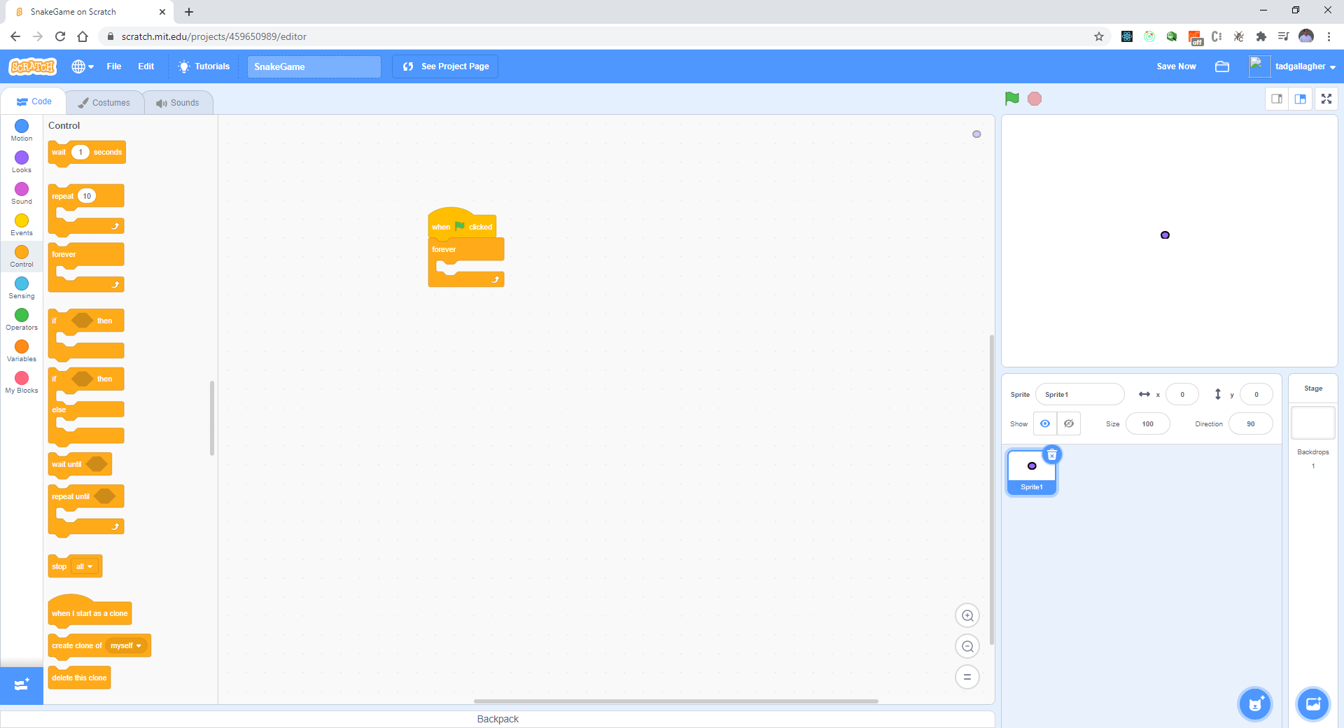
Snake needs to move – Up, Right, Left, Right (just by pressing once)

Slide 6
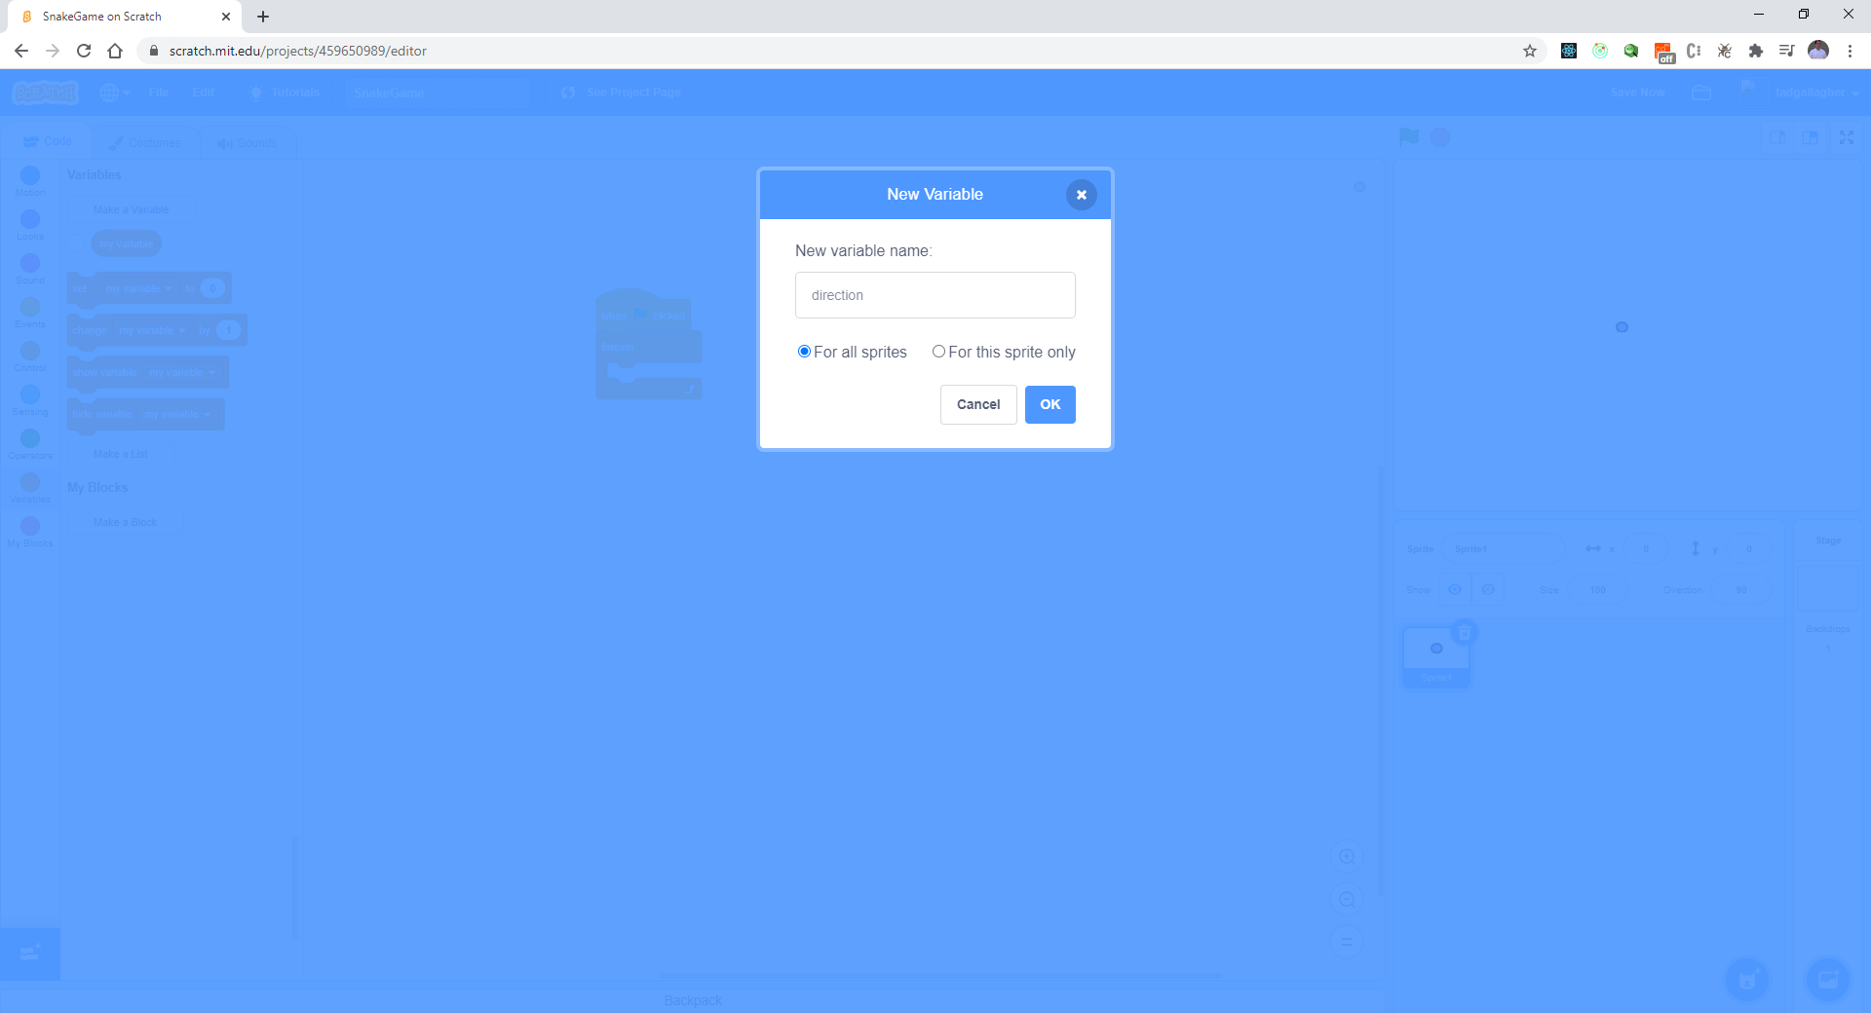
Create a direction variable

Slide 7
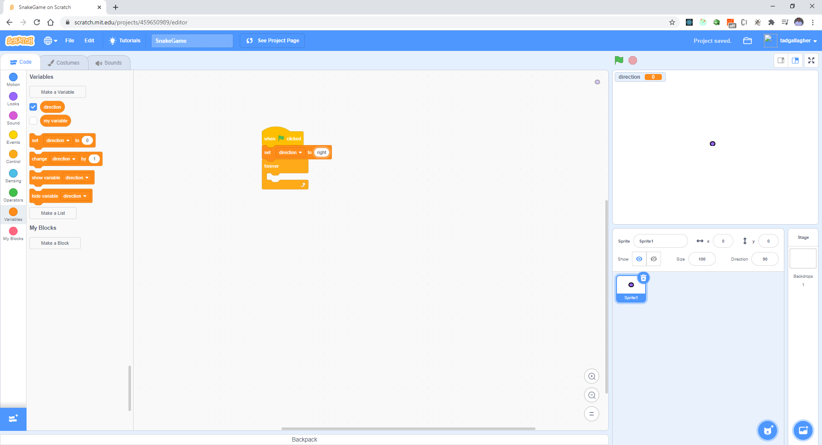
Initialize “direction” to right in the beginning

Slide 8
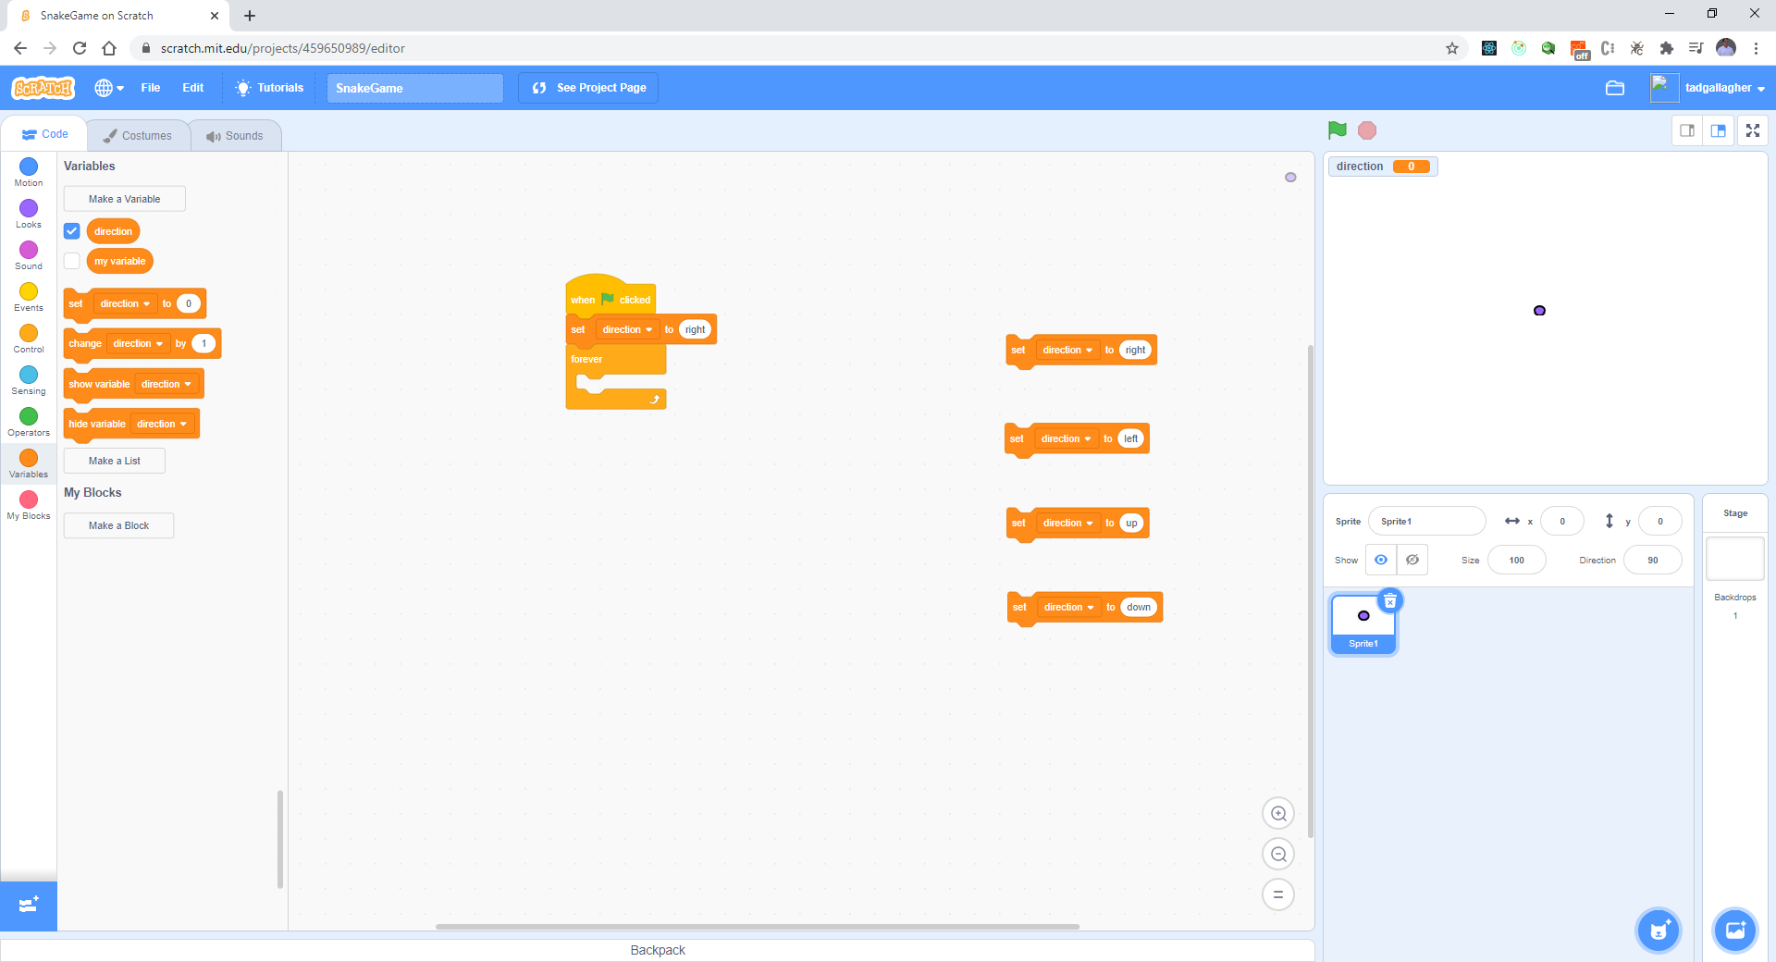
Let’s set the other direction values

Slide 9
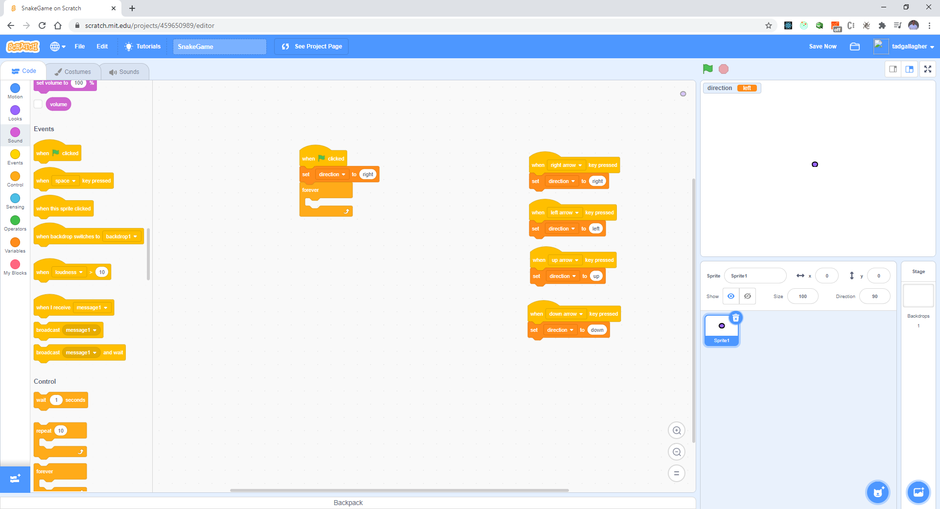
Add the events for directions

Slide 10
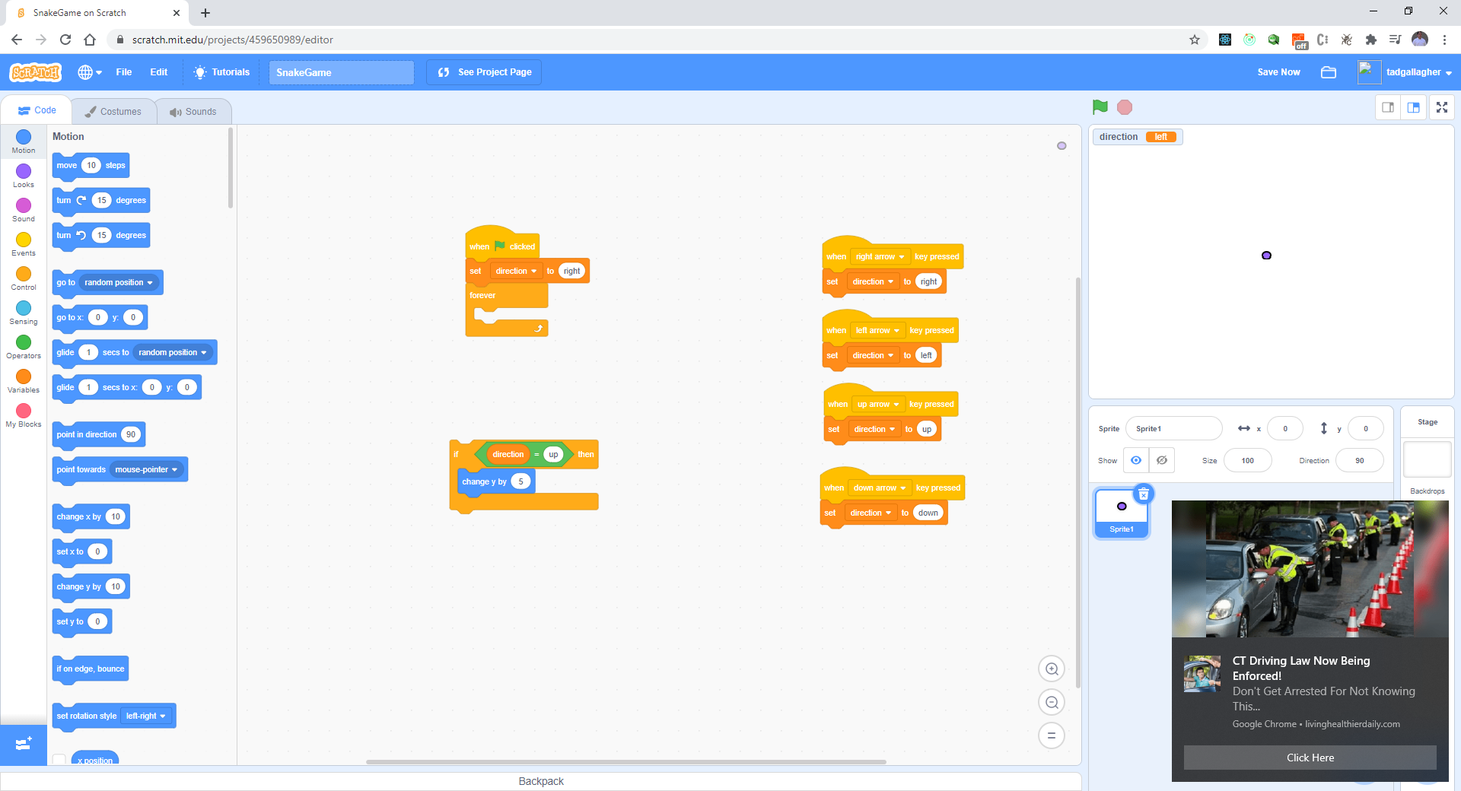
Check for key press (do all 4)

Slide 11
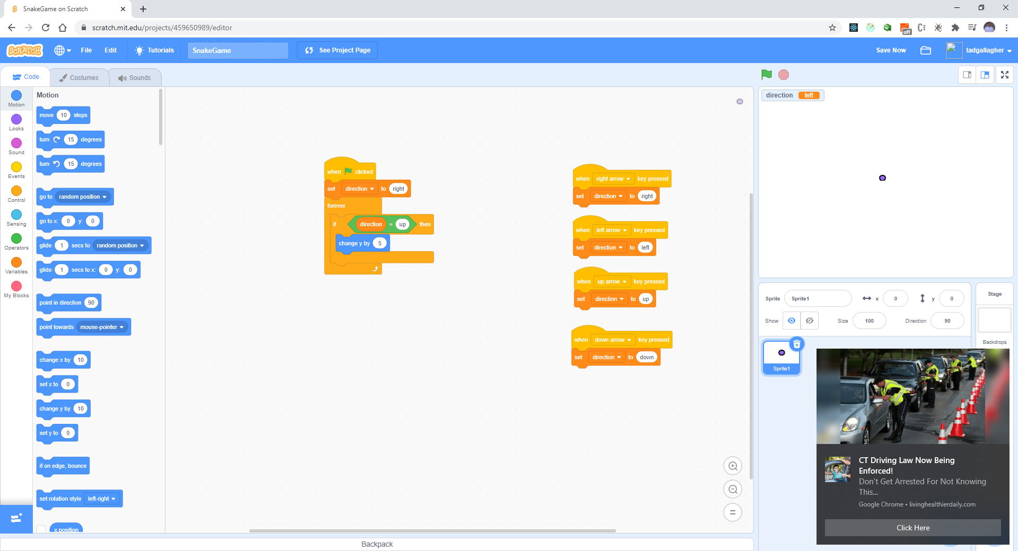
Add to Loop

Slide 12
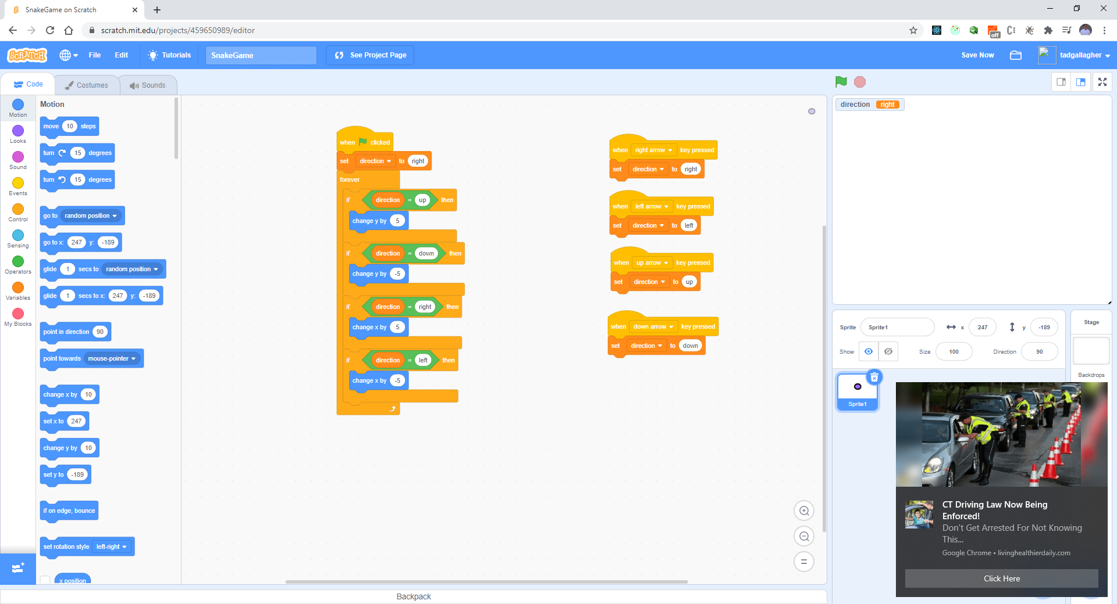
Do condition for all 3 others (right, left, down)

Slide 13
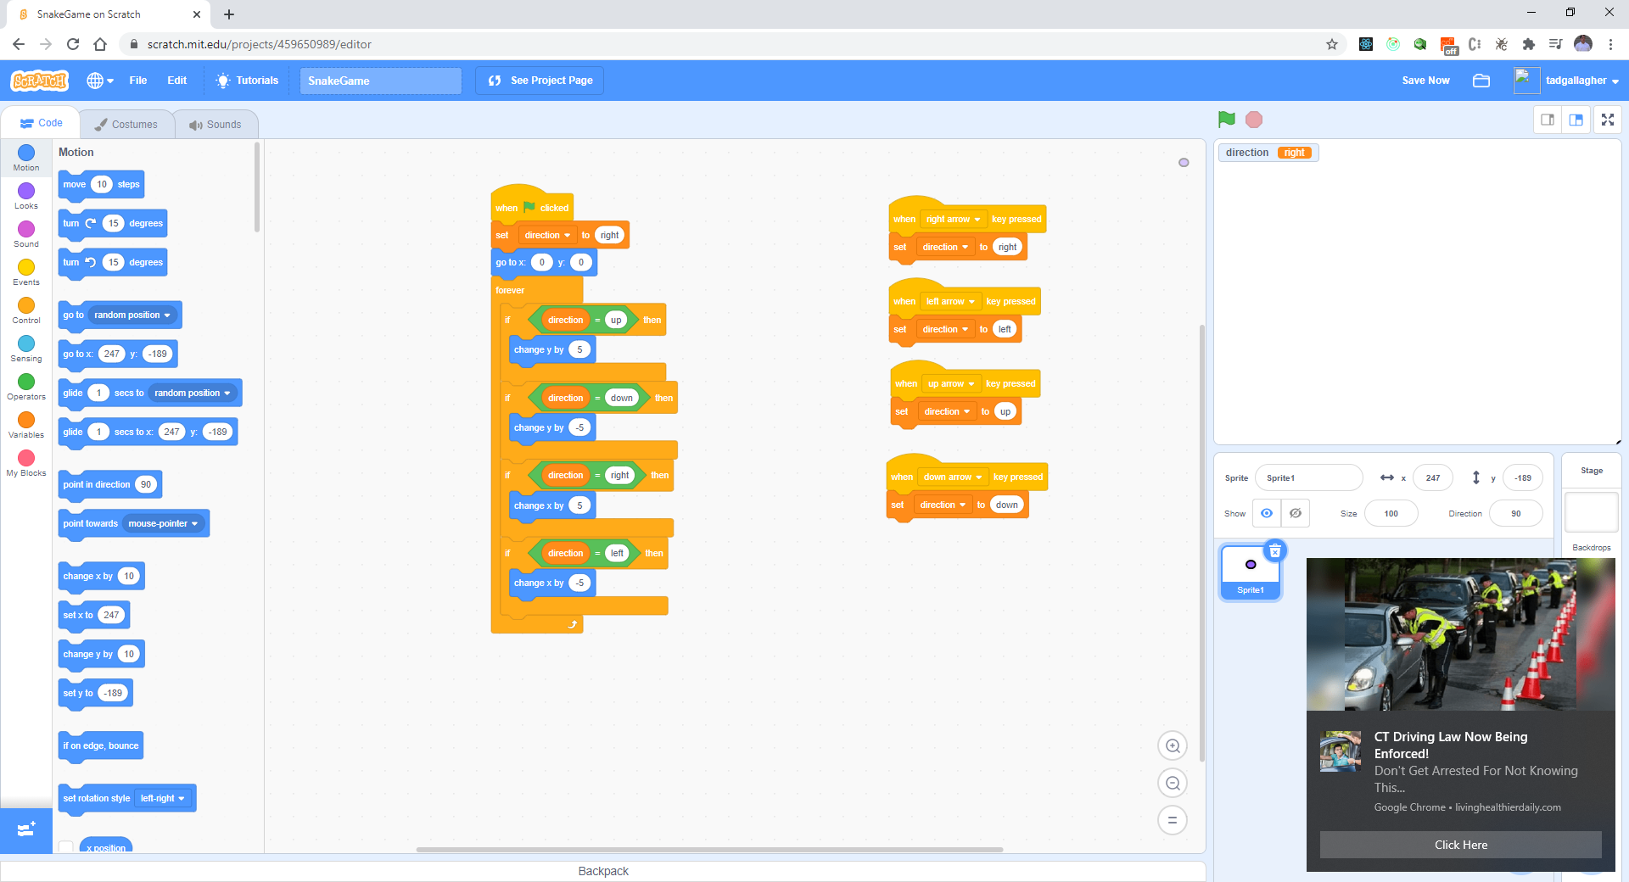
Initialize to center

Slide 14
Test your work
Verify you only press a key once to change direction

Slide 15
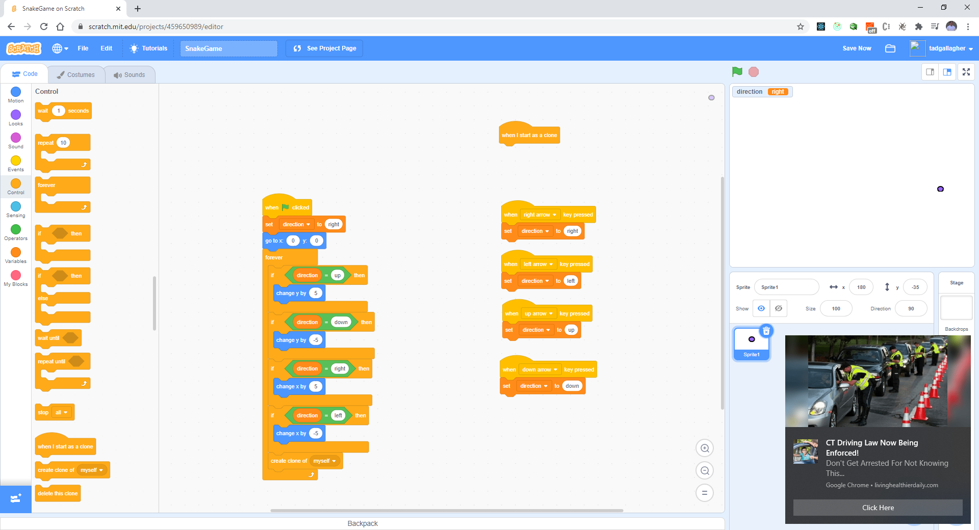
Create a clone

Slide 16
Test your work
Does the dot have a tail?

Slide 17
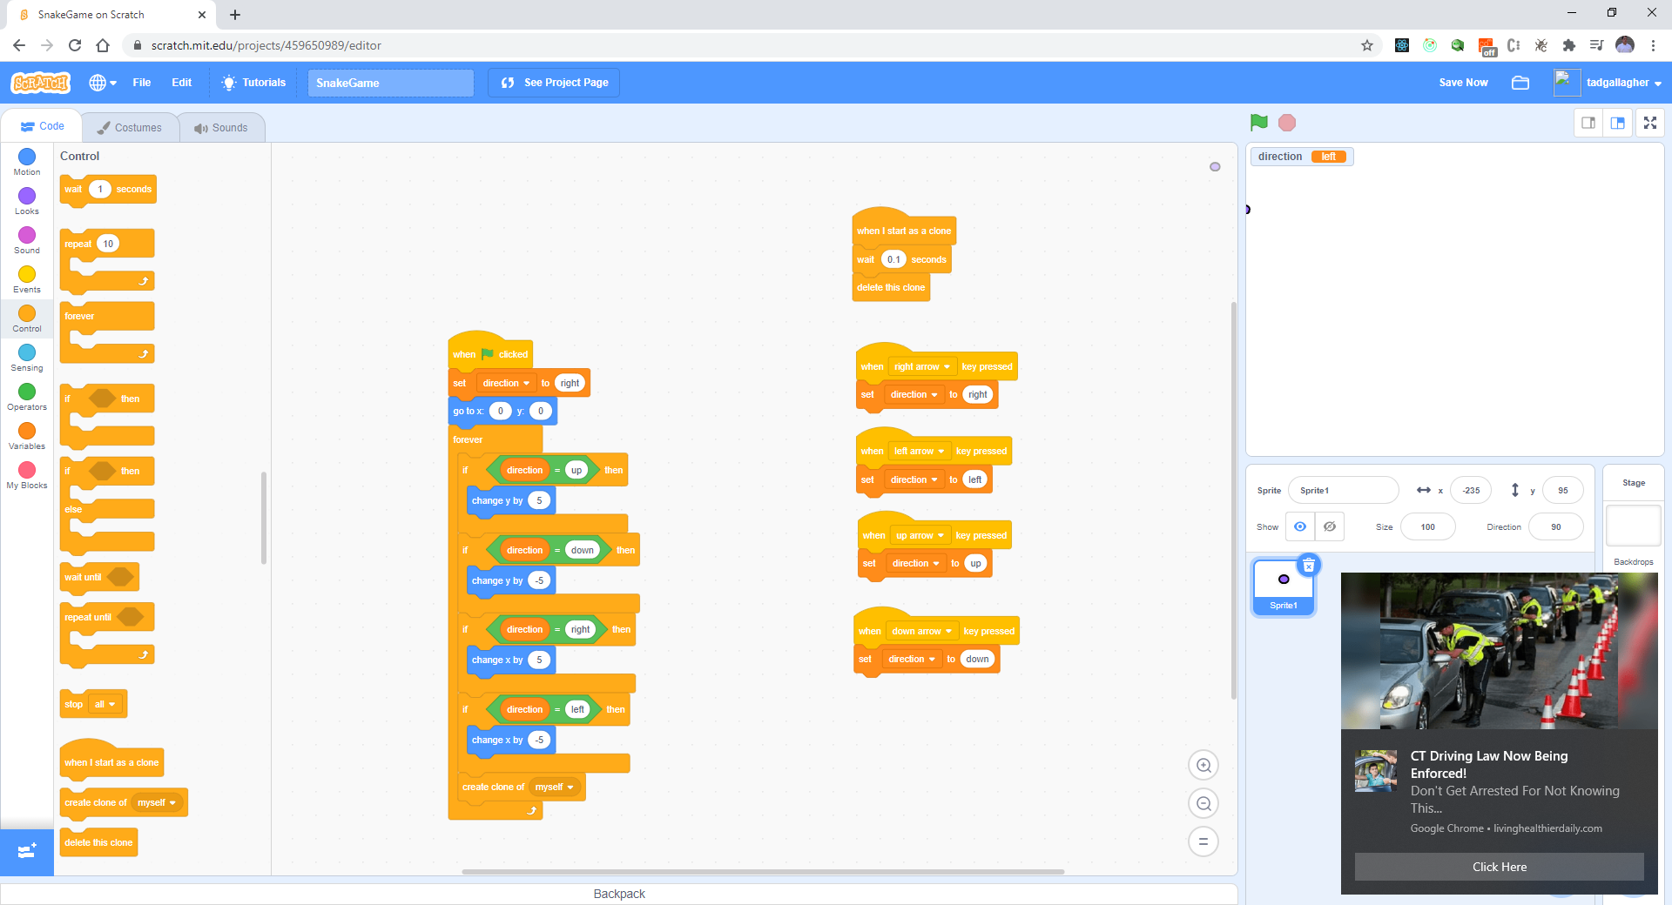
Add the following:

Slide 18
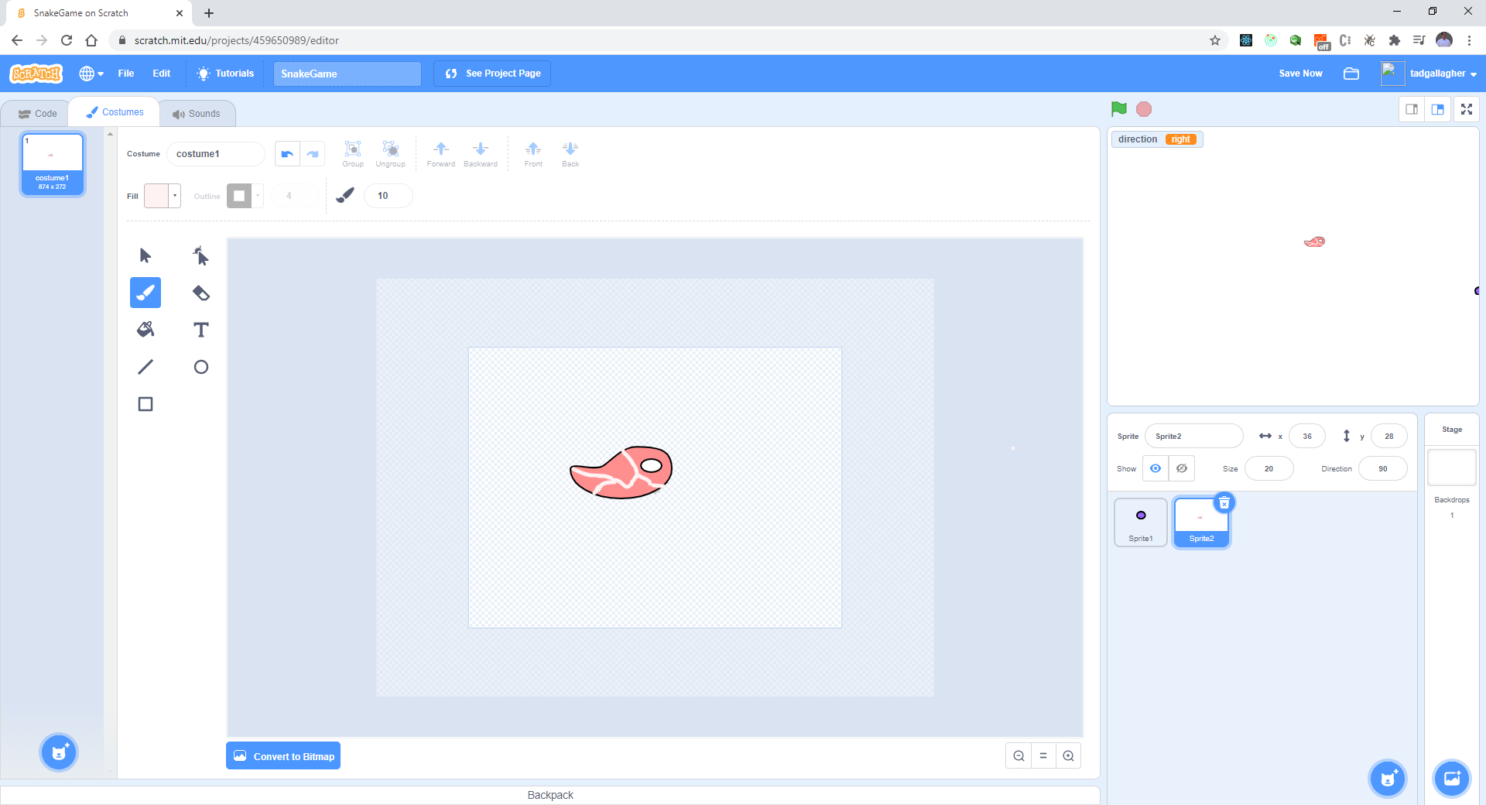
Every time the snake eats his tail should grow Create a food sprite – Make a steak

Slide 19
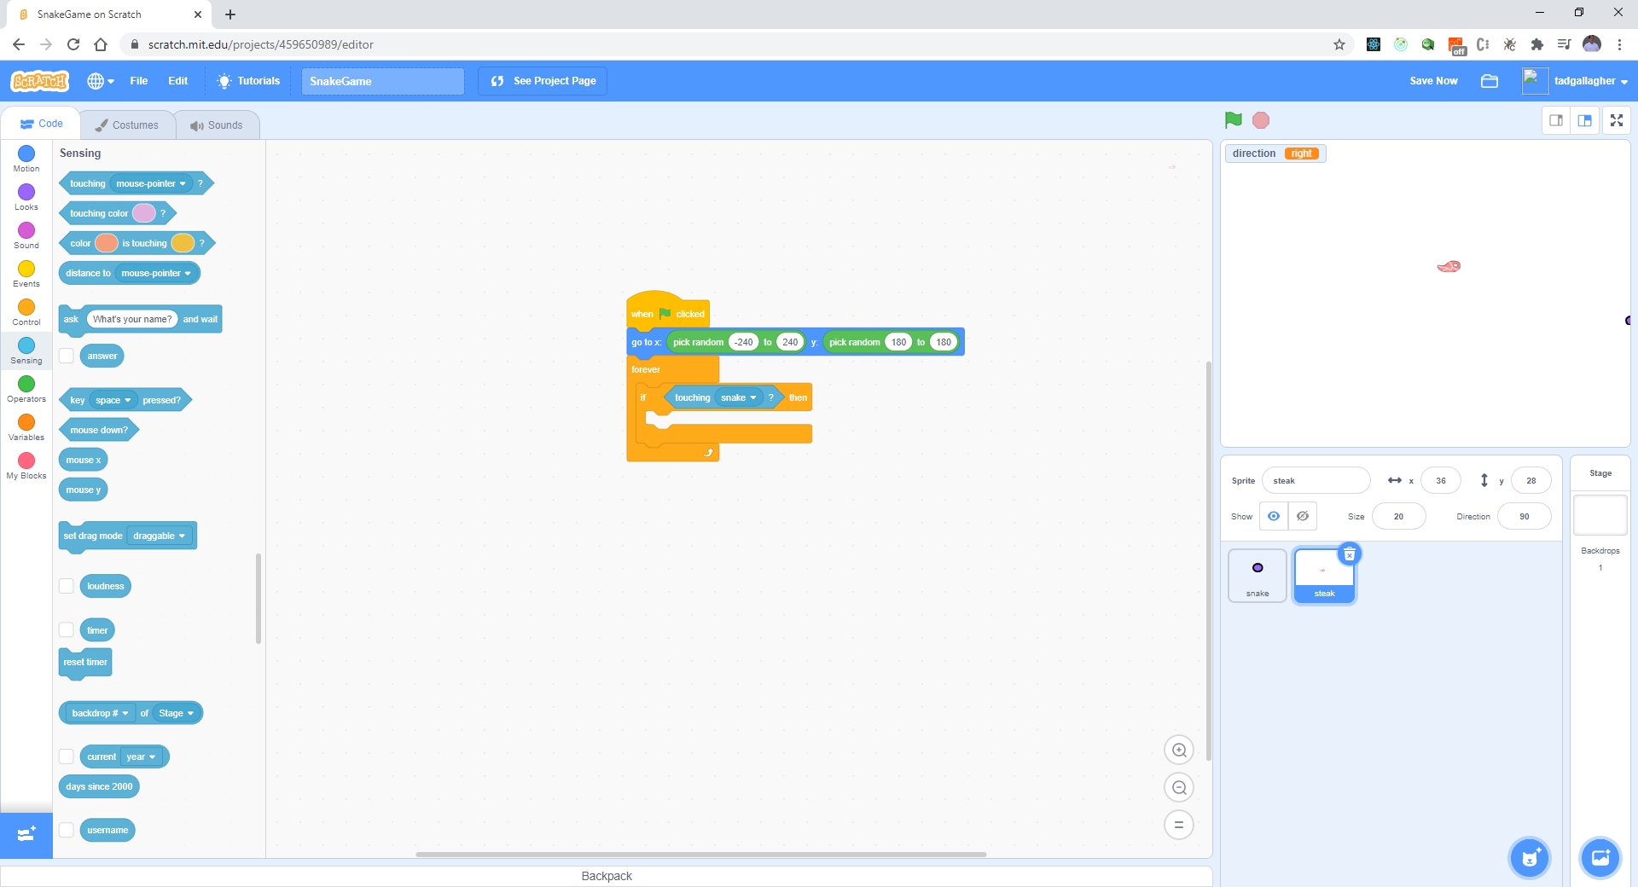
Code Steak (food)

Slide 20
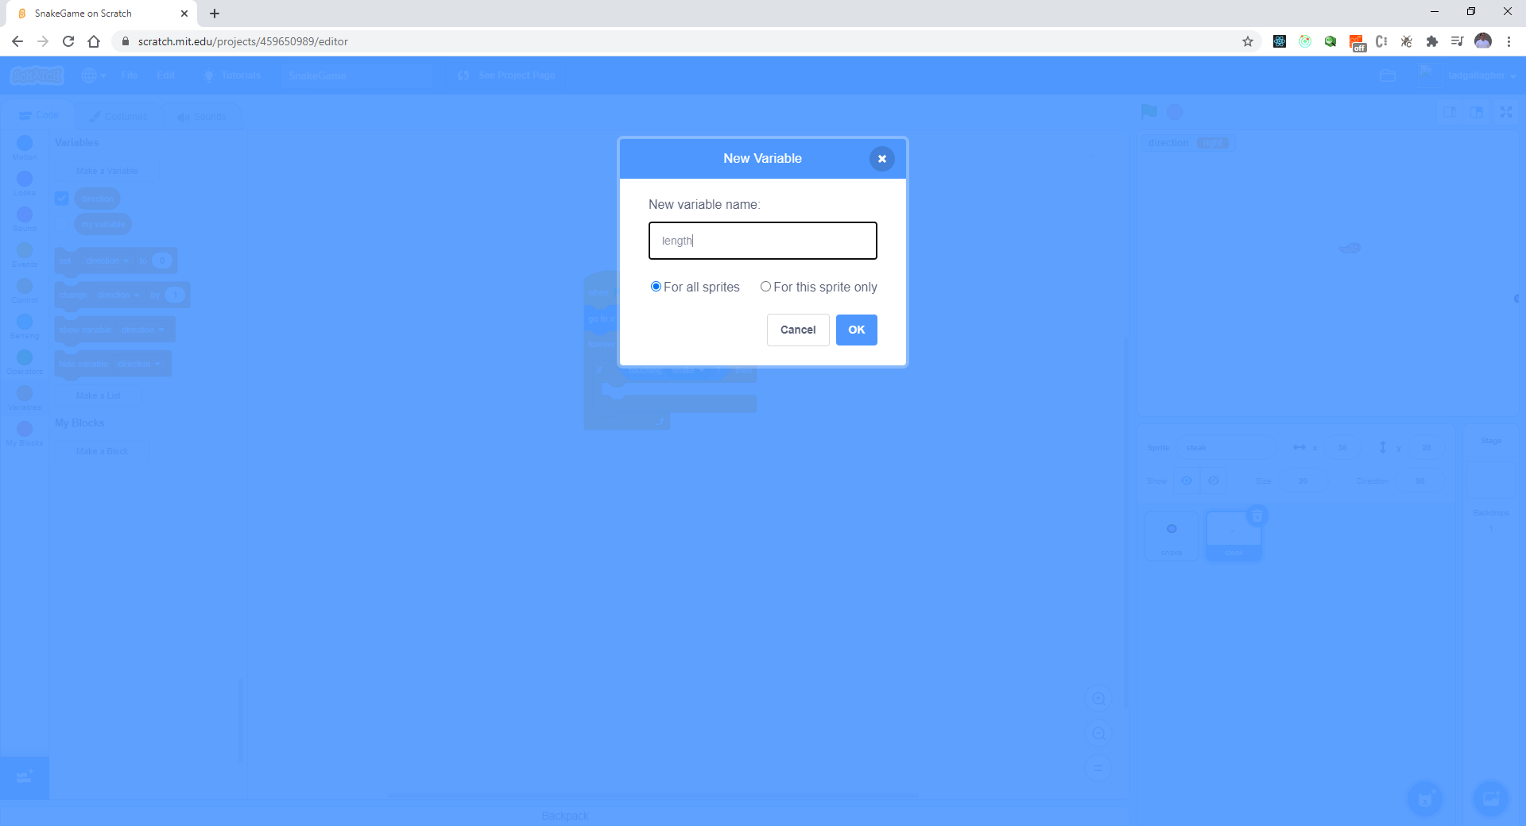
Create a “length” variable

Slide 21
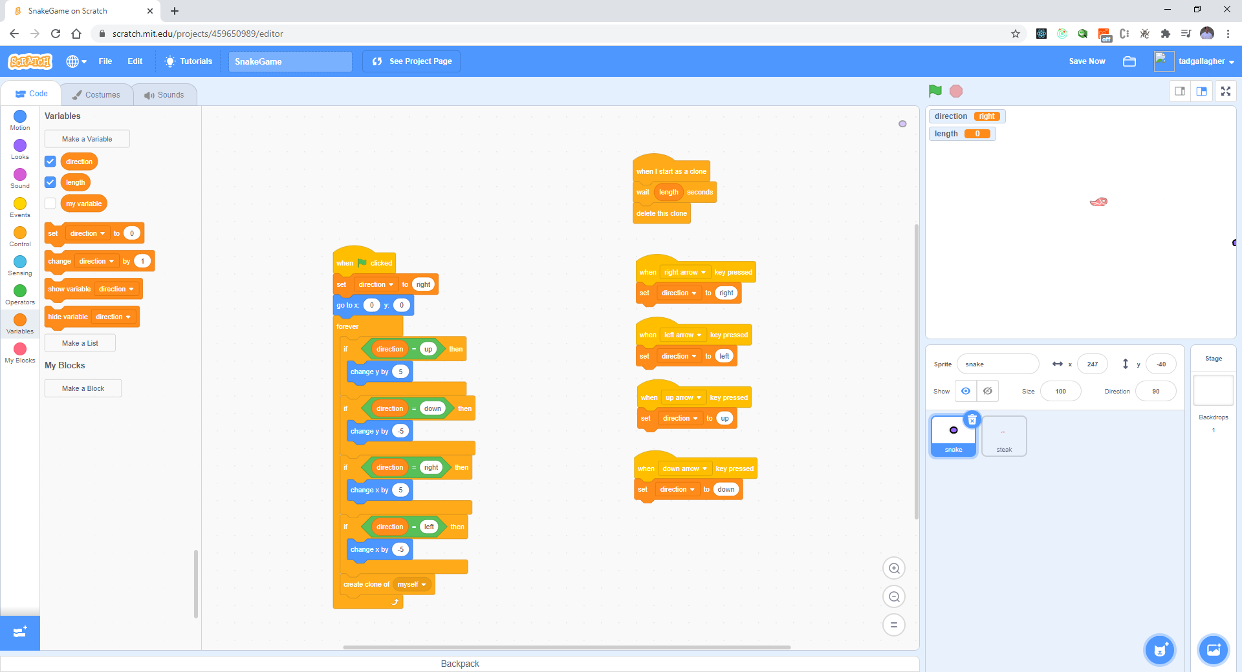
Change code with “length”

Slide 22
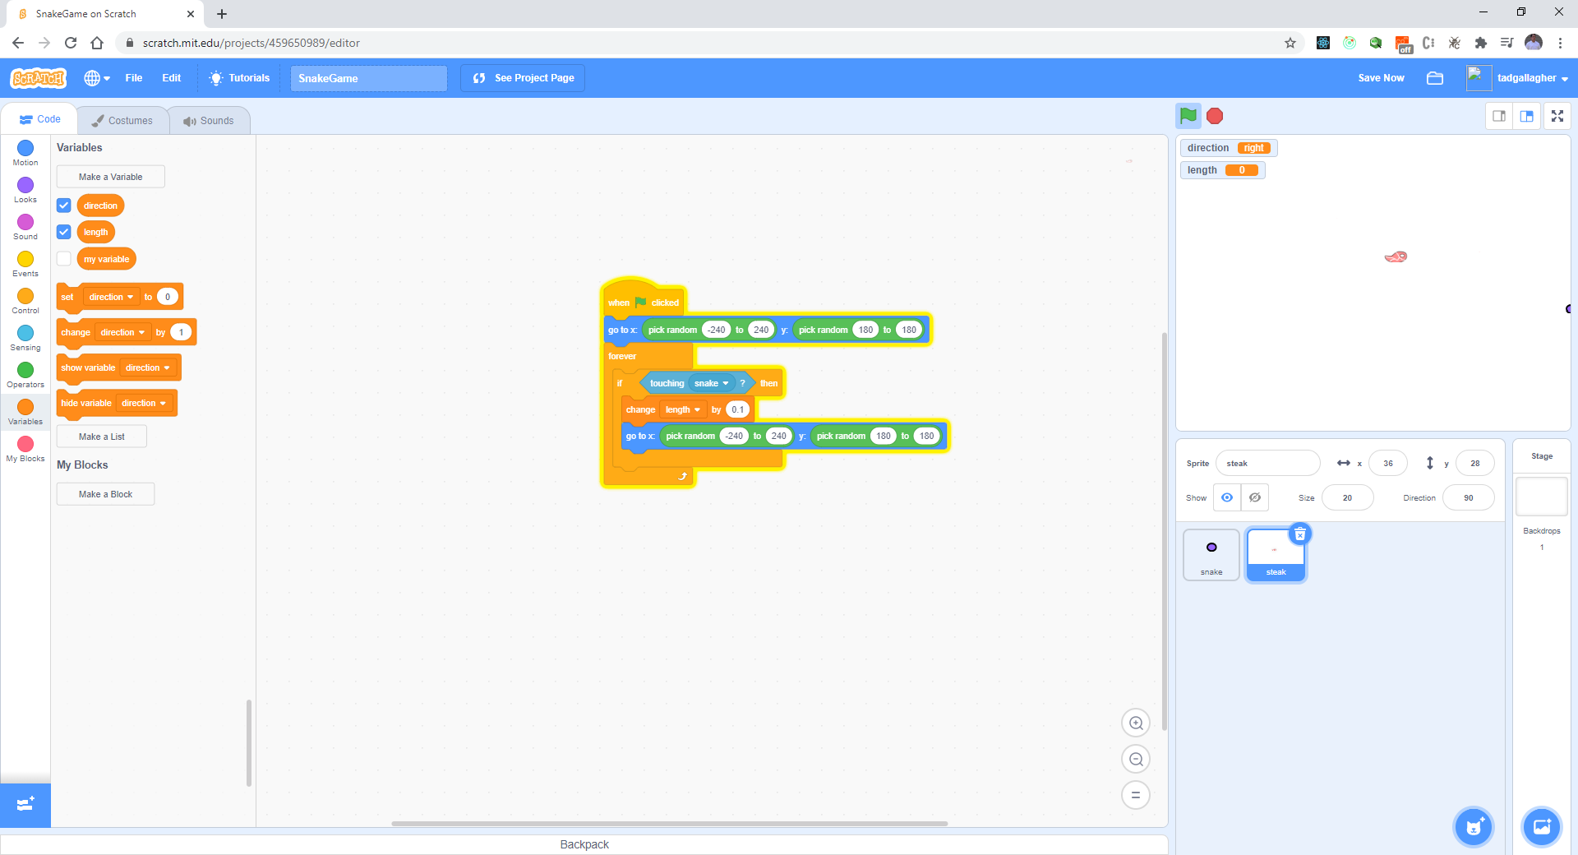
Change Steak code as follows:

Slide 23
Test your work
Does the snake tail get longer?

