Slide 1
TicTacToe with AI

Slide 2
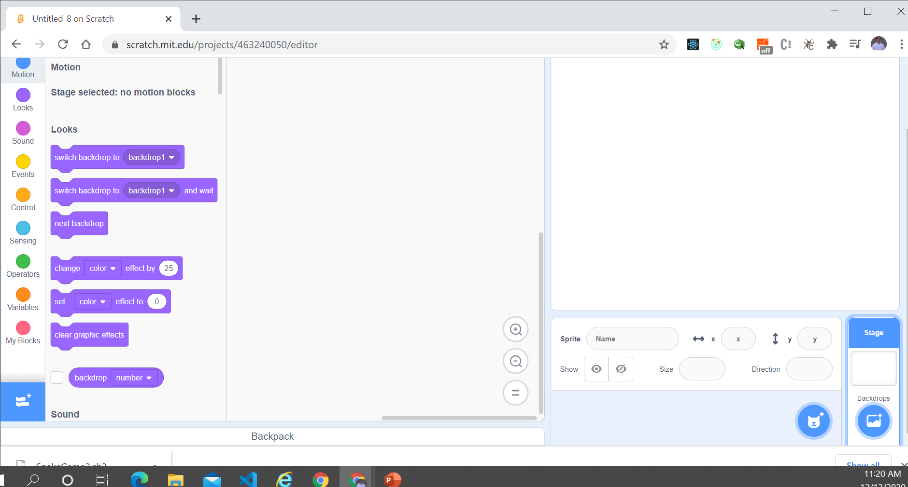
New Game and Delete Scratchy

Slide 3
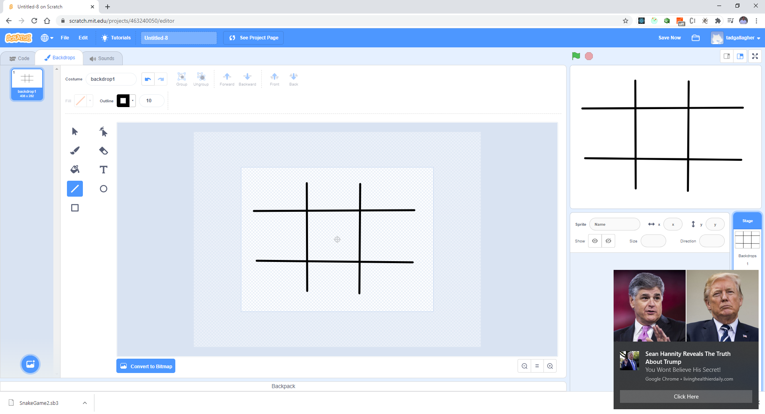
Draw Grid

Slide 4
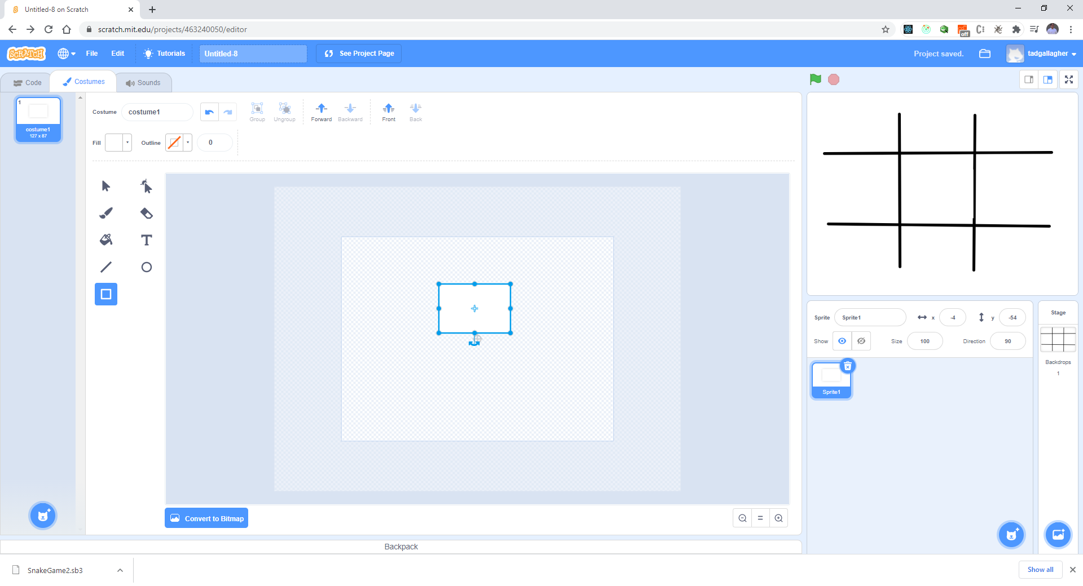
Make the Sprite – White Box

Slide 5

Name it “white”

Slide 6
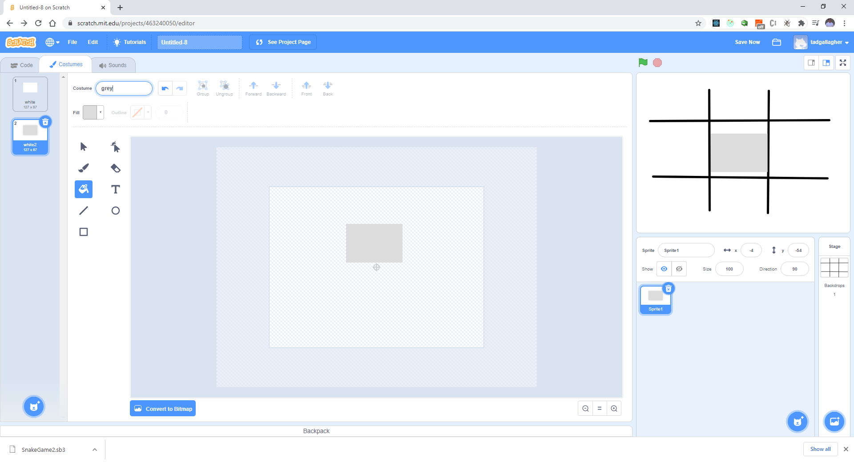
Duplicate the “white” and make grey

Slide 7
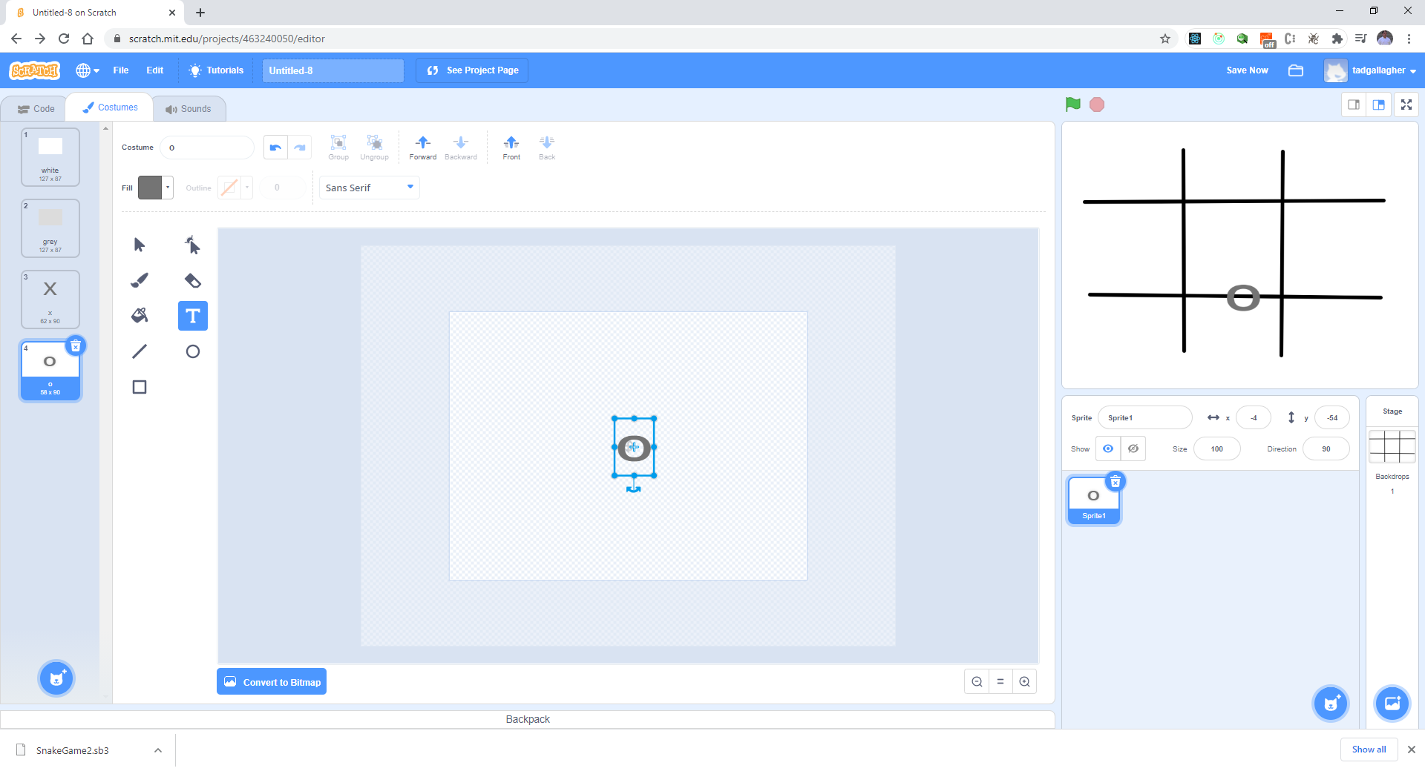
Make 2 more costumes X and O

Slide 8
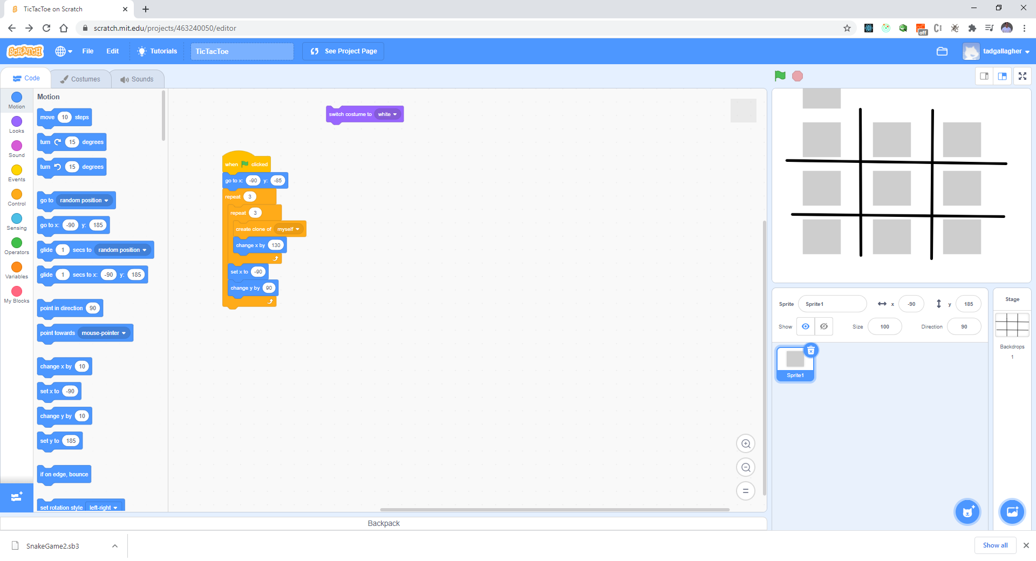
Let’s start the code!

Slide 9
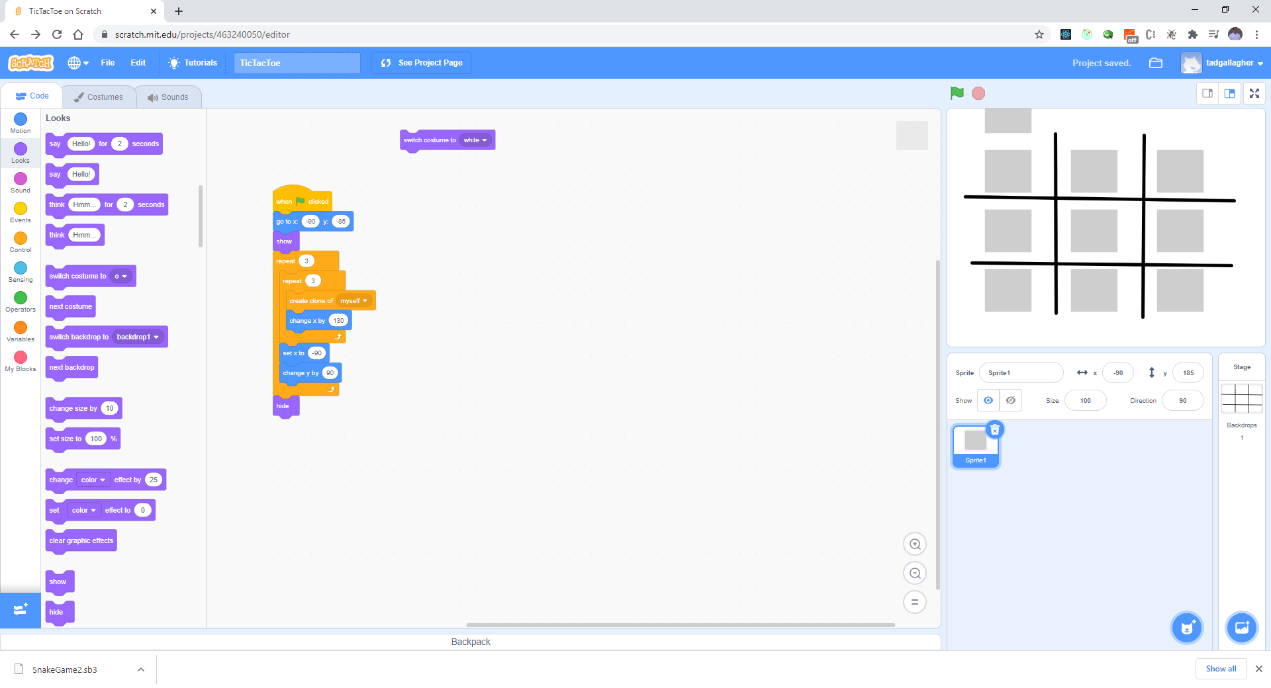
Get rid of extra sprite

Slide 10
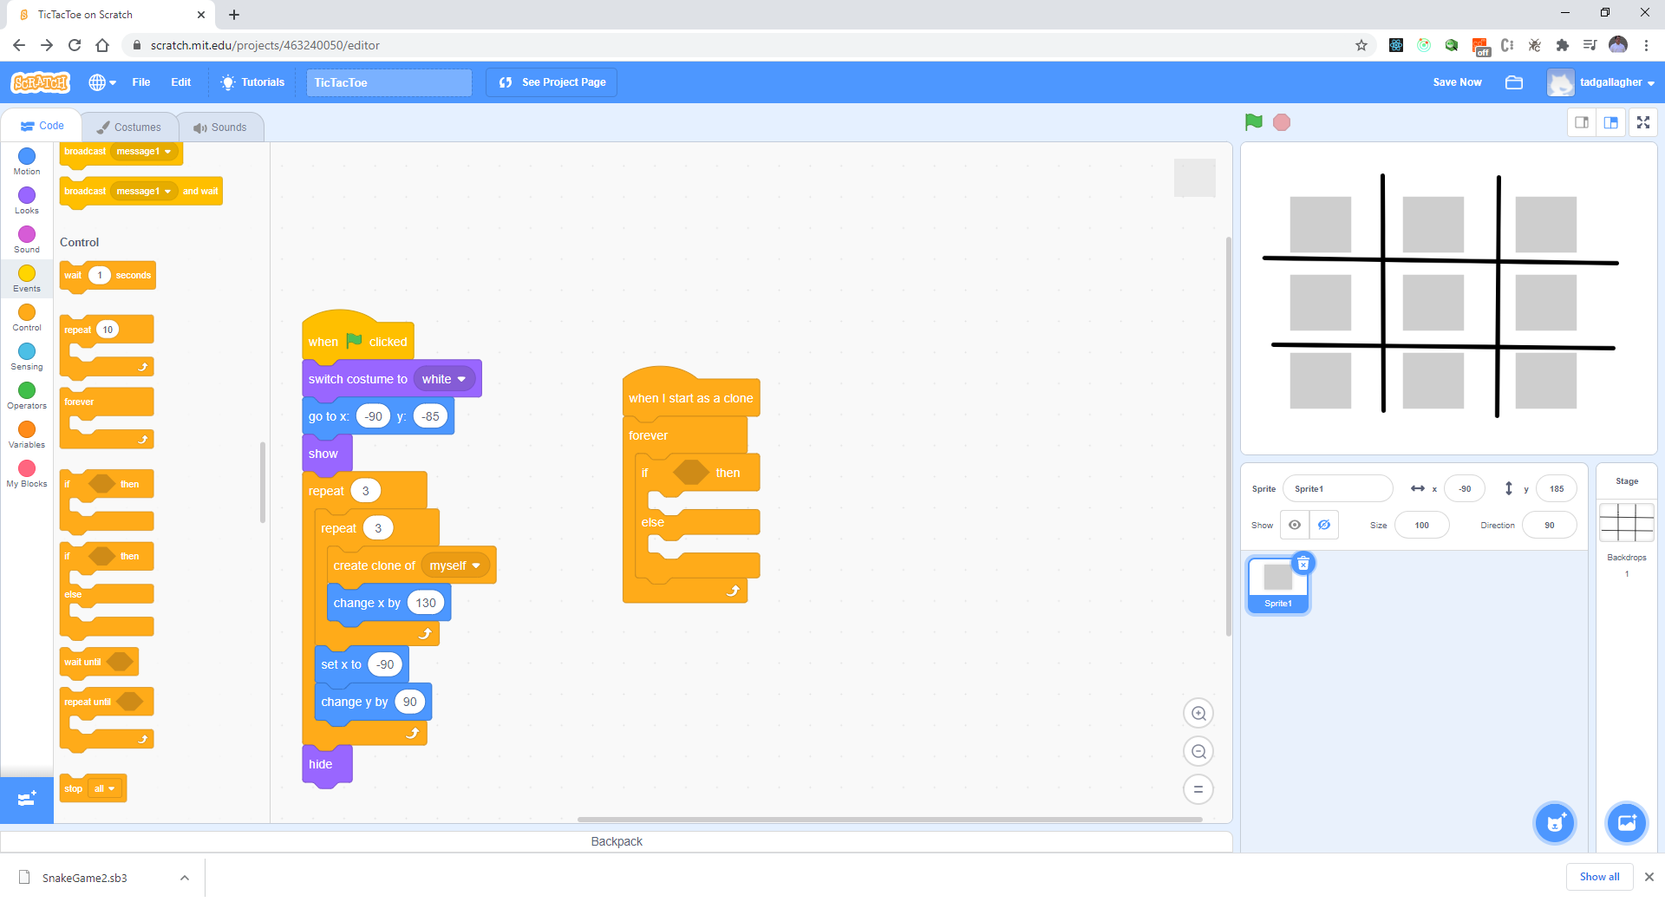
Add code

Slide 11
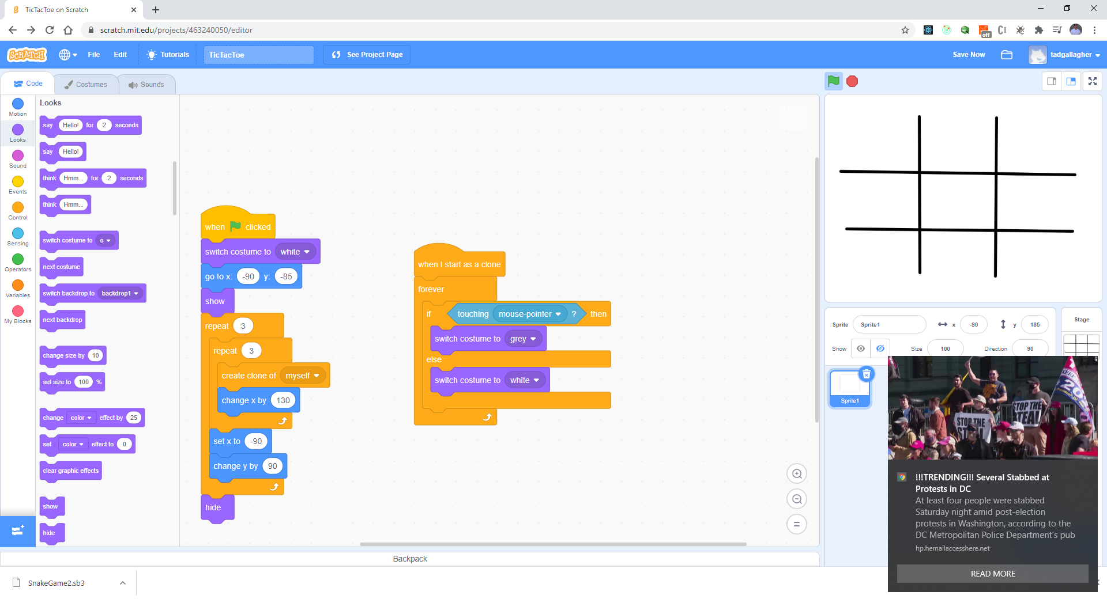
Add more code to switch backgrounds

Slide 12
Test your code
Move your mouse around

Slide 13
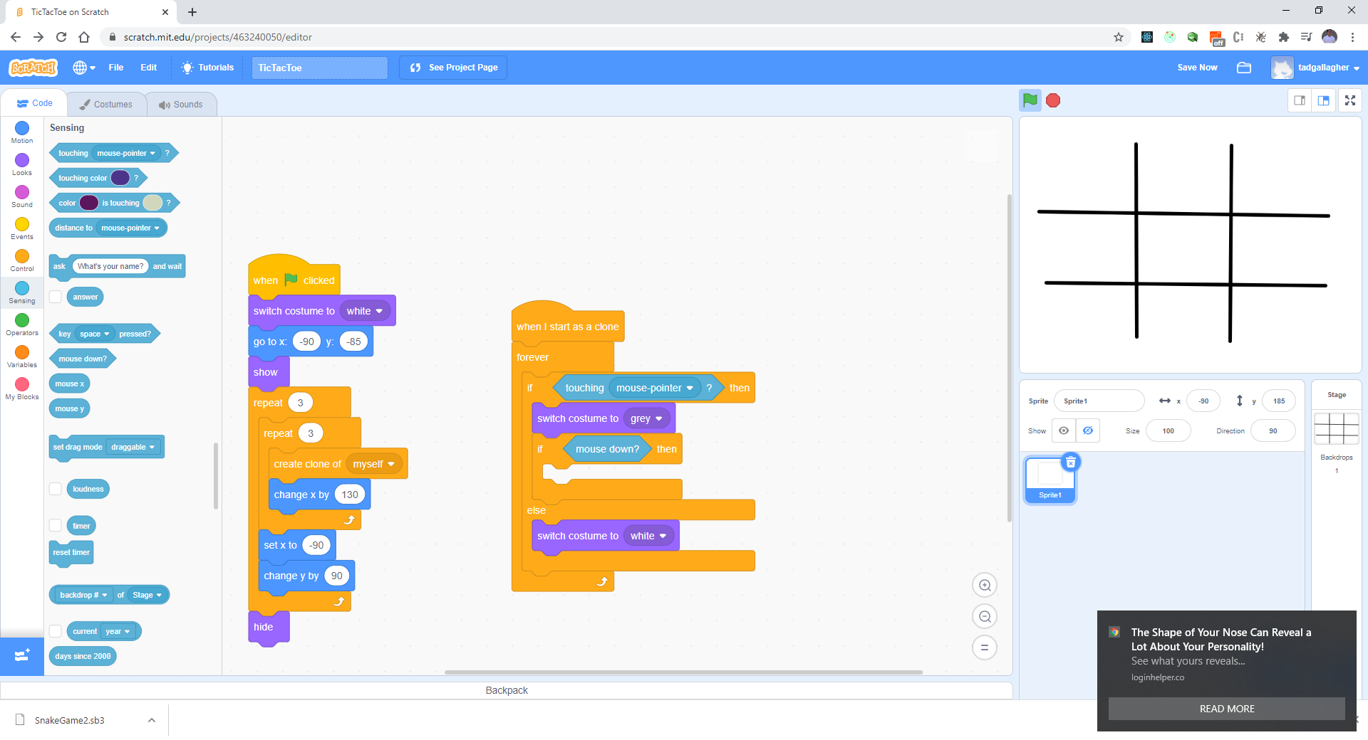
Check for mouse click

Slide 14
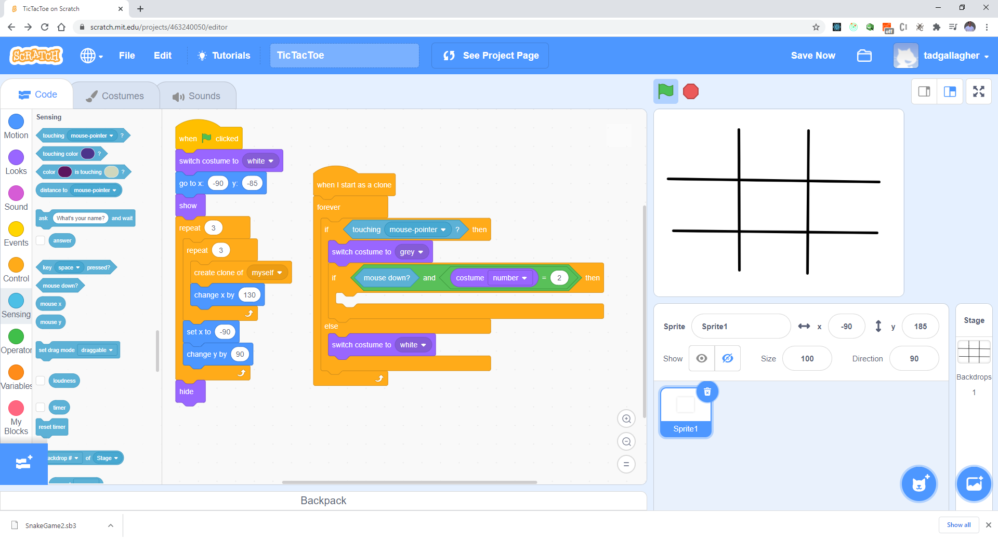
Update code

Slide 15
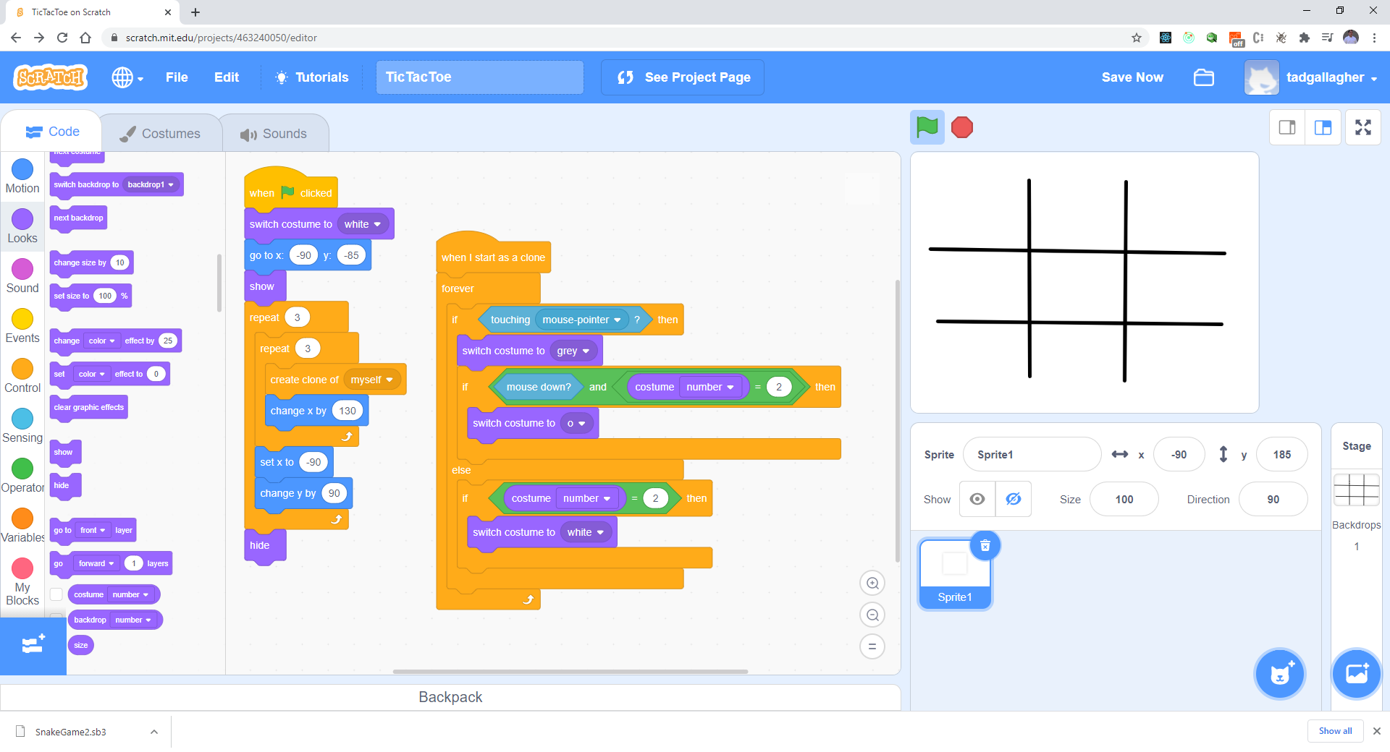
Add code

Slide 16
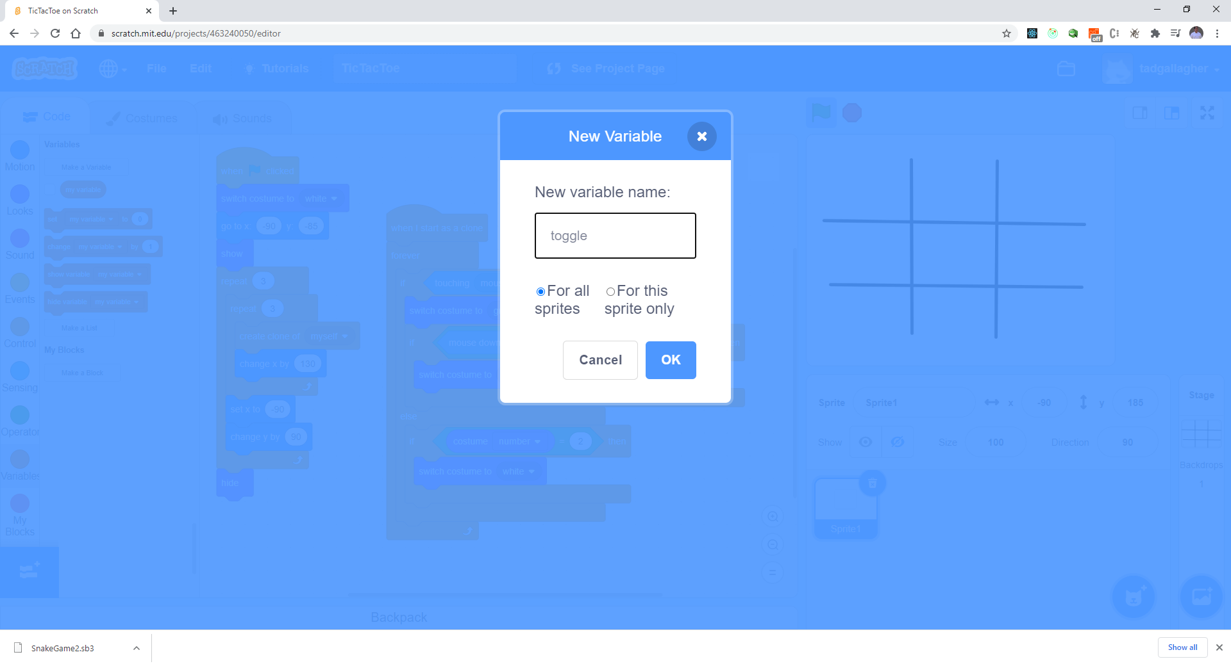
Make a variable called “toggle”

Slide 17
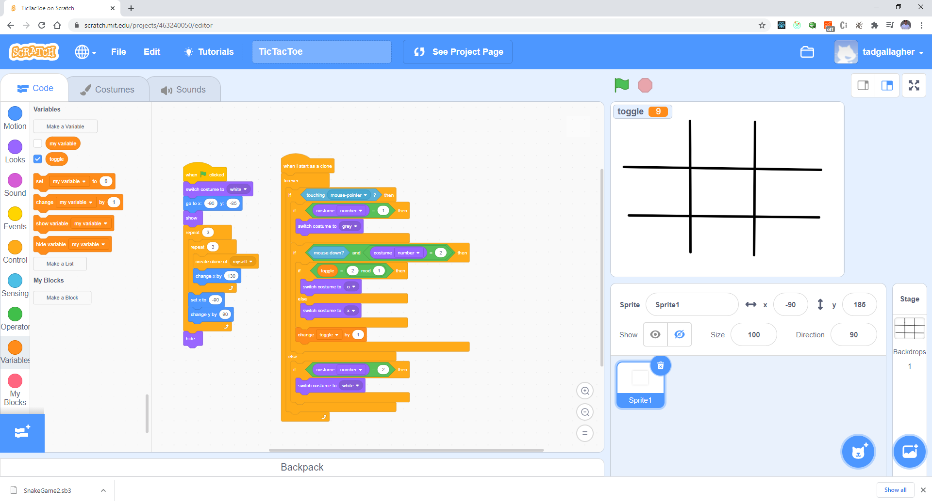
Final Code

Slide 18
Test your work
Does it toggle between X and O?

